Slide 1

Fall 2020 Guide: Parents
Please take the time to read through this document - it should ensure that you have a smooth and enjoyable experience during this very unique season/situation..

Slide 2
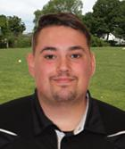
Personal Message from the Executive Director
Whilst we are excited to re-start soccer in Western Mass, we do so with the foresight this season will be a completely unique experience. After months of shut-down soccer has been given the green light. However the re-opening comes with serious restraints and modifications laid-out by our governing bodies.
These modifications are aimed at safeguarding players and to enforce current social distancing protocols for spectators. Many of these modifications will be extremely unpopular - but this is what is required to play soccer! If you are unwilling to adapt to these changes please withdraw your participation immediately.
This Fall will not be a “normal” season - we are expecting lower numbers, we have multiple game modifications - this season should be viewed as an opportunity for our children get off the sofa, out of the house and doing something fun, stimulating and healthy!!
Kind Regards,
David Barton
Executive Director

Slide 3
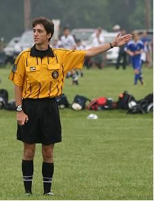
Temporary Modifications to the Game
In order for us to play our league season, we are REQUIRED to make the following temporary changes to the laws of the game:
Heading - All intentional heading of a soccer ball is suspended for all ages.
Shoulder to Shoulder contact is suspended and or any other intentional physical contact is to be considered a violation of Law 12, Playing in a Dangerous Manner, Indirect Free Kick restart or other applicable foul or misconduct based on the referee’s decision.
Slide Tackling is suspended for all ages
Throw-Ins are suspended and to be replaced by a Kick-in.
Corner Kicks are suspended and to be replaced by a Corner Kick-in.
  The ball may not be kicked directly into the opponent’s penalty area.
  Opponents must remain at least 10 yds (8 yards for small sided) from the corner arc until the ball is in play
The use of a traditional defensive Wall is currently suspended.
The use of a Drop Ball as a restart is suspended. To replace this procedure, an Indirect Free Kick will be awarded to the team whom the referee deemed to be in possession when the referee stops play.

Slide 4

Pre-Game Checklist
Monitor your child’s health. Take temperature daily. The average normal body temperature is generally accepted as 98.6°F (37°C). Some studies have shown that the “normal” body temperature can have a wide range, from 97°F (36.1°C) to 99°F (37.2°C). A temperature over 100.4°F (38°C) most often means you have a fever caused by an infection or illness.
If your child has any symptoms, even mild ones, do not send them to practice or a game. Public health urges you to stay home and isolate until:
  You have had no fever for at least 72 hours (without the use of medicine) AND
  Other symptoms (cough, shortness of breath) have improved AND
  At least 7 days have passed since your symptoms first appeared.
Anyone in your household that you have had close contact with (within six feet for approximately 10 minutes) should self-quarantine for 14 days, even if you haven’t been tested for COVID-19.
Notify the club immediately if your child has become sick.
Ensure that your child has a water bottle, equipment (ball and GK Gloves if necessary), light and dark shirt (no shared scrimmage vests will be provided).
Ensure your child’s personal equipment, cleats, balls, shin guards etc. are cleaned and sanitized before and after every training.
Be sure your child has necessary sanitizer with them at every session.

Slide 5
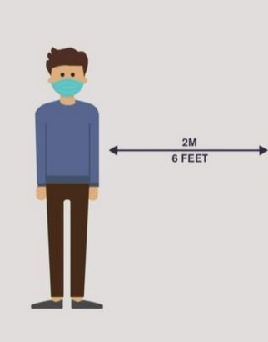
Spectator Requirements
The league is required to stagger it’s game times to allow teams and spectators to exit and enter field space without engaging with the previous or subsequent teams. Participants are required to leave the field (including parking lot) immediately after their game has ended. Spectators arriving early should wait in car until field is clear.
There is a limit of only 1 spectator p/player. This is a state requirement - if there are too many spectators at any given game the activity will be halted until the numbers are good. We know various BOH departments will be actively monitoring fields - don’t give them a reason to shut down soccer in that town.
All spectators must adhere to current social distatanicing protocol - 6ft apart, face masks must be worn etc
To assist with social distancing requirements, spectators will be permitted to sit/observe the game from behind the goal line no less than 15 feet from the goal line and not within 10 feet of the goal post where space accommodates. Viewing on the sideline may be done 8ft from the touchline. Spectators are not permitted to observe the game from the coaches/teams side.

Slide 6
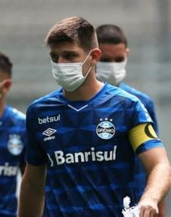
Players Required to Wear Masks During Games
Upon review of the Executive Office of Energy and Environmental Affairs Workplace Safety and Reopening Standards for Businesses and Other Entities Providing Youth and Adult Amateur Sports Activities – Phase III, Step 1 as amended on August 13, 2020:
Players will be required to wear face coverings before, during and after their games, including engagement in active play. The only type of face covering that is permissible for players is the ear-looped style face covering. These standards will be enforced by member organizations along with support from the game officials as appropriate.
Players are permitted to remove the mask to “catch their breath” at points in the game where they are 6ft away from all other participants, i..e:
  After long runs down the field, plays without close contact, during stoppages etc
To accommodate this additional strain on recovery time the league encourages coaches to rotate their players as needed and will give teams a designated “hydration break” half way through each half.

Slide 7
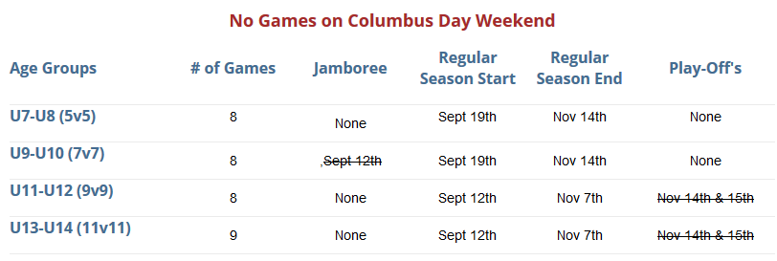
Pre & Post-Season Tournaments Cancelled
As of August 13th 2020 we’re currently at Phase III, Step 1 of the reopening plan. This means there is still a restriction on all Tournament play. Unfortunately due to these restrictions we will not be offering a Fall 2020 Jamboree Event or 9v9 & 11v11 Play-Offs:

