Slide 1
Charlton Youth Soccer and Challenger Sports
Online Soccer Tool Access for Coaches, Players, and Parents

Slide 2

Challenger Sports Online Access
https://www.thechallengerway.com/
Promo Code for Free Access: TGRI
Access is Free
Videos, Demos, and Printable Activities

Slide 3
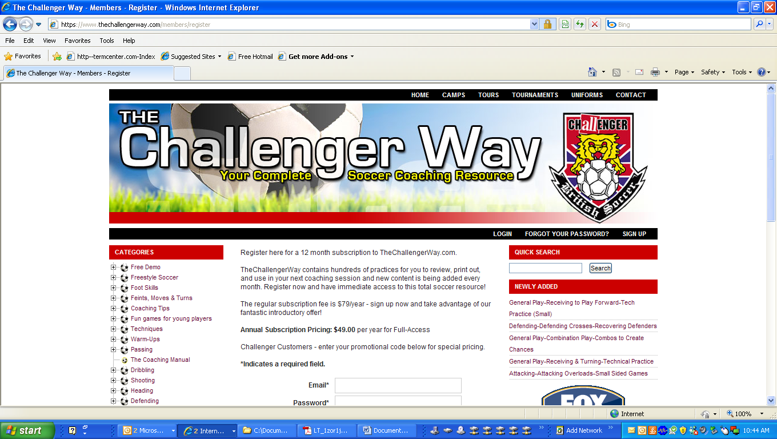
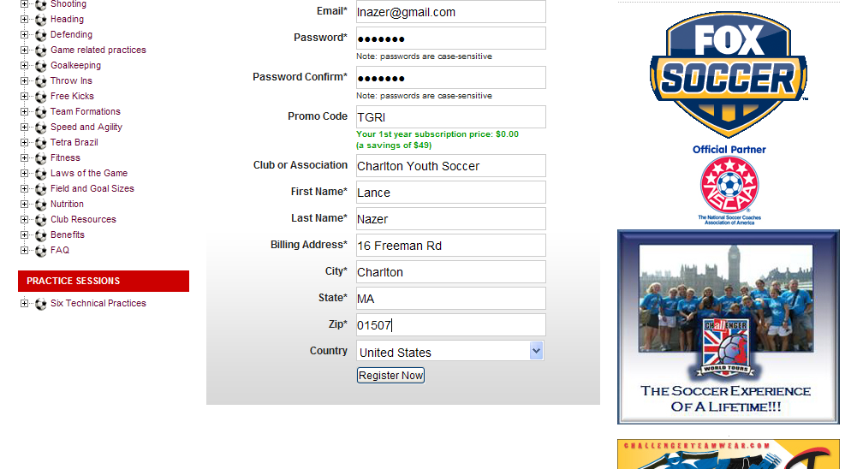
Create Your Account
Go to: https://www.thechallengerway.com/
Click “Sign-up”
Enter in your information.
Enter Promo Code: TGRI
Annual fee changes to $0.00
Click “Register Now”

Slide 4
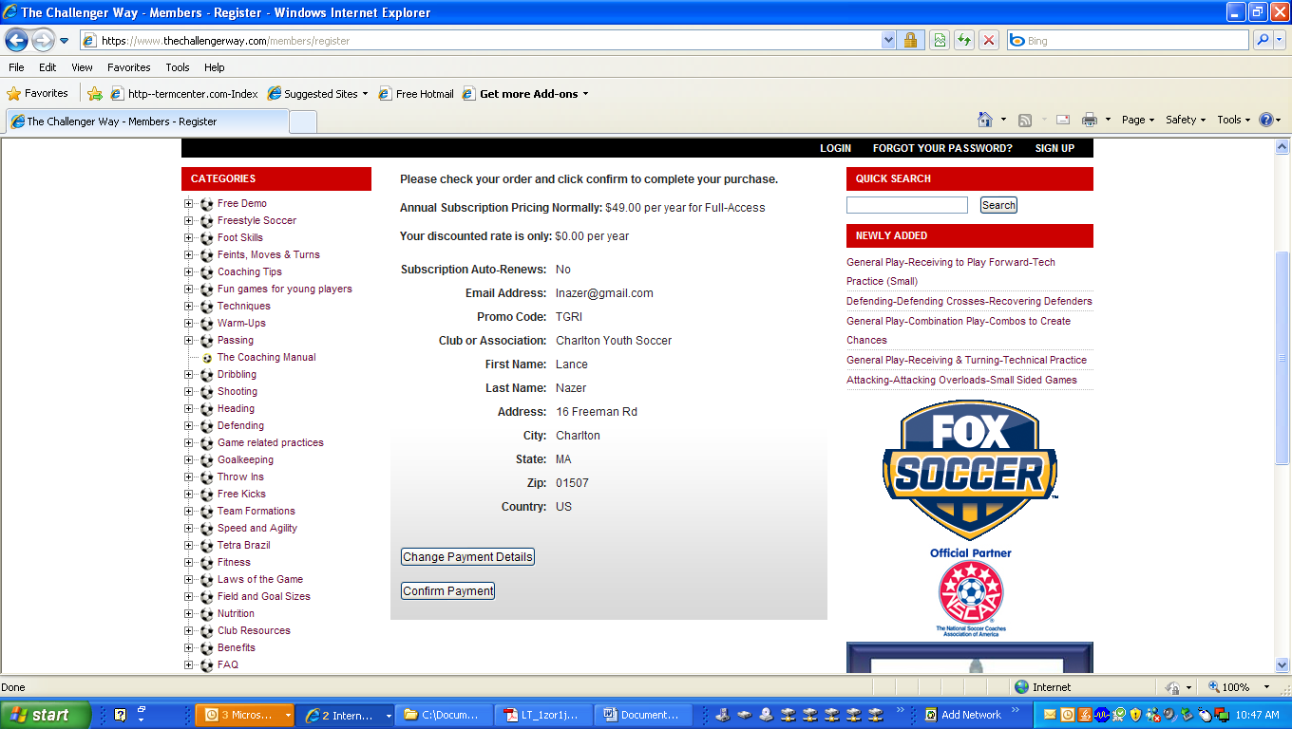
Account Review and Confirmation
Your Account Information will be available for viewing.
Click “Confirm Payment”

Slide 5
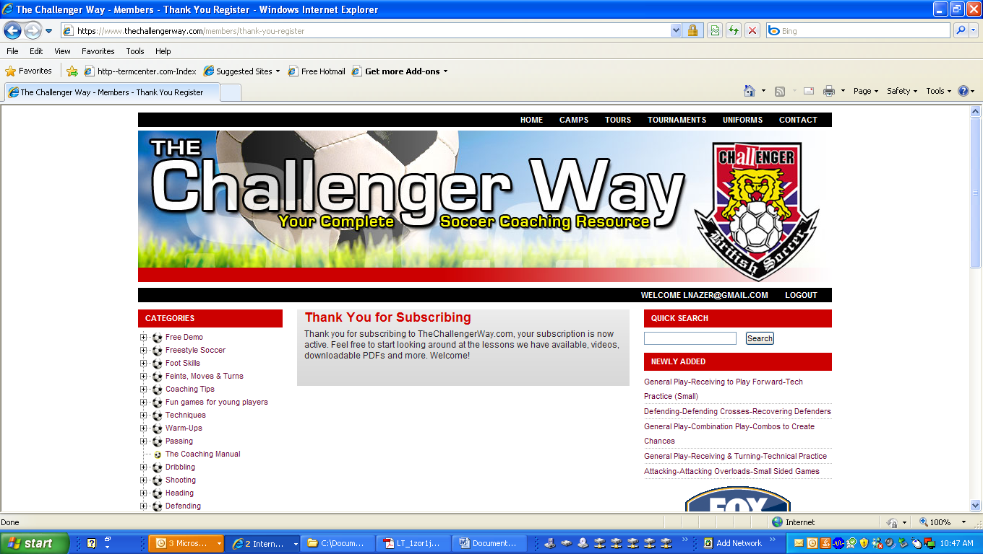
Ready to use your complete Soccer Coaching Resource
Click Category links to begin or use the quick search function.
Enjoy the Partnership of CYS and Challenger Sports.

