Slide 1

High Performance
Sports Parenting
Dr. Adam H. Naylor
www.telos-spc.com
@ahnaylor

Slide 2
The Sports Medicine/Performance Team
Sports Medicine Professionals
Sport Science Professionals
Sports Coach
Mom and Dad

Slide 3
The Parental Paradox
I care…
this is good….
this is bad.

Slide 4
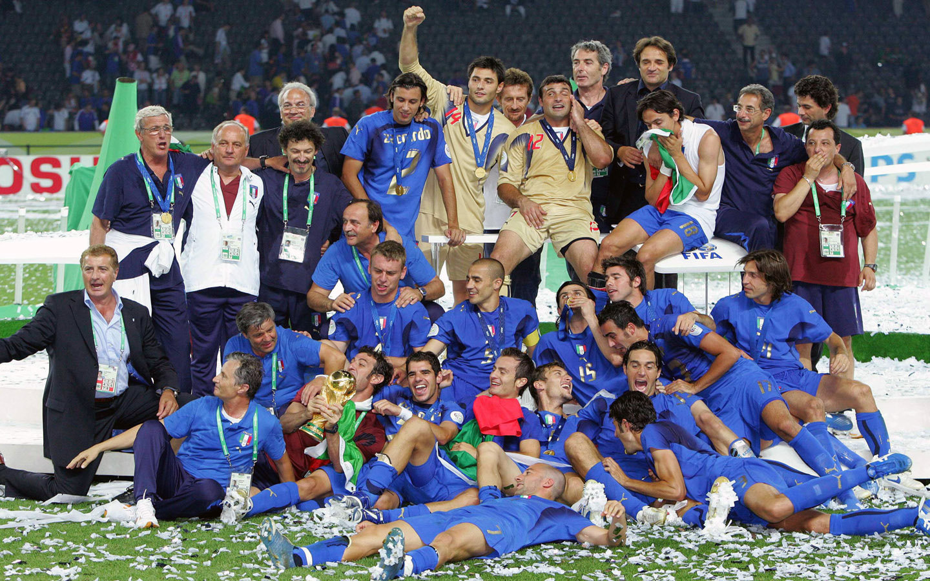
Every Team is a Team of Role Players
What’s Your Role?

Slide 5

March 13, 2033

Slide 6
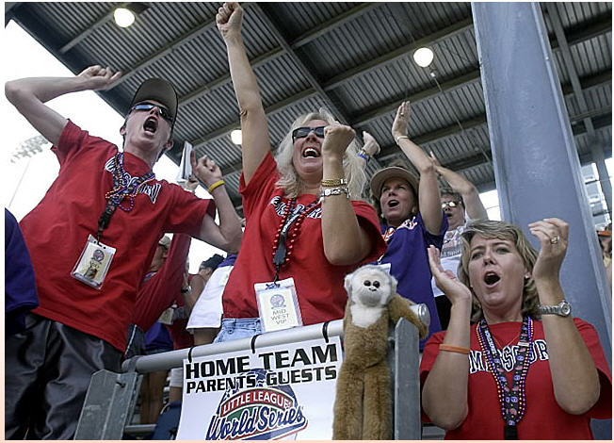
What are you doing?
Providing experiences ($ and time)
Interpreting experiences
Modeling behaviors
Subtlety of Sports Parenting:
Teaching Values without Pushing

Slide 7
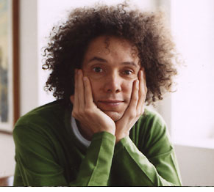
10 Year / 10,000 Hour Rule

Slide 8

10 Year / 10,000 Hour Rule

Slide 9
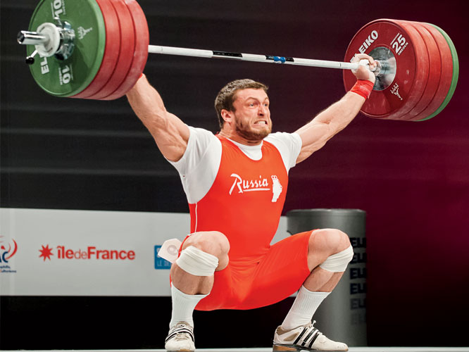
Not Just Practice Quantity…
Challenge

Slide 10
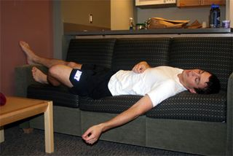
Not Just Practice Quantity…
Quality Rest

Slide 11

Not Just Practice Quantity…

Slide 12
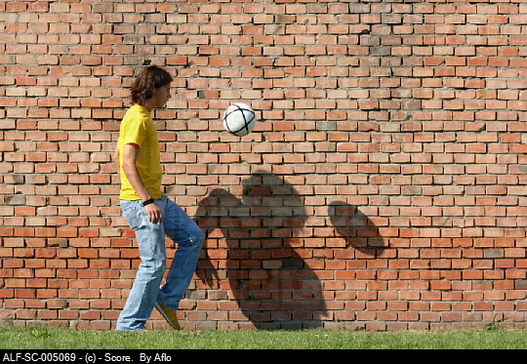
Deliberate PLAY
Precedes Deliberate Practice

Slide 13
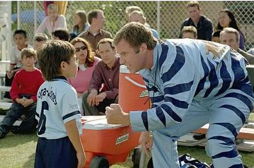
What are you saying?

Slide 14

“You learned that so quickly! You’re so smart!”

Slide 15
“You’re so good, you made that save without even looking!”

Slide 16
“Look at that move. Is he the next Lionel Messi or what?”

Slide 17
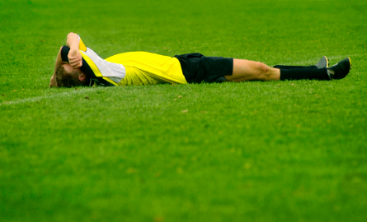
Look and listen closely….
“If I don’t learn something quickly, I’m not smart.”
“I better quit trying or they might realize I’m not that good.”
“I should only try moves I have mastered or they’ll figure out I’m no Messi.”

Slide 18

Talk about effort and encourage healthy struggle.

Slide 19
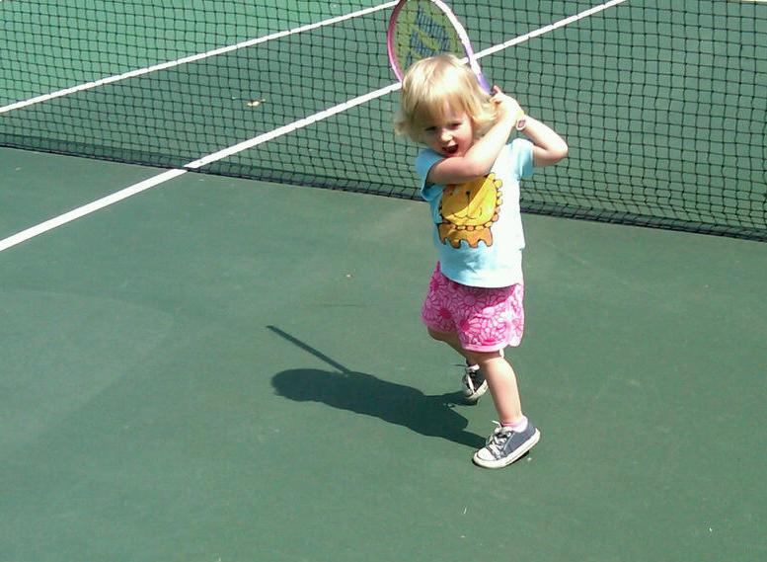
Talent is a Dirty Word
Without effort, energy, attitude, commitment, and all the rest... athletic skills cannot blossom.

Slide 20
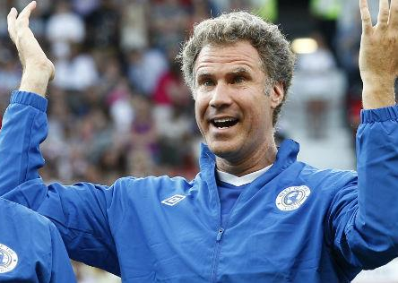
What are you showing?

Slide 21

What are you showing?
60-70% of what you say is unsaid.

Slide 22
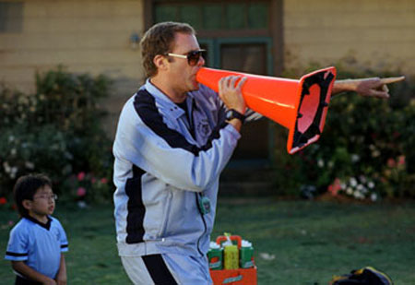
What are you saying and showing?

Slide 23

Look Beyond the Obvious
Do you have a community of scorekeepers or sportspeople?

Slide 24
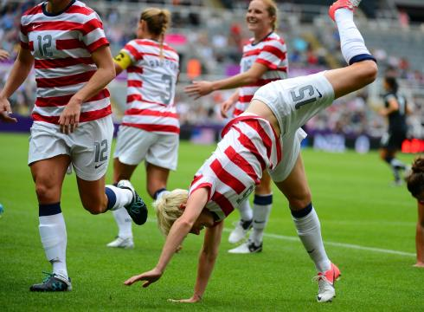
Competitors are Kids at Heart
Are we allowing athletes to be wide eyed and enthusiastic?

Slide 25
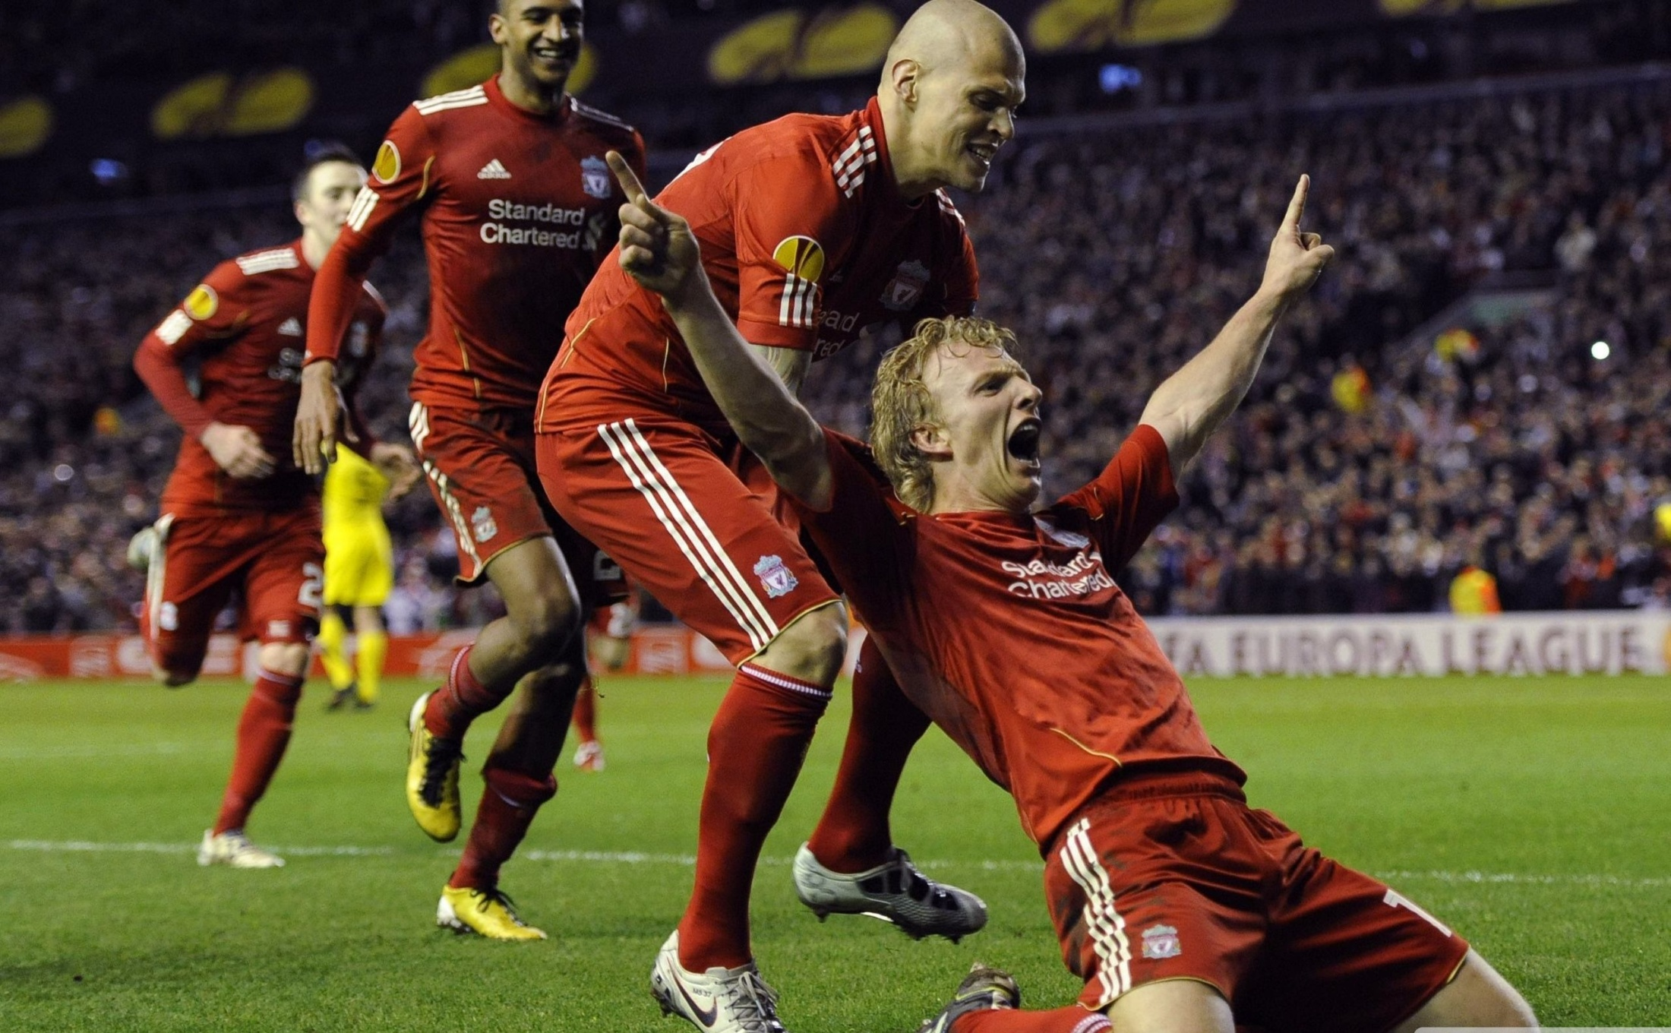
What Do You Choose to Celebrate?

Slide 26



Thank You
Dr. Adam Naylor
www.telos-spc.com
adam@telos-spc.com
617-821-7133
On Twitter @ahnaylor

