Slide 1
New - Coach Cancellation Request
Coach can click the “Cancel Request” button
Must enter the valid reason and be within minimum time requirements
This will send the request to MAYS
If MAYS Approve it the game is cancelled
Notices will go out and the game will start the rescheduling process
Email to Coach if Not Approved
Tracking in MAYS and Smgr Rescheduling Module

Slide 2
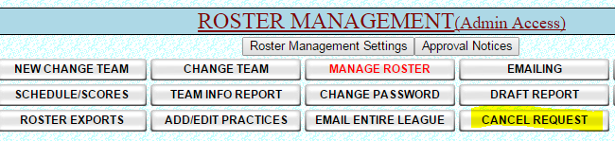
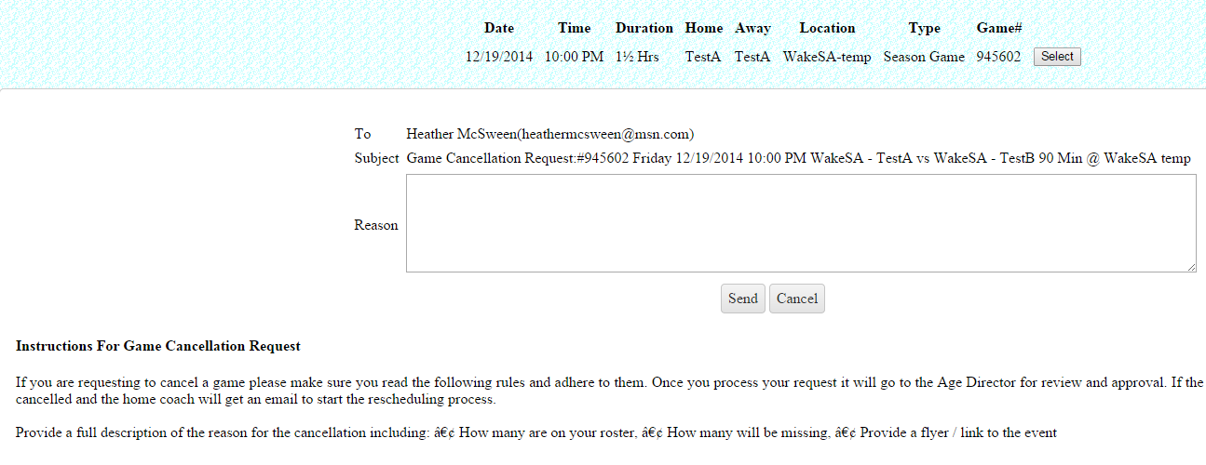
Game Cancellation Cont.
A page requiring the reason pops up for the Coach to fill out. Instructions and rules
Are displayed on the page so the coach knows what is required to Cancel.

Slide 3
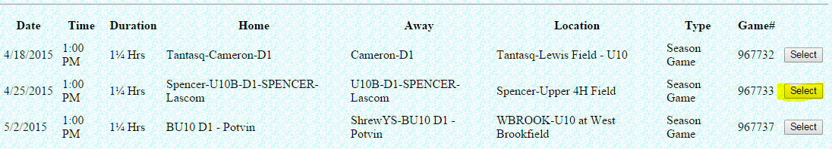
Game Selection page for cancellation request – Click the Select button

Slide 4
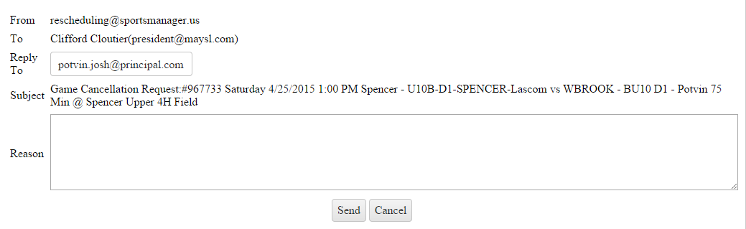
Enter reason for cancellation request and click send.

Slide 5
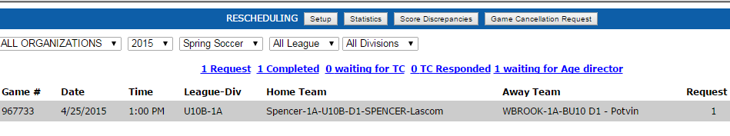
The request is shown in the queue on the MAYSL site as waiting for approval

