Slide 1

Grafton Soccer Club
Revolution Academy

Slide 2
Current Soccer Environment
100 different coaches =
  100 different languages +
  100 different game and practice philosophies +
  100 technical and tactical philosophies +
11 different clubs with
  11 different languages
  11 different game and practice
  11 different technical and Tactical philosophies

Slide 3
What does is equal
One confused Kid
One frustrated Kid
One kid less likely to have success and fun in soccer
One Hot Mess!!!!!

Slide 4

One Game
One Language
One Style of Play
Academy Coaches Group Training
One Curriculum
Academy skills sessions
Academy Squads

Slide 5
Consistent
Training
Language
Less Confusion
Easier Transitions
Happier kids that are more likely to stick around longer

Slide 6
Components
Skills Academy – Professional Training night one night a week
Group night training – Professional coach mentoring our U8 and U10 coaches
Academy Squads – selected teams that train with a professional coach 2 days a week with one game (would preclude a child from playing club)
Technical Director – 3 hours per week would handle all details and parent interaction with Rev’s program

Slide 7
Time Crunch
GSC 2-3 sessions per week
Club Soccer 3-5 sessions per week
Other Sports 2-3 sessions per week
  5-8 sessions a week of Soccer plus other sports
  “Burnout in Youth Sports” 156K google hits

Slide 8
Better Way
Rev’s Academy Squad replaces both Town and Club teams
Decrease in sessions per week of 2-3 (From 5-8 down to 3-4)
Would allow kids to freely play other sports without nearly the amount of conflicts

Slide 9
US Soccer recommends
3 Sessions per week at U12 and U13
2 90 minute training session
1 70 minute game

Slide 10
Revs academy schedule will include
2 60-90 minute training sessions per week
1 Game
1 60 minute skills session optional
Players will not be allowed to play club soccer
Commitment is for one year (Fall and Spring seasons)

Slide 11
Fall session
League play will be U14 Mays
Exist the option of promotion to Maple (depending on if the team’s opponent’s in Mays are competitive)

Slide 12
Cost
Includes
  GSC League Fees
  Maple or Mays League Fees
  Coaching Fees (for Rev’s coach)
  Skills Academy Fees
  Will be less than $1,000 for the year

Slide 13
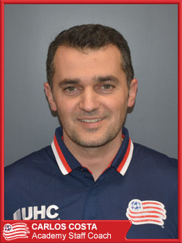
Carlos Costa
Bachelor of Science in Physical Education
Master's Degree in Health Education
NSCAA Regional Diploma
NSCAA National Diploma
NSCAA Advanced National Diploma
Former Coach Bellingham HS
Employment
Bellingham High School
Santa Clara Soccer School
New England Revolution Academy

Slide 14
Tryouts
Boys
Tuesday May 31st 6:30 - 7:30 @Riverview
Wednesday June 1st 5:30 - 6:30 @ Riverview
Girls
Tuesday May 31st 5:30- 6:30 @Riverview
Wednesday June 1st 6:30 - 7:30 @ Riverview
The first night will be small area games
The second night will be large field scrimmage

