Slide 1
Coaches Meeting Travel League Overview
Ciro Toscano
MAYSL Town Rep

Slide 2
Overview
Grafton Soccer Club participates in the Midland Area Youth Soccer League (MAYSL)
WHAT TO DO:
  BEFORE THE FIRST GAME
  BEFORE EACH GAME/AT THE START OF THE GAME
  DURING THE GAME
  AFTER THE GAME
WHERE TO FIND INFORMATION
  LEAGUE RULES AND BYLAWS
  SOCCER RULES
SPORTSMANAGER HIGHLIGHTS

Slide 3
BEFORE THE FIRST GAME
Review your schedule on SportsManager for potential issues
  Limited allowable reschedules (school or religious)
Make copies of your “OFFICIAL” roster
  This is the only roster you should ever use or club is fined!!!
  Make sure all numbers are on roster and match uniforms
  Roster change process to be strictly followed
Make sure you have your Pass Card and Lanyards
Verify your primary email on SportsManager
Provide team instructions to access schedule and directions
Provide Parent Code of Conduct
Make sure you are familiar with league/ FIFA soccer rules!!!
Make sure you are familiar with ZERO TOLERANCE POLICY

Slide 4
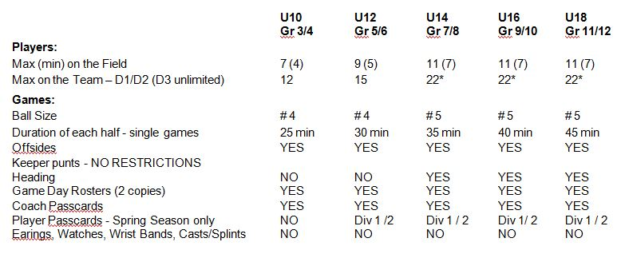
QUICK FACTS
Maximum 3 coaches w/pass cards/lanyards on sidelines

Slide 5
BEFORE/AT START OF EACH GAME
Check the schedule ON-LINE for any changes
Contact your opposing coach confirming time and location
Make sure you know what to do for weather related issues
  Home games – GSC closes fields OR ref cancels at field otherwise need 2 hrs notice and you need to get in touch with me 617-957-2415
  Away Games – stay in touch with coach and check emails/schedule
Check field/goals prior to the start of game (home coach)
Referee introductions and rosters submittal (2 copies)
  Referee no-show: Wait time is 15 min. Options: not play or play with a mutually acceptable substitute ref (add comment to game report)
Team Check-in/Coin-toss
  Discuss expectations prior to start of season
  Select two captains

Slide 6
DURING/AFTER THE GAME
Follow Zero Tolerance Rules/Parental code of conduct
  Discuss any issues “politely” at halftime or after the game
Substitutions – At midfield with referee’s approval
  Own throw in/opponents throw in (if substituting)/ goal kick
No heading U10/U12 (indirect kick)
Team/Referee Handshakes (good game) - Conduct
Learn the rules of the game before the season
  FIFA Laws of the game
Enter score on SportsManger
  Complete referee evaluation/game report

Slide 7
WHERE TO FIND INFORMATION
USSF rules can be found at http://www.fifa.com/worldfootball/lawsofthegame.html
MAYS rules and other information can be found at www.sportsmanager.us/OrgManager/MAYSL.htm
Grafton Soccer Club information can be found at www.gscsoccer.org

Slide 8
SPORTSMANAGER HIGHLIGHTS
Team Information Package
  View Roster/Update Jersey Numbers
Email/Text Team
View Schedules/Standings/Field Directions/Contacts
Score Games
Request a Game Cancellation
Reschedule Games
    Home team starts process (cancellation link from SportManager)
    Get field availability and propose 3 dates
    Discussing the dates in advance can expedite the process

