Slide 1
Coaches Meeting
2018 Spring Season
Saturday, March 24th - Coaches Clinic @ GHS GYM
Hosted by the Revs Academy Staff
· U6 & U8 Coaches Session – 9:00 to 10:30
· U10+ Coaches Session – 10:30 to 12.00pm
All coaches should plan to attend. If you have never received a coaching license this is mandatory.

Slide 2
MISSION STATEMENT
The Grafton Soccer Club provides an opportunity for the youth of Grafton to participate and develop in the game of soccer within a fun and safe environment, promoting individual skills and fitness, team play, sportsmanship and a passion for the game.

Slide 3
Hi COACH!
Coaches you are now a role model for the young players. Understand who we are coaching. Consider the long-term development of the children.
Be aware of the indirect lessons you are teaching the children. They are watching and listening to you.
You are our representatives. Our Club ambassadors. Make Grafton and GSC proud!

Slide 4
PRACTICE & GAME EXPECTATIONS
Player Safety
Concussion Prevention / No head balls U12 and under
Only coaches with league approved passcards may be on field with the players.
Player Development
Age appropriate expectations
Touches, Touches, Touches
No Laps, NO Lines, No Lectures, and Watch Your Language
KEEP IT POSITIVE!! www.positivecoach.org
Coaches tend to focus on what players should do better, instead of positively reinforcing what they are doing right. Both types of feedback are necessary for player skill development.
A Positive Coach will celebrate many “wins” during a season despite what the final scores are.

Slide 5
PRACTICE EXPECTATIONS
Prepare a Practice Plan
Age Appropriate and with a Specific Theme
Helpful Resources / Steal a Practice Plan
  http://www.mayouthsoccer.org/coaches/session_plans/
  http://www.gscsoccer.org/
    Click on the Revolution Academy Icon and then Group Night. The Practice Plans there are available for use.
    U8 plans -> password: grafton3&4
    U10 plans -> password: grafton5&6
    U12+ plans -> password: grafton7&8

Slide 6
EVALUATIONS
Every Coach for Every Player.
All evaluations must be completed thoughtfully and emailed to your Age Group Coordinator and me.

Slide 7
EVALUATIONS EXAMPLE
 |  |  | Player Evaluation Form - Travel U12
Season: Fall 2017
Coach: Bob Troast
Age Group: Fall U12
# | Player | Grade in school this season | Rank team from #1(strongest player). The top player on your team is 1, the next is 2, etc. | Estimate each player's skill level in relation to the league overall (top 10%, top 25%, top 50%, or bottom 50%) | Rate the player's foot skills compared to the group: strong OR average OR still developing | In a game situation, is the player: aggressive and engaged in the game, OR following the group of kids and unlikely to touch the ball, OR disconnected from the play | Positioning: Does the player understand and exercise field positioning during a game? Yes, no, or sometimes | Practice Attitude: eager and pays attention OR easily distracted OR difficult at practice | Notes
89 | Alderton, Lucas | 5 | 9 | top 50% | Average | Aggressive and Engaged most of the time | Sometimes | Eager and pays attention
97 | Brousmiche, Garrett | 5 | 1 | top 10 | Strong | Aggressive and Engaged | Yes | Eager and pays attention
88 | Cable, Sean | 5 | 9 | top 50% | Average | Aggressive and Engaged most of the time | Yes | Easily Distracted
85 | Connolly, Joseph | 5 | 8 | top 50% | Average | Aggressive and Engaged | Sometimes | Eager and pays attention
57 | Hanna, James | 5 | 4 | top 25 | Strong | Aggressive and Engaged | Sometimes | Eager and pays attention
53 | Harger, Joseph | 5 | 7 | top 50% | Average | Aggressive and Engaged | Sometimes | Eager and pays attention
12 | Haroutunian, Van | 5 | 15 | bottom 50% | Still Developing | Disconnected | No | Difficult at Practice
98 | Martinez, Joseluis | 5 | 13 | bottom 50% | Still Developing | Following and unlikely to touch the ball | No | Easily Distracted
92 | McInerny, Lucas | 5 | 12 | bottom 50% | Average | Aggressive and Engaged most of the time | Sometimes | Easily Distracted
42 | Opacki, Owen | 5 | 11 | top 50% | Average | Aggressive and Engaged | No | Easily Distracted
10 | Patel, Aarav | 5 | 4 | top 25% | Strong | Aggressive and Engaged | Sometimes | Eager and pays attention
83 | Proulx, Zachary | 5 | 13 | bottom 50% | Still Developing | Following and unlikely to touch the ball | No | Easily Distracted
33 | Sizensky, Mathieu | 5 | 1 | top 10 | Strong | Aggressive and Engaged | Yes | Eager and pays attention
87 | Troast, Robert | 5 | 4 | top 25% | Average | Aggressive and Engaged | Yes | Eager and pays attention
93 | Yarrow, Tyler | 5 | 1 | top 10 | Strong | Aggressive and Engaged | Yes | Eager and pays attention

Slide 8

Guest Speaker
Wendy Bell will be sharing valuable insights in child development.
13+ years of experience teaching elementary school students in both the 3rd and 4th grades.
5+ years as an elementary school principal at Paton Elementary School in Shrewsbury.
Wendy is a Grafton mom of 3 awesome kids and serves on the GSC BOD.

Slide 9
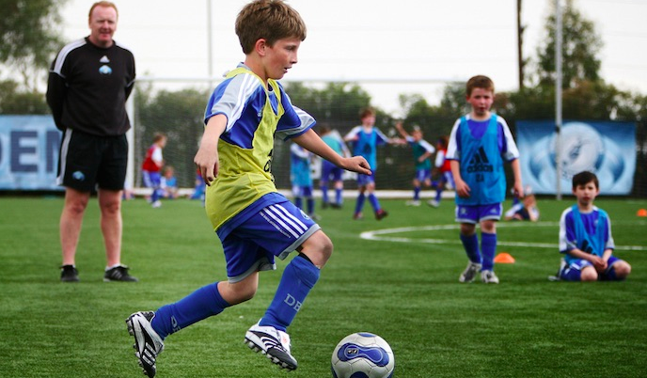

Child Development 101
“Sports, when approached in the right way, can be as valuable as academics in the development of a happy child.”
- Dr. Edward M. Hallowell, child and adult psychiatrist specializing in ADD/ADHD

Slide 10

Three Developmental Domains
Psychomotor: Physical Domain
Cognitive: Learning Domain
Psychosocial: Emotional Domain
Notes:
Must consider all 3 when thinking about how developed a child is. Some students are physically larger, but emotionally and cognitive young. Some are cognitive strong and can take in a lot of information and understand for instance, how to play the game, but have difficulty physically completing the tasks.

Slide 11
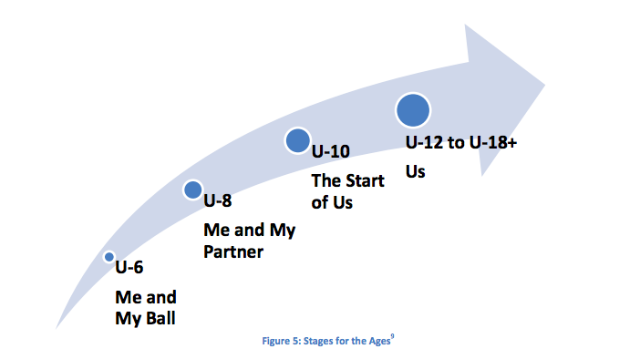
Developmental Continuum
US Youth Soccer Player Development Model 2012
Notes:
You can think about development in soccer skills as going from egocentric to team-centric as the child progresses in years.

Slide 12
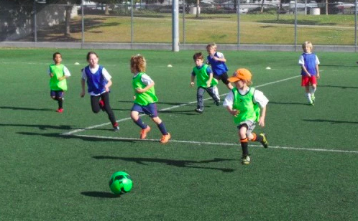
U6 (Ages 4-6) Development
Egocentric, highly imaginative
Too much information overwhelming
Psychomotor
  Running, jumping, skipping, hopping, balance not fully developed
  Changing direction often results in tumbling
  Play full speed until they drop, rest briefly, then return to full speed
Cognitive
  Linking skills together challenging
  Do well with one task at a time
  Visual demonstration necessary
  In soccer this equates to: “My ball”
  Boundaries and Directionality are meaningless
Psychosocial
  One “best friend”
  Just learning how to socialize in larger groups
Notes:
When working with our youngest children it is crucial to consider that not one of the three areas of development are “working” well yet. U6 coaches have the hardest job. You have to keep attention, keep it fun, and keep it organized “chaos”.

Slide 13
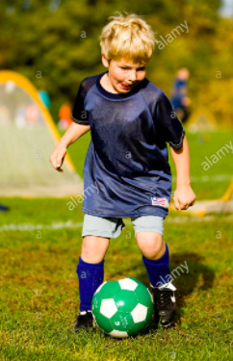
Characteristics of U6 Athletes
“Me and My Ball”
Constantly in motion
Short attention span (easily distracted)
Egocentric
Parallel Play
Easily bruised psychologically
Primitive eye-foot and eye/hand coordination
Little concern for team activities
Balance on the dominant foot
No sense of pace; they will often run until they drop
Catching skills not developed
Notes:
Children like to play parallel with others but side-by-side rather than together – “Me first…” rather than “Let’s both do this

Slide 14
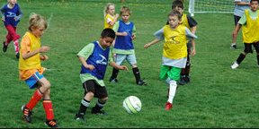
U8 (Ages 6-8) Development
Development of structure, cooperative play and development of friendships, thinking beyond themselves and begin to look to actively pass to a teammate.
Psychomotor:
  Skeletal system growing- beware of injuries to growth plates
  Cardiovascular system less efficient- takes longer to recover and cool down
Cognitive:
  Controlling ball takes most of attention, so tactical decision making is weak
  Personal evaluation weak- believe if they tried hard they performed well
Psychosocial:
  Great need for approval of adults
  Like to show off skills
  Play because it is FUN, team identity is limited.
  “Level” and “Ability” concepts non-existent

Slide 15
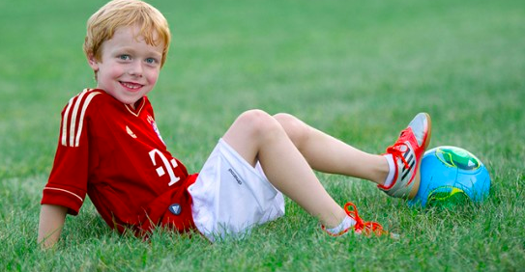
Characteristics of U8 Athletes
“Me, the ball, and my friend”
Attention span is a bit longer than the U-6 player, but still not at the “team at all costs” intensity
Inclined more toward group activities
Still in constant motion
Still very sensitive (dislike personal failure in front of peers); ridicule from the coach in front of the group is very destructive
Beginning to develop some physical confidence
Still into running, jumping, climbing and rolling
More into imitation of the big guys (pro soccer players, HS athletes)
Still lack a sense of pace; will run very hard most of the time and chase the ball until they drop

Slide 16
Questions?

Slide 17
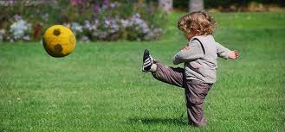
In Town Program
VP Girls In Town – Dan Wright
  Girls U6 Coordinator – Brian Gerwe
  Girls U8 Coordinator – Brendan Ryan
VP Boys In Town – George Stifo
  Boys U8 Coordinator – Erica Vellone

