Slide 1
Coaches Meeting
2018 Spring Season
Saturday, March 24th - Coaches Clinic @ GHS GYM
Hosted by the Revs Academy Staff
· U6 & U8 Coaches Session – 9:00 to 10:30
· U10+ Coaches Session – 10:30 to 12.00pm
All coaches should plan to attend. If you have never received a coaching license this is mandatory.

Slide 2
MISSION STATEMENT
The Grafton Soccer Club provides an opportunity for the youth of Grafton to participate and develop in the game of soccer within a fun and safe environment, promoting individual skills and fitness, team play, sportsmanship and a passion for the game.

Slide 3
Hi COACH!
Coaches you are now a role model for the young players. Understand who we are coaching. Consider the long-term development of the children.
Be aware of the indirect lessons you are teaching the children. They are watching and listening to you.
You are our representatives. Our Club ambassadors. Make Grafton and GSC proud!

Slide 4
PRACTICE & GAME EXPECTATIONS
Player Safety
Concussion Prevention / No head balls U12 and under
Only coaches with league approved passcards may be on field with the players.
Player Development
Age appropriate expectations
Touches, Touches, Touches
No Laps, NO Lines, No Lectures, and Watch Your Language
KEEP IT POSITIVE!! www.positivecoach.org
Coaches tend to focus on what players should do better, instead of positively reinforcing what they are doing right. Both types of feedback are necessary for player skill development.
A Positive Coach will celebrate many “wins” during a season despite what the final scores are.

Slide 5
PRACTICE EXPECTATIONS
Prepare a Practice Plan
Age Appropriate and with a Specific Theme
Helpful Resources / Steal a Practice Plan
  http://www.mayouthsoccer.org/coaches/session_plans/
  http://www.gscsoccer.org/
    Click on the Revolution Academy Icon and then Group Night. The Practice Plans there are available for use.
    U8 plans -> password: grafton3&4
    U10 plans -> password: grafton5&6
    U12+ plans -> password: grafton7&8

Slide 6
EVALUATIONS
Every Coach for Every Player.
All evaluations must be completed thoughtfully and emailed to your Age Group Coordinator and me.

Slide 7
EVALUATIONS EXAMPLE
 |  |  | Player Evaluation Form - Travel U12
Season: Fall 2017
Coach: Bob Troast
Age Group: Fall U12
# | Player | Grade in school this season | Rank team from #1(strongest player). The top player on your team is 1, the next is 2, etc. | Estimate each player's skill level in relation to the league overall (top 10%, top 25%, top 50%, or bottom 50%) | Rate the player's foot skills compared to the group: strong OR average OR still developing | In a game situation, is the player: aggressive and engaged in the game, OR following the group of kids and unlikely to touch the ball, OR disconnected from the play | Positioning: Does the player understand and exercise field positioning during a game? Yes, no, or sometimes | Practice Attitude: eager and pays attention OR easily distracted OR difficult at practice | Notes
89 | Alderton, Lucas | 5 | 9 | top 50% | Average | Aggressive and Engaged most of the time | Sometimes | Eager and pays attention
97 | Brousmiche, Garrett | 5 | 1 | top 10 | Strong | Aggressive and Engaged | Yes | Eager and pays attention
88 | Cable, Sean | 5 | 9 | top 50% | Average | Aggressive and Engaged most of the time | Yes | Easily Distracted
85 | Connolly, Joseph | 5 | 8 | top 50% | Average | Aggressive and Engaged | Sometimes | Eager and pays attention
57 | Hanna, James | 5 | 4 | top 25 | Strong | Aggressive and Engaged | Sometimes | Eager and pays attention
53 | Harger, Joseph | 5 | 7 | top 50% | Average | Aggressive and Engaged | Sometimes | Eager and pays attention
12 | Haroutunian, Van | 5 | 15 | bottom 50% | Still Developing | Disconnected | No | Difficult at Practice
98 | Martinez, Joseluis | 5 | 13 | bottom 50% | Still Developing | Following and unlikely to touch the ball | No | Easily Distracted
92 | McInerny, Lucas | 5 | 12 | bottom 50% | Average | Aggressive and Engaged most of the time | Sometimes | Easily Distracted
42 | Opacki, Owen | 5 | 11 | top 50% | Average | Aggressive and Engaged | No | Easily Distracted
10 | Patel, Aarav | 5 | 4 | top 25% | Strong | Aggressive and Engaged | Sometimes | Eager and pays attention
83 | Proulx, Zachary | 5 | 13 | bottom 50% | Still Developing | Following and unlikely to touch the ball | No | Easily Distracted
33 | Sizensky, Mathieu | 5 | 1 | top 10 | Strong | Aggressive and Engaged | Yes | Eager and pays attention
87 | Troast, Robert | 5 | 4 | top 25% | Average | Aggressive and Engaged | Yes | Eager and pays attention
93 | Yarrow, Tyler | 5 | 1 | top 10 | Strong | Aggressive and Engaged | Yes | Eager and pays attention

Slide 8
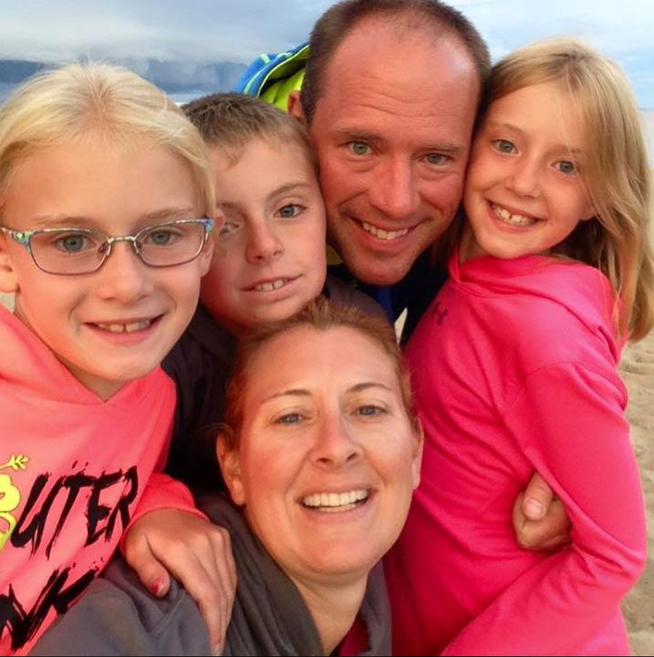
Guest Speaker
Wendy Bell will be sharing valuable insights in child development.
13+ years of experience teaching elementary school students in both the 3rd and 4th grades.
5+ years as an elementary school principal at Paton Elementary School in Shrewsbury.
Wendy is a Grafton mom of 3 awesome kids and serves on the GSC BOD.

Slide 9

Continuum of Youth Soccer Development
“Sports, when approached in the right way, can be as valuable as academics in the development of a happy child.”
- Dr. Edward M. Hallowell, child and adult psychiatrist specializing in ADD/ADHD

Slide 10

Three Developmental Domains
Psychomotor: Physical Domain
Cognitive: Learning Domain
Psychosocial: Emotional Domain

Slide 11
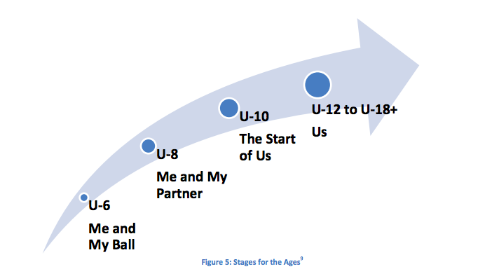
Developmental Continuum
US Youth Soccer Player Development Model 2012

Slide 12
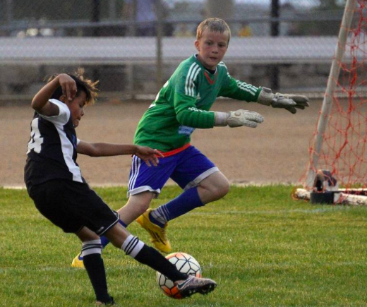
U10 (ages 8-10) Development
Team Identity, learn fundamentals, build sports skills
Psychomotor
  Great gains in strength, endurance, and power.
  Large variability in size and strength of children this age
Cognitive
  Growing ability to recall (memory), can remember and follow more complex instructions therefore can solve higher-level problems
  Can focus longer and stay “on task”
  Beginning to think in advance of an action about cause/effect.
  Aware of what they do and don’t know
Psychosocial
  Begin to initiate play on their own
  Becoming more serious about their play and who they want to play with
  Peer group attachment and peer pressure becomes significant, need to belong
  Play for FUN

Slide 13
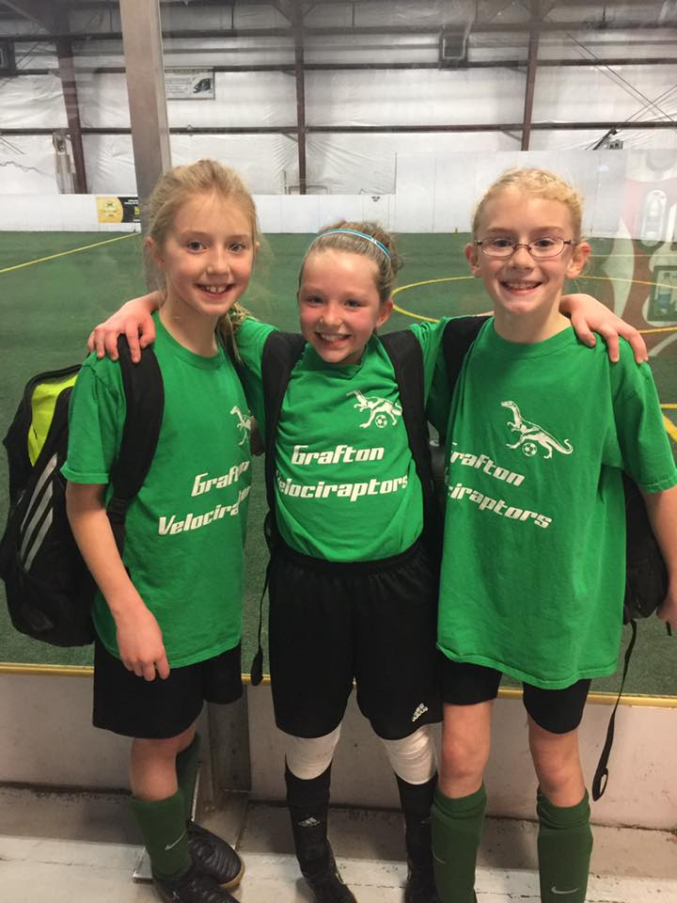
Characteristics of U10 Athletes
“The Start of Us”
In soccer, can control a ball, some mastery of skills
Beginning to anticipate a game as it unfolds
Beginning to apply strategy to a game that involves multiple players on the field/court
Becoming very self-aware of what they can and can’t do
Longer attention span, can typically focus on multiple directions at a time

Slide 14
U12 (ages 10-12) Development
For the love of the game. Many players at this age are deciding if they want to commit deeply to soccer, stay in the game with a part-time commitment, or drop the sport altogether.
Psychomotor
  strength and power becomes a factor in performance
  Can strike the ball with ample distance and directional confidence
  Coordination improves, gains confidence with the ball above their waist
Cognitive
  Can sequence thoughts and actions to perform more complex tasks
  Understands the game and uses teammates to help solve problems on the field
  Reasonable game results can be expected: can run strike ball, and think simultaneously
Psychosocial
  Cliques, popularity influences self-esteem, acceptance in the group is crucial
Notes:
The coach must also be sensitive to the many biological and psychological changes that are occurring for these children now and through the U-14 agegroup.

Slide 15
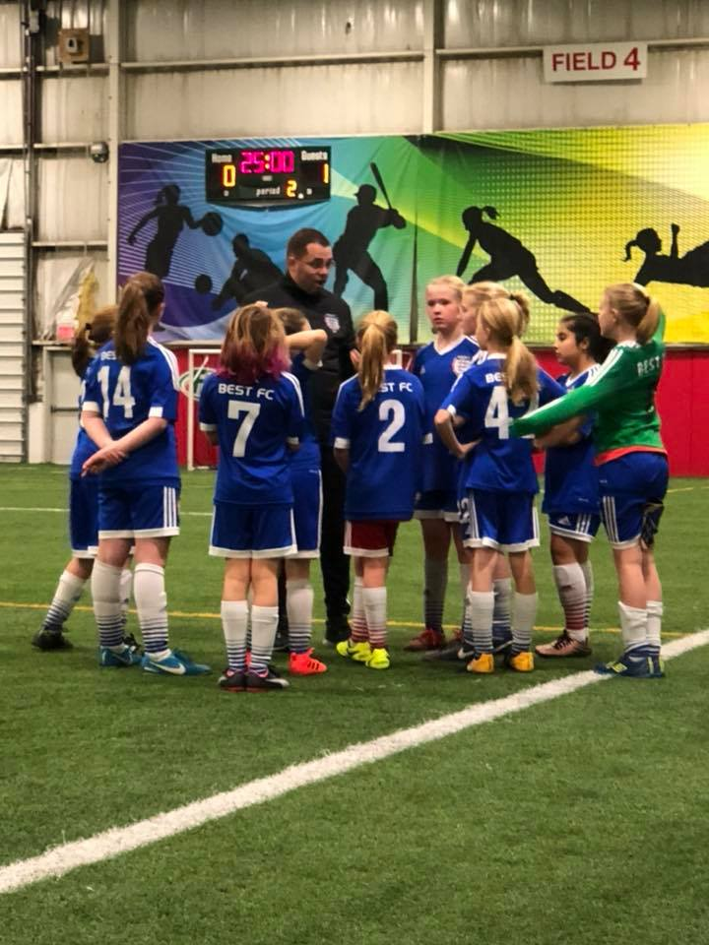
Characteristics of U12 Athletes
“Us”
Fertile period for learning- myriad of problems, but gold mine for learning
Follows complex instruction
Can create own variations of the game
Can participate in tactical strategy
Can combine skills and produce simultaneously
Performance during match play is inconsistent
Should be able to pass successfully most of the time
Fun is not necessarily the motivator anymore: nature of training sessions is crucial- it will stimulate or stifle the learning process
Notes:
Nice picture!

Slide 16
Questions?

Slide 17
Coaches Meeting Travel League Overview
Ciro Toscano
MAYSL Town Rep

Slide 18
Overview
Grafton Soccer Club participates in the Midland Area Youth Soccer League (MAYSL)
WHAT TO DO:
  BEFORE THE FIRST GAME
  BEFORE EACH GAME/AT THE START OF THE GAME
  DURING THE GAME
  AFTER THE GAME
WHERE TO FIND INFORMATION
  LEAGUE RULES AND BYLAWS
  SOCCER RULES
SPORTSMANAGER HIGHLIGHTS

Slide 19
BEFORE THE FIRST GAME
Review your schedule on SportsManager for potential issues
  Limited allowable reschedules (school or religious)
Make copies of your “OFFICIAL” roster
  This is the only roster you should ever use or club is fined!!!
  Make sure all numbers are on roster and match uniforms
  Roster change process to be strictly followed
Make sure you have your Pass Card and Lanyards
Verify your primary email on SportsManager
Provide team instructions to access schedule and directions
Provide Parent Code of Conduct
Make sure you are familiar with league/ FIFA soccer rules!!!
Make sure you are familiar with ZERO TOLERANCE POLICY

Slide 20
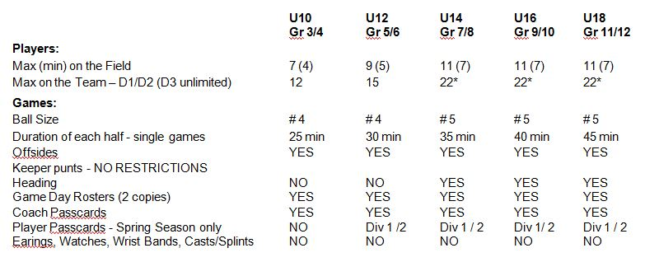
QUICK FACTS
Maximum 3 coaches w/pass cards/lanyards on sidelines

Slide 21
BEFORE/AT START OF EACH GAME
Check the schedule ON-LINE for any changes
Contact your opposing coach confirming time and location
Make sure you know what to do for weather related issues
  Home games – GSC closes fields OR ref cancels at field otherwise need 2 hrs notice and you need to get in touch with me 617-957-2415
  Away Games – stay in touch with coach and check emails/schedule
Check field/goals prior to the start of game (home coach)
Referee introductions and rosters submittal (2 copies)
  Referee no-show: Wait time is 15 min. Options: not play or play with a mutually acceptable substitute ref (add comment to game report)
Team Check-in/Coin-toss
  Discuss expectations prior to start of season
  Select two captains

Slide 22
DURING/AFTER THE GAME
Follow Zero Tolerance Rules/Parental code of conduct
  Discuss any issues “politely” at halftime or after the game
Substitutions – At midfield with referee’s approval
  Own throw in/opponents throw in (if substituting)/ goal kick
No heading U10/U12 (indirect kick)
Team/Referee Handshakes (good game) - Conduct
Learn the rules of the game before the season
  FIFA Laws of the game
Enter score on SportsManger
  Complete referee evaluation/game report

Slide 23
WHERE TO FIND INFORMATION
USSF rules can be found at http://www.fifa.com/worldfootball/lawsofthegame.html
MAYS rules and other information can be found at www.sportsmanager.us/OrgManager/MAYSL.htm
Grafton Soccer Club information can be found at www.gscsoccer.org

Slide 24
SPORTSMANAGER HIGHLIGHTS
Team Information Package
  View Roster/Update Jersey Numbers
Email/Text Team
View Schedules/Standings/Field Directions/Contacts
Score Games
Request a Game Cancellation
Reschedule Games
    Home team starts process (cancellation link from SportManager)
    Get field availability and propose 3 dates
    Discussing the dates in advance can expedite the process

Slide 25
Thank You!
(Now go home, or go downstairs.. downstairs is better)

