Slide 1
Coaches Meeting
2021 Spring Season

Slide 2
MISSION STATEMENT
The Grafton Soccer Club provides an opportunity for the youth of Grafton to participate and develop in the game of soccer within a fun and safe environment, promoting individual skills and fitness, team play, sportsmanship, and a passion for the game.

Slide 3
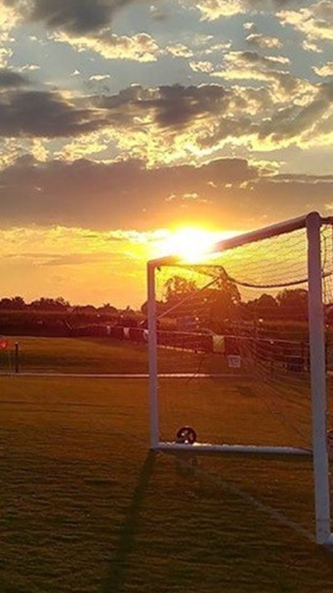
Player Safety
EEE, Concussions, and Overall Safety
& the MYSA Return to Soccer Guidelines
KEEP IT POSITIVE!! www.positivecoach.org
Notes:
Player Safety
Concussion Prevention / No head balls U12 and under – this is also the reason no younger players are permitted to play up to U14.
Only coaches with credentials may be on field with the players.
Player Development
Age appropriate expectations
Touches, Touches, Touches
KEEP IT POSITIVE!! www.positivecoach.org
Coaches tend to focus on what players should do better, instead of positively reinforcing what they are doing right. Both types of feedback are necessary for player skill development.
A Positive Coach will celebrate many “wins” during a season despite what the final scores are.

Slide 4
Return to Soccer Guidelines
Fall 2020 and Winter 2020/21
Mass Youth Soccer = Success
The Protocols Work and it is important each club and team resists complacency through the Spring season.

Slide 5
Return to Soccer Guidelines (cont)
November 2020
Mass Youth Soccer removed the previous COVID game modifications except for face coverings requirements.
Play the game per league rules

Slide 6
Return to Soccer Guidelines (cont)
March 22, 2021
No limit stated as actual numbers of spectators in total or per player for outdoor games/practices.
Spectators should be respectful of any specific field rules when traveling.
Spectators should stay in family pods and stay 6 ft from other family pods.

Slide 7
Return to Soccer Guidelines (cont)
Player’s Face Coverings
Required while actively playing and while on the sidelines
Face Covering may be pulled down for a short mask break as long as they are 6’ or more away from others.
Face coverings must be worn during arrival and departure from the field.

Slide 8
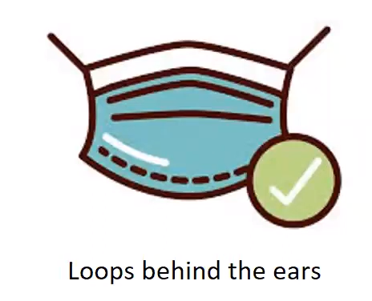
Return to Soccer Guidelines (cont)
Acceptable Masks for Players

Slide 9
Return to Soccer Guidelines (cont)
Please do not have any team gathering before or after soccer activities.
It is important to stay vigilant with Social Distancing!

Slide 10
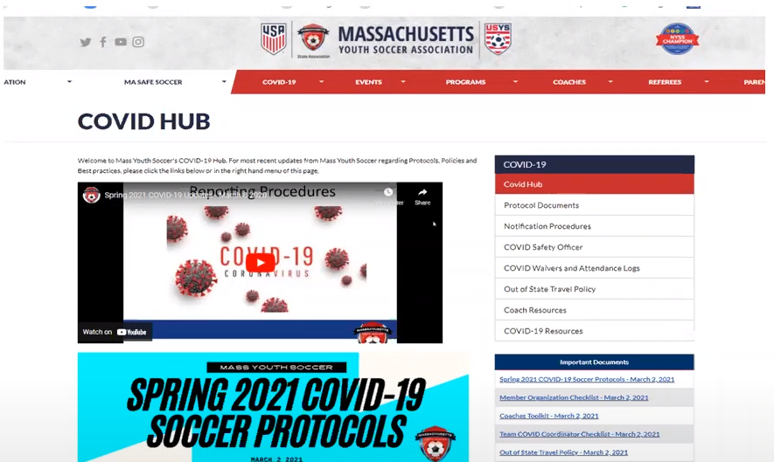
Resources

Slide 11
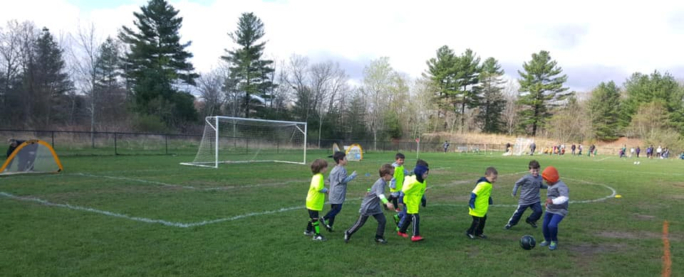
Coaching Young Players
I want to have fun
I want to play games
I want to be challenged and learn
I don’t want to be lectured
I don’t want to take laps
I don’t want to stand in line

Slide 12
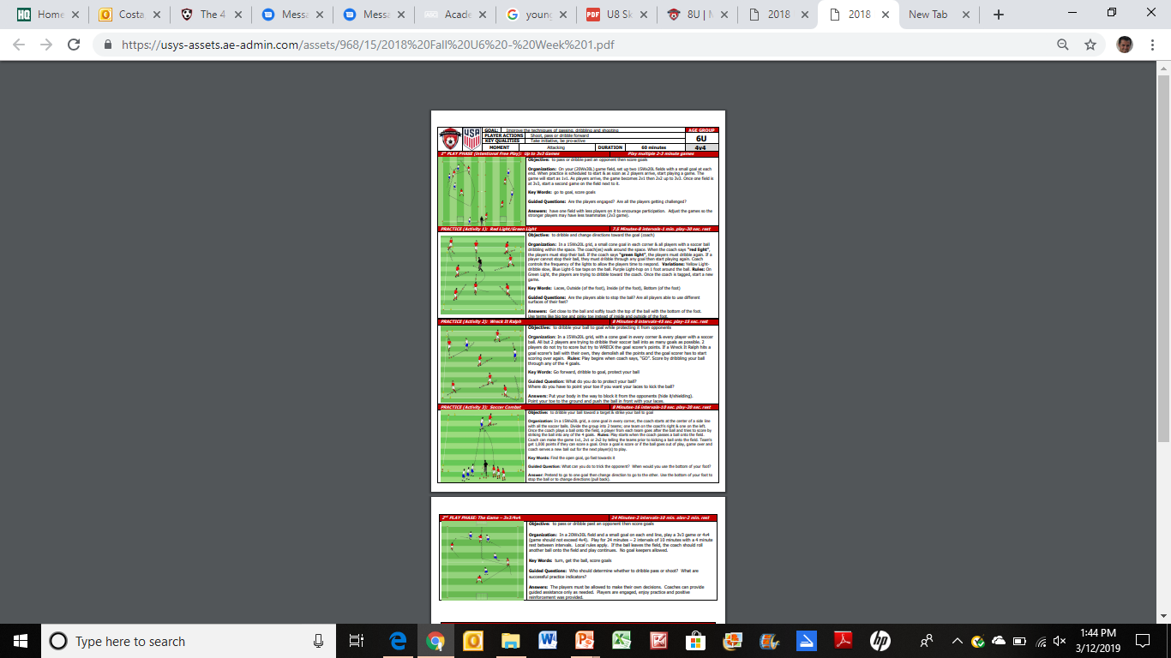
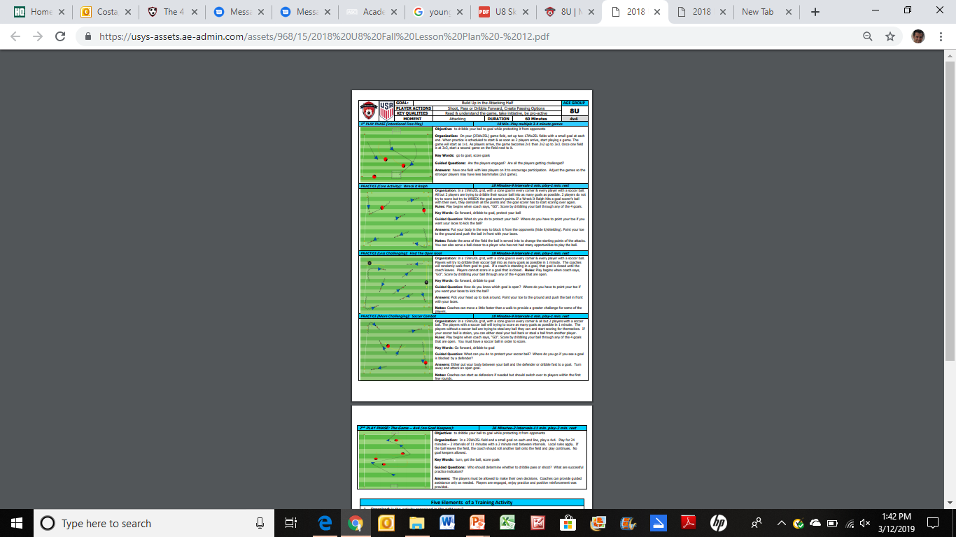
Practice Plan Framework
U 6
U 14
PLAY
PRACTICE
PLAY

Slide 13
Practice Plan Framework
PLAY
PRACTICE
PLAY
Upon player arrival, players should engage in small-sided
games (1v1, 2v1, 2v2). This is the warm-up. Coach should
provide the boundaries and allow the players to discover
Solutions. Minimal direction from coaches.
Players are engaged in different forms of targeted learning
The theme of the practice is introduced in this phase and
this is the instructional section of the practice. Players
should experience a balance of both success and failure
during the practice stage (appropriate level of challenge).
Practices should allow for the opportunity to play in a
game-like environment with freedom and without
Interruption. The coach should celebrate when the
players demonstrate the lesson of the practice during this
play.

Slide 14
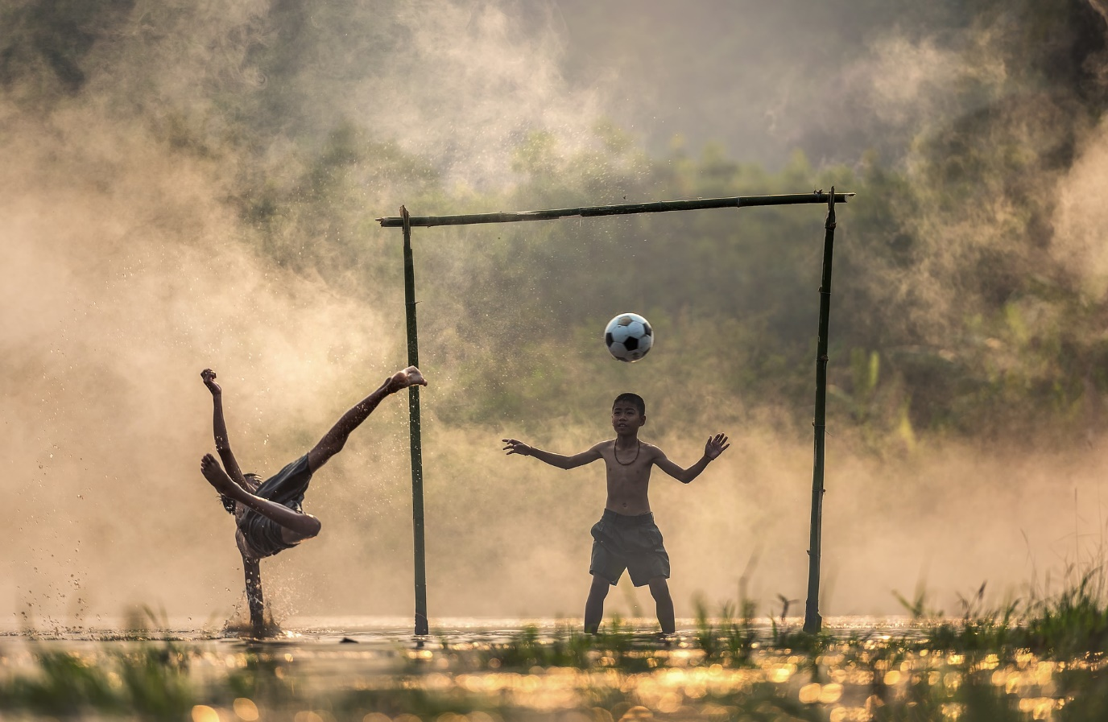
Evaluations
Every Coach for Every Player.
Emailed to your Age Group Coordinator

Slide 15
Open BOD Positions
Secretary
VP Girls In Town
Notes:
Player Safety
Concussion Prevention / No head balls U12 and under – this is also the reason no younger players are permitted to play up to U14.
Only coaches with credentials may be on field with the players.
Player Development
Age appropriate expectations
Touches, Touches, Touches
KEEP IT POSITIVE!! www.positivecoach.org
Coaches tend to focus on what players should do better, instead of positively reinforcing what they are doing right. Both types of feedback are necessary for player skill development.
A Positive Coach will celebrate many “wins” during a season despite what the final scores are.

Slide 16
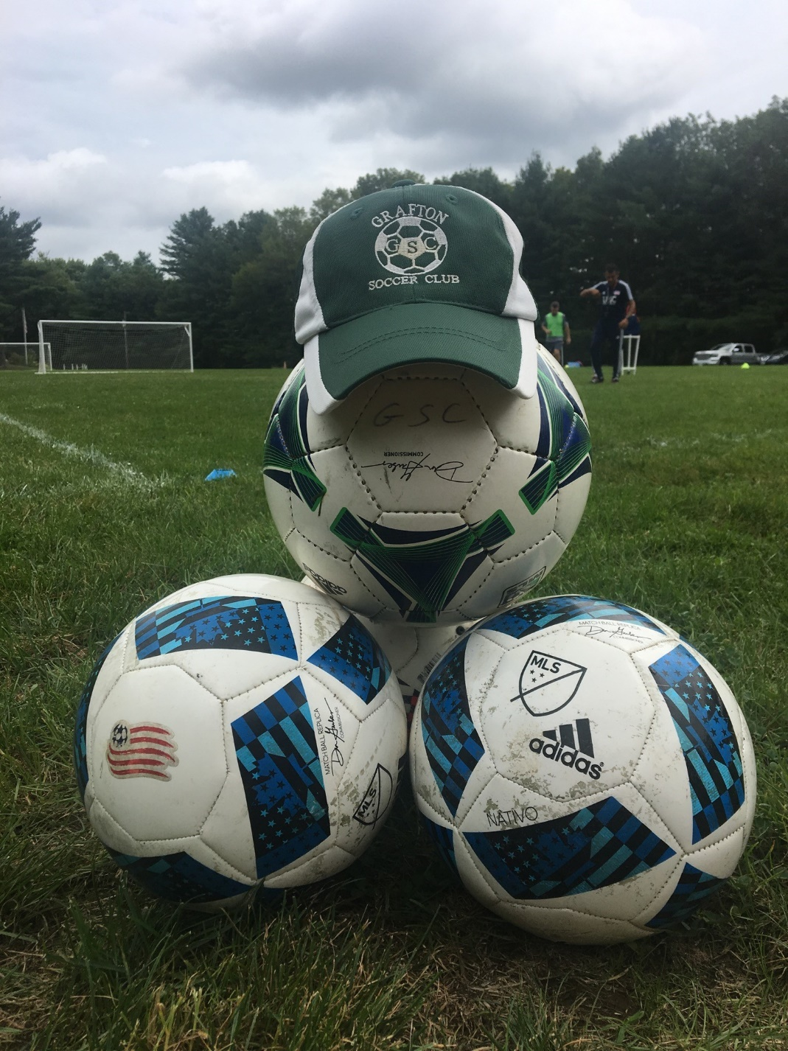
Thank you

