Slide 1

GETTING THE MOST OUT OF THE NEW SEASON
1st & 2nd Grade
Fall 2023
SESSION PLAN PACK
MANSFIELD YOUTH SOCCER

Slide 2
At the grassroots level, children learn and develop to their full potential through game-like experiences in an enjoyable environment that supports individual growth.

Slide 3
GETTING PLAYERS READY TO PLAY
Each week, think about how you can make it slightly harder for the players by increasing the complexity of an activity.
Respect each child as an individual and adapt the session or challenge to meet their ability level.
Throughout the season try to pair or
group players together for different
outcomes so that their individual needs are met more often.
Warm-ups for our young players should be engaging, enjoyable and active.
Start with small sided games
Always end with a game/scrimmage. Allow players the opportunity to execute the session objectives.
Stick to one session topic (for example scoring goals to allow players the opportunity to execute the desired task
Allow players the opportunity to learn through guided discovery, using key words and guided questions.
All sessions should be as close to the game as possible. Ensure all activities are fun and include the ball.

Slide 4
Week One

Slide 5
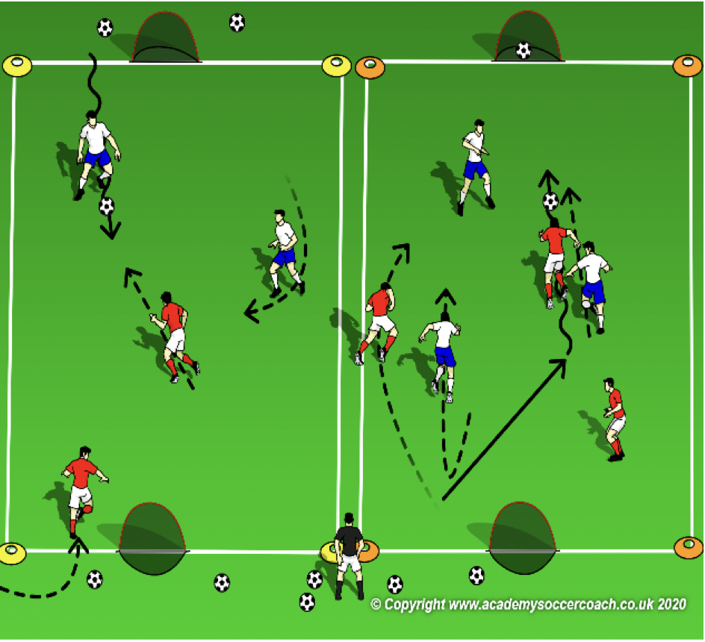
PLAY 1 –1st & 2nd Grade
ORGANIZATION
Mark out two fields. (Field size dependent on age group)
Free play:
Field 1: Teams play 2v2/3v3 or 4v4 (Depending on age group and number of players.
Field 2: Teams play 2v2/3v3 or 4v4 (Depending on age group and number of players.
Allow players to play freely introducing key words
PLAYER ACTIONS
-Pass/dribble -Spread out -Pass options
KEY WORDS
Use space, hips open, pass, dribble

Slide 6
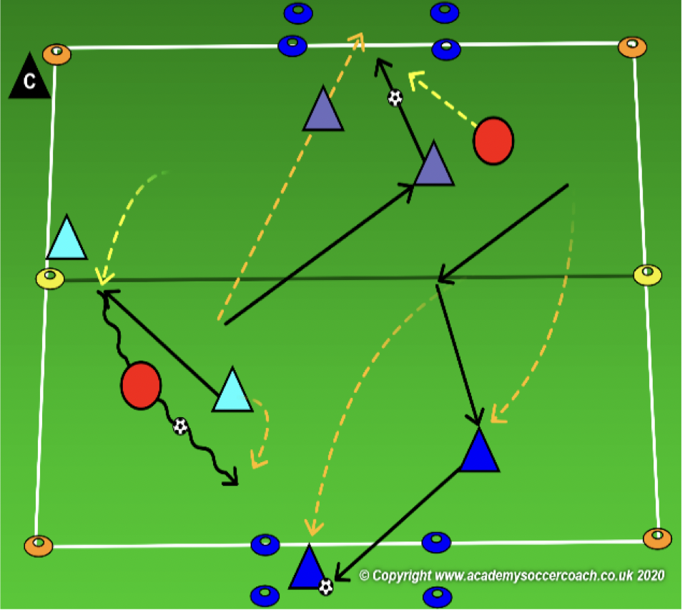
Core Activity – 1st & 2nd Grade
OBJECTIVE: To move the ball forward past the bandits and score \
PLAYER ACTIONS: Pass or dribble forward
ORGANIZATION: In a 25Wx35L grid, a 6Wx3L yard box goal on each end line & all players in pairs, the coach will select 1 pair to be the bandits. Each pair needs 1 ball to share except for the bandits. The pairs with a ball will try to dribble into either goal or pass to their teammate within the goal. After scoring at 1 end, play to score in the other. How many goals can you score in 90 seconds? The mission of the bandits is to steal the ball from any pair trying to score. Once they have stolen it, the bandits try to dribble the ball to either of their hideouts (goals.) The passing pairs can steal their ball back before they get it to a hideout. If the bandits get the ball to a hideout, the pair loses all their points & must start scoring again. Rotate bandits after each interval.
RULES: bandits cannot defend inside of the goals.
KEY WORDS: Look up, find an opening, play through it
GUIDED QUESTIONS: Where can you go if the bandit is closing your opening to the goal? What are some ways you can
play the ball through an opening? Which part of your foot can you use to dribble forward?
ANSWERS: Tell your teammate to move to create a new opening. You can dribble through or pass through the openings. Use your laces by pointing your toe down, making a fist with your toe & use your laces to push the ball forward
Note: If a bandit steals a ball and get it to a hideout, they can now begin scoring goals. The team that lost their ball must now become the bandits. The must steal a ball & score to stop being the bandits.

Slide 7
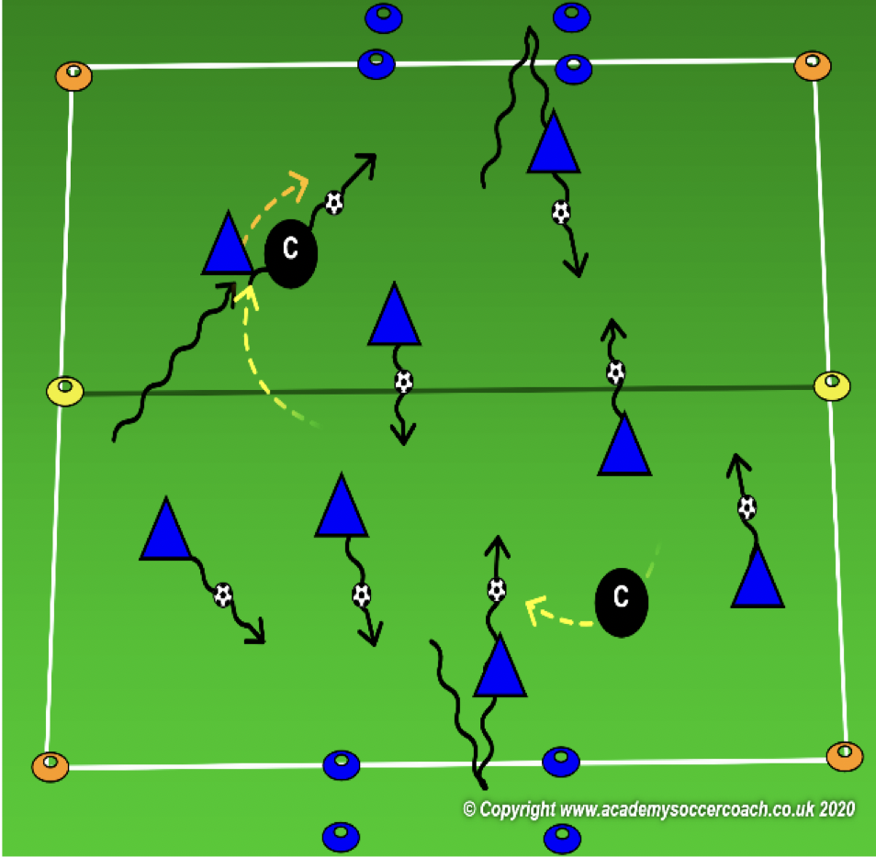
Less Challenging – 1st & 2nd Grade
OBJECTIVE: To move the ball forward past the bandits and score
PLAYER ACTIONS: Dribble forward
ORGANIZATION: In a 25Wx35L grid, a 6Wx3L yard box goal on each end line & all players with a soccer ball, the coach will be the bandits. The players will try to dribble into either goal. After scoring at 1 end, play to score in the other. How many goals can you score in 90 seconds? The mission of the bandits is to steal the ball from any player trying to score. Once they have stolen it, the bandits try to dribble the ball to either of their hideouts (goals.) The dribblers can steal their ball back before it is taken to a hideout. If a bandit gets the ball to a hideout, the player who lost all their ball, loses all their points & must start scoring again.
RULES: bandits cannot defend inside of the goals.
KEY WORDS: Look up, find an opening, be patient
GUIDED QUESTIONS: Where can you go if another dribbler is in your way? What can you do if the bandit/coach
is blocking the goal? Which part of your foot can you use to dribble forward?
ANSWERS: Look up to find a new opening to the goal. Be patient, dribble away from the bandit then pick a new route to the goal. Use your laces by pointing your toe down, making a fist with your toe & use your laces to push the ball forward
Note: Once the players understand the direction & where to score, challenge them to work with a partner. The 2 players share a ball and try to cooperate to score in the goals.

Slide 8
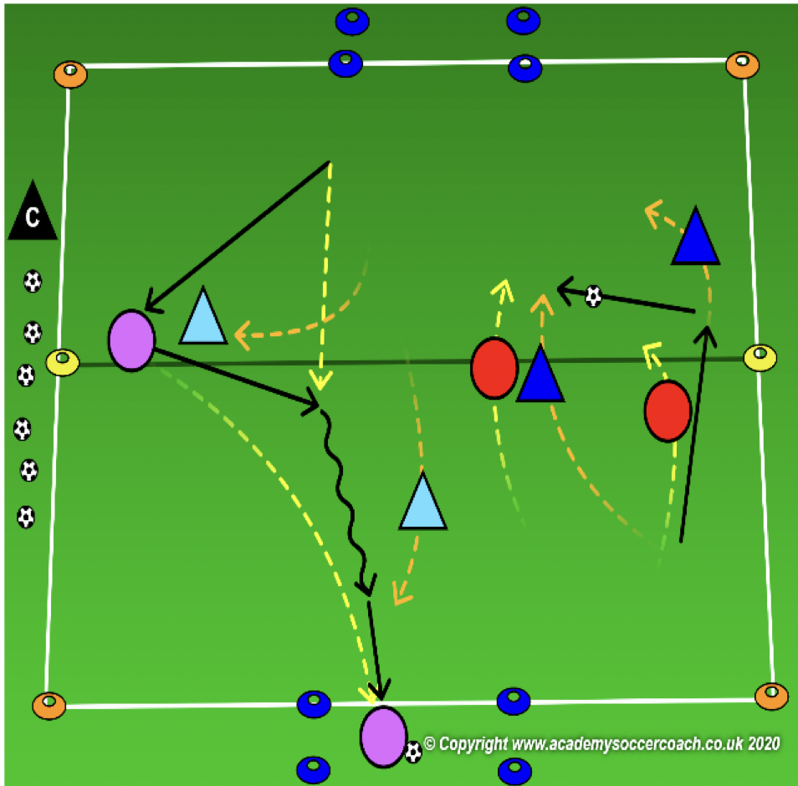
More Challenging – 1st & 2nd Grade
OBJECTIVE: To move the ball forward past the bandits and score
PLAYER ACTIONS: Pass or dribble forward, spread out
ORGANIZATION: In a 25Wx35L grid, a 6Wx3L yard box goal on each end line, coach will create teams of 2 players each. 2 teams will play against one another and, on the same field & at the same time, two other teams will also play against one another. All teams share the field & the goals. In both games, each team defends 1 goal and attacks the other.
RULES: A goal is scored be either dribbling into a goal or passing to a teammate into the opponent’s goal. After a goal is scored, the scoring team backs up to allow the ball back into play & the game continues.
KEY WORDS: Look up, find an opening, play through it
GUIDED QUESTIONS: What are some obstacles you must look for in this game? How can you help your team
create an opening? Which part of your foot can you use to dribble forward?
ANSWERS: You must look up to find your teammates, the goal, the opponents & other players using the field. If you see space away from the crowd and you can still get the ball, spread out into that new space to help create a new opening. Use your laces by pointing your toe down, making a fist with your toe & use your laces to push the ball forward.
Note: If you have more than 4 teams, either rotate teams are set up a second field. If the game is too chaotic, simple play 1 game of 2v2 and rotate teams.

Slide 9
PLAY 2 – 1st & 2nd Grade
ORGANIZATION
Split players into two teams and play 3v3 / 4v 4
PLAYER ACTIONS
Pass/dribble, Spread out, Pass options
KEY WORDS
Use space, hips open, pass, dribble, get open

Slide 10
Week Two

Slide 11
PLAY 1 –1st & 2nd Grade
ORGANIZATION
Mark out two fields. (Field size dependent on age group)
Free play:
Field 1: Teams play 2v2/3v3 or 4v4 (Depending on age group and number of players.
Field 2: Teams play 2v2/3v3 or 4v4 (Depending on age group and number of players.
Allow players to play freely introducing key words
PLAYER ACTIONS
-Pass/dribble -Spread out -Pass options
KEY WORDS
Use space, hips open, pass, dribble

Slide 12
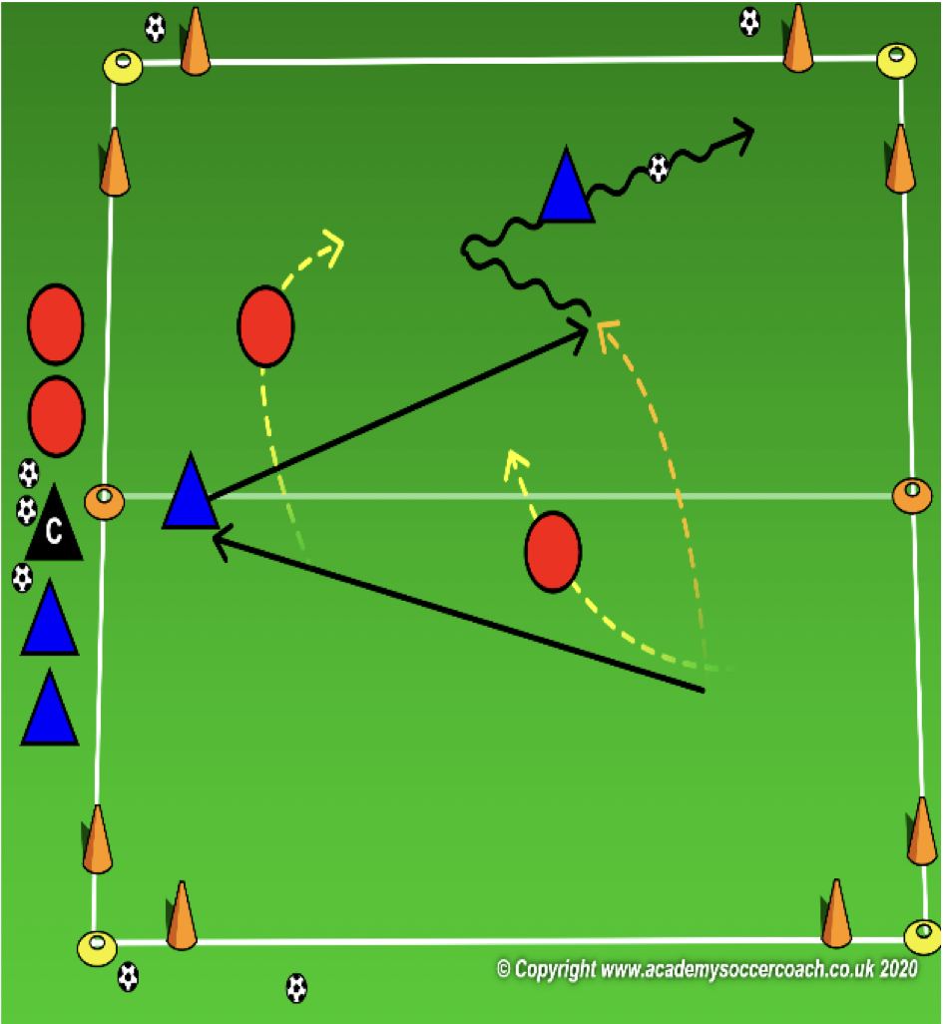
Core Activity – 1st & 2nd Grade
OBJECTIVE: To pass or dribble past an opponent in order to create scoring chances
PLAYER ACTIONS: Pass or dribble forward, Create passing options
ORGANIZATION: Divide your (25W x 35L) game field into two 15W x 25L fields with a small goal in each corner; 4 goals. Play a 2v2 game with 2 teams on the sideline who switch after 2 minutes. Both teams will defend the 2 goals on one 1⁄2 of the field & attack the 2 goals in the opponent’s 1⁄2. Place several soccer balls around the field for quicker restarts.
Rules: Coach keeps track of time. After 2 minutes, both teams leave the field and the teams on the side enter. As soon as a player steps onto the field, the game begins.
KEY WORDS: Find the open goal, switch it
GUIDED QUESTIONS: What can you do if no one is near you? Where can you play the ball if the
goal in front of you is too crowded? How can you aim the ball to the goal?
ANSWERS: Dribble the ball toward the closest goal & score. If the goal in front of you is too crowded, switch the ball with a big kick to the other goal. Turn your body to the goal, point the toe of your non- kicking foot to the goal & strike through the center of the ball.
Note: You may only need to use 1 of the fields for 8 players. If more players are in attendance, use the second field and divide the players so 2 games are played simultaneously. If you have less players, make 3 teams. Play 2 games and rest for 1.

Slide 13
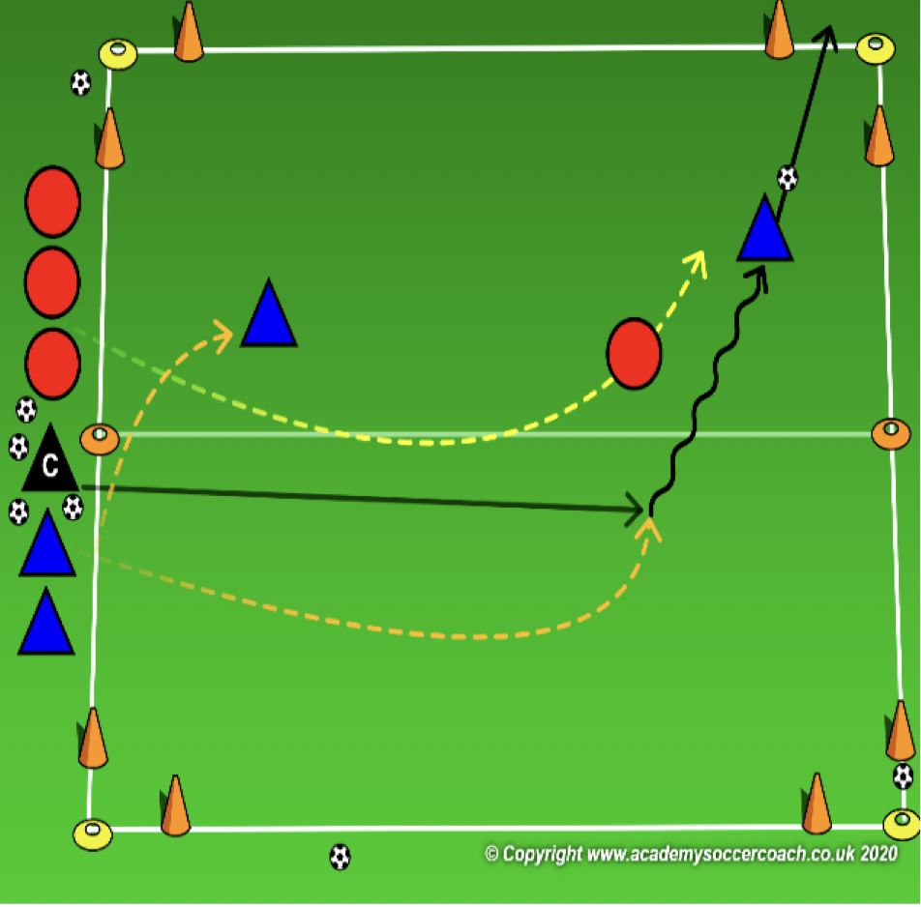
Less Challenging – 1st & 2nd Grade
OBJECTIVE: To pass or dribble past an opponent in order to create scoring chances
PLAYER ACTIONS: Pass or dribble forward, Create passing options
ORGANIZATION: Divide your (25W x 35L) game field into two 15W x 25L fields with a small goal in each corner; 4 goals. The coach starts at midfield with all the soccer balls. Divide the group into 2 teams; 1 team on the coach’s right & the other on the left. Each team will have 2 goals to defend & 2 to score in. Prior to playing a ball onto the field, the coach will announce which team gets 2 players & which has 1. Once the ball is playing onto the field, both teams try to win the ball & score in either of the opponent’s goals.
Rules: Play starts as soon as a ball is played onto the field. Game is over when it is scored or leaves the field. Once the game is over, all players leave the playing area & the coach plays another ball onto the field for the next players to play.
KEY WORDS: Find the open goal, switch it
GUIDED QUESTIONS: If your teammate has the ball, where can you go to help? Where can you play the ball if
the goal in front of you is too crowded? How can you aim the ball to the goal?
ANSWERS: Move across the field to the other goal. If the goal in front of you is too crowded, switch the ball with a big kick to the
other goal. Turn your body to the goal, point the toe of your non-kicking foot to the goal & strike through the center of the ball.
Note: Use multiple fields is needed. If games are not ending quickly, add a time limit to how long the teams have to score.

Slide 14
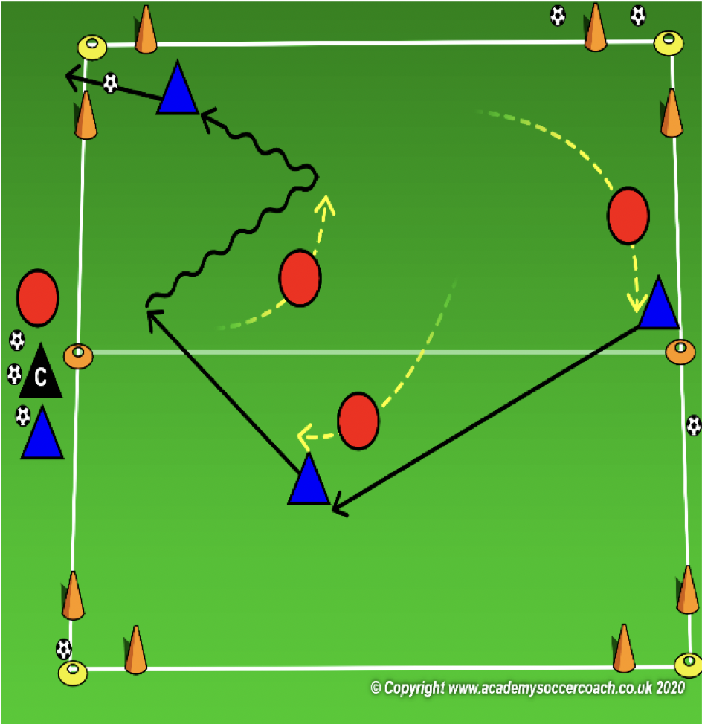
More Challenging – 1st & 2nd Grade
OBJECTIVE: To pass or dribble past an opponent in order to create scoring chances
PLAYER ACTIONS: Pass or dribble forward, Create passing options
ORGANIZATION: Divide your (25W x 35L) game field into two 15W x 25L fields with a small goal in each corner; 4 goals. Play a 3v3 game. Rotate subs into the game as needed &, at a minimum, every 2 minutes. Both teams will defend the 2 goals on one 1⁄2 of the field & attack the 2 goals in the opponent’s 1⁄2. Place several soccer balls around the field for quicker restarts.
Rules: Coach keeps track of time. If the ball leaves the field, the team who didn’t kick it out or score can retrieve any ball around the field & play continues.
KEY WORDS: Find the open goal, switch it
GUIDED QUESTIONS: After you have played a ball into your teammate, where do you go next? Where can you play the ball if the goal in front of you is too crowded? How can you aim the ball to the goal?
ANSWERS: Stay close to help your teammate or move across the field to the other goal. If the goal in front of you is too crowded, switch the ball with a big kick to the other goal. Turn your body to the goal, point the toe of your non-kicking foot to the goal & strike through the center of the ball.
Note: You may only need to use 1 of the fields for 8 players. If more players are in attendance, use the second field and divide the players so 2 games are played simultaneously. If you have less players, play with smaller teams or uneven teams.

Slide 15
PLAY 2 – 1st & 2nd Grade
ORGANIZATION
Split players into two teams and play 3v3 / 4v 4
PLAYER ACTIONS
Pass/dribble, Spread out, Pass options
KEY WORDS
Use space, hips open, pass, dribble, get open

Slide 16
Week Three

Slide 17
PLAY 1 –1st & 2nd Grade
ORGANIZATION
Mark out two fields. (Field size dependent on age group)
Free play:
Field 1: Teams play 2v2/3v3 or 4v4 (Depending on age group and number of players.
Field 2: Teams play 2v2/3v3 or 4v4 (Depending on age group and number of players.
Allow players to play freely introducing key words
PLAYER ACTIONS
-Pass/dribble -Spread out -Pass options
KEY WORDS
Use space, hips open, pass, dribble

Slide 18
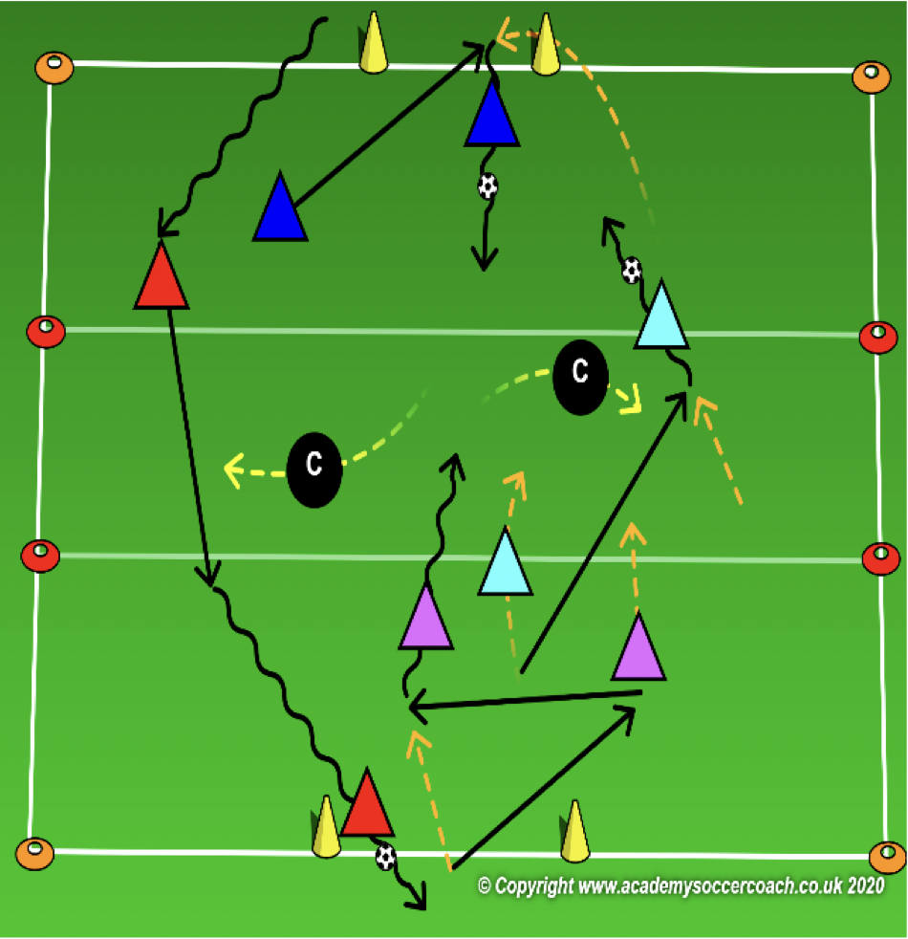
Core Activity – 1st & 2nd Grade
OBJECTIVE: To move the ball forward past the bandits and score
PLAYER ACTIONS: Shoot, Pass or dribble forward
ORGANIZATION: In a 25Wx35L grid, a 5-yard zone in the middle (the dog pound) & a goal on each end line, play the game. Coaches start in the pound as dog catchers. Dog catchers do not use a soccer ball & must stay in the pound. Each player has a partner & 1 ball to share. Players (Bulldogs) start at 1 end line. Bulldogs try to sneak through the dog pound without waking the catchers. If they get through the pound without losing their ball and score in the goal, their team gets 100 points. Once they have scored, they go back through the pound to score in the goal at the opposite end.
Rules: When the coach yells, “Who Let The Dogs Out?” the game begins. If a dog catcher steals your ball, you & your partner lose all your points & must start scoring over again. If you miss the goal, no points. You must shoot toward the opposite goal before you can return and score again. How many points can you score in 90 seconds?
KEY WORDS: Play quickly through the pound, move forward without the ball
GUIDED QUESTIONS: How can you get through the dog pound the fastest? Where should your partner without the ball move to help you get through the pound? If your teammate is close to you, what part of your foot should you use to pass him/her the ball?
ANSWERS: You can dribble through if you have space or kick it through to your partner. Your partner should find an opening on the other side of the pound for you to pass the soccer ball to him/her. Use the inside of your foot by turning your toe up & to the side with the heel down then swing your foot through the middle of the ball.
Note: Players can start as dog catchers also but will be in the pound with their partner. After a few rounds, if the dog catcher steals a ball, the dog catcher and bulldog can switch roles.

Slide 19
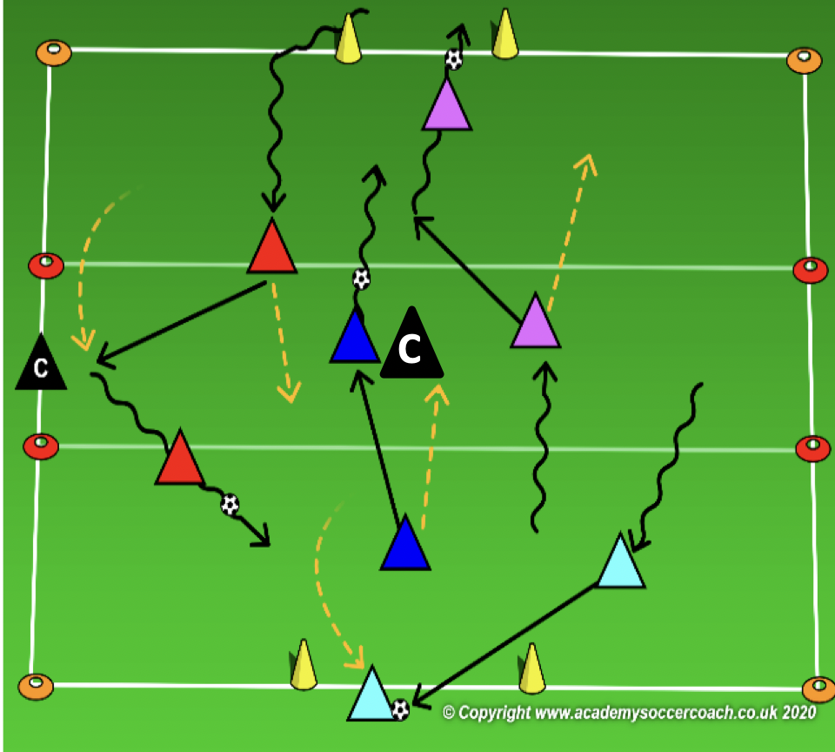
Less Challenging – 1st & 2nd Grade
OBJECTIVE: To move the ball forward past the bandits and score
PLAYER ACTIONS: Shoot, Pass or dribble forward
ORGANIZATION: In a 25Wx35L grid, a 5-yard zone in the middle (the dog pound) & a goal on each end line, play the game. Each player has a partner & 1 ball to share. Players (Bulldogs) start at 1 end line. Bulldogs try to play as fast as the can through the dog pound. Once they get through the pound, they can score in the goal. Their team gets 100 points for each goal scored. Once they have scored, they go back through the pound to score in the goal at the opposite end.
Rules: When the coach yells, “Who Let The Dogs Out?” the game begins. If your ball is kicked over the sideline, you & your partner lose all your points & must start scoring over again. If you miss the goal, no points. You must shoot toward the opposite goal before you can return and score again. How many points can you score in 90 seconds?
KEY WORDS: Play quickly through the pound, move forward without the ball
GUIDED QUESTIONS: What is the fastest way to get the ball to the goal? Where should your go after you kick the ball to
your partner? If your teammate is close to you, what part of your foot should you use to pass him/her the ball?
ANSWERS: A big kick to your partner toward the other goal moves the ball fastest. You should move closer to the goal you are trying to score in and help your partner. Use the inside of your foot by turning your toe up & to the side with the heel down then swing your foot through the middle of the ball.
Note: Coaches can step into the dog pound to act as obstacles for players to pass or dribble around.

Slide 20
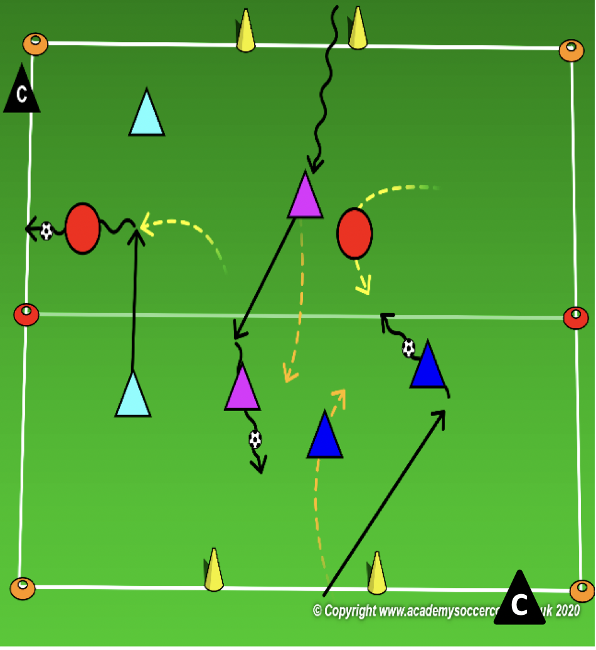
More Challenging – 1st & 2nd Grade
OBJECTIVE: To move the ball forward past the bandits and score
PLAYER ACTIONS: Shoot, Pass or dribble forward
ORGANIZATION: In a 25Wx35L grid & a goal on each end line, play the game. Coaches or players can start as dog catchers. Dog catchers do not use a soccer ball & can move anywhere on the field. Each player has a partner & 1 ball to share. Players (Bulldogs) start at 1 end line. Bulldogs try to play past the dog catchers. If they get past the dog catchers without losing their ball and score in the goal, their team gets 100 points. Once they have scored, they go back across the field to score in the goal at the opposite end.
Rules: When the coach yells, “Who Let The Dogs Out?” the game begins. If a dog catcher steals your ball, you & your partner lose all your points & must start scoring over again. If you miss the goal, no points. You must shoot toward the opposite goal before you can return and score again. How many points can you score in 90 seconds?
KEY WORDS: laces, move forward without the ball
GUIDED QUESTIONS: Which part of your foot should you use to shoot or make a big kick? Where should your partner without the ball move to help you get through the pound? If your teammate is close to you, what part of your foot should you use to pass him/her the ball?
ANSWERS: Use your laces by pointing your toe down so your laces are facing your soccer ball: it helps to make a fist with
your toes. Your partner should find an opening on the other side of the pound for you to pass the soccer ball to him/her. Use the inside of your foot by turning your toe up & to the side with the heel down then swing your foot through the middle of the ball.
Note: After a few rounds, if the dog catcher steals a ball, the dog catcher and bulldog can switch roles.

Slide 21
PLAY 2 – 1st & 2nd Grade
ORGANIZATION
Split players into two teams and play 3v3 / 4v 4
PLAYER ACTIONS
Pass/dribble, Spread out, Pass options
KEY WORDS
Use space, hips open, pass, dribble, get open

Slide 22
Week Four

Slide 23
PLAY 1 –1st & 2nd Grade
ORGANIZATION
Mark out two fields. (Field size dependent on age group)
Free play:
Field 1: Teams play 2v2/3v3 or 4v4 (Depending on age group and number of players.
Field 2: Teams play 2v2/3v3 or 4v4 (Depending on age group and number of players.
Allow players to play freely introducing key words
PLAYER ACTIONS
-Pass/dribble -Spread out -Pass options
KEY WORDS
Use space, hips open, pass, dribble

Slide 24
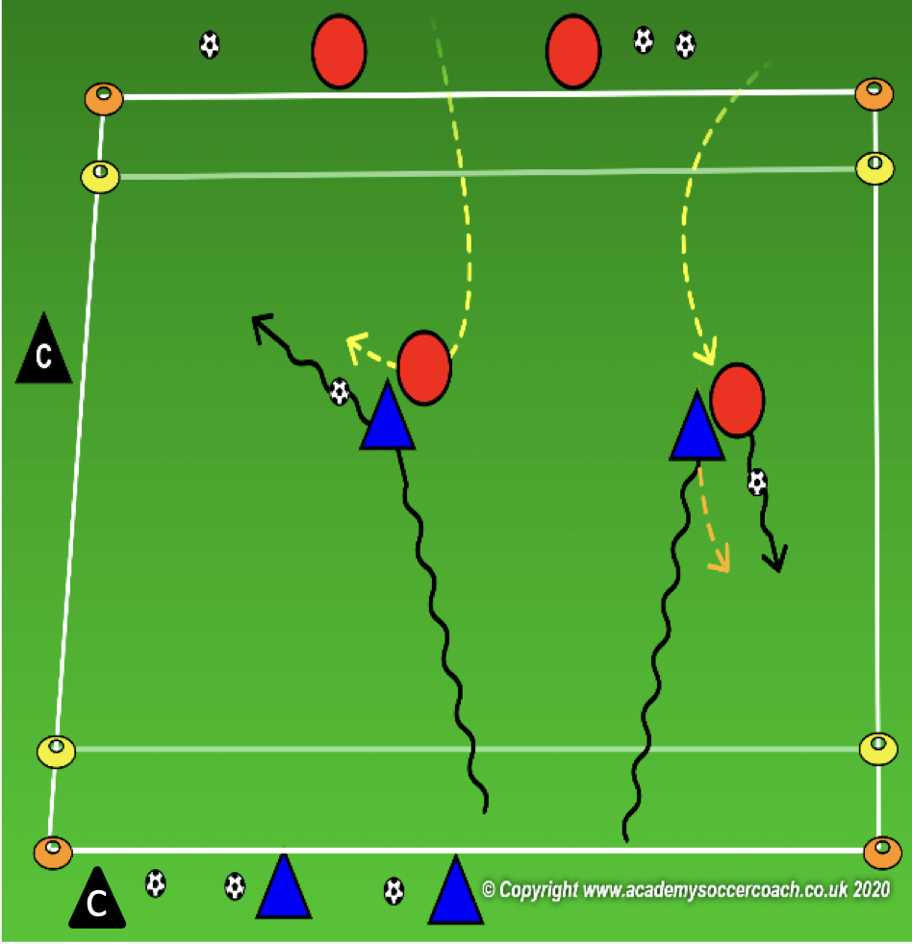
Core Activity – 1st & 2nd Grade
OBJECTIVE: To pass or dribble past an opponent in order to score
PLAYER ACTIONS: Pass or dribble forward
ORGANIZATION: Divide your (25W x 35L) game field into two 15W x 25L fields with a 5-yard end zone on each end. One team starts with soccer balls behind one end zone & the other team starts behind the opposite end zone. On the coach’s command, 2 players with a soccer ball each enter the field and try to score in the opponent’s end zone. The team without soccer balls send 2 players onto the field to stop the attack & steal the ball to score in the dribbler’s end zone.
Rules: both teams try to score in the opponent’s end zone by dribbling into the space. Defenders can only steal the ball outside of the end zone. Once 1 ball is scored or knocked out of play, the players can help their teammate to score the ball still in play. After 1 minute, the round is over. Players exit the field, and the next players begin. All goals are worth 10 points.
KEY WORDS: Find the opening, fake the defender
GUIDED QUESTIONS: What can you do if there is an opening all the way to the end zone? How can you use
your teammate to fake the defender? If you see an opening to the endzone, how can you dribble the fastest?
ANSWERS: Dribble the ball toward the end zone to score. Swing your leg toward the ball without hitting it so the defender thinks you are passing to your teammate. Then dribble to the end zone. By pointing your toe down & making a fist with it. Then push the ball in front of you with your laces & run onto the ball.
Note: Encourage the attacker in the 1v1 at the beginning then, if it occurs, encourage the decisions of the attacking team of 2. Switch ends after 5 rounds.

Slide 25
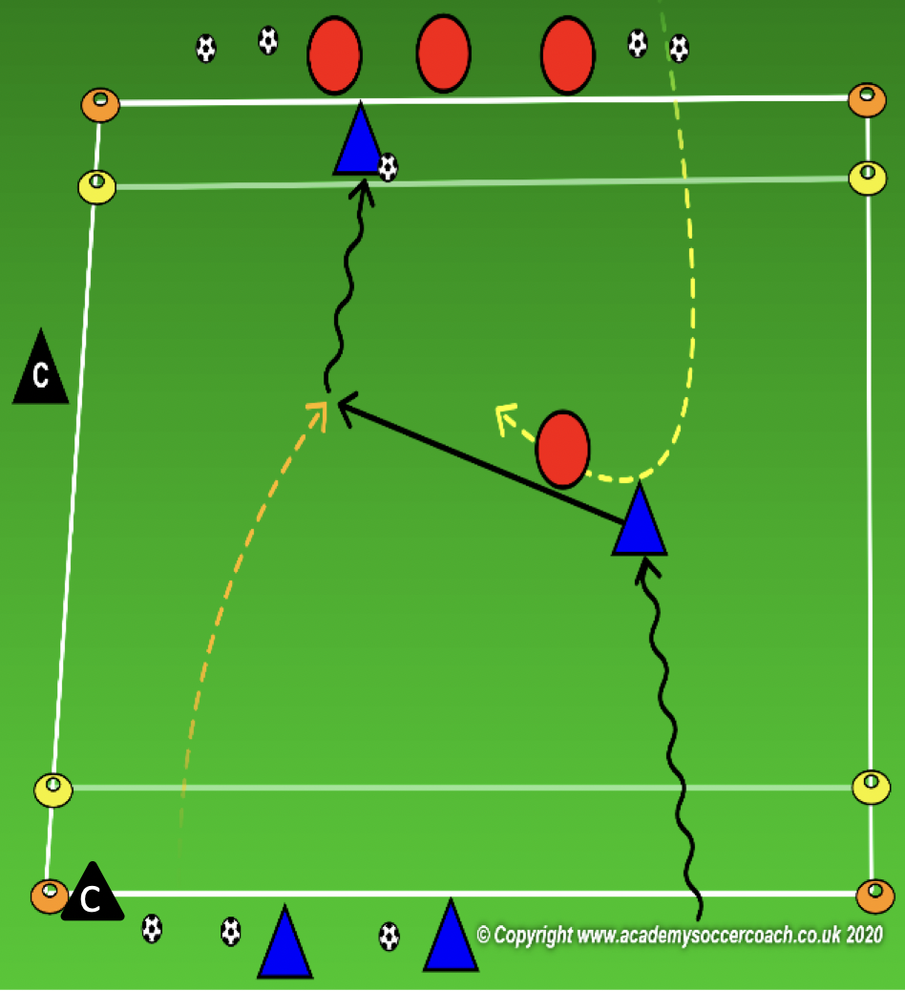
Less Challenging – 1st & 2nd Grade
OBJECTIVE: To pass or dribble past an opponent in order to score
PLAYER ACTIONS: Pass or dribble forward
ORGANIZATION: Divide your (25W x 35L) game field into two 15W x 25L fields with a 5-yard end zone on each end. One team starts with soccer balls behind one end zone & the other team starts behind the opposite end zone. On the coach’s command, 2 players with 1 soccer ball enter the field and try to score in the opponent’s end zone. The team without soccer balls send 1 player onto the field to stop the attack & steal the ball to score in the opponent’s end zone.
Rules: both teams try to score in the opponent’s end zone by dribbling into the space. Defenders can only steal the ball outside of the end zone. Once the ball is scored or knocked out of play, the round is over. If neither team scores in 1 minute, the round is also over. Players exit the field and the next players begin. All goals are worth 10 points.
KEY WORDS: Find the opening, fake the defender
GUIDED QUESTIONS: What can you do if there is an opening all the way to the end zone? How can you use
your teammate to fake the defender? If you see an opening to the endzone, how can you dribble the fastest?
ANSWERS: Dribble the ball toward the end zone to score. Swing your leg toward the ball without hitting it so the defender thinks you are passing to your teammate. Then dribble to the end zone. By pointing your toe down & making a fist with it. Then push the ball in front of you with your laces & run onto the ball.
Note: Encourage the team with the ball and the decisions they will have to make. Help the players understand how to take advantage of the team without the ball.

Slide 26
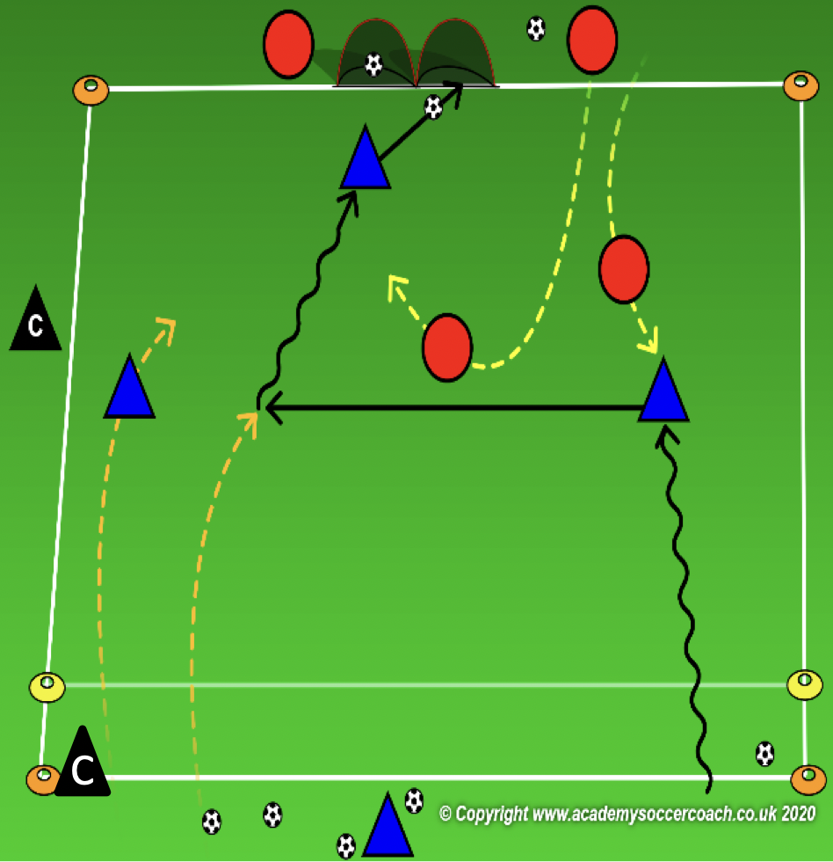
More Challenging – 1st & 2nd Grade
OBJECTIVE: To pass or dribble past an opponent in order to score
PLAYER ACTIONS: Pass or dribble forward
ORGANIZATION: Divide your (25W x 35L) game field into two 15W x 25L fields with a 5-yard end zone on 1 end line & a goal on the other (this can be 2 pugg goals side by side.) The team of 3 starts with a soccer ball and attacks the small goal. The team of 2 does not have a ball and they score by stopping the ball in the end zone.
Rules: First team to score wins the round. The game will last up to 1 minute or 1 goal. Once a goal is scored or time runs out, all players exit the field and the next group of players enter. If the soccer ball leaves the field without scoring, the coach can pass another ball onto the field to keep the game going.
KEY WORDS: Look up, find the opening, fake the defender
GUIDED QUESTIONS: What should you do when confronted by an opponent? When should you kick the
ball further in front of you? If you see an opening to the endzone, how can you dribble the fastest?
ANSWERS: When an opponent is in front of you keep the ball closer so you can shield the ball from or pass away from the defender. If you see an opening to the goal, kick the ball further in front of you so you can move faster to the goal. By pointing your toe down & making a fist with it. Then push the ball in front of you with your laces & run onto the ball.
Note: It is important for 1 team to start with the ball. This allows the coach time to observe the players who are taking more of an attacking initiative. Switch sides of 4 or 5 rounds.

Slide 27
PLAY 2 – 1st & 2nd Grade
ORGANIZATION
Split players into two teams and play 3v3 / 4v 4
PLAYER ACTIONS
Pass/dribble, Spread out, Pass options
KEY WORDS
Use space, hips open, pass, dribble, get open

Slide 28
Week Five

Slide 29
PLAY 1 –1st & 2nd Grade
ORGANIZATION
Mark out two fields. (Field size dependent on age group)
Free play:
Field 1: Teams play 2v2/3v3 or 4v4 (Depending on age group and number of players.
Field 2: Teams play 2v2/3v3 or 4v4 (Depending on age group and number of players.
Allow players to play freely introducing key words
PLAYER ACTIONS
-Pass/dribble -Spread out -Pass options
KEY WORDS
Use space, hips open, pass, dribble

Slide 30
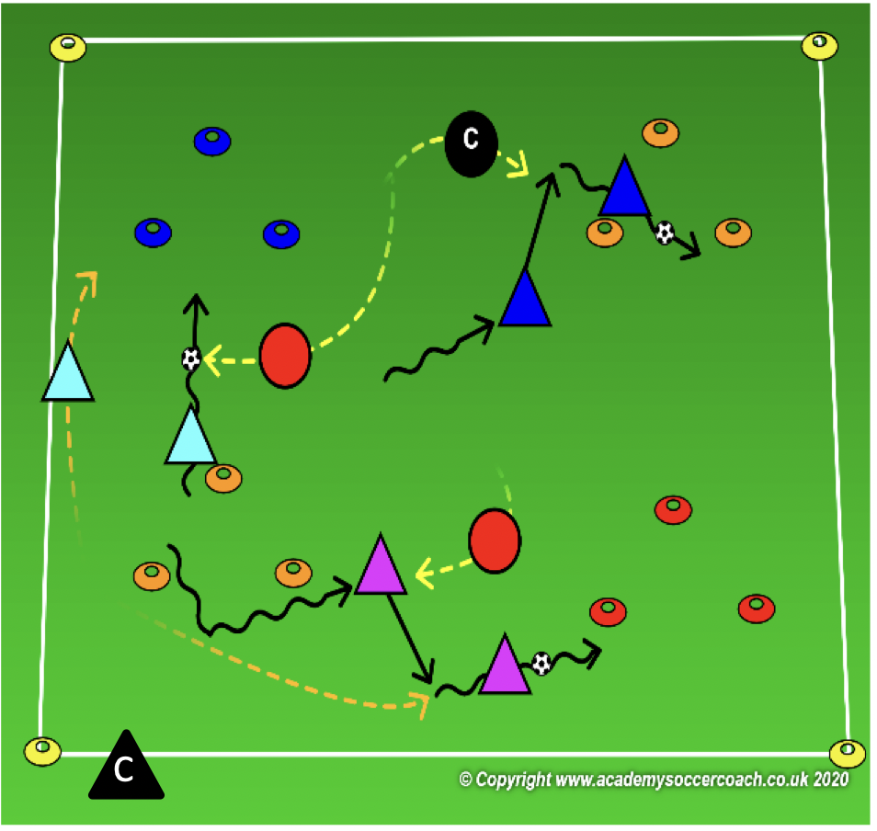
Core Activity – 1st & 2nd Grade
OBJECTIVE: Protect the goals from opponents trying to score
PLAYER ACTIONS: Protect your goal, Steal the ball
ORGANIZATION: In a 25Wx35L grid, with several 3-yard triangular shaped goals, the coach will select enough defenders so there is 1 less defender than goals. The rest of the players have a partner & a soccer ball to share. The players with soccer balls try to dribble or pass into or through as many goals as they can in 1 minute. The defenders must guard all the goals & tackle the ball away if a team tries to score.
Rules: Defenders cannot enter the triangles. If an attacking team can stop the ball with a triangle, they can stop to rest or plan where to attack next. If a defender steals their ball, the attacking team loses all their goals and must start counting over again.
KEY WORDS: block your goal, win the ball
GUIDED QUESTIONS: how do you know where the attackers are? Where can you move to if you see your goal is safe,
but another goal is not protected? How do tackle the ball away from the attacker?
ANSWERS: If helps to keep your head up & look around to see if an attacker is coming toward your goal. Try to move your body so you are between the attacker with the ball & the goal he/she is trying to score in. Get close the attacker then either poke the ball away with your toe or put your foot in front of the ball to keep it from going forward.
Note: Remember to focus on the defending players. If a team stops in a triangle, they can no longer score until they come out. What can the defenders to protect a different goal when they do come out?

Slide 31
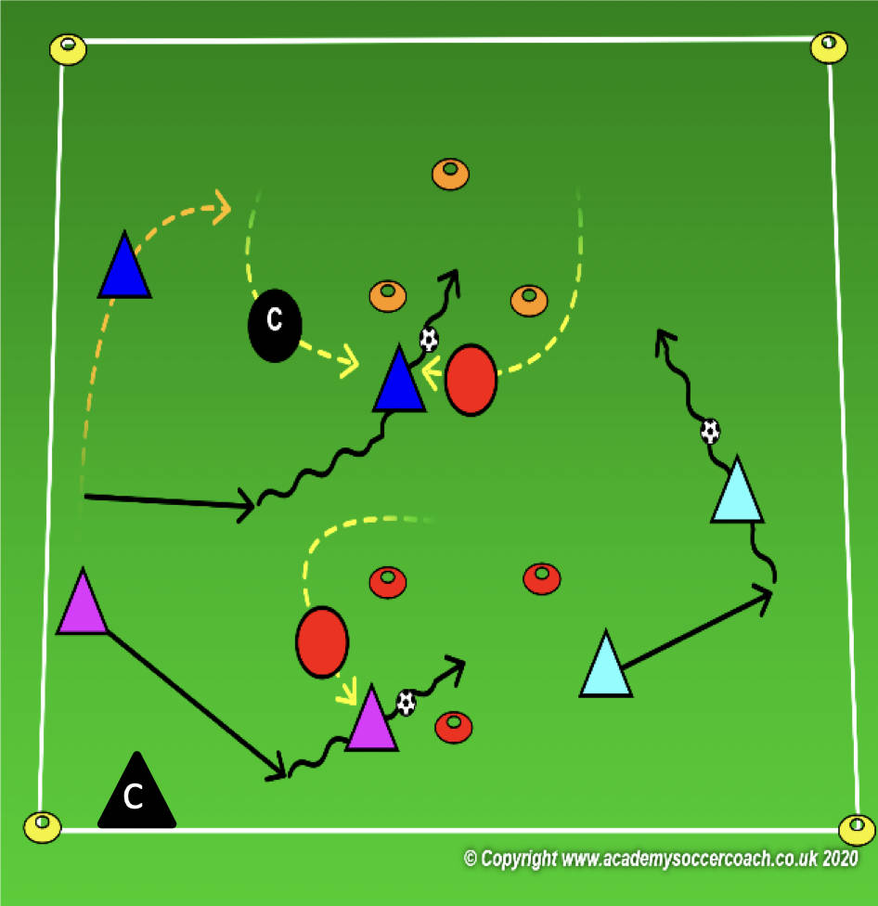
Less Challenging – 1st & 2nd Grade
OBJECTIVE: Protect the goals from opponents trying to score
PLAYER ACTIONS: Protect your goal
ORGANIZATION: In a 25Wx35L grid, with two x 3-yard triangular shaped goals, the coach will select 2 defenders to guard the goals; 1 defender guards each goal. The rest of the players have a partner & a soccer ball to share. The players with soccer balls try to dribble or pass into or through as many goals as they can in 1 minute. The defenders must guard all the goals & can poke the ball away or simply tag the attacker with the ball.
Rules: Defenders cannot enter the triangles. If an attacking team can stop the ball with a triangle, they can stop to rest or plan where to attack next. If a defender pokes the ball away from the attackers or can tag the player with the ball, the attacking team loses all their goals and must start counting over again.
KEY WORDS: block your goal, poke the ball away
GUIDED QUESTIONS: When should you stay close to your goal? What can you do if the attacking player kicks
the ball too far in front of them & you think you can get to it first? How do tackle the ball away from the attacker?
ANSWERS: If the attackers start to get close to your goal, stay back to block your goal. If an attacker kicks the ball too far in front of them, step closer to it to poke the ball away. Get close the attacker then either poke the ball away with your toe or put your foot in front of the ball to keep it from going forward.
Note: Remember to focus on the defending players. If a team stops in a triangle, they can no longer score until they come out. What can the defenders to protect a different goal when they do come out? Coaches can partner with an attacking player if need be but allow the players to take on the role of defenders.

Slide 32
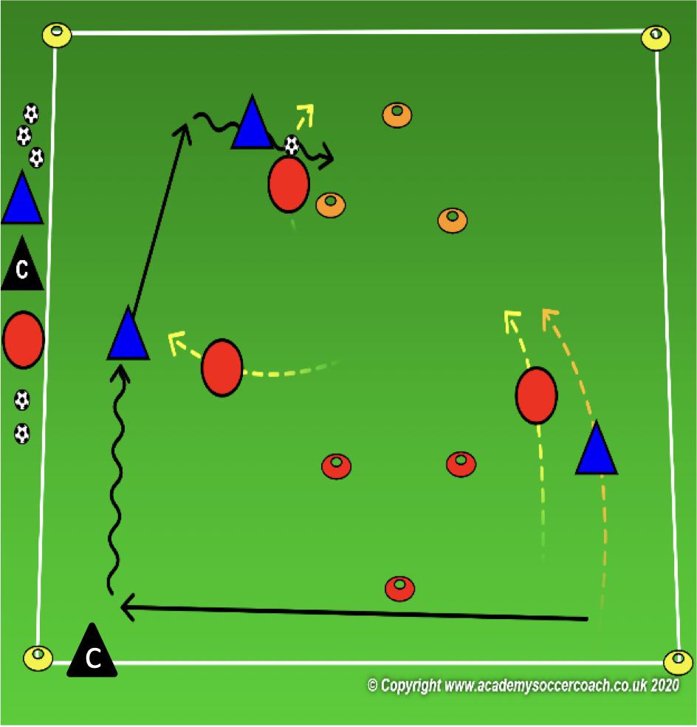
More Challenging – 1st & 2nd Grade
OBJECTIVE: Protect the goal from opponents trying to score
PLAYER ACTIONS: Protect your goal, Steal the ball
ORGANIZATION: In a 25Wx35L grid, with two x 3-yard triangular shaped goals; 1 in each half of the field, the coach will select 2 teams of 3 players each. Each team scores in 1 goal & defends the other. The team with the ball tries to score by passing or dribbling through the opponent’s goal. If the team without the ball steals the ball, they will attack the goal on the other end of the field.
Rules: Defending team cannot enter the triangular goal they are defending. If a team scores, they leave the soccer ball for the opponents, drop back and protect their goal & meanwhile, the attacking team can try to score before they set up
KEY WORDS: block your goal, win the ball
GUIDED QUESTIONS: When should 2 defenders be close together? Where should the 3rd defending player go if
his/her teammates are already protecting the goal? How do tackle the ball away from the attacker?
ANSWERS: If the attacking team has more players in one area of the field, the defending team may want to send another player over to help. If 2 of your teammates are close to the ball, try to find another opening either to the goal or to an opponent to close. Try to win the ball if they try to play it through the opening. Get close the attacker then either poke the ball away with your toe or put your foot in front of the ball to keep it from going forward.
Note: Remember to focus on the defending players. Help the team without the ball identify moments to protect their goal or steal the ball. U8 players could struggle to remain focused when they do not have the ball so encourage them to stay alert so they can steal the ball.

Slide 33
PLAY 2 – 1st & 2nd Grade
ORGANIZATION
Split players into two teams and play 3v3 / 4v 4
PLAYER ACTIONS
Pass/dribble, Spread out, Pass options
KEY WORDS
Use space, hips open, pass, dribble, get open

Slide 34
Week Six

Slide 35
PLAY 1 –1st & 2nd Grade
ORGANIZATION
Mark out two fields. (Field size dependent on age group)
Free play:
Field 1: Teams play 2v2/3v3 or 4v4 (Depending on age group and number of players.
Field 2: Teams play 2v2/3v3 or 4v4 (Depending on age group and number of players.
Allow players to play freely introducing key words
PLAYER ACTIONS
-Pass/dribble -Spread out -Pass options
KEY WORDS
Use space, hips open, pass, dribble

Slide 36
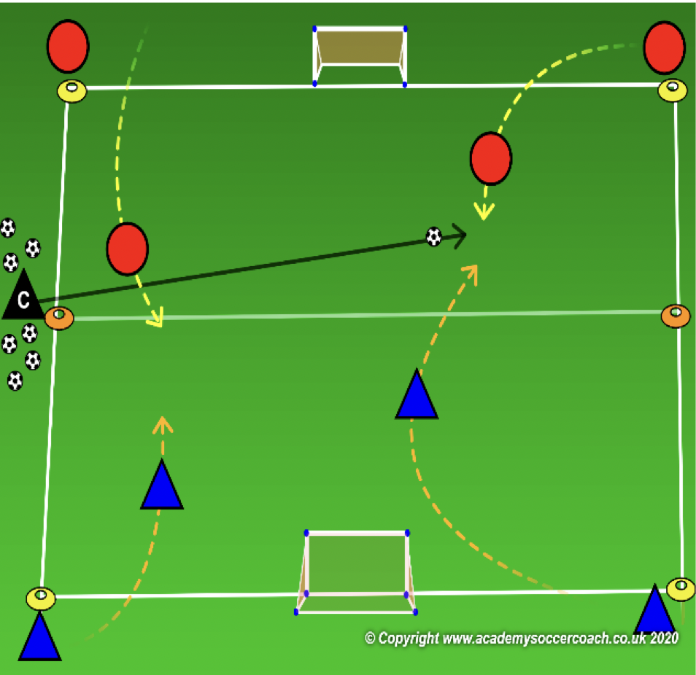
Core Activity – 1st & 2nd Grade
OBJECTIVE: To deny the opponent’s ability to create scoring chances or score goals.
PLAYER ACTIONS: Protect the goal, Steal the ball
ORGANIZATION: On your 25W x 35L game field, set up a 13W x 20L field with a goal on each end line. If you have more players, set up 2 fields. Divide the team into 2 groups. Each group starts at opposite ends & divided equally between the 2 corners of their end line. The coach starts outside the center line with all the soccer balls. The game starts when the coach serves a ball onto the field. 1 player from each corner enters the field to play 2v2. The game is over when either team scores or the ball leaves the field of play. Once the game is over, all players leave the field & the coach serves another ball for the next players to play.
Rules: Players cannot enter the field before a new ball is served in.
KEY WORDS: block your goal, get back
GUIDED QUESTIONS: What should you do if your team does not have the ball? Where should you go if the
attacker gets past you? How do you tackle the ball?
ANSWERS: One of you should try to steal the ball and one of you should help by getting close to your teammate and block the goal at the same time. Get back to your goal to protect it. Step close to the ball and poke it away or block it from going to the goal.
NOTES: Try to serve the ball to the player who has not been involved in the play as much. All serves should favor 1 team or the other instead of down the middle.

Slide 37
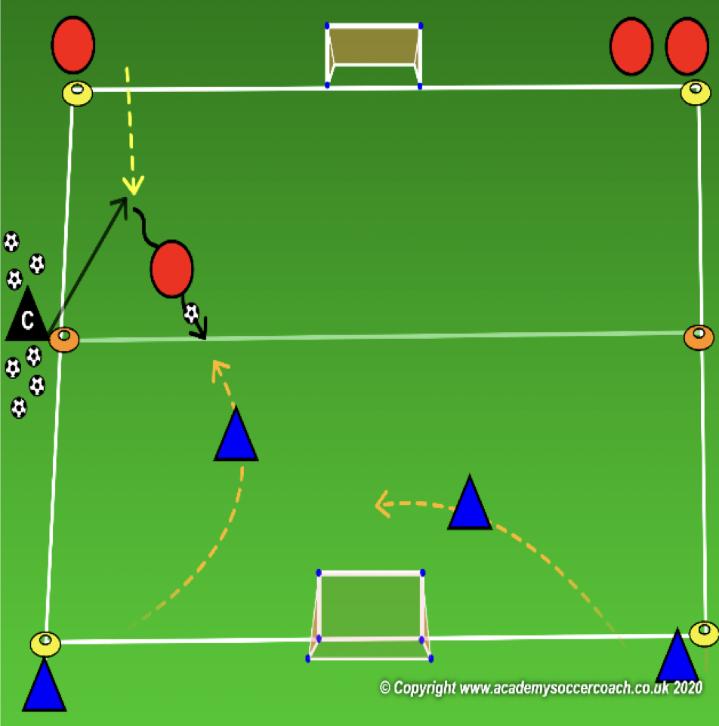
Less Challenging – 1st & 2nd Grade
OBJECTIVE: To deny the opponent’s ability to create scoring chances or score goals.
PLAYER ACTIONS: Protect the goal, Steal the ball
ORGANIZATION: On your 25W x 35L game field, set up a 13W x 20L field with a goal on each end line. If you have more players, set up 2 fields. Divide the team into 2 groups. Each group starts at opposite ends & divided equally between the 2 corners of their end line. The coach starts outside the center line with all the soccer balls. The game starts when the coach serves a ball onto the field. Whichever side the coach serves the ball can have 1 player join the game. The team who does not get the ball can have 2 players join the game: play 1v2. The game is over when either team scores or the ball leaves the field of play. Once the game is over, all players leave the field & the coach serves another ball for the next players to play.
Rules: Players cannot enter the field before a new ball is served in.
KEY WORDS: block your goal, step to the ball
GUIDED QUESTIONS: What should you do if your team does not have the ball? Where should you go if the
attacker gets past you? How do you tackle the ball?
ANSWERS: One of you should try to steal the ball and one of you should help by getting close to your teammate and block the goal at the same time. Get back to your goal to protect it. Step close to the ball and poke it away or block it from going to the goal.
NOTES: Try to serve the ball to the player who has not been involved in the play as much. All serves should favor 1 team or the other instead of down the middle.

Slide 38
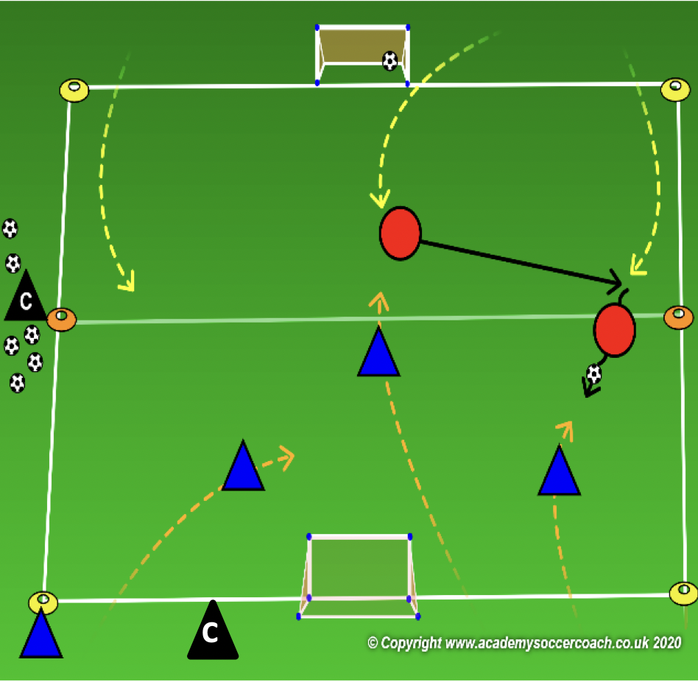
More Challenging – 1st & 2nd Grade
OBJECTIVE: To deny the opponent’s ability to create scoring chances or score goals.
PLAYER ACTIONS: Protect the goal, Steal the ball
ORGANIZATION: On your 25W x 35L game field & a goal on each end line, Divide the team into 2 groups. Each group starts at opposite ends & divided equally between the 2 corners of their end line. The coach starts outside the center line with all the soccer balls. The game starts when the coach serves a ball onto the field. Whichever side the coach serves the ball can have 4 players join the game. The team who does not get the ball can have 3 players join the game: play 3v4. The game lasts for 1 minutes. If a ball goes out of play or is scored, a new ball is played in. After 1 minute, all players leave the field and a new round begins.
Rules: Players cannot enter the field before a new ball is served in.
KEY WORDS: block your goal, step to the ball
GUIDED QUESTIONS: What should you do if your team does not have the ball? Where should you go if the
attacker gets past you? How do you tackle the ball?
ANSWERS: One of you should try to steal the ball and one of you should help by getting close to your teammate and block the goal at the same time. Get back to your goal to protect it. Step close to the ball and poke it away or block it from going to the goal.
NOTES: Try to serve the ball to the player who has not been involved in the play as much. All serves should favor 1 team or the other instead of down the middle.

Slide 39
PLAY 2 – 1st & 2nd Grade
ORGANIZATION
Split players into two teams and play 3v3 / 4v 4
PLAYER ACTIONS
Pass/dribble, Spread out, Pass options
KEY WORDS
Use space, hips open, pass, dribble, get open

Slide 40
Week Seven

Slide 41
PLAY 1 –1st & 2nd Grade
ORGANIZATION
Mark out two fields. (Field size dependent on age group)
Free play:
Field 1: Teams play 2v2/3v3 or 4v4 (Depending on age group and number of players.
Field 2: Teams play 2v2/3v3 or 4v4 (Depending on age group and number of players.
Allow players to play freely introducing key words
PLAYER ACTIONS
-Pass/dribble -Spread out -Pass options
KEY WORDS
Use space, hips open, pass, dribble

Slide 42
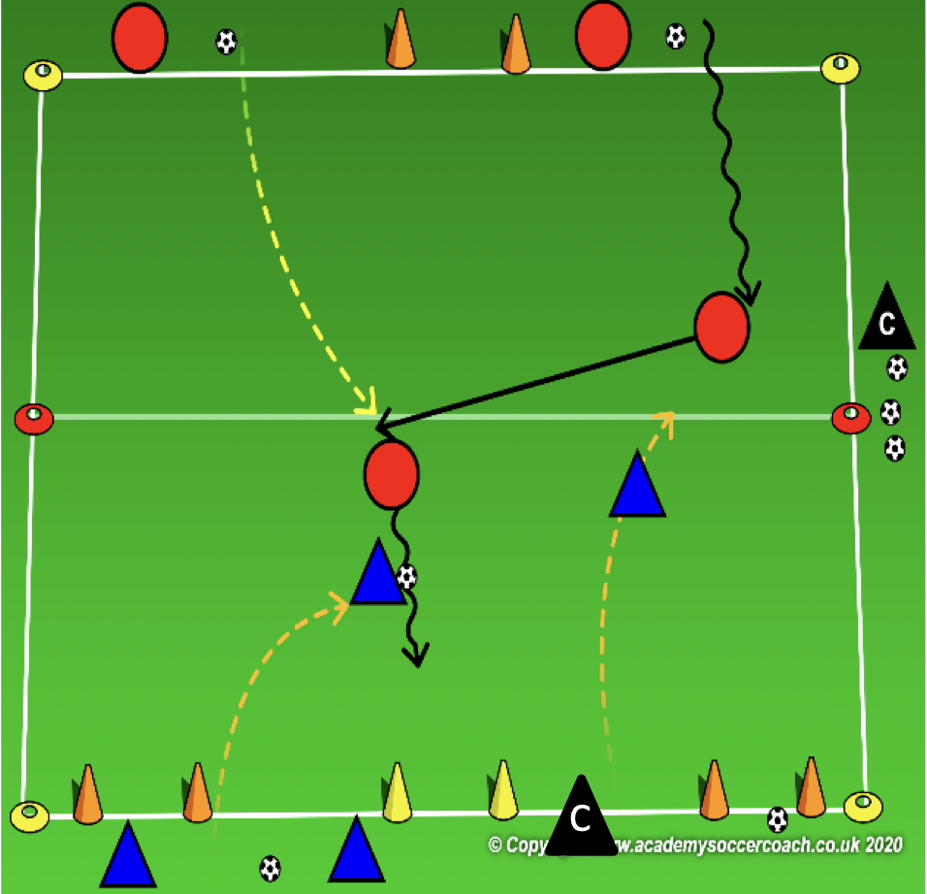
Core Activity – 1st & 2nd Grade
OBJECTIVE: Protect the goals from opponents trying to score
PLAYER ACTIONS: Protect your goal, Steal the ball
ORGANIZATION: Divide your 15Wx25L grid, with 3 small goals on one end line and 1 goal on the other, play a 2v2 game. Half the team starts on one end line and half on the other. The team defending the single goal starts with the ball. 2 players from the attacking team enter the field. As soon as they enter, 2 players from the opposite end also enter the field. The team who starts with the ball can attack any of the 3 goals on their opponent’s end line. If the defending team wins the ball, they can attack the single goal.
RULES: defending team cannot enter the field until the attacking team takes their first touch on the soccer ball. Game last for 1 minute. Coach can serve another ball onto the field if the game ball leaves the field or is scored. Multiple goals can be scored within 1 minute. After 1 minute, switch the players on the field and play again.
KEY WORDS: block your goal, win the ball
GUIDED QUESTIONS: Which of the 3 goals is most dangerous? Where should a defender be if a goal is dangerous?
What should you do if the attacker kicks the ball too far in front of him/her?
ANSWERS: The goal closest to the ball is the most dangerous. Someone should try to block the goal so the attacker can’t score. Step closer to the ball and try to poke tackle the ball away from the attacker.
Note: Remember to focus on the defending players. If a team stops in a triangle, they can no longer score until they come out. What can the defenders to protect a different goal when they do come out? Coaches can partner with an attacking player if need be but allow the players to take on the role of defenders.

Slide 43
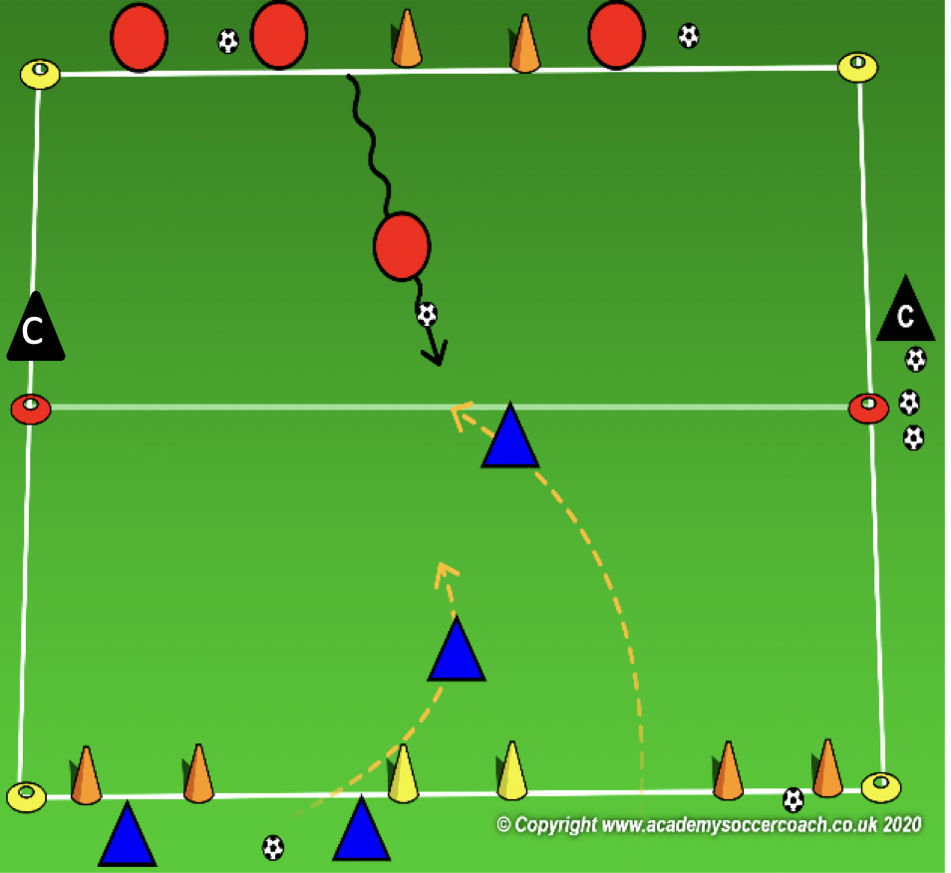
Less Challenging – 1st & 2nd Grade
OBJECTIVE: Protect the goals from opponents trying to score
PLAYER ACTIONS: Protect your goal, Steal the ball
ORGANIZATION: Divide your 15Wx25L grid, with 3 small goals on one end line and 1 goal on the other, play a 1v2 game. Half the team starts on one end line and half on the other. The team defending the single goal starts with the ball. 1 player from the attacking team enter the field. As soon as he/she touches the soccer ball, 2 players from the opposite end also enter the field. The team who starts with the ball can attack any of the 3 goals on their opponent’s end line. If the defending team wins the ball, they can attack the single goal.
RULES: defending team cannot enter the field until the attacking team takes their first touch on the soccer ball. Game last for 30 seconds or until a goal is scored or the ball leaves the playing area. Once the game is over, all players exit the field & a new round begins with new players.
KEY WORDS: block your goal, win the ball
GUIDED QUESTIONS: Which of the 3 goals is most dangerous? Where should a defender be if a goal is dangerous?
What should you do if the attacker kicks the ball too far in front of him/her?
ANSWERS: The goal closest to the ball is the most dangerous. Someone should try to block the goal so the attacker can’t score. Step closer to the ball and try to poke tackle the ball away from the attacker.
Note: After several rounds, switch who is attacking and who is defending. A tendency is to coach the attacking player or team since they only have 1. This is a defending session, so the emphasis is on the players who start as defenders. What can they do to cooperate and defend the goals?

Slide 44
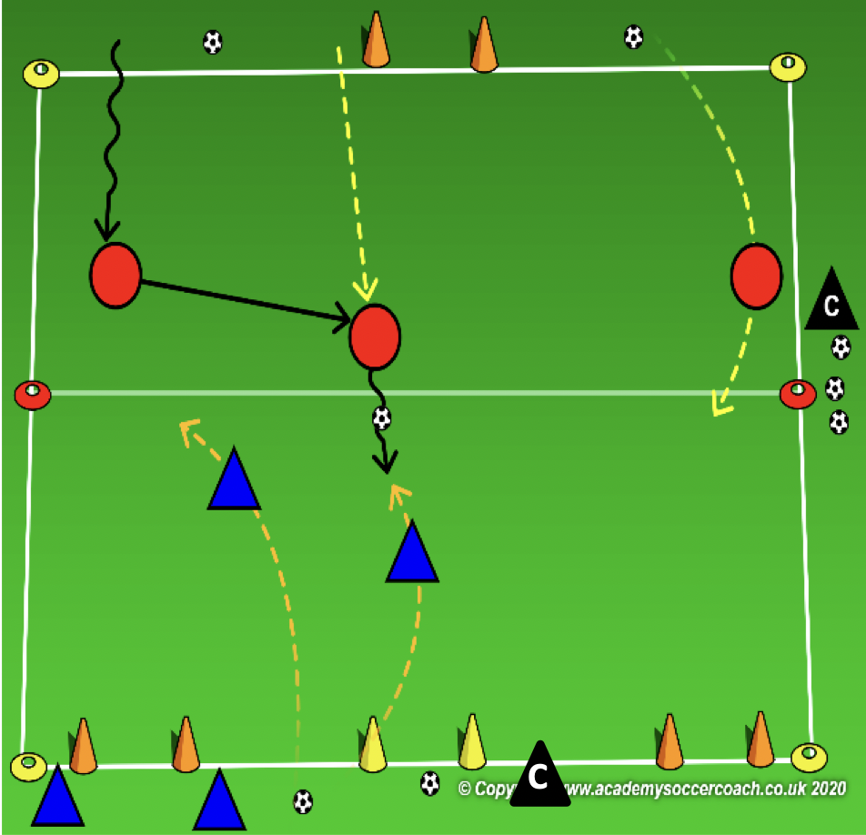
More Challenging – 1st & 2nd Grade
OBJECTIVE: Protect the goals from opponents trying to score
PLAYER ACTIONS: Protect your goal, Steal the ball
ORGANIZATION: Divide your 15Wx25L grid, with 3 small goals on one end line and 1 goal on the other, play a 2v3 game. Half the team starts on one end line and half on the other. The team defending the single goal starts with the ball. 3 players from the attacking team enter the field. As soon as they enter, 2 players from the opposite end also enter the field. The team who starts with the ball can attack any of the 3 goals on their opponent’s end line. If the defending team wins the ball, they can attack the single goal.
RULES: defending team cannot enter the field until the attacking team takes their first touch on the soccer ball. Game last for 1 minute. Coach can serve another ball onto the field if the game ball leaves the field or is scored. Multiple goals can be scored within 1 minute. After 1 minute, switch the players on the field and play again.
KEY WORDS: block your goal, win the ball
GUIDED QUESTIONS: Which of the 3 goals is most dangerous? Where should a defender be if a goal is dangerous?
What should you do if the attacker kicks the ball too far in front of him/her?
ANSWERS: The goal closest to the ball is the most dangerous. Someone should try to block the goal so the attacker can’t score. Step closer to the ball and try to poke tackle the ball away from the attacker.
Note: Remember to focus on the defending players. If a team stops in a triangle, they can no longer score until they come out. What can the defenders to protect a different goal when they do come out? Coaches can partner with an attacking player if need be but allow the players to take on the role of defenders.

Slide 45
PLAY 2 – 1st & 2nd Grade
ORGANIZATION
Split players into two teams and play 3v3 / 4v 4
PLAYER ACTIONS
Pass/dribble, Spread out, Pass options
KEY WORDS
Use space, hips open, pass, dribble, get open

Slide 46
Week Eight

Slide 47
PLAY 1 –1st & 2nd Grade
ORGANIZATION
Mark out two fields. (Field size dependent on age group)
Free play:
Field 1: Teams play 2v2/3v3 or 4v4 (Depending on age group and number of players.
Field 2: Teams play 2v2/3v3 or 4v4 (Depending on age group and number of players.
Allow players to play freely introducing key words
PLAYER ACTIONS
-Pass/dribble -Spread out -Pass options
KEY WORDS
Use space, hips open, pass, dribble

Slide 48
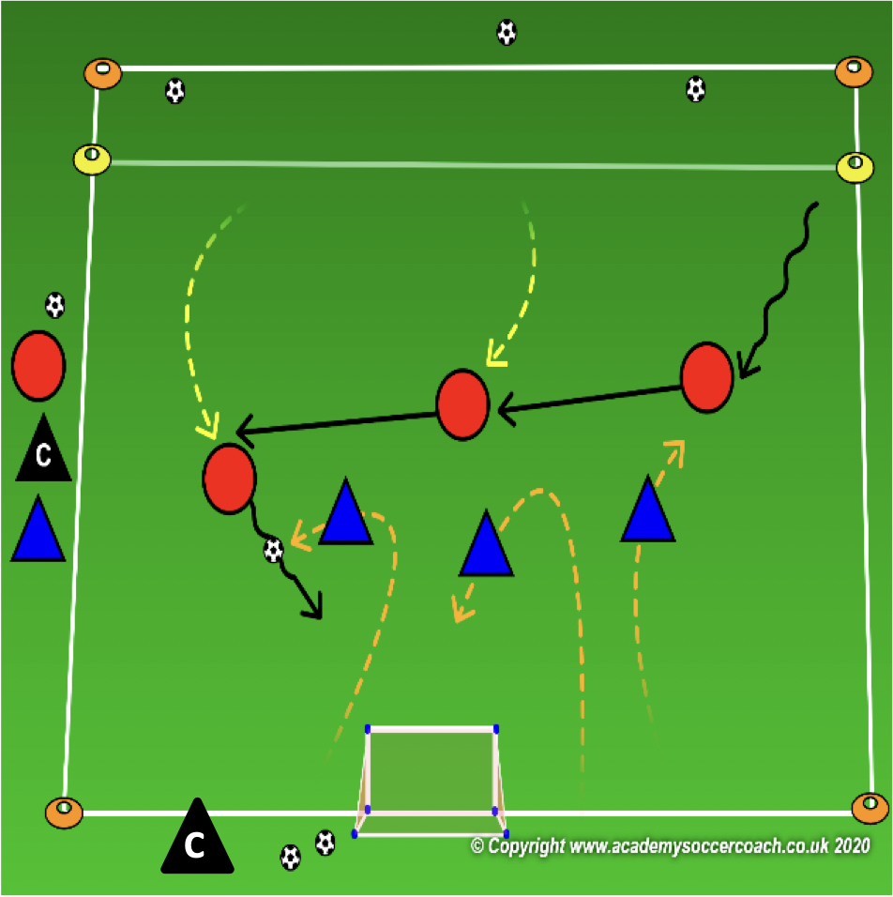
Core Activity – 1st & 2nd Grade
OBJECTIVE: To deny the opponent’s ability to create scoring chances or score goals.
PLAYER ACTIONS: Protect the goal, Steal the ball
ORGANIZATION: On your 25W x 35L game field with a goal on one end line & a 3 yard end zone on the other, play a 3v3 game. The focus team defends the goal & scores by stopping the ball in the opponent’s end zone. The focus team can enter the end zone with a pass to a teammate or dribbling in. The opposing team scores in the goal.
RULES: the team defending the end zone cannot wait in the end zone but can step in to defend a player trying to score. Play local laws/rules of the game other than scoring.
KEY WORDS: step to the ball, get the ball
GUIDED QUESTIONS: If you are the closest defender to the ball, what should you do? When should you try to steal the ball from the opponent? How can you approach the player with the ball so you can get closer to the ball & protect your goal at the same time?
ANSWERS: Step closer to ball and pressure it. Do not let the player with the ball go straight to goal. If the opponent kicks the ball too far in front of themselves, step closer and try to tackle the ball away. Bend your run so you block the goal on your way to the ball.
NOTES: This is a defending session so the coaching should be directed to the team without the ball & the decisions they need to make in order to pressure the ball & steal the ball while protecting their own goal.

Slide 49
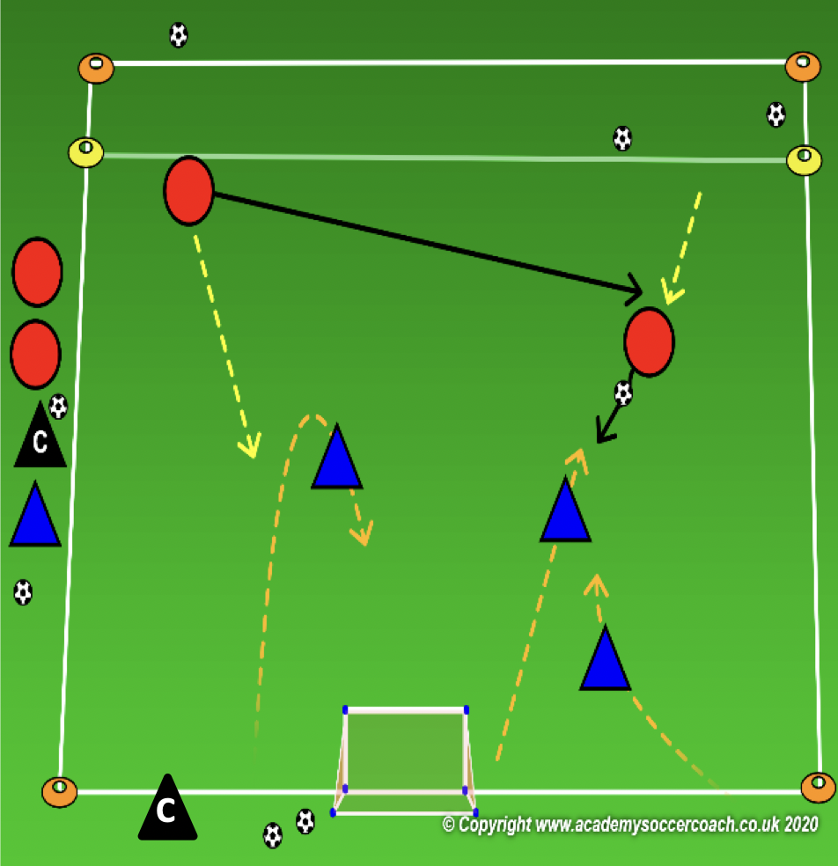
Less Challenging – 1st & 2nd Grade
OBJECTIVE: To deny the opponent’s ability to create scoring chances or score goals.
PLAYER ACTIONS: Protect the goal, Steal the ball
ORGANIZATION: On your 13W x 25L game field with a goal on one end line & a 3 yard end zone on the other, play a 2v3 game. The focus team defends the goal with 3 players & scores by stopping the ball in the opponent’s end zone. The focus team can enter the end zone with a pass to a teammate or dribbling in. The opposing team players with 2 players & scores in the goal.
RULES: the team defending the end zone cannot wait in the end zone but can step in to defend a player trying to score. Play local laws/rules of the game other than scoring.
KEY WORDS: step to the ball, get the ball
GUIDED QUESTIONS: If you are the closest defender to the ball, what should you do? When should you try to steal the ball from the opponent? How can you approach the player with the ball so you can get closer to the ball & protect your goal at the same time?
ANSWERS: Step closer to ball and pressure it. Do not let the player with the ball go straight to goal. If the opponent kicks the ball too far in front of themselves, step closer and try to tackle the ball away. Bend your run so you block the goal on your way to the ball.
NOTES: If needed, 2 fields can be set up; same size as the first play stage. Simply add the end zone to one end. This game can be 3v2 or 2v2. Adjust the numbers based on the session goal & attendance.

Slide 50
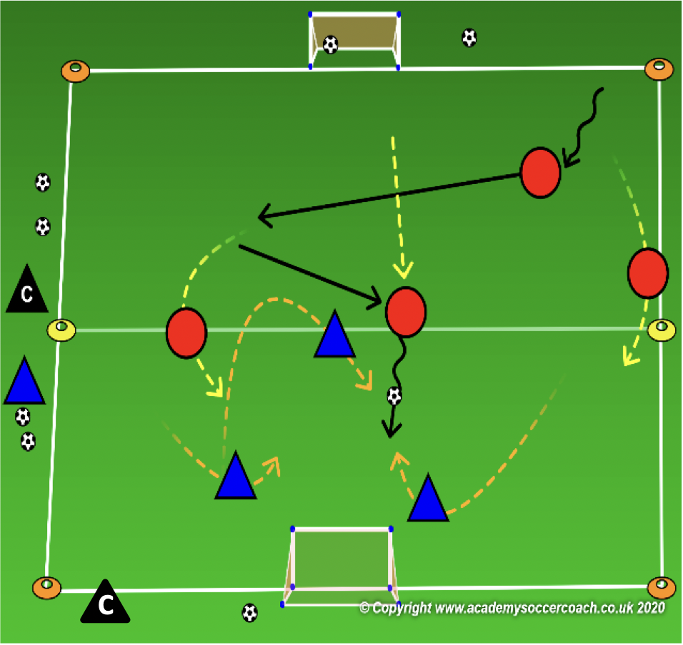
More Challenging – 1st & 2nd Grade
OBJECTIVE: To deny the opponent’s ability to create scoring chances or score goals.
PLAYER ACTIONS: Protect the goal, Steal the ball
ORGANIZATION: On your 25W x 35L game field with a goal on each end line, play a 3v4 game. The focus team defends their goal with 3 players & scores in the opponent’s goal. The opposing team players with 4 players & scores in their opponent’s goal.
RULES: Play local laws/rules of the game other than scoring.
KEY WORDS: step to the ball, get the ball
GUIDED QUESTIONS: If you are the closest defender to the ball, what should you do? When should you try to steal the ball from the opponent? How can you approach the player with the ball so you can get closer to the ball & protect your goal at the same time?
ANSWERS: Step closer to ball and pressure it. Do not let the player with the ball go straight to goal. If the opponent kicks the ball too far in front of themselves, step closer and try to tackle the ball away. Bend your run so you block the goal on your way to the ball.
NOTES: The team without the ball is the team to focus on. How can the cooperate to pressure the ball & steal the ball while protecting their ball.

Slide 51
PLAY 2 – 1st & 2nd Grade
ORGANIZATION
Split players into two teams and play 3v3 / 4v 4
PLAYER ACTIONS
Pass/dribble, Spread out, Pass options
KEY WORDS
Use space, hips open, pass, dribble, get open

Slide 52
Week Nine

Slide 53
PLAY 1 –1st & 2nd Grade
ORGANIZATION
Mark out two fields. (Field size dependent on age group)
Free play:
Field 1: Teams play 2v2/3v3 or 4v4 (Depending on age group and number of players.
Field 2: Teams play 2v2/3v3 or 4v4 (Depending on age group and number of players.
Allow players to play freely introducing key words
PLAYER ACTIONS
-Pass/dribble -Spread out -Pass options
KEY WORDS
Use space, hips open, pass, dribble

Slide 54
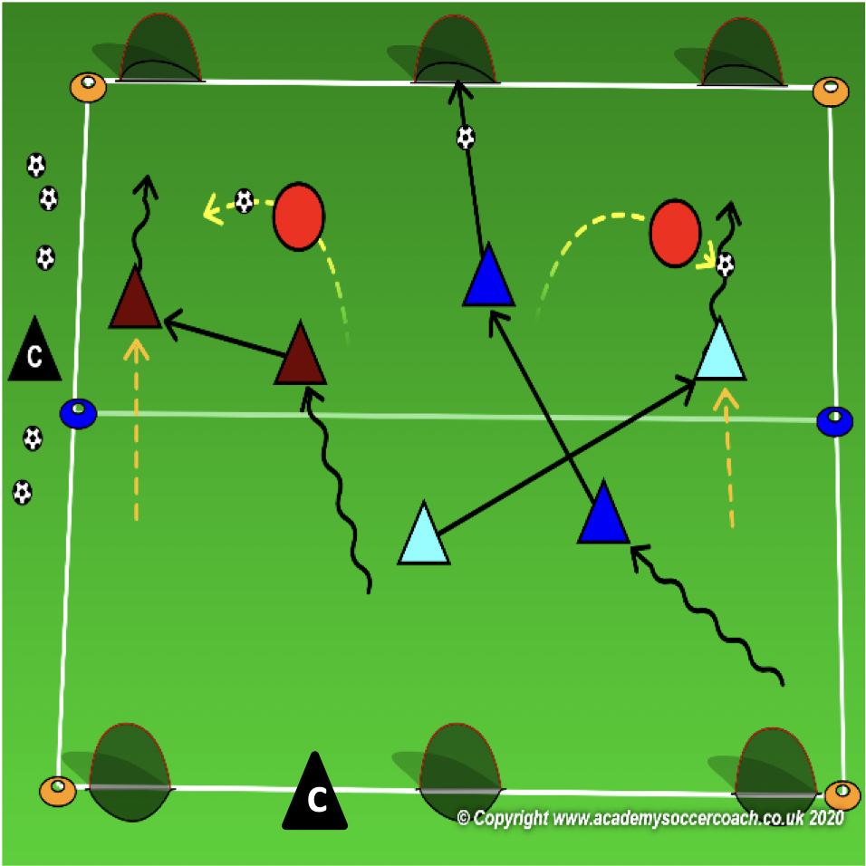
Core Activity – 1st & 2nd Grade
OBJECTIVE: To pass or dribble past an opponent in order to create scoring chances
PLAYER ACTIONS: Shoot, Pass or dribble forward
ORGANIZATION: In a 25Wx35L grid with 3 goals on each end line, the coach will select 2-3 players to defend. All other players have a partner & a soccer ball to share. The teams with a ball can dribble or pass past the defenders & score in any of the 3 goals on an end line. Once they have scored, they can get any soccer ball from the goal or behind the goal & try to score in any of the 3 goals on the opposite end line. Challenge the players to score as many goals as they can in 2 minutes.
RULES: if a defender steals their soccer ball & can play it off the field, the players who lost their ball lose all their points & must begin scoring over. Players can shoot, pass or dribble into a goal. Rotate defenders after each round.
KEY WORDS: look up, move with your teammate
GUIDED QUESTIONS: How do you know where the goal & opponents are? How can the 2 players with a ball beat any 1 defender? Why is it important to turn your body toward your teammate when you are ready to pass the ball?
ANSWERS: Look up to see if you have an opening or if it’s closed. Try to dribble the ball toward a defender to see if he/she follows you then pass to your teammate. Facing my teammate will help me make a more accurate pass.
Note: After 2-3 successful rounds, coaches can have the players switch roles if they steal a ball from the attackers & the game continues.

Slide 55
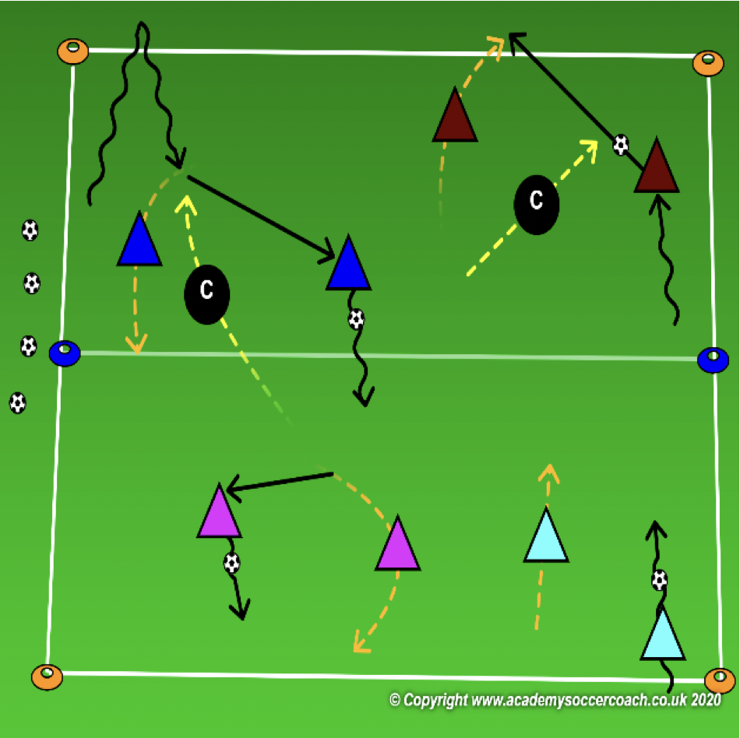
Less Challenging – 1st & 2nd Grade
OBJECTIVE: To pass or dribble past an opponent in order to create scoring chances
PLAYER ACTIONS: Pass or dribble forward
ORGANIZATION: In a 25Wx35L grid play groups of 2 vs the coaches to the end lines. The coach will start as defenders. All other players have a partner & a soccer ball to share. The teams with a ball can dribble or pass past the defenders & score by crossing an end line. Once they have scored, they can get any soccer ball from beyond the end line & try to score by crossing the opposite end line. Challenge the players to score as many goals as they can in 2 minutes.
RULES: if a defender/coach steals their soccer ball & can play it off the field, the players who lost their ball lose all their points & must begin scoring over. Players can pass to their teammate over the end line or dribble over the end line.
KEY WORDS: look up, move with your teammate
GUIDED QUESTIONS: How do you know where the goal & opponents are? How can the 2 players with a ball beat any 1 defender? Why is it important to turn your body toward your teammate when you are ready to pass the ball?
ANSWERS: Look up to see if you have an opening or if it’s closed. Try to dribble the ball toward a defender to see if he/she follows you then pass to your teammate. Facing my teammate will help me make a more accurate pass.
Note: After 2-3 successful rounds, coaches can step out of the activity, select 2-3 players to be defenders & return to the Core Activity.

Slide 56
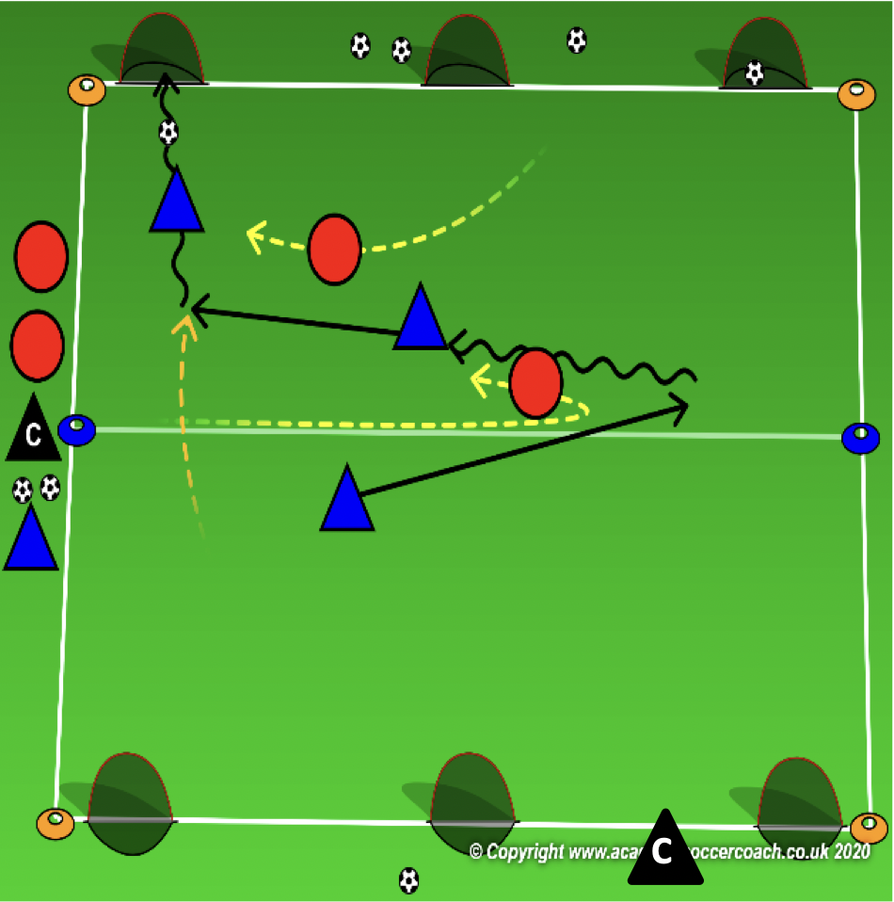
More Challenging – 1st & 2nd Grade
OBJECTIVE: To pass or dribble past an opponent in order to create scoring chances
PLAYER ACTIONS: Shoot, Pass or dribble forward
ORGANIZATION: In a 25Wx35L grid with 3 goals on each end line, play a 3v2 game. The team of 3 starts with the ball & can dribble or pass past the defenders & score in any of the 3 goals on an end line. Once they have scored, they can get any soccer ball from the goal or behind the goal & try to score in any of the 3 goals on the opposite end line. Challenge the players to score as many goals as they can in 4 minutes.
RULES: if a defender steals their soccer ball & score in any goal, the attacking team loses all their points & must begin scoring over. Players can shoot, pass or dribble into a goal. Rotate defenders after each round.
KEY WORDS: look up, move with your teammate
GUIDED QUESTIONS: How do you know where the goal & opponents are? How can the 2 players with a ball beat any 1 defender? Why is it important to turn your body toward your teammate when you are ready to pass the ball?
ANSWERS: Look up to see if you have an opening or if it’s closed. Try to dribble the ball toward a defender to see if he/she follows you then pass to your teammate. Facing my teammate will help me make a more accurate pass.
Note: Coach can also make this a game of 3v2 where each team defends 3 goals and scores on the 3 goals on the opposite end line.

Slide 57
PLAY 2 – 1st & 2nd Grade
ORGANIZATION
Split players into two teams and play 3v3 / 4v 4
PLAYER ACTIONS
Pass/dribble, Spread out, Pass options
KEY WORDS
Use space, hips open, pass, dribble, get open

Slide 58
Week Ten

Slide 59
PLAY 1 –1st & 2nd Grade
ORGANIZATION
Mark out two fields. (Field size dependent on age group)
Free play:
Field 1: Teams play 2v2/3v3 or 4v4 (Depending on age group and number of players.
Field 2: Teams play 2v2/3v3 or 4v4 (Depending on age group and number of players.
Allow players to play freely introducing key words
PLAYER ACTIONS
-Pass/dribble -Spread out -Pass options
KEY WORDS
Use space, hips open, pass, dribble

Slide 60
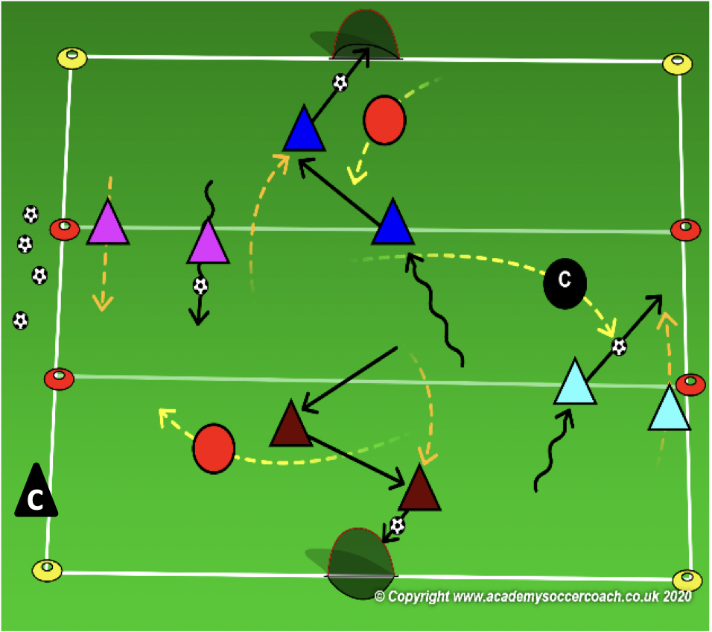
Core Activity – 1st & 2nd Grade
OBJECTIVE: To deny the opponent’s ability to build and create scoring chances.
PLAYER ACTIONS: Pressure the ball, Protect the goal, Steal the ball
ORGANIZATION: Divide your 25W x 35L game field into thirds & a goal on each end line. Coach will select 1 player to defend each 1/3 of the field. Each defender must remain in their zone (1/3). The rest of the players will have a partner & a soccer ball to share. The attackers try to dribble or pass through each third & score in the goal at one end. Once they have scored, they will play back through the thirds & try to score in to goal at the opposite end.
RULES: if the attackers miss the goal, no point scored & they play to the other end. If a defender steals their soccer ball, they lose all their points & must start scoring over again.
KEY WORDS: force to the sides, win the ball, block your goal
GUIDED QUESTIONS: Why is it important to step closer to the ball? When should you try to tackle the ball? How
should you approach the ball, so you are pressuring the ball & blocking your goal at the same time?
ANSWERS: to force the head of the attacker down & make mistakes? If the attacker kicks the ball too far in front of him/her, step in to tackle it. Bend your run to block the goal then begin to move closer to the ball to steal it.
NOTES: Defenders can count the number of times they steal the ball & challenge new defenders to beat their score. Coach can defend 1 zone if needed or partner with a player to attack.

Slide 61
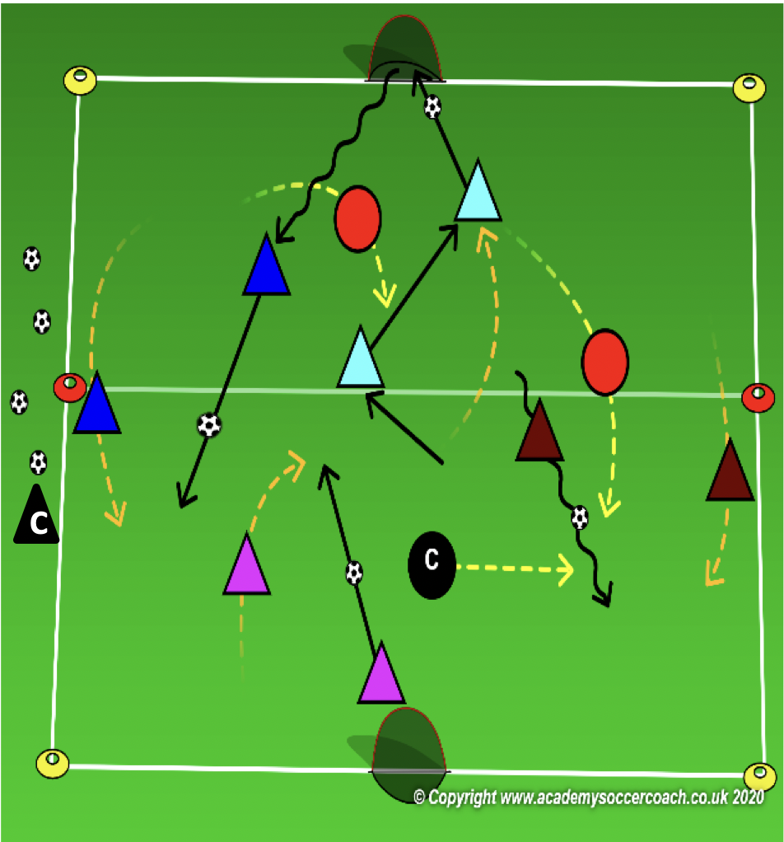
Less Challenging – 1st & 2nd Grade
OBJECTIVE: To deny the opponent’s ability to build and create scoring chances.
PLAYER ACTIONS: Pressure the ball, Protect the goal, Steal the ball
ORGANIZATION: Divide your 25W x 35L game field in 1/2 & a goal on each end line. Coach will select 1 player to defend each 1/2 of the field & 1 more defender who can enter both halves. Each defender must remain in their 1/2 except for the identified defender who can go anywhere. The rest of the players will have a partner & a soccer ball to share. The attackers try to dribble or pass through each 1/2 & score in the goal at one end. Once they have scored, they will play back through the field & try to score in to goal at the opposite end.
RULES: if the attackers miss the goal, no point scored & they play to the other end. If a defender steals their soccer ball, they lose all their points & must start scoring over again.
KEY WORDS: force to the sides, win the ball, block your goal
GUIDED QUESTIONS: Why is it important to step closer to the ball? When should you try to tackle the ball?
How should you approach the ball, so you are pressuring the ball & blocking your goal at the same time?
ANSWERS: to force the head of the attacker down & make mistakes? If the attacker kicks the ball too far in front of him/her, step in to tackle it. Bend your run to block the goal then begin to move closer to the ball to steal it.
NOTES: Defenders can count the number of times they steal the ball & challenge new defenders to beat their score. Coach can defend 1 zone if needed or partner with a player to attack. Coach should not be the free defender.

Slide 62
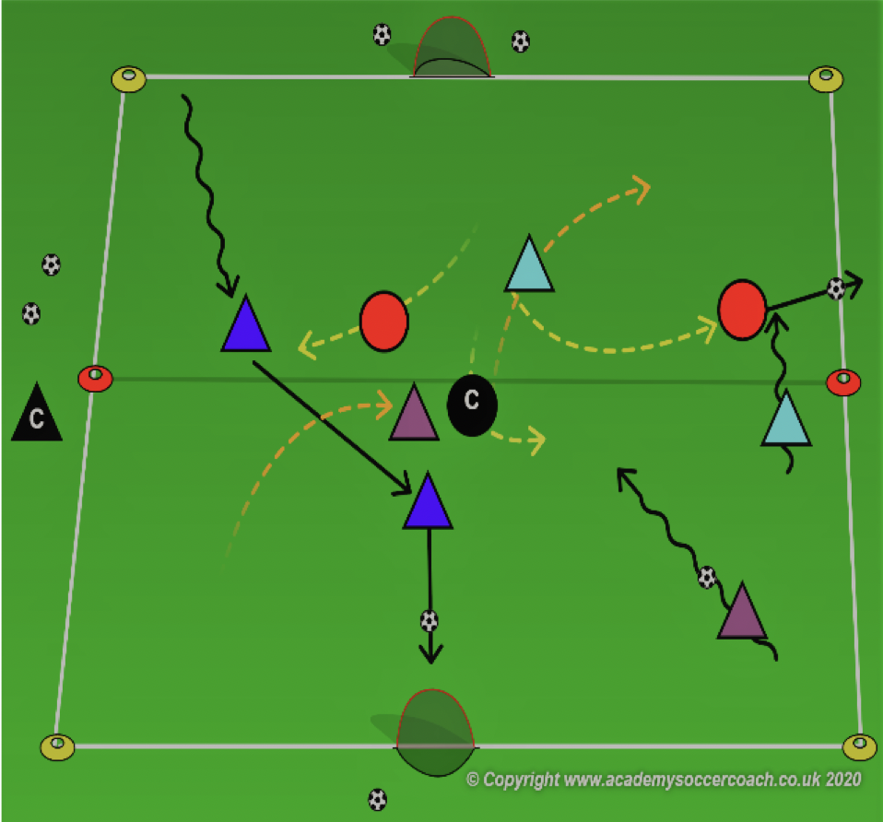
More Challenging – 1st & 2nd Grade
OBJECTIVE: To deny the opponent’s ability to build and create scoring chances.
PLAYER ACTIONS: Pressure the ball, Protect the goal, Steal the ball
ORGANIZATION: Divide your 25W x 35L game field in 1/2 & a goal on each end line. Coach will select 3 players to defend. Each defender must protect both goals. The rest of the players will have a partner & a soccer ball to share. The attackers try to dribble or pass through each 1/2 & score in the goal at one end. Once they have scored, they will play back through the field & try to score in to goal at the opposite end.
RULES: if the attacker misses the goal, no point scored & they play to the other end. If a defender steals their soccer ball, they lose all their points & must start scoring over again.
KEY WORDS: force to the sides, win the ball, block your goal
GUIDED QUESTIONS: Why is it important to step closer to the ball? When should you try to tackle the ball? How
should you approach the ball, so you are pressuring the ball & blocking your goal at the same time?
ANSWERS: to force the head of the attacker down & make mistakes? If the attacker kicks the ball too far in front of him/her, step in to tackle it. Bend your run to block the goal then begin to move closer to the ball to steal it.
NOTES: Defenders can count the number of times they steal the ball & challenge new defenders to beat their score. Coach can defend 1 zone if needed or partner with a player to attack.

Slide 63
PLAY 2 – 1st & 2nd Grade
ORGANIZATION
Split players into two teams and play 3v3 / 4v 4
PLAYER ACTIONS
Pass/dribble, Spread out, Pass options
KEY WORDS
Use space, hips open, pass, dribble, get open

Slide 64
Thank you for taking your time to help better our MYS Soccer Family

