Slide 1

MYS
Coaches Meeting
Spring 2023
Notes:
Welcome! Thank you all for agreeing to coach or be a team parent this fall. We truly cannot do this without you.
My name is Amie Gardner, I’m the new In-Town Director for MYS. I have been with MYS in some way shape or form since Fall 2011.
My main vision for In-Town is for kids to learn to play soccer, develop their skills, build relationships, and HAVE FUN! We’re not looking to make the next Messi or Harry Kane or even Fagundez. That’s the job of Clubs and Academies. We’re here to get them to love the game of soccer.

Slide 2

Agenda
Introductions
Events
Coaching Credentials/CORI
Basic Logistics for Spring
Field Map
Field Set-up
Uniforms and Equipment
Zero Tolerance
2nd Grade Transitions
Questions?
Notes:
This is our Agenda for the evening. Please let me or the person speaking get through the slide and we’ll ask for questions about the information on that particular slide then. Once we are done, I will stick around for questions.

Slide 3
Introductions:
MYS Board of Directors and Support
President – Jess Grey
Vice President – George Apazidis
Registrar – Doug LaCamera
Travel Director – Danie Correia & Dan Cooper
In-Town Director – Graham Wilson
Treasurer – Mark Powers
Fundraising Director – OPEN
Secretary – Tori Holmes
Equipment Director – John McPherson
Field Director – Nicole Mannarino
Public Relations – Jackie McNamara
Referee Director – Teri Fleming
Events Director – Amie Gardner
At Large – OPEN
Tournament Director – Danie Correia
Compliance – OPEN
Scheduling – Danie Correia & Dan Cooper
Director of Coaching – Aaron Salter
Notes:
We really need a Field Director. If you are interested in learning more about this position, PLEASE contact me and I’ll get you to the right person.

Slide 4
Age Group Coordinators (AGCs)
Pre-K – Nicole Mannarino
Grade K Boys – Carrie Dunn
Grade K Girls – Erika Miao
Grade 1 Boys – Jen Gentili
Grade 1 Girls – Amy Trout
Grade 2 Boys – Amie Gardner
Grade 2 Girls – Amy Trout
Grade 3-5 Co-ed – Amie Gardner/Graham Wilson
Notes:
A huge thank you to these ladies who are extremely busy Moms – especially this time of year as kids go back to school. They have been working since February on securing coaches, making rosters, changing rosters, fulfilling “play with” requests, and updating rosters.
During the season, they are the person to communicate with about concerns, problems, etc. with your Age Group. A kid hasn’t come all season and we’re halfway through? Email your AGC. Something isn’t working on your field? Email the AGC. Safety issue or parking issue? Email the AGC. They will either know the answer – OR they will accelerate it to me or the appropriate person. They are the communication link between you and me and the rest of the Board. I plan to be present, but I also will not always be able to be there every single week. With 5 kids, 4 of whom are playing sports and one who is traveling out of state frequently, I’ll actually be a solo Mom trying to get my other kids to their stuff. So, they are the go to person. We also have Nick, from Legacy, who will be on site as well. They all have my cell phone and can reach me if there is an emergency.

Slide 5
Events and Fundraising
40th Anniversary Dinner and Celebration – past March 10th – So much fun!
Volunteer Options:
  Concessions during the season
  MYS at the Revs Night! – Saturday, June 17th
  POSSIBLE 40th Anniversary Field Day – Just for the kids!
Sponsorships
Notes:
Danie – our Events Director, Fundraising Director and Tournament Director will cover the information in this slide.

Slide 6
Coach Requirements
Credentials reset every year in July, so you need to check in for the year and see what you need to do:
  Upload headshot
  Complete CORI background check (New coaches need to show their license as well)
  Complete Concussion Training or Health & Safety course (both fulfill the requirement)
  Complete Safe Sport Abuse Prevention Training
Questions? Email corimys@gmail.com
Notes:
If you completed this for Fall, you are all set. If you are new this Spring, you will need to reach out to Amanda to get started on the Coaching process.
If you are new, have a headshot ready before you create an account. Makes it so much easier. Also, if you are new, you will need to show your license to our CORI Administrator, Amanda Waldron, before you can get your credentials for Fall.
Returning folks, please keep your lanyards. If you need a new one, email Amanda at the email address on the slide.

Slide 7
Basic Logistics
Season starts Saturday, April 6th and goes 9 weeks to June 8th
  No Games Memorial Day Weekend
  Jamboree is June 8th
  June 15th is a Make-up Weekend (in case it rains)
  Detailed Schedule will be out soon
Time Slots
    8:15 AM – Grade 2
    8:30 AM – Grades 3rd thru 6th
    9:45 AM – Grade K
    11:00 AM – Grade 1
    12:30 PM – Grade PK
Notes:
Our season starts Saturday, April 8th. There are no games Memorial Day Weekend.
The Jamboree will be held on June 10th. If we need a make-up week, the Jamboree will still be held on the 10th and we’ll just do a regular session on the 17th. This is because it’s Revs Day at Gillette and many people may be there starting at noon.
Detailed schedule will be out at the beginning of next week. Unless I get to it earlier, but no promises.
Times slots are the same as last year. I’m asking coaches to be a little early (5-10 minutes) to be ready to get on the fields to start for their group. We are also going to be asking parents to head out of the complex right after their session is over. Parking will be tight again this year.

Slide 8
Basic Logistics (cont.)
Session Break-Down
  Lessons follow the Play-Practice-Play that USYSA is currently practicing
  We do have a Legacy coach on-site until 1pm, and hopefully available for ALL grades
Field Logistics
  All fields at Plymouth Street Complex
  PK through Grade 1 will play on Small Sided Fields
  Note: Grade 2 will play on two 7 v 7 fields or a full Small Sided field
  In-Town Co-ed 3-6 will play on one 7v7 and one 9 v 9 fields

Slide 9
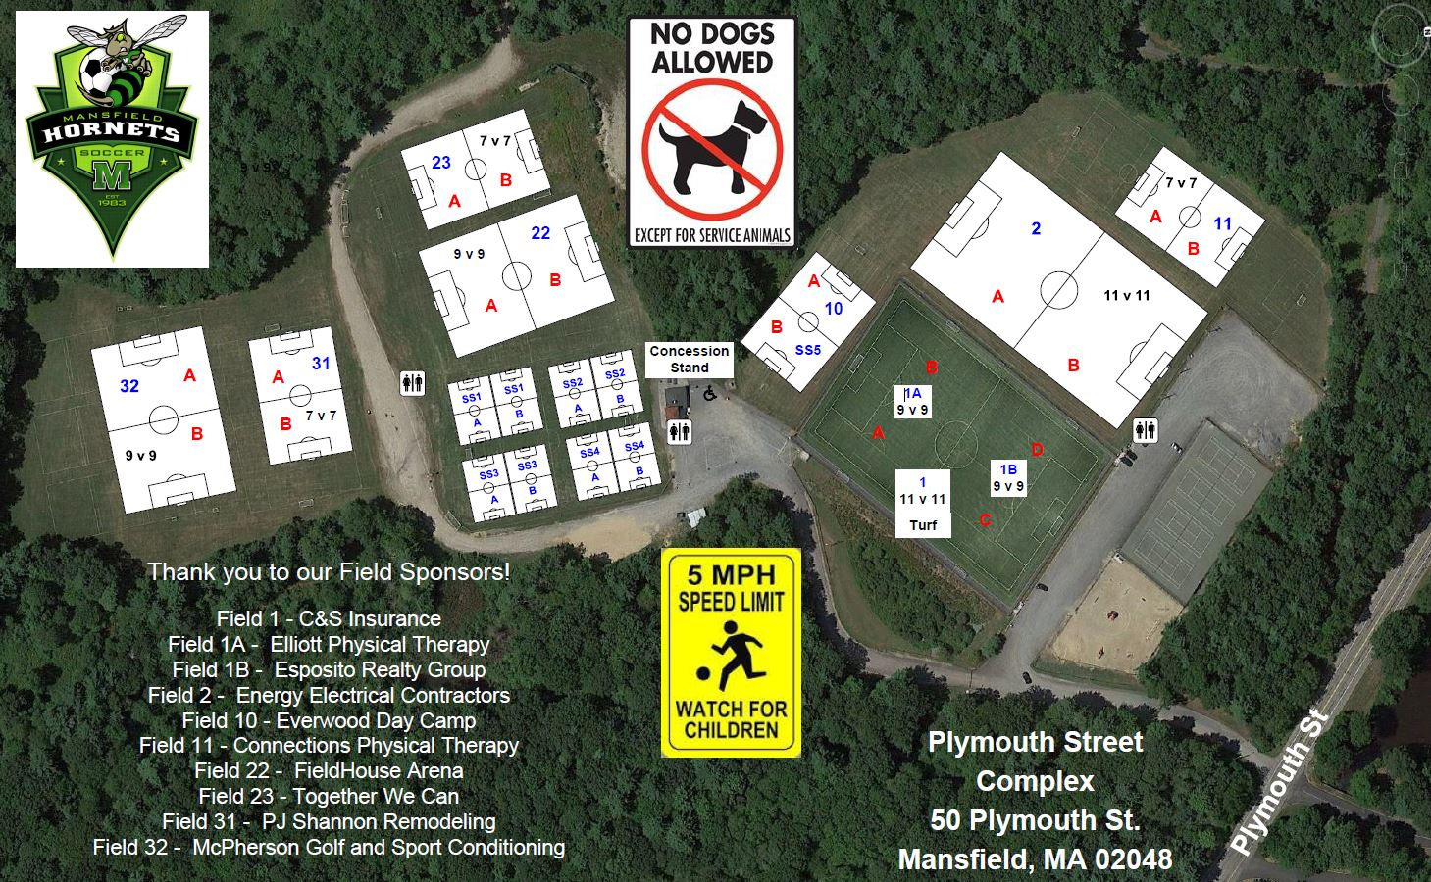
Field Map
Notes:
Small Sided fields are in the same spot for the Spring. We will need all 6 fields for 2nd grade and Kindergarten. 1st grade needs 5 fields. Only PK uses 4 fields.
The changes are with locations of 9v9s and 7v7 for Spring.
3rd through 6th is using Fields 21, 31 and 32.

Slide 10
Field Set Up
Goals – we have 10 brand new goals that have wheels on the backs plus pugs and the older white goals.
  Grade 2 – Please Help put out the goals each week
  Grade K – Will need to rearrange the goals
  Grade PK – please help put away the goals each week
Where do parents stand?
  PK thru Grade 1 – will practice and play two small sided games with kids in the middle and parents on the outside.
  Grade 2 – IF you are not on a 7v7, your team will practice on a full SS field. Then your scrimmage can be on two full SS fields.
  Grade 3rd thru 6th – Kids and coaches on one side of the field and parents on the other.
Notes:
Instructions for putting away will be sent out next week. Coaches, I ask that you ask a parent or two to help put away. I won’t always be able to be there each week as my 12yo travels. So if there is anyone available and willing to put the pugs away in the middle container, that would be amazing.

Slide 11
Uniforms
If a uniform was ordered BEFORE March 17th, then it should be here in time for handing out the first day.
If a uniform was ordered AFTER March 17th, then it will arrive a few weeks into the season. Players should wear a white shirt and we can use pinnies for the opposite color.
Uniform Distribution will be at a tent by the steel storage containers
Notes:
I think we’re going to try to do uniform distribution the same as we did in the Fall – at a tent. BUT it will depend on how many uniforms we have to hand out. If there aren’t many, it might be easier to do it by coach. So stay turned.

Slide 12
Equipment
  Coaches Bag
      Cones
      1 Ball
Notes:
I think we are going to need to use pinnies this year. Only for those who don’t have a uniform yet.

Slide 13
Zero Tolerance
WHAT IS IT: Neither parents, coaches, or assistants should question or criticize the refs. There should be no shouting or talking to the refs.
Please remember that these Referees are TWEENS and TEENS and learning themselves.
Any notice to the In-Town Director or Director of Coaching will result in a ZT-1 and Coaches/Parents will be asked to take a week off from the fields. Multiple ZTs and we will ask you to take the Season off from the fields.
We ask Coaches to be a good role model to players and parents. If you are having trouble with a parent or another coach, please contact me or the Director of Coaching.
Please make parents aware that yes, even In-Town, has a Zero Tolerance policy.

Slide 14
Pause
End of main Coaching meeting
Discuss 2nd Grade Transitions

Slide 15
2nd grade Transitions
Introduction to 7v7
Intro positions (3-2-1 formation)
Goalies – use a Pinnie! (Rotate this position.)
Other rules (Goal kicks, throw-ins, offsides)
Continued use of Referees
Kids on one sideline, parents on the other
Coach evals:
Notes:
We have 2 7v7 fields: one for Girls and one for Boys. The week that you aren’t on 7v7, you will have a SS field for the practice session, then put half your team on one SS field and half on the other teams. So – two SS fields for team scrimmages.
Introduce positions on the field. We ask that you rotate kids in these positions. We want them to keep getting experience in all the positions still.
Same with Goalie.
We will have goal kicks, corner kicks, throw-ins. BUT NO offsides. For goal kicks, please remember to have the other team go back to their half of the field. We use the mid-field line, there isn’t a different build up line on the field.
We will continue to use Referees – their priority will be the 7v7s and 3rd thru 6th. So coaches may need to help referee the games on the Small Sided fields.
Teams on one side of the field, parents on the other. Field 10 is pretty obvious where the teams stand. Field 11, the parents side is the woods side. Teams stand on the side shared with the 11v11.
Coach Evals – most of you have done this, but lets review anyways.

Slide 16
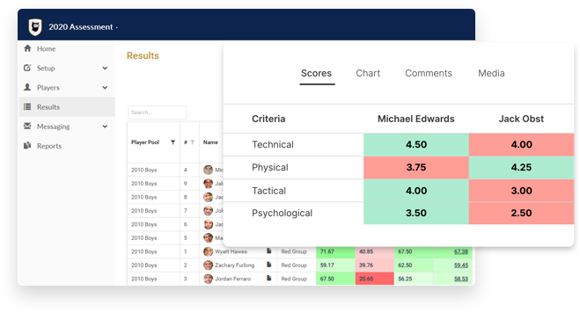
Coach Evaluations
Rank players in 4 areas
  Technical Skills
  Tactical/Game Situation
  Physical
  Commitment
Team Genius or Excel Spreadsheet

Slide 17
QUESTIONS

