Slide 1
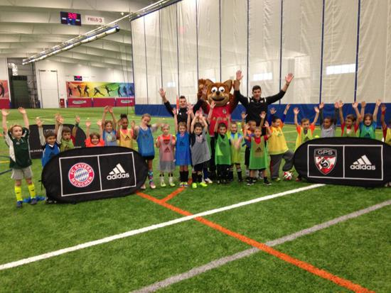

Global Premier Soccer
Town Partner Curriculum
3rd & 4th Grade

Slide 2
Week 1

Slide 3

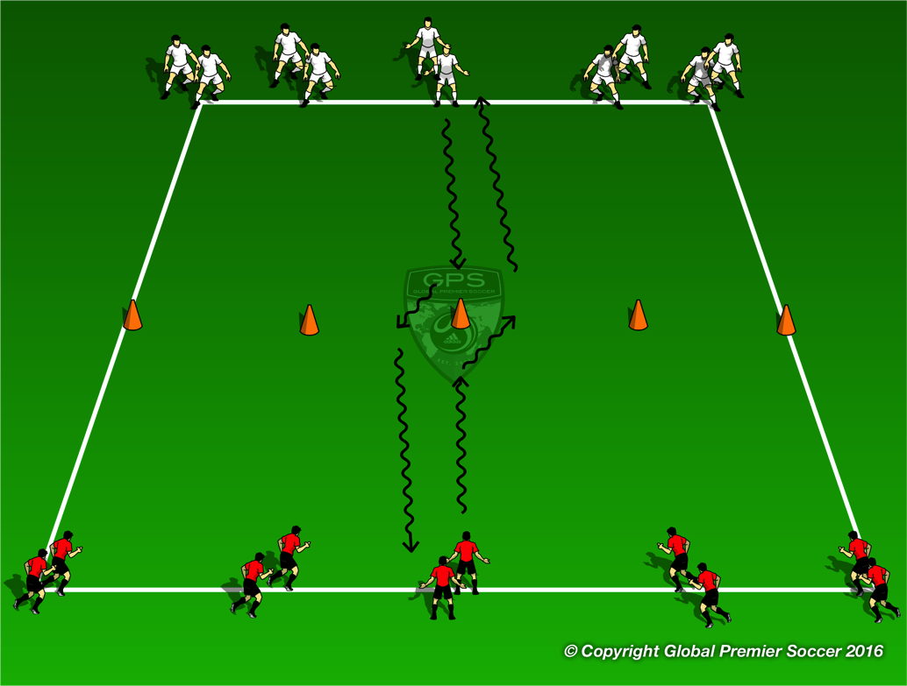
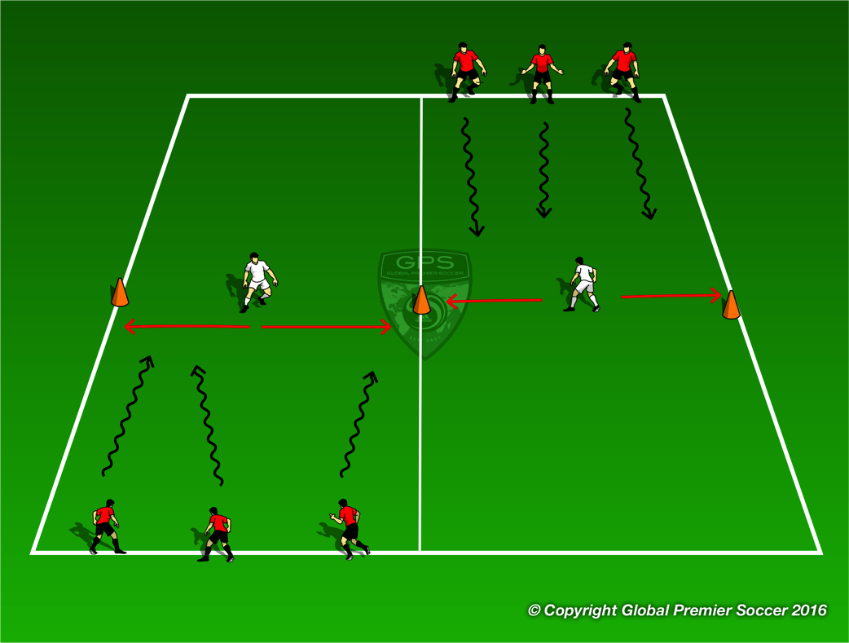
Week 1: Dribbling
Organisation
Players work in groups of 4. First player in each line dribbles towards central cone, performs a fake & take to the right and accelerates to the line opposite.
Progressions
Fake & Take to the left
Coaching Points
To the right Fake to move to the left with a big step Use outside of right foot to push the ball to the right. Accelerate after the move | To the left Fake to move to the right with a big step Use outside of left foot to push the ball to the left. Accelerate after the move
Organisation
Create 2 channels. Places cones to mark the center of the channel and have a defender stand between them. The defender can only move left or right along that line. Each player has a ball and dribbles down the channel trying to get past the defender. Once at the end of the channel they move to the next channel
Progressions
Switch defenders Add a goal at end of channel
Coaching Points
Keep ball close to feet to enable ball manipulation Use fake & take move to beat defender

Slide 4
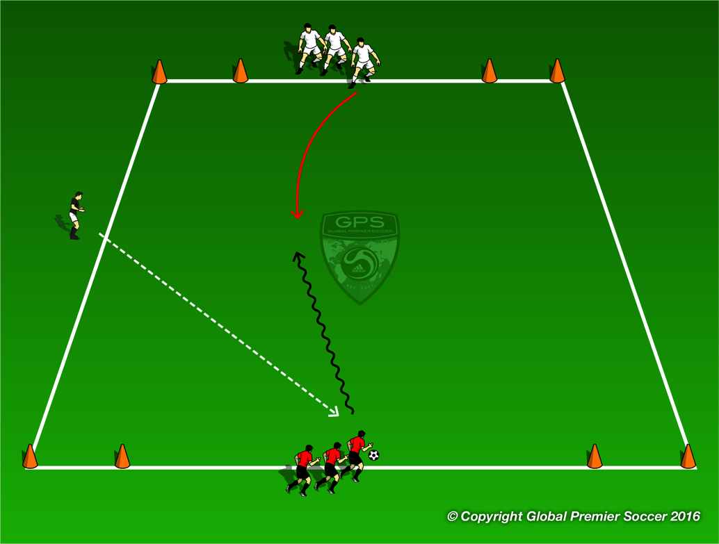
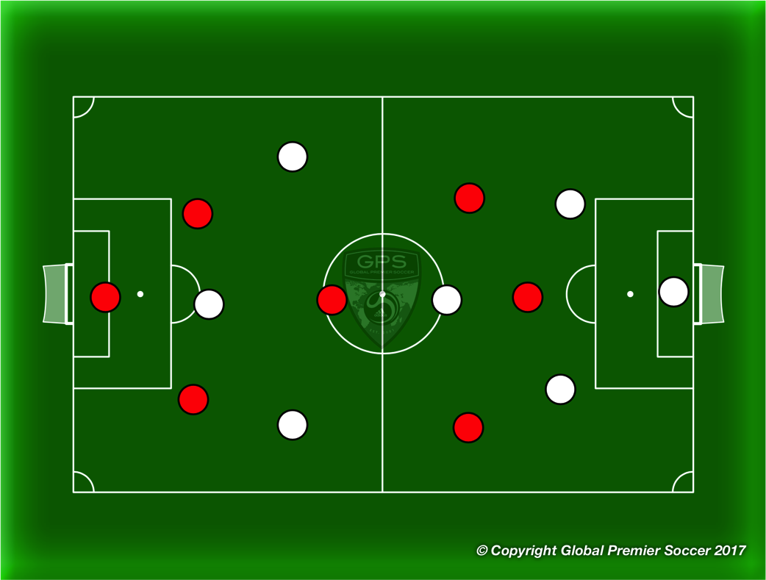
Week 1: Dribbling
Organisation
Set out a 14x14 yard area with a goal in each corner. Split players into two teams, one on each side of the area between goals. Coach passes a ball into play and the first player in each team plays 1v1 to goal. Player scores by dribbling through a goal.
Progressions
Play 2v2
Coaching Points
Attack at speed Keep ball close and under control Use move to beat defender Accelerate after move
Organisation
Play 7v7. Both teams play 1-2-1-2-1.
Progressions
Coaching Points

Slide 5
Week 2

Slide 6
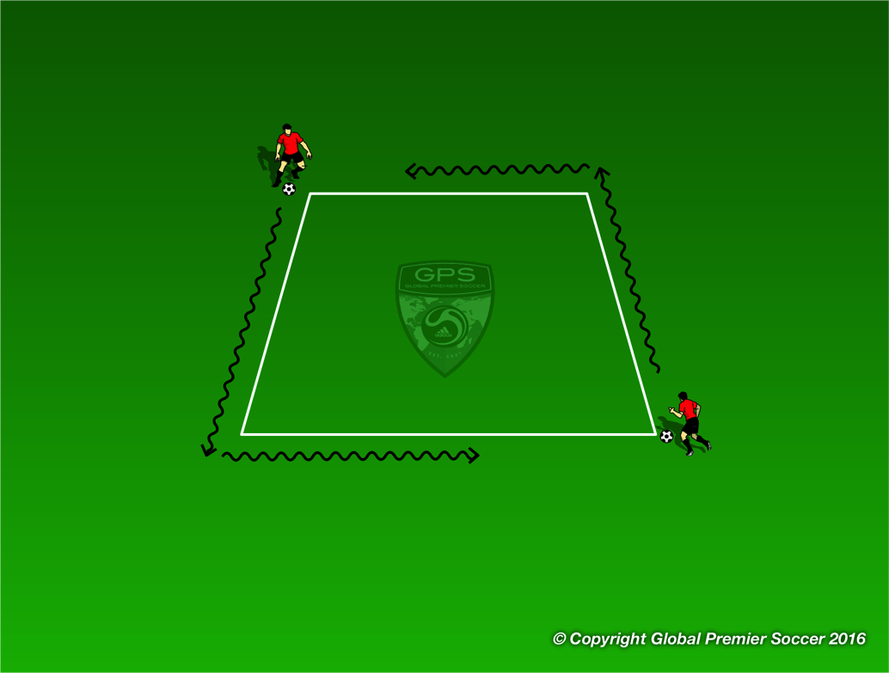
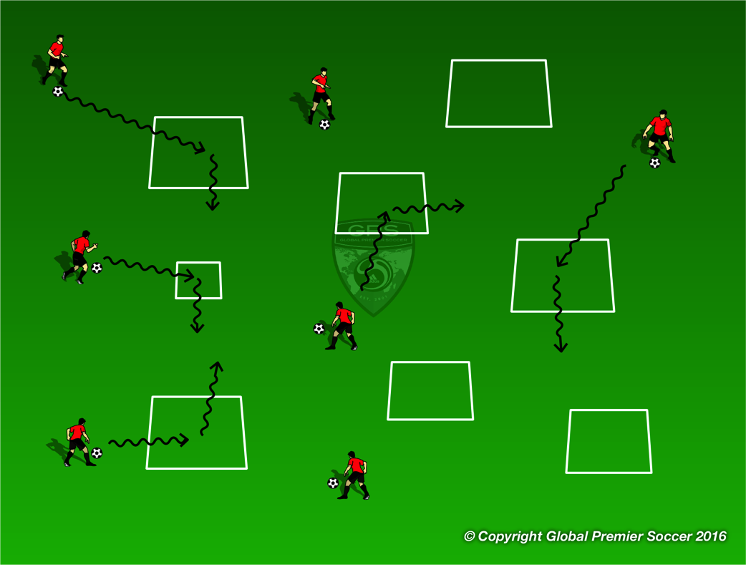
Week 2: Dribbling
Organisation
Players work in pairs. Each pair has one 3x3 yard box. Players leave the ball inside the box and stand on opposite corners. 1 player is the tagger and one player is the runner. Players can not go into the box and. Tagger tries to catch the runner by tagging them on the back. Tagger has 30 seconds to catch them
Progressions
Play same game but this time players must dribble the ball
Coaching Points
Little touches on the ball to keep it close Use different parts of the foot to change direction. Head up to see other player
Organisation
Players now have a ball each and dribble around the area and through as many of the boxes from the previous game as possible.
Coaching Points
Keep ball close Head up to see space Dribble at speed into space
Progressions
Players dribble into the box and turn left Players dribble into the box and turn right Players dribble into the box and turn and dribble out | Players perform 5 toe taps in each box Players perform 5 foundations in each box

Slide 7
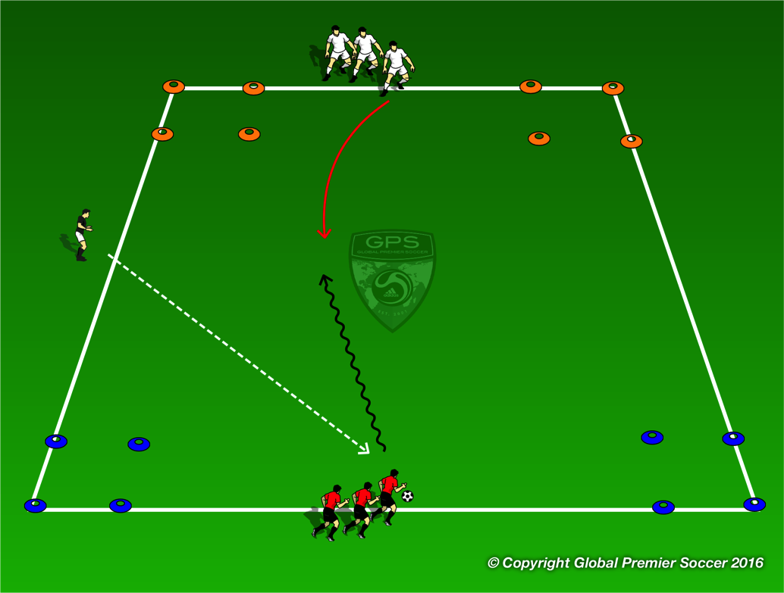
Week 2: Dribbling
Organisation
Set out a 15x20 yard area with a box in each corner. 2 colors at one end 2 at the other. Split players into two teams, each starting between a set of boxes. Coach passes ball into area and players go 1v1 to try and stop the ball in wither box opposite their start point.
Progressions
Play 2 1v1 games at the same time.
Coaching Points
Use body to protect ball Move ball using various part of feet Move ball quickly to try and unbalance defender Exploit space at speed
Organisation
Play 7v7. Both teams play 1-2-1-2-1.
Progressions
Coaching Points

Slide 8
Week 3

Slide 9
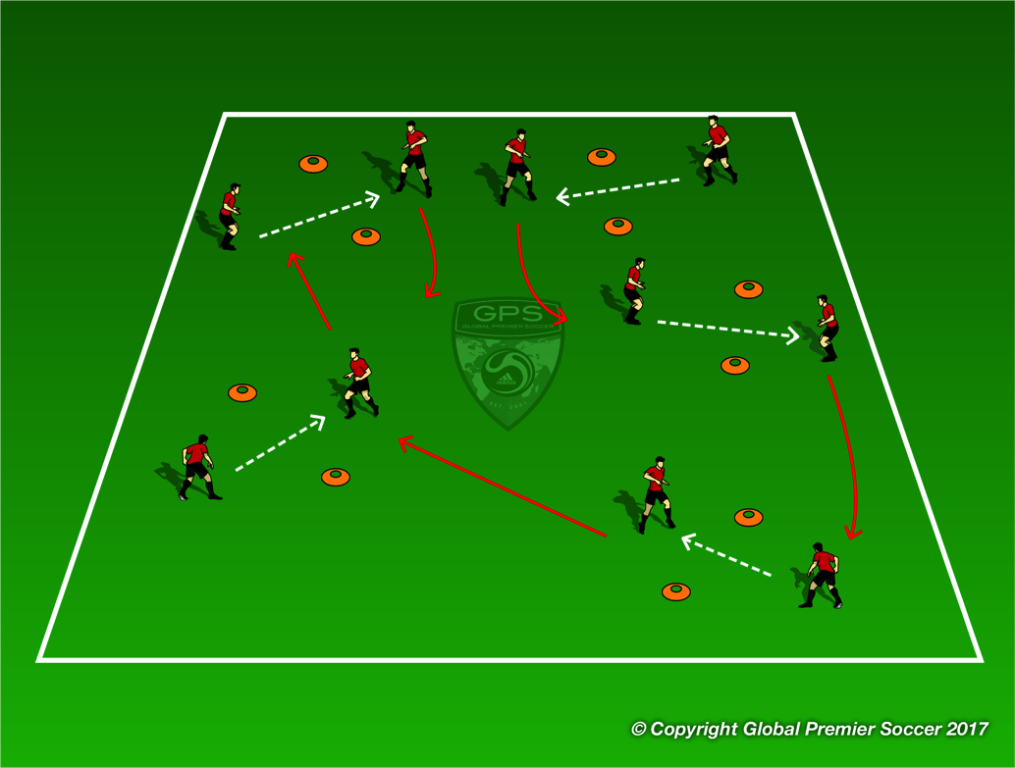
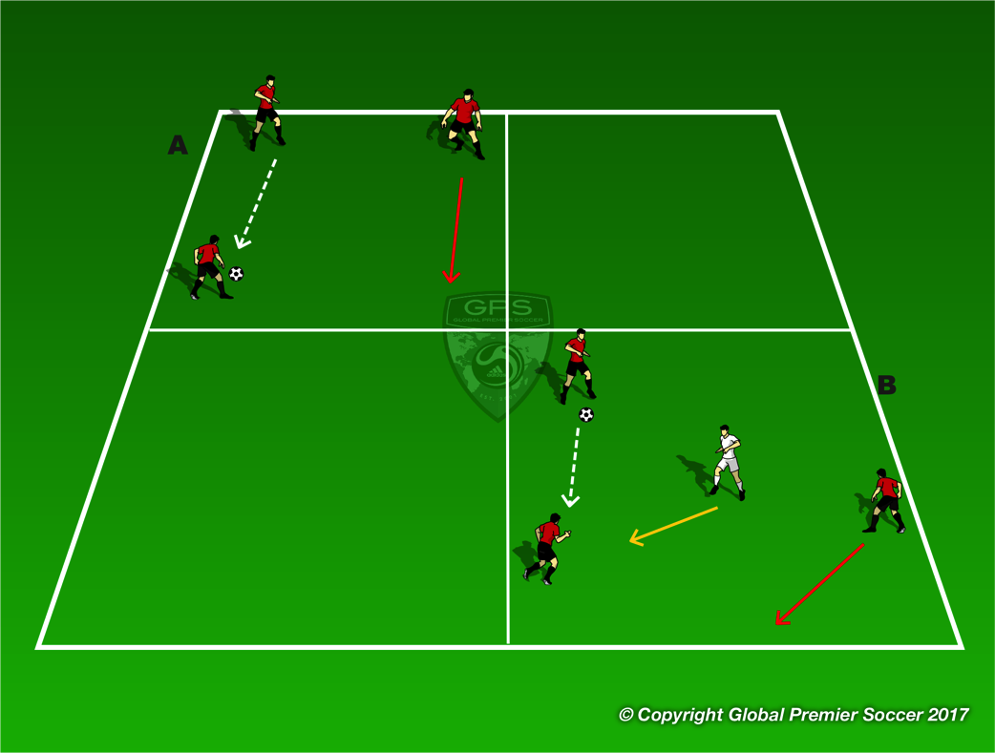
Week 3: Passing & Receiving
Organisation
Use pairs of cones to create multiple ‘gates’ throughout the playing area. Players are in pairs, and pass through the gate. After each pass they move to a new gate and repeat. Aim to do as many as possible in a minute.
Progressions
3 passes in each gate before moving on. Coach plays as a defender as players move between gates First time passes
Coaching Points
Use inside of the foot for the pass, make eye contact with team mate before pass. Receiving player needs to move in line with the ball. | Can receiving player take first touch in direction of the next gate.
Organisation
A – 3 players in each grid, passing the ball between them. Players without the ball move to supporting positions with each pass.
Progressions
. B – same set up but keeping the ball from defender.
Coaching Points
Players off the ball move into supporting positions while keeping space. Try to give player with ball 2 options. Off the ball, adjust your position every time ball moves. | Draw in the defender and then pass. Open body to be able to pass left or right.

Slide 10
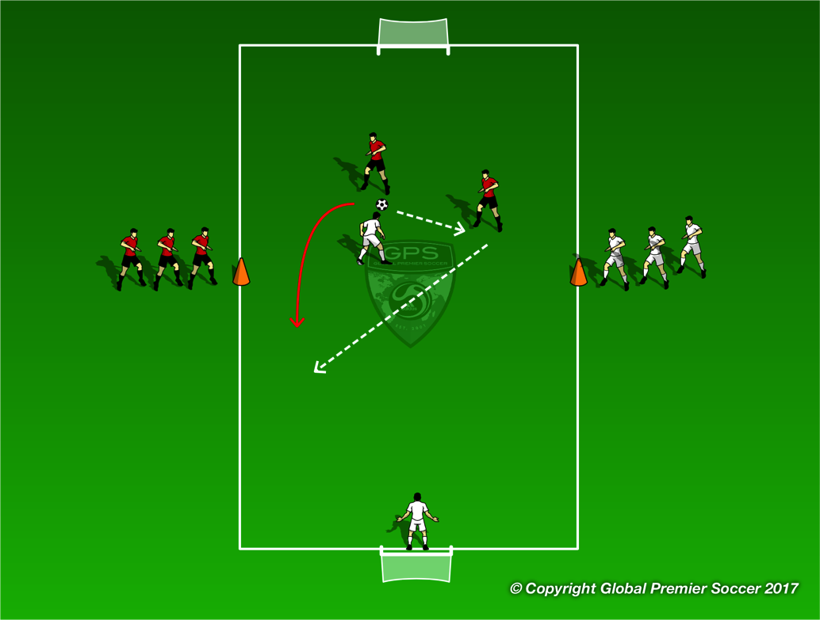
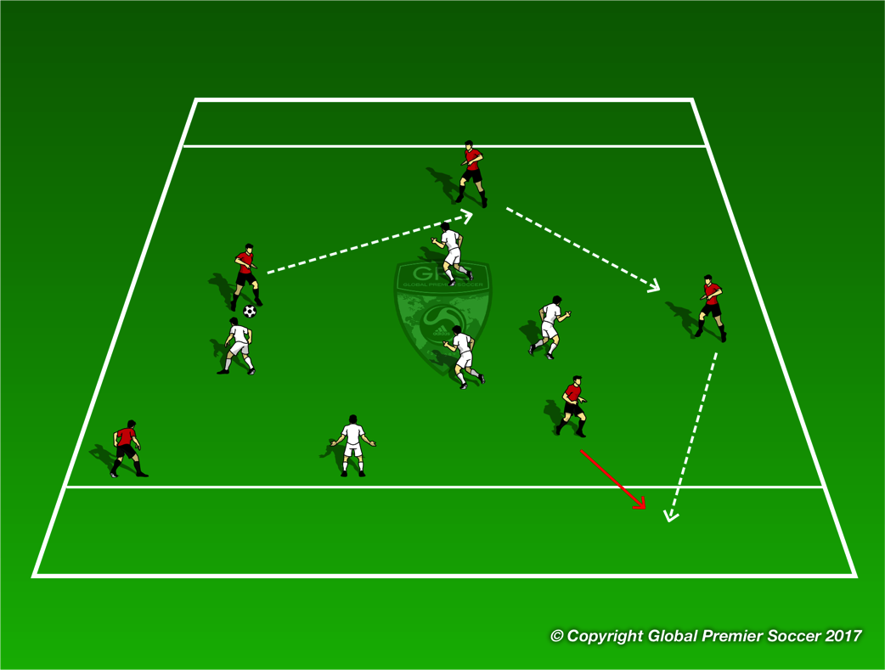
Week 3: Passing & Receiving
Organisation
Teams start on the orange cones. On coach command 2 players from each run around the back of their own goal and into the field. Team without the ball, 1 player must drop back as a GK to leave 2v1 on the field.
Progressions
3v3 with same rule, one player drops back as GK.
Coaching Points
Keep space between the 2 players to make it harder for defender. Player off the ball move to give a supporting angle. Pass, then move. Try to combine to take the defender out the game.
Organisation
Scrimmage with end zones instead of goals. Teams score by passing the ball for a team mate to receive in the end zone.
Progressions
Regular scrimmage.
Coaching Points
‘Make the field big’ by spreading out, makes it harder for defenders to cover everyone. Movement off the ball to give angles where there player with the ball can find you. | Don’t force the pass into the end zone, try to keep possession.

Slide 11
Week 4

Slide 12
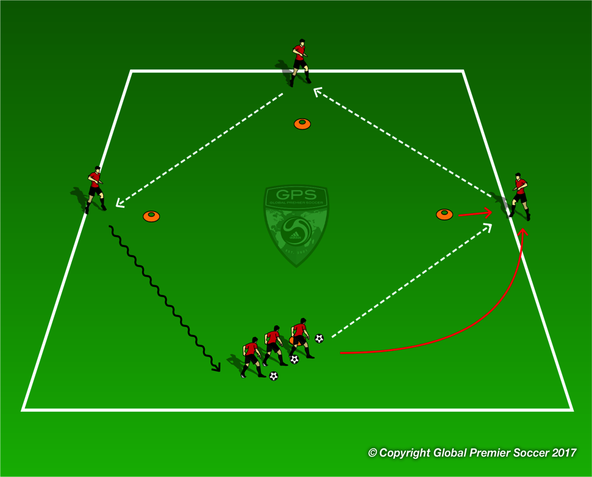
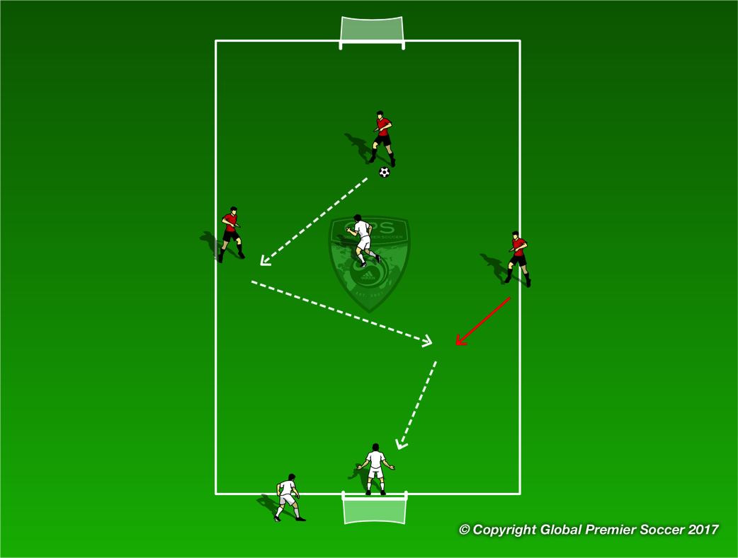
Week 4: Passing & Receiving
Organisation
Cones placed in diamond formation, with 1 on each cone, and spare players at the starting cone. Replicate if you have more than 6 players to increase repetitions. Players pass the ball around the outside of the diamond, aim to keep it outside. Follow your pass to next cone.
Progressions
Play a give and go at each cone.
Coaching Points
ABCs – Awareness, Body Shape, Control Pass firmly with inside of the foot. Receiving player should check off the cone to create space and give the passer a bigger target. | Receive with open body so you are facing where you want to pass. Head up, check the next player is ready before playing your pass.
Organisation
Teams play 3v3, but defending team has one player drop out to rest and one drop into gk to create 3v1 + GK. Reds do the same if they lose possession. Continuous game.
Progressions
Same set up in other grids, play a tournament!
Coaching Points
Support the player with the ball. Angles of support – player needs to have a lane to pass to you. ABCs. Quick transition between attack/defence.

Slide 13
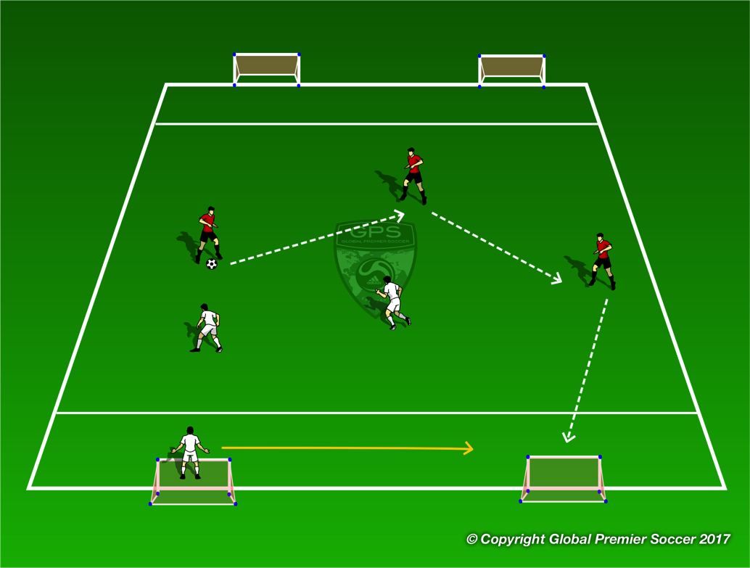
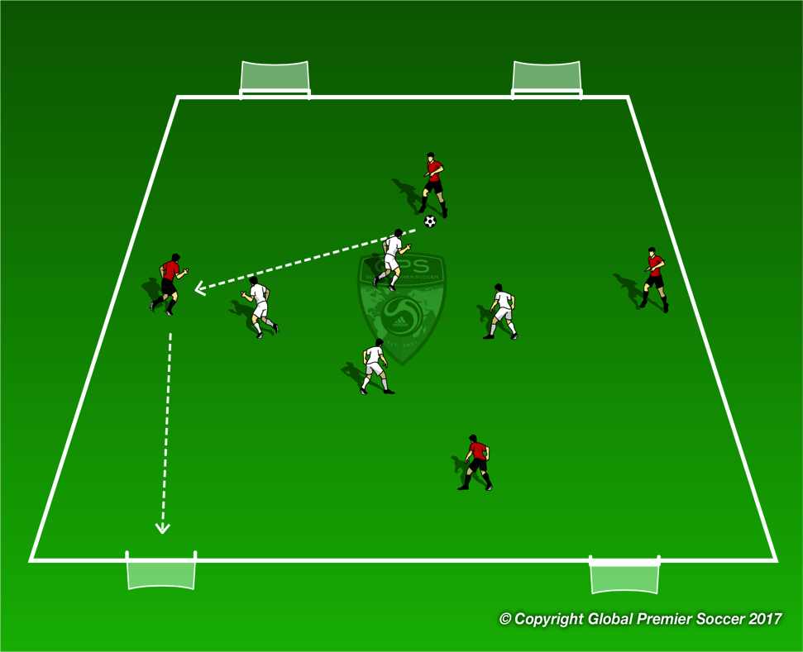
Week 4: Passing & Receiving
Organisation
3v3, each team attacks 2 goals. Team without possession has a goalkeeper who must drop in to the goal zone.
Progressions
See next exercise
Coaching Points
Support the player with the ball, ahead and behind when needed. ABCs Angles of support. Look to switch the point of attack to attack the open goal.
Organisation
4 goals, each team attacks 2 goals.
Progressions
Full scrimmage
Coaching Points
Support the player with the ball, ahead and behind when needed. ABCs Angles of support. Look to switch the point of attack to attack the open goal.

Slide 14
Week 5

Slide 15
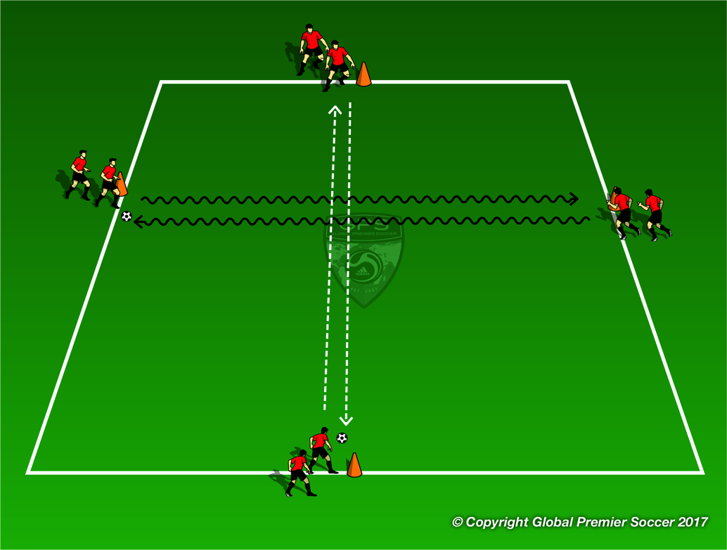
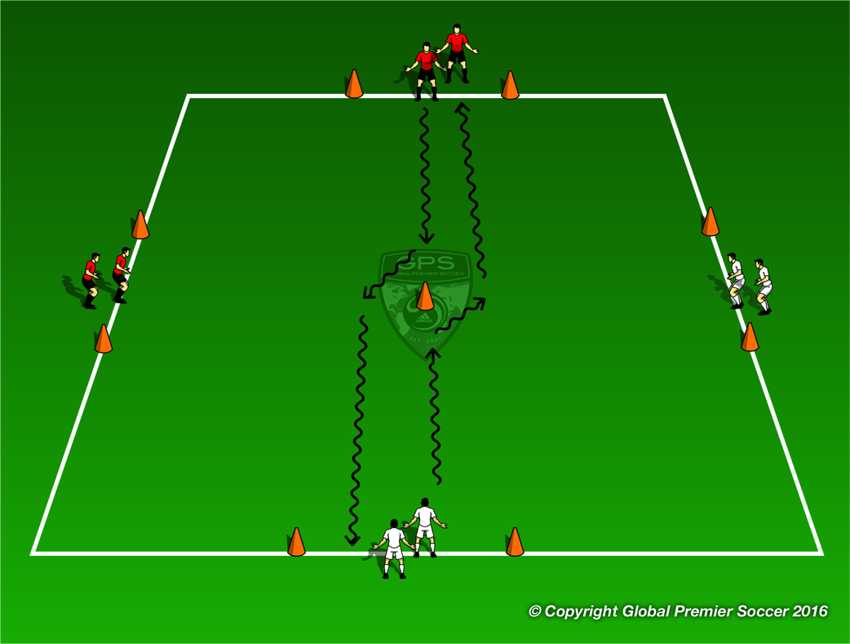
Week 5: Defending 1v1
Organisation
Split players into 4 groups. Groups 1 & 2 (top & bottom) pass the ball back and forth joining the opposite line each time. Groups 3 & 4 (left & right) dribble the ball back and forth joining other line each time.
Progressions
Add another 2 groups next too group 1 & 2 who pass the ball back and forth in two touches
Coaching Points
Passing Use inside of foot to pass the ball Move off middle cone to receive ball Take first touch towards next passing target | Dribbling Use a different part of the foot with every touch Foundations Toe Taps Inside/outside
Organisation
The first player from each line dribbles towards the middle cone. Both players move to the right as they approach the cone and join the opposite line. As they move past the cone the next 2 lines do the same.
Progressions
Coaching Points
Keep ball close Perform move a good distance from the cone Accelerate after the move.

Slide 16
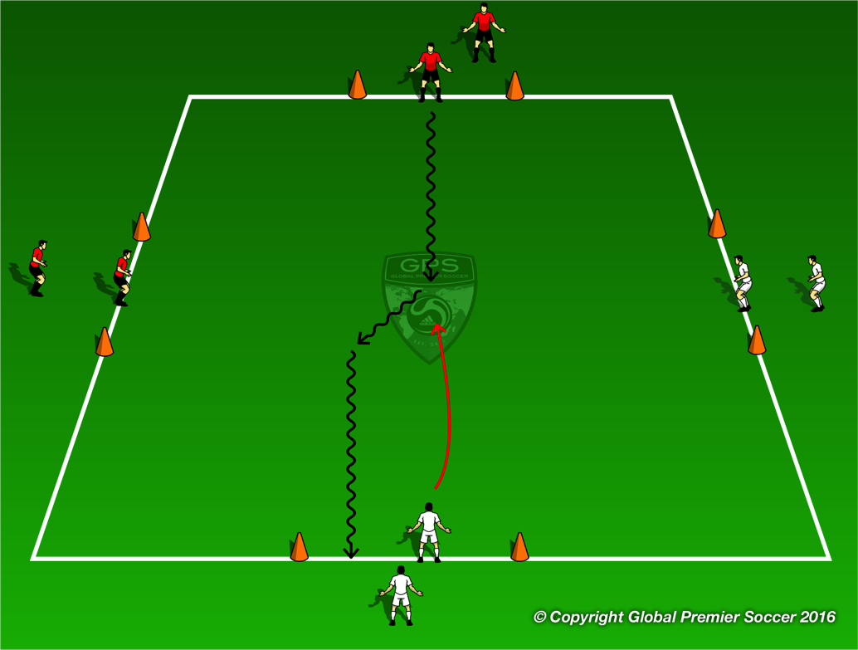
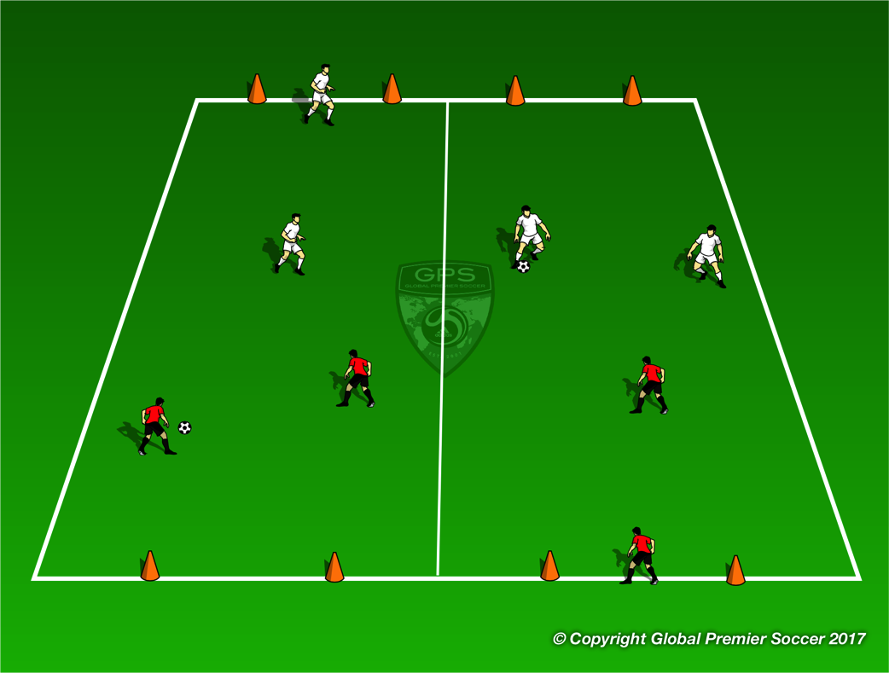
Week 5: Defending 1v1
Organisation
Now take the central cone away. 1 player dribbles into the area. Person opposite moves in as defender and play 1v1. Players try and dribble through coned goal of opposite team.
Progressions
Coaching Points
Get the the ball quickly Angle run to force attacker one way Slow feet on approach Be on the half turn (surfer pose) Aggressive to win the ball
Organisation
2v2 games. Team without the ball must have one player drop back and become GK leaving 2v1 on the field
Progressions
Coaching Points
Get the the ball quickly Angle run to force attacker one way Slow feet on approach Be on the half turn (surfer pose) Aggressive to win the ball

Slide 17
Week 6

Slide 18
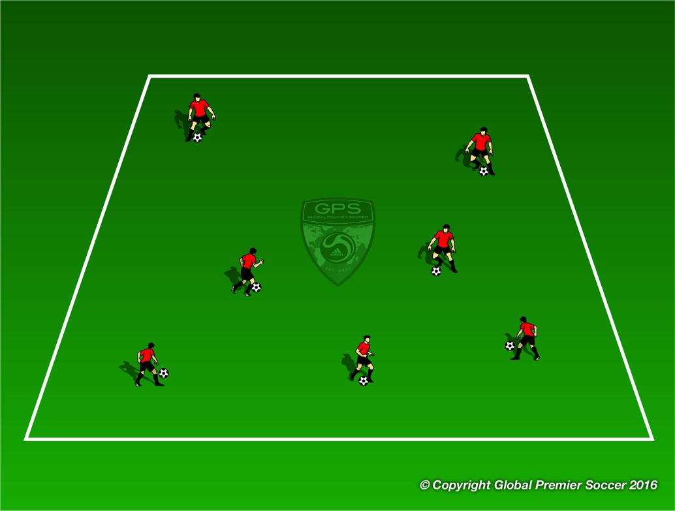
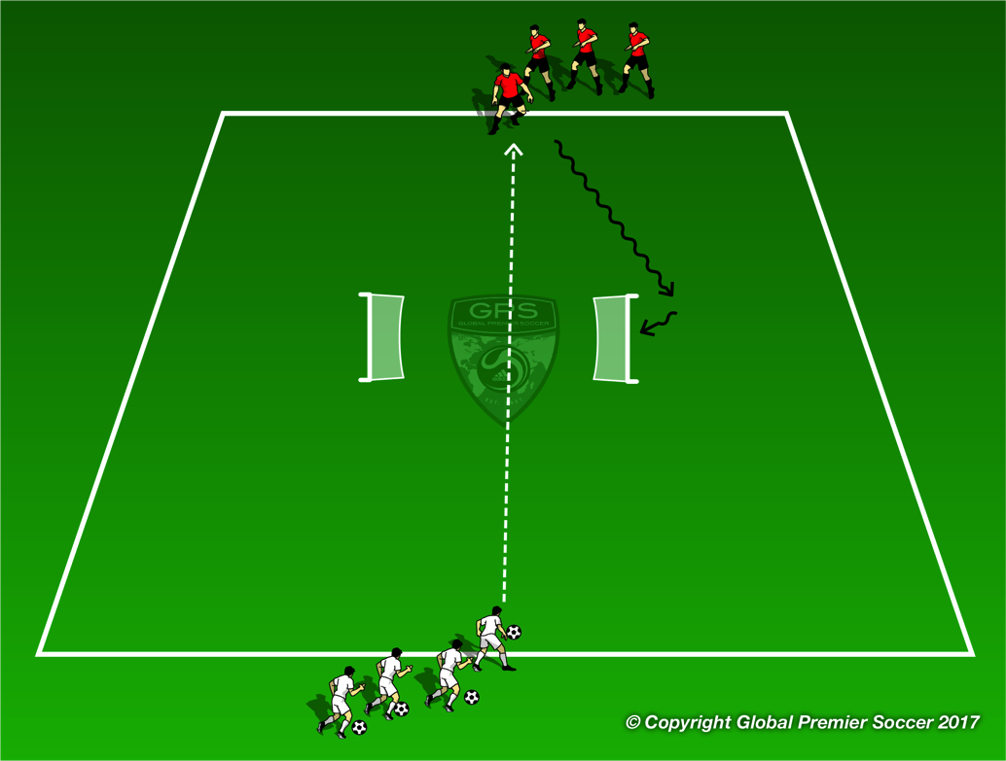
Week 5: Defending 1v1
Organisation
Each player has a ball and dribbles inside the area. On coach command players try and kick everyone else’s ball out of the area.
Progressions
One player without a ball who is defender. How quick can you clear the area of soccer balls
Coaching Points
Force attacker into pressure or to the side line Force mistake or bad touch from attacker Poke ball away Block tackle to win ball.
Organisation
2 groups opposite at each end of the area, with 2 outwards facing goals in the center. White passes to red, who attacks and aims to score in either goal. White defends, switch to opposite group.
Progressions
Players pass back and forth until coach commands “GO”, player with the ball attacks.
Coaching Points
Get to ball quickly Slow feet on approach Force attacker away from goal Patience to wait for good opportunity to tackle

Slide 19

Week 5: Defending 1v1
Organisation
2v2 games. Team without the ball must have one player drop back and become GK leaving 2v1 on the field
Progressions
Coaching Points
Force attacker into pressure or to the side line Force mistake or bad touch from attacker Poke ball away Block tackle to win ball.
Organisation
Play 7v7. Both teams play 1-2-1-2-1.
Progressions
Coaching Points
Cover key points from the session

Slide 20
Week 7

Slide 21
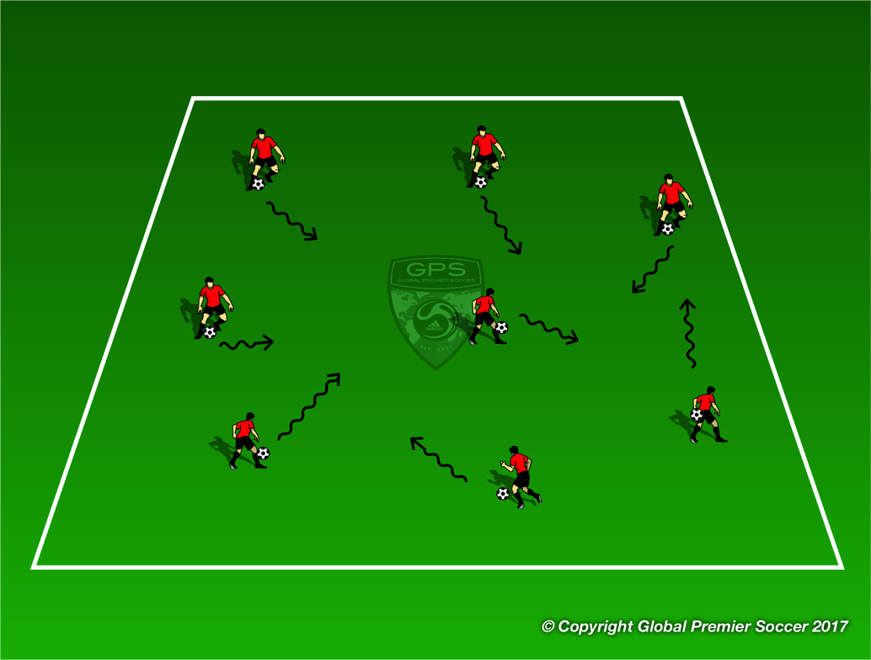
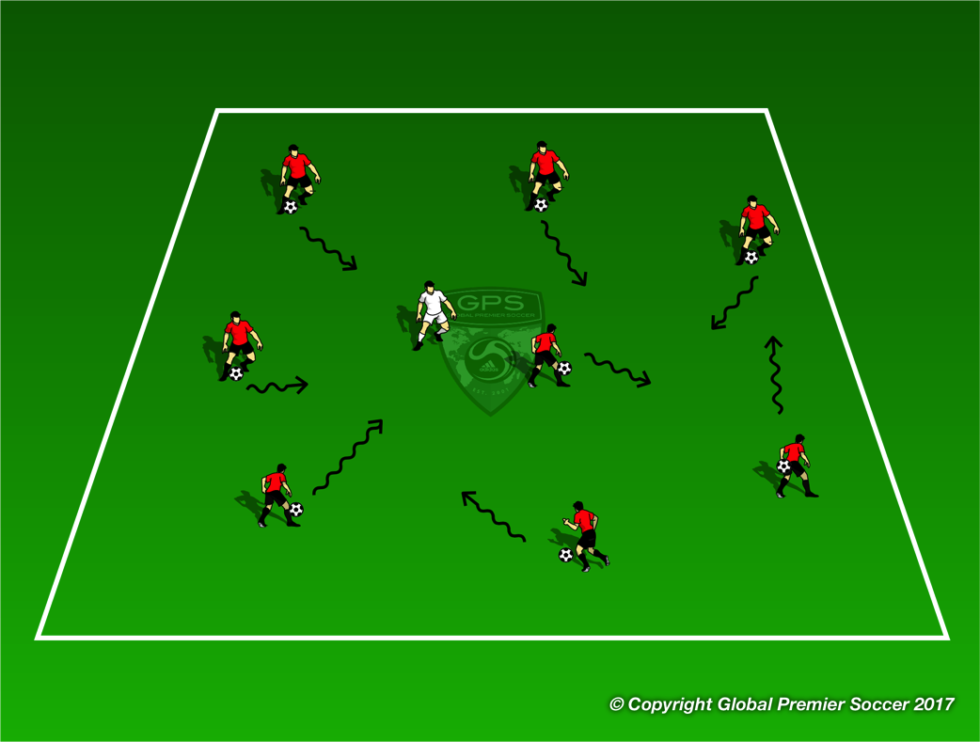
Week 7: Attacking 1v1
Organisation
Set out a 20x20 yard area. Each player has a ball and dribbles freely in the space/ Ask players to perform any 1v1 moves they know from previous soccer sessions
Progressions
Show players a new move and allow them to try and execute it. Scissors, double scissors, roll over, double touch, fake & take.
Coaching Points
Small touches to keep ball close Accelerate after move
Organisation
Now add one player in the area without a ball. This player tries to steal any ball from another player. Once the defender gets two touches on a new ball the player losing the ball becomes new defender
Progressions
Add 2 defenders
Coaching Points
Small touches to keep ball close Use move to unbalance and beat defender Accelerate after move

Slide 22
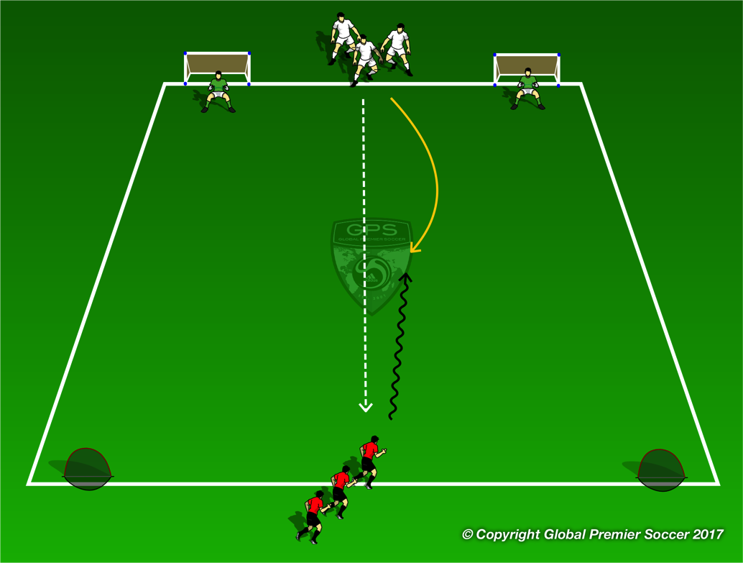
Week 7: Attacking 1v1
Organisation
Teams start at opposite ends between the goals. Have GKs in the goals the attacking team are trying to score in. Defending team pass the ball cross and move in to try and stop attacker getting a shot on goal. Defenders attack counter goals if they win the ball.
Progressions
Play 2v2
Coaching Points
Attack at speed Change speed or direction to beat defenders
Organisation
2v2 games. Team without the ball must have one player drop back and become GK leaving 2v1 on the field
Progressions
Have teams switch fields to play other teams
Coaching Points
Creativity on the ball Play without fear. Try moves Quick sprint back to box when point is gained

Slide 23
Week 8

Slide 24
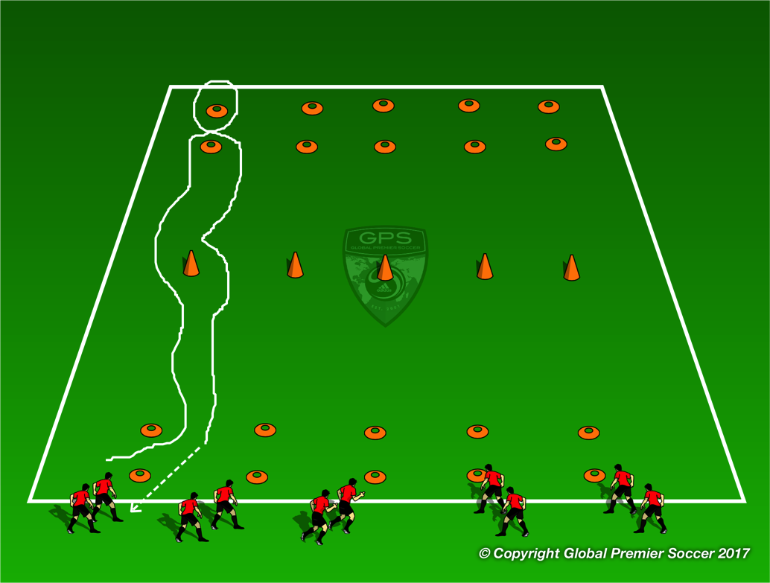
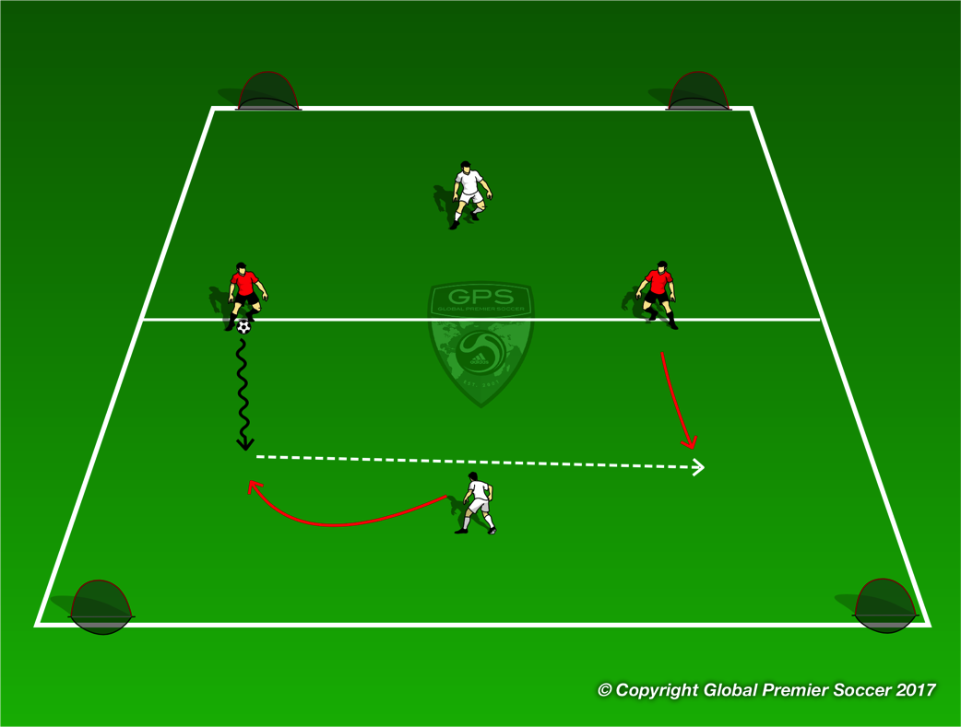
Week 8: Attacking 2v1
Organisation
Players work in small groups. Players dribble through first two cones, use move to go past cone, through last two cones and then back through repeating the same pattern
Progressions
Vary 1v1 move being used
Coaching Points
Little touches to keep ball close Change speed when space opens up Change speed after move
Organisation
Players work in pairs. Red start with the ball on the half way line. They attack one side against one defender. If they score they get the ball and attack the opposite end. If defender wins the ball they try and pas to their team mate in the other half to score. Reds then become defenders, one in each half.
Progressions
Coaching Points
Attack at speed Beat defender 1v1 Pass or dribble

Slide 25
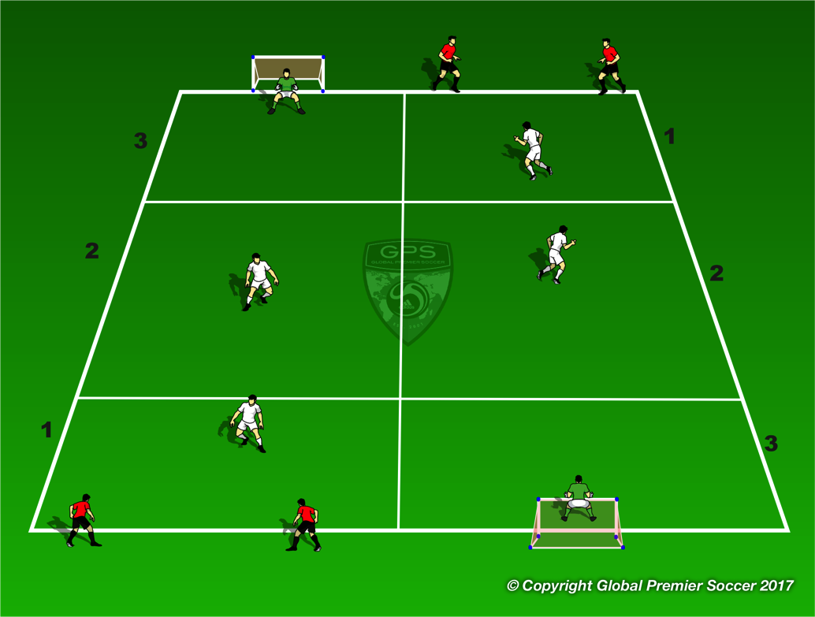
Week 8: Attacking 2v1
Organisation
Players work in pairs. Have one pair work in each zone with one defender in each box and GKs in the box with the goal. Attacking players try and break through the two boxes to get a shot on goal and then move onto next channel.
Progressions
Switch defending pairs
Coaching Points
Attack at speed Beat defender 1v1 Pass or dribble?
Organisation
Play 7v7. Both teams play 1-2-1-2-1.
Progressions
Coaching Points
Cover key points from the session

Slide 26
Week 9

Slide 27
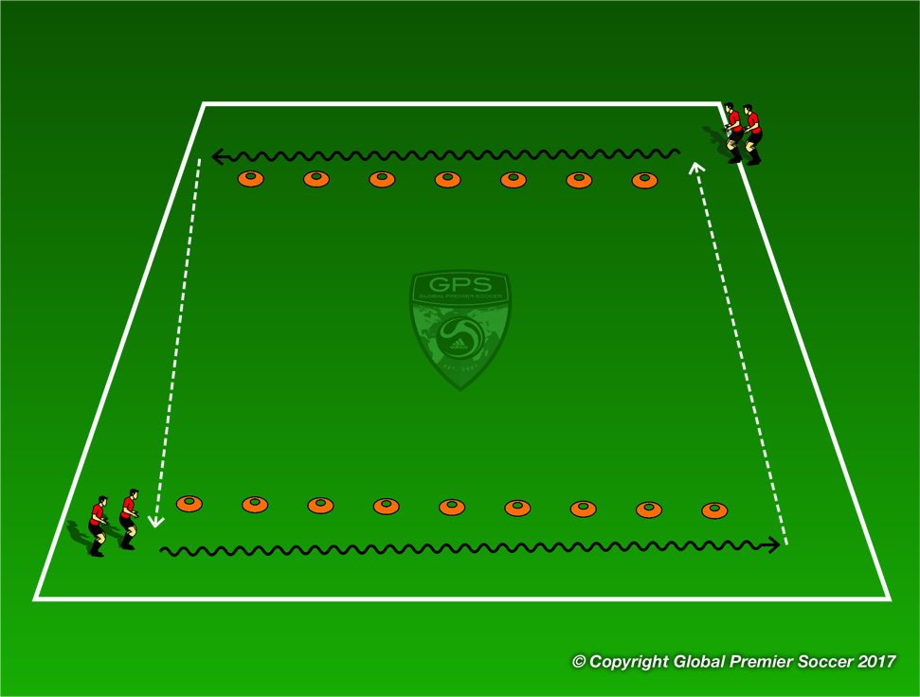
Week 9: Attacking 3v2
Organisation
Set out cones as shown varying distances apart. First player in each line dribbles on the outside of the cones taking a touch on the ball each time they pass a cone before passing across to next line.
Progressions
Use different surfaces for each touch
Coaching Points
Use inside of foot or pinky toe to push ball Avoid breaking stride
Organisation
Create 2 channels. Places cones to mark the centre of the channel and have a defender stand between them. The defender can only move left or right along that line. Each player has a ball and dribbles down the channel trying to get past the defender. Once at the end of the channel they move to the next channel
Progressions
Add one defender in the space between the start line and the defending line to increase pressure.
Coaching Points
Dribble at speed into space Change direction quickly to beat defender Use 1v1 move to unbalance defender

Slide 28
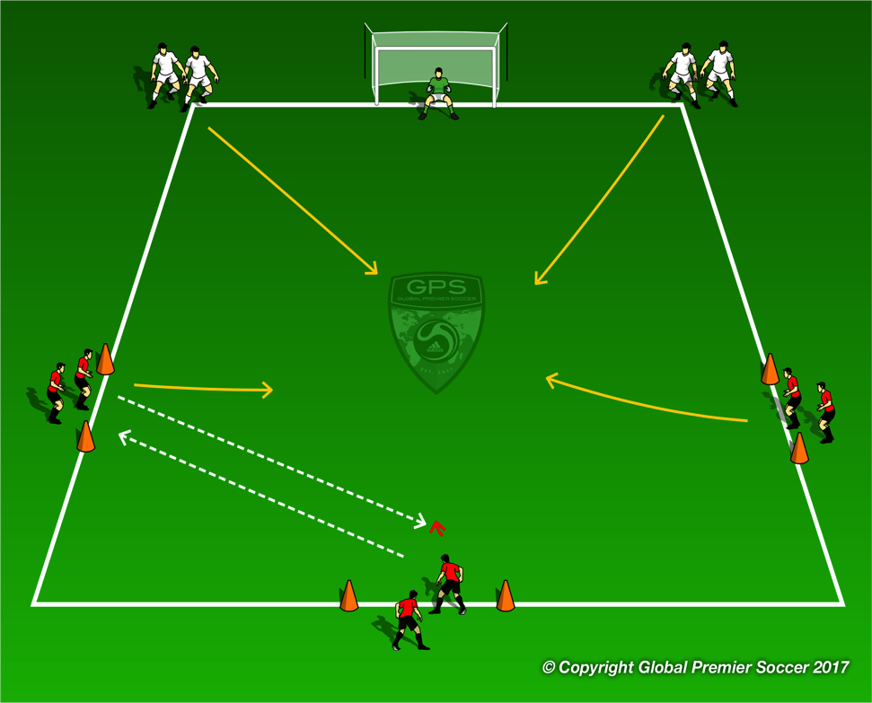
Week 9: Attacking 3v2
Organisation
Ball starts with middle red player who passes the ball wide. The ball is set straight back and play begins. 2 white defenders enter the area and play 3v2. If white team win the ball they pass to any waiting red player for a point.
Progressions
Coaching Points
Dribble at speed into space Change direction quickly to beat defender Use 1v1 move to unbalance defender Combine with team mate to create shooting opportunity
Organisation
Play 7v7. Both teams play 1-2-1-2-1.
Progressions
Coaching Points
Cover key points from the session

Slide 29
Week 10

Slide 30
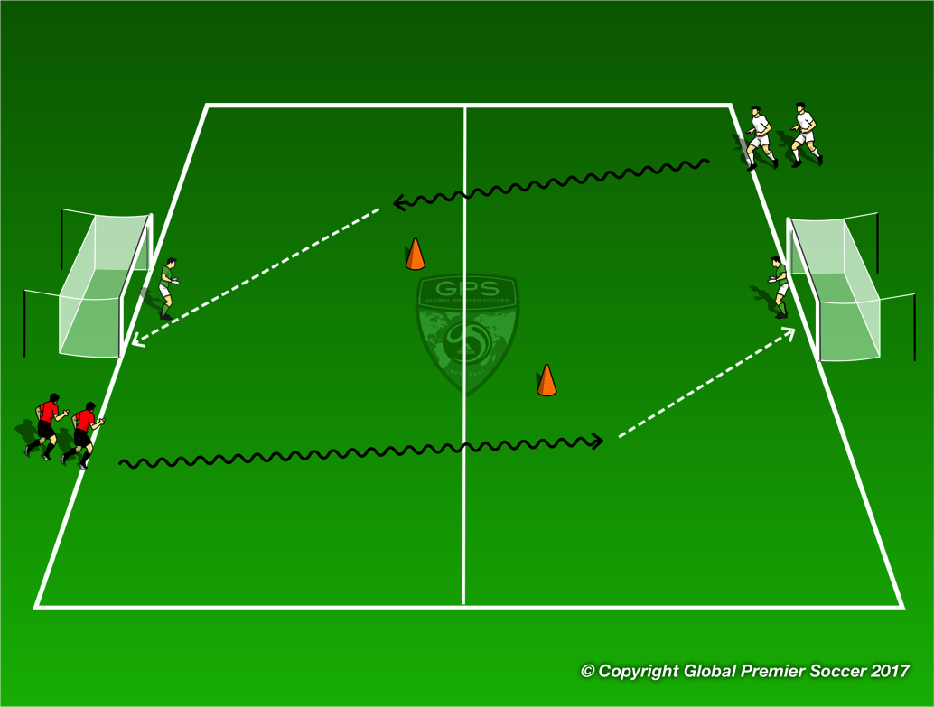
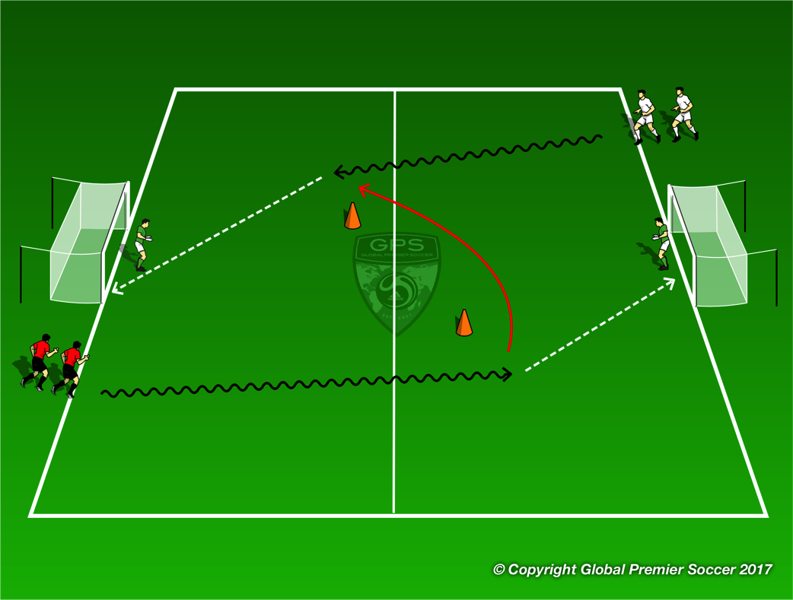
Week 10: Shooting
Organisation
Split players into two teams. First player from each team dribbles towards goal opposite. Players cant shoot until they pass the cone on their half. Player whos ball goes in the goal first gets point for their team.
Progressions
Coaching Points
Big touch out of feet towards goal Positive touches to goal Last touch to set for shot – small angle
Organisation
Red player dribbles and shoots for goal. Once red player has shot white player dribbles towards goal opposite. Red player chases and tries to block shot. Once white player shoots red player goes for goal and white player who just shot now chases. Rotation continues
Progressions
Coaching Points
Big touch out of feet towards goal Positive touches to goal Last touch to set for shot – small angle Transition to defence

Slide 31


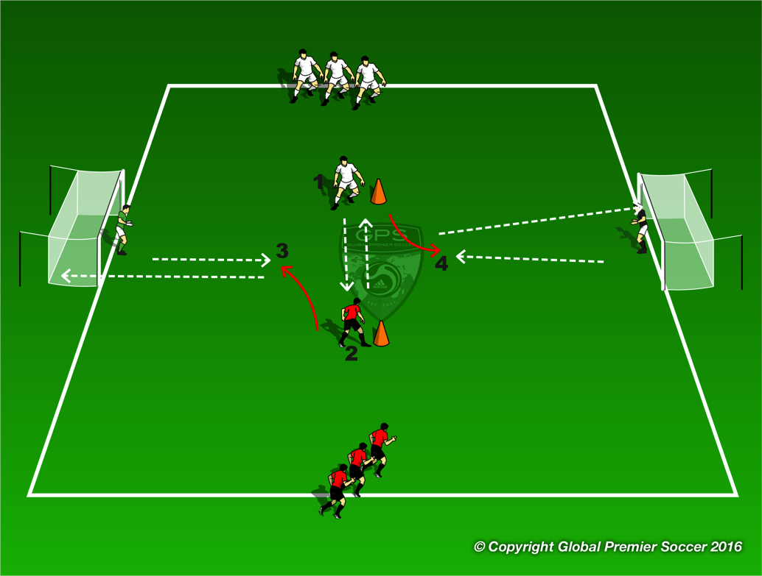
Week 10: Shooting
Organisation
Each player has a ball and passes the ball to the player opposite who set the ball into space. Red player shoot the ball the wihite player sets and visa versa.
Progressions
Players now pass one ball back and forth. The red team can take a touch towards either goal at any point and shoot for goal White player tries to block shot.
Coaching Points
Quality of passes Good touch out of feet – weight of touch Spot position of GK Shot for space in the goal
Organisation
Play 7v7. Both teams play 1-2-1-2-1.
Progressions
Coaching Points
Cover key points from the session

