Slide 1
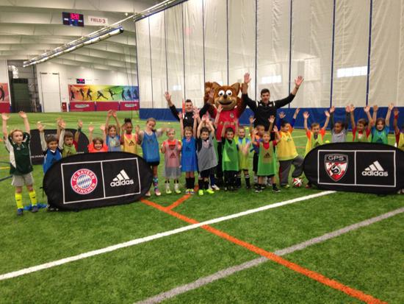

Global Premier Soccer
Town Partner Curriculum
5th & 6th Grade

Slide 2
Week 1

Slide 3

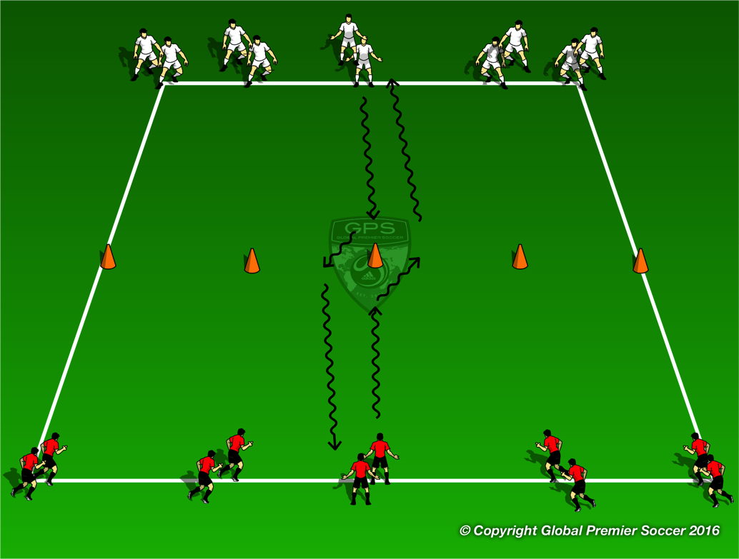
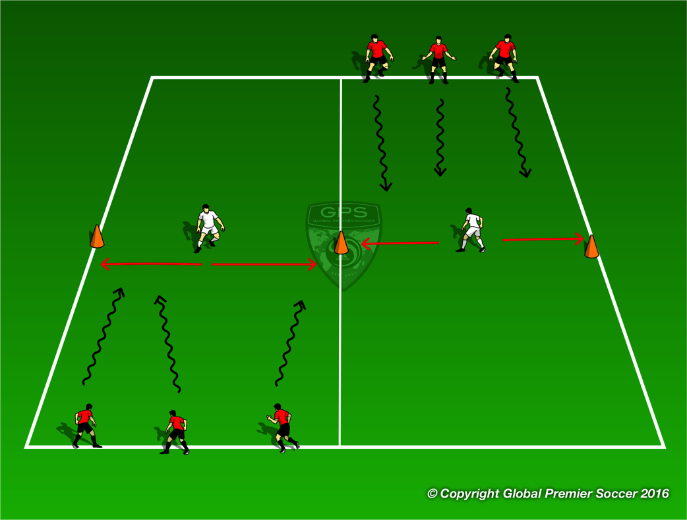
Week 1: Dribbling
Organisation
Players work in groups of 4. First player in each line dribbles towards central cone, performs a fake & take to the right and accelerates to the line opposite.
Progressions
Fake & Take to the left
Coaching Points
To the right Fake to move to the left with a big step Use outside of right foot to push the ball to the right. Accelerate after the move | To the left Fake to move to the right with a big step Use outside of left foot to push the ball to the left. Accelerate after the move
Organisation
Create 2 channels. Places cones to mark the center of the channel and have a defender stand between them. The defender can only move left or right along that line. Each player has a ball and dribbles down the channel trying to get past the defender. Once at the end of the channel they move to the next channel
Progressions
Switch defenders Add a goal at end of channel
Coaching Points
Keep ball close to feet to enable ball manipulation Use fake & take move to beat defender

Slide 4
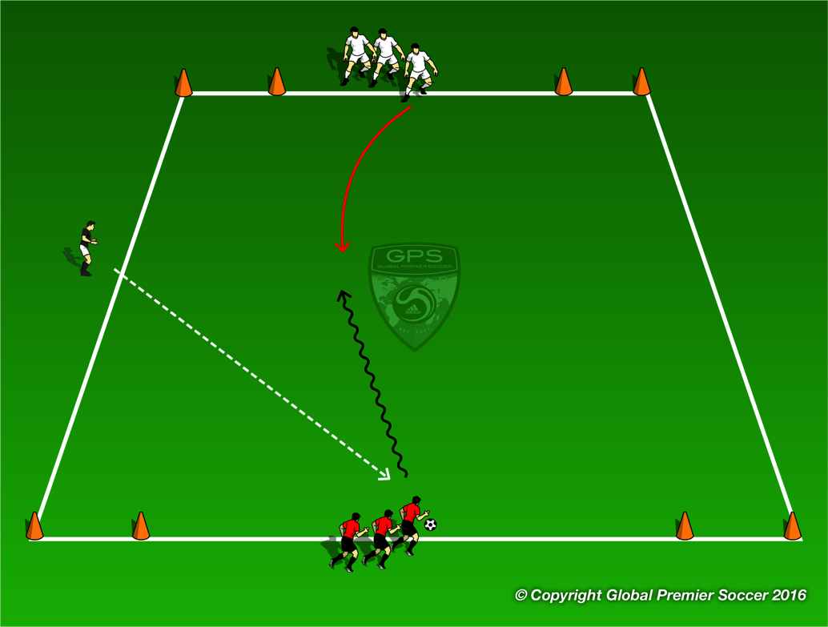
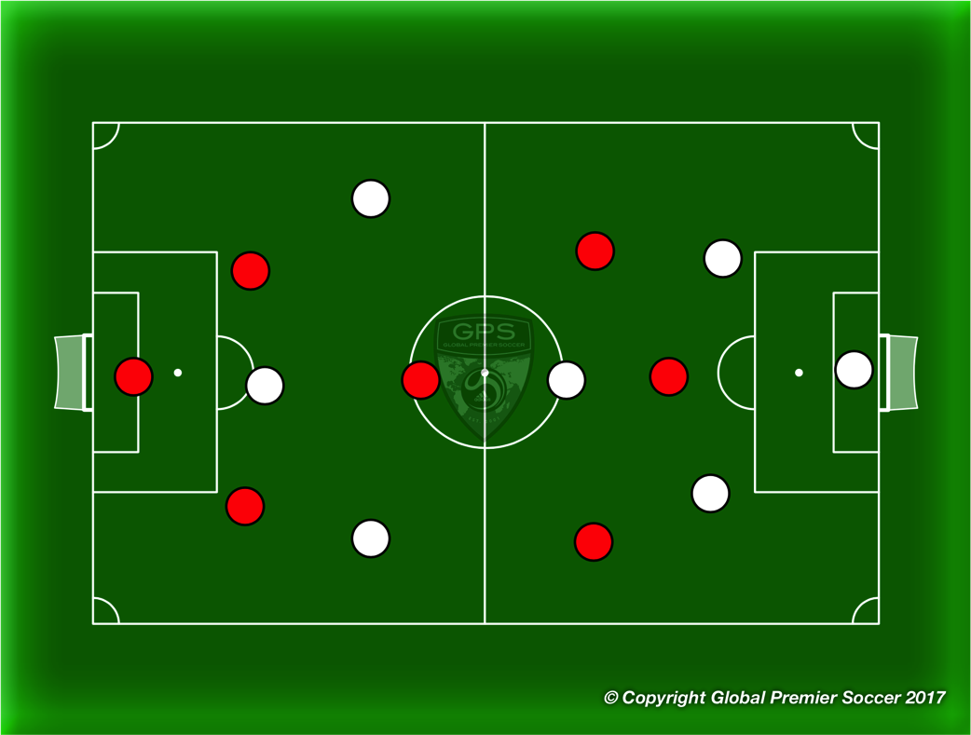
Week 1: Dribbling
Organisation
Set out a 14x14 yard area with a goal in each corner. Split players into two teams, one on each side of the area between goals. Coach passes a ball into play and the first player in each team plays 1v1 to goal. Player scores by dribbling through a goal.
Progressions
Play 2v2
Coaching Points
Attack at speed Keep ball close and under control Use move to beat defender Accelerate after move
Organisation
Play 7v7. Both teams play 1-2-1-2-1.
Progressions
Coaching Points

Slide 5
Week 2

Slide 6
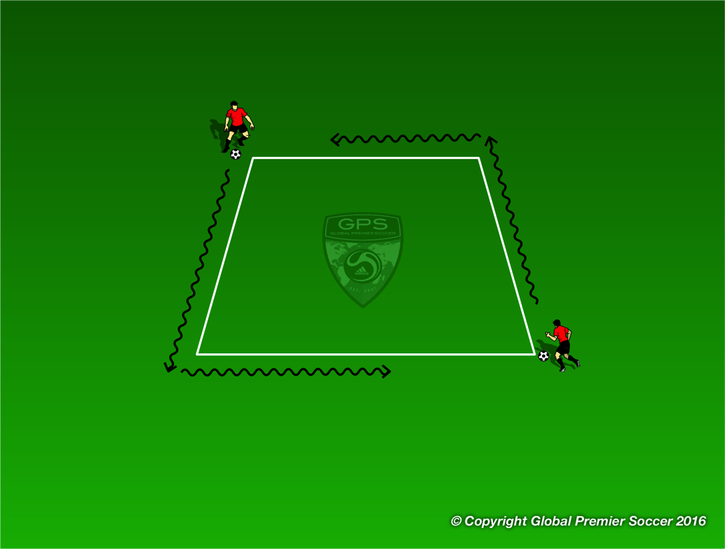
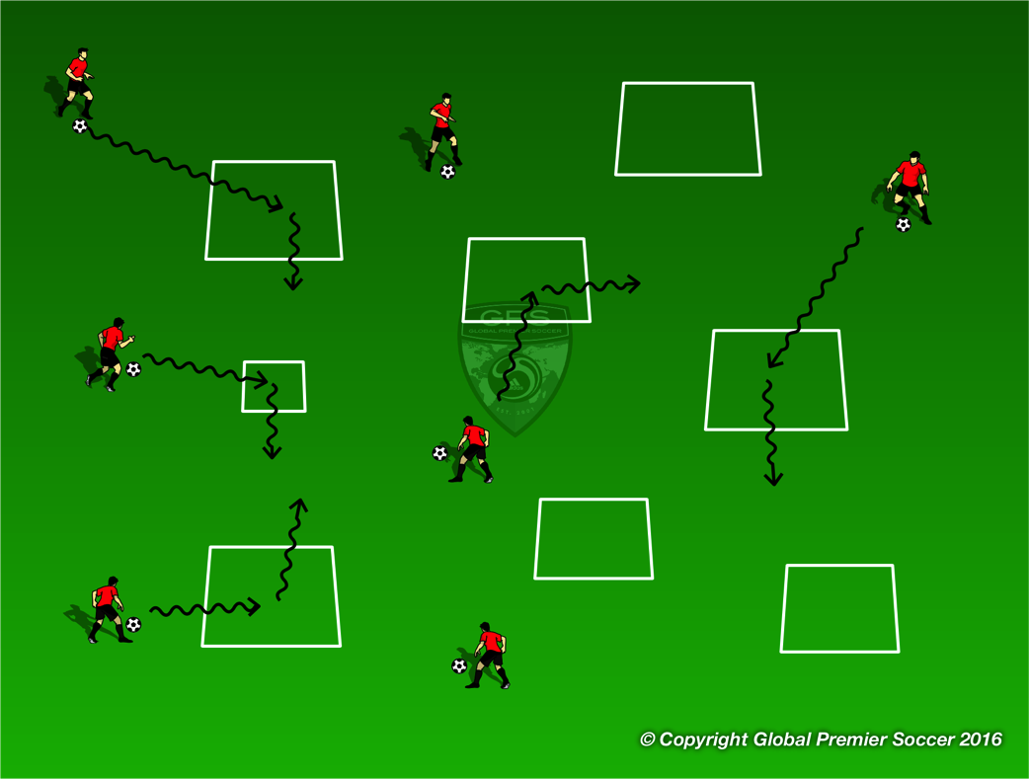
Week 2: Dribbling
Organisation
Players work in pairs. Each pair has one 3x3 yard box. Players leave the ball inside the box and stand on opposite corners. 1 player is the tagger and one player is the runner. Players can not go into the box and. Tagger tries to catch the runner by tagging them on the back. Tagger has 30 seconds to catch them
Progressions
Play same game but this time players must dribble the ball
Coaching Points
Little touches on the ball to keep it close Use different parts of the foot to change direction. Head up to see other player
Organisation
Players now have a ball each and dribble around the area and through as many of the boxes from the previous game as possible.
Coaching Points
Keep ball close Head up to see space Dribble at speed into space
Progressions
Players dribble into the box and turn left Players dribble into the box and turn right Players dribble into the box and turn and dribble out | Players perform 5 toe taps in each box Players perform 5 foundations in each box

Slide 7
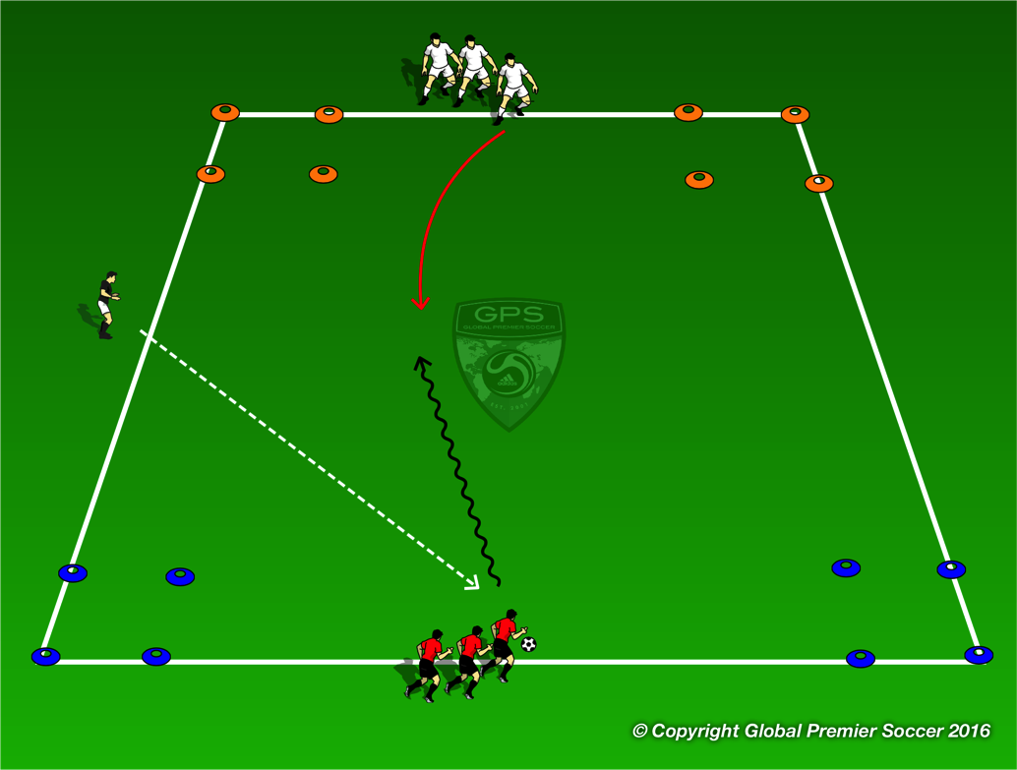
Week 2: Dribbling
Organisation
Set out a 15x20 yard area with a box in each corner. 2 colors at one end 2 at the other. Split players into two teams, each starting between a set of boxes. Coach passes ball into area and players go 1v1 to try and stop the ball in wither box opposite their start point.
Progressions
Play 2 1v1 games at the same time.
Coaching Points
Use body to protect ball Move ball using various part of feet Move ball quickly to try and unbalance defender Exploit space at speed
Organisation
Play 7v7. Both teams play 1-2-1-2-1.
Progressions
Coaching Points

Slide 8
Week 3

Slide 9
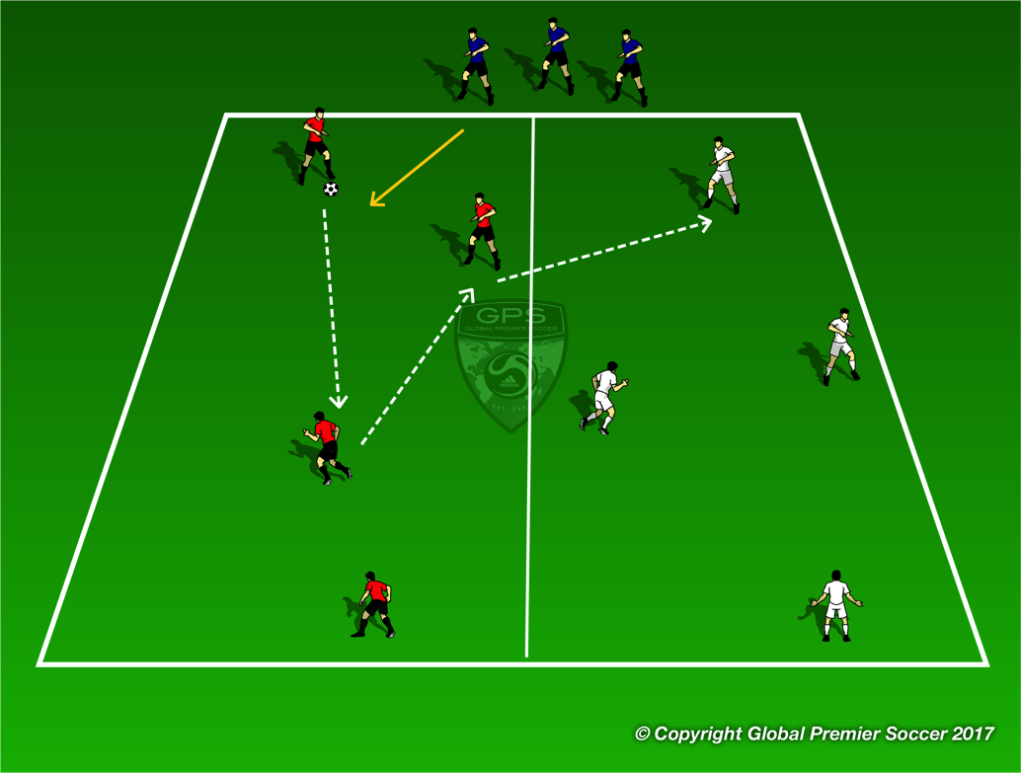
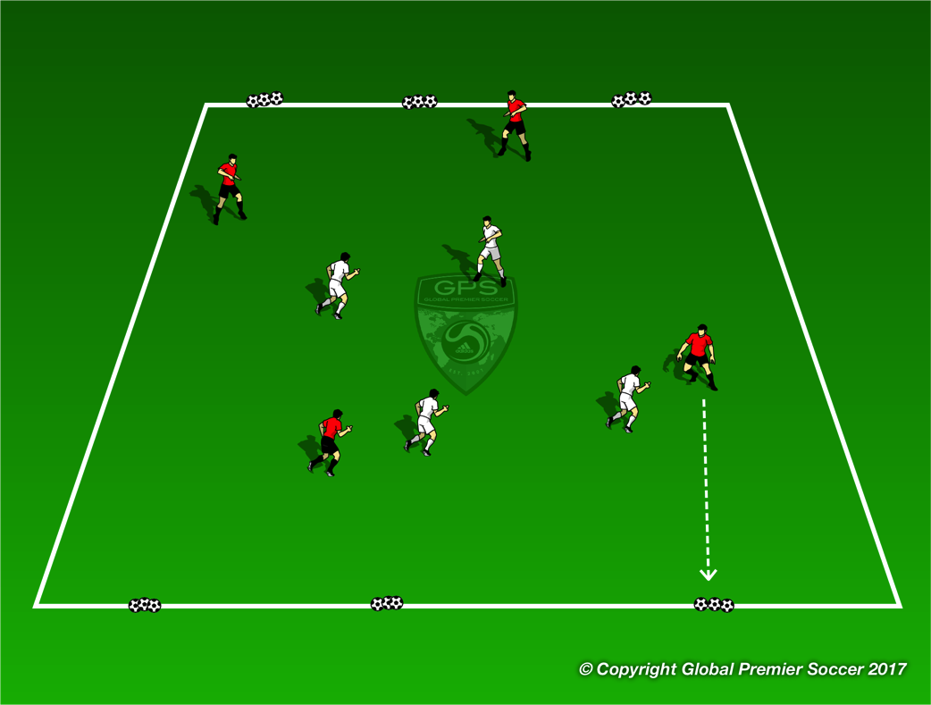
Week 3: Passing & Receiving
Organisation
Area is split in half with a team in each one. Additional players start outside the area. Red team attempts to make 2 passes in their own area, before switching the ball to white team. A blue player comes into the red area to defend. After a successful switch a new blue player comes into the white area to defend.
Progressions
Increase number of passes before a switch
Coaching Points
Spacing – spread out in the area to make it harder for the defender. Angles – make sure the player with the ball can ‘see’ you and has a lane to pass. | Use inside of the foot to pass. Try to disguise your pass.
Organisation
Create targets out of lines of 3 balls balanced on cones. Play 4v4 team scores by hitting the targets.
Progressions
Make targets smaller if they are having success. Both teams can hit any targets
Coaching Points
Encourage ‘big’ diamond shape in possession to create space. Use inside of foot for accuracy when passing or trying to hit the targets.

Slide 10
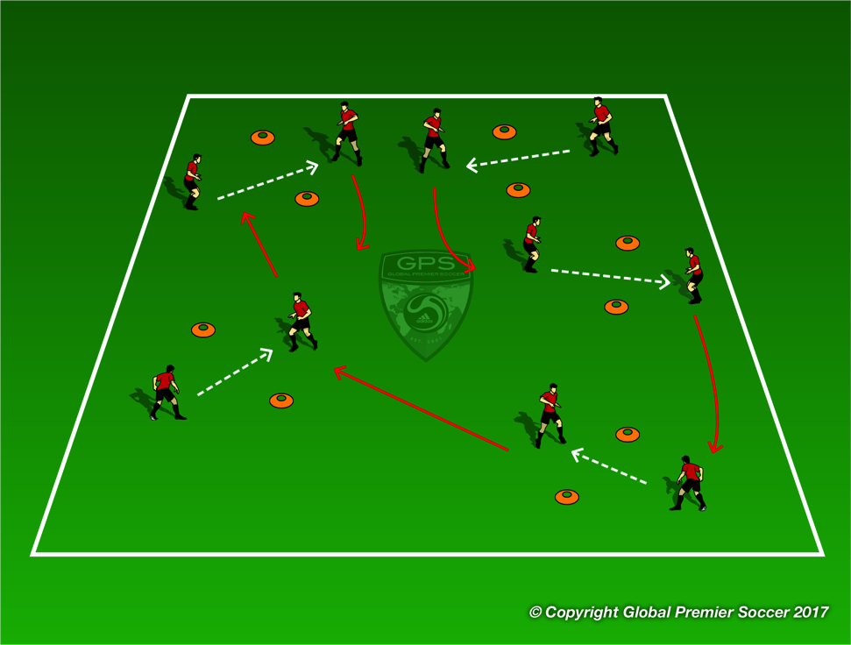
Week 3: Passing & Receiving
Organisation
Use pairs of cones to create multiple ‘gates’ throughout the playing area. Players are in pairs, and pass through the gate. After each pass they move to a new gate and repeat. Aim to do as many as possible in a minute.
Progressions
3 passes in each gate before moving on. Coach plays as a defender as players move between gates First time passes
Coaching Points
Use inside of the foot for the pass, make eye contact with team mate before pass. Receiving player needs to move in line with the ball. | Can receiving player take first touch in direction of the next gate.
Organisation
Play 7v7. Both teams play 1-2-1-2-1.
Progressions
Coaching Points

Slide 11
Week 4

Slide 12

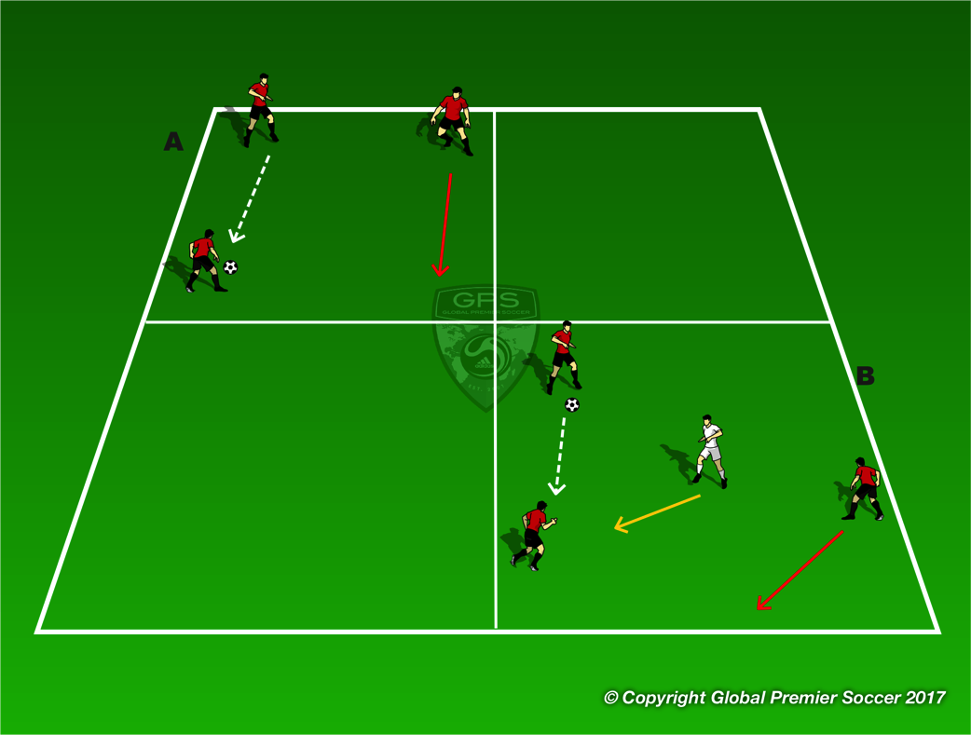
Week 4: Passing & Receiving
Organisation
Use pairs of cones to create multiple ‘gates’ throughout the playing area. Players are in pairs, and pass through the gate. After each pass they move to a new gate and repeat. Aim to do as many as possible in a minute.
Progressions
3 passes in each gate before moving on. Coach plays as a defender as players move between gates First time passes
Coaching Points
Use inside of the foot for the pass, make eye contact with team mate before pass. Receiving player needs to move in line with the ball. | Can receiving player take first touch in direction of the next gate.
Organisation
A – 3 players in each grid, passing the ball between them. Players without the ball move to supporting positions with each pass.
Progressions
. B – same set up but keeping the ball from defender.
Coaching Points
Players off the ball move into supporting positions while keeping space. Try to give player with ball 2 options. Off the ball, adjust your position every time ball moves. | Draw in the defender and then pass. Open body to be able to pass left or right.

Slide 13
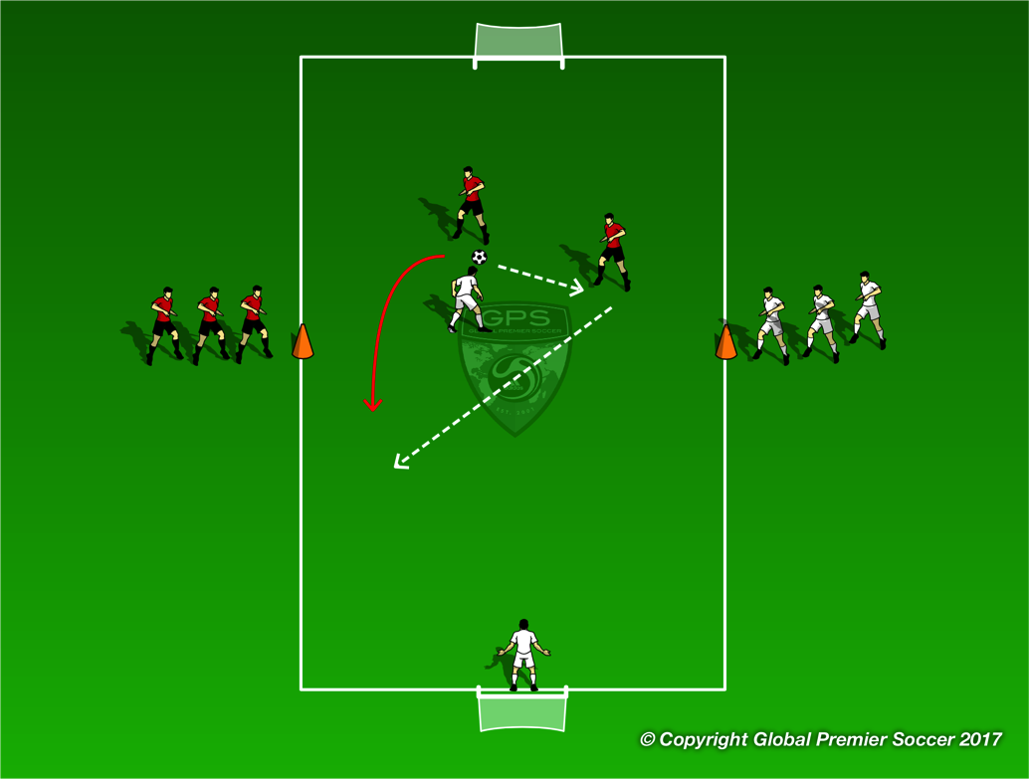
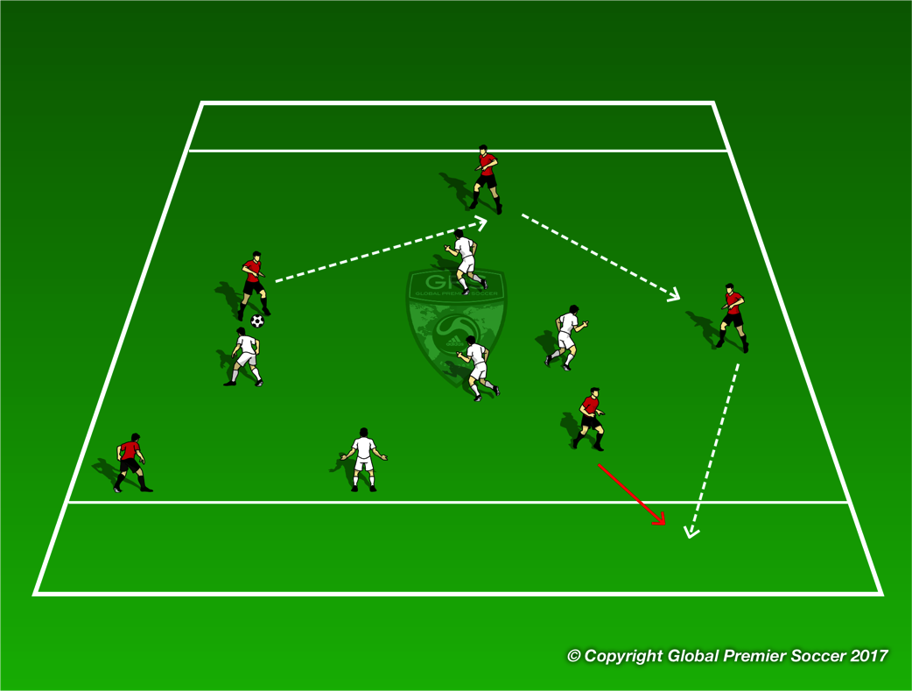
Week 4: Passing & Receiving
Organisation
Teams start on the orange cones. On coach command 2 players from each run around the back of their own goal and into the field. Team without the ball, 1 player must drop back as a GK to leave 2v1 on the field.
Progressions
3v3 with same rule, one player drops back as GK.
Coaching Points
Keep space between the 2 players to make it harder for defender. Player off the ball move to give a supporting angle. Pass, then move. Try to combine to take the defender out the game.
Organisation
Scrimmage with end zones instead of goals. Teams score by passing the ball for a team mate to receive in the end zone.
Progressions
Regular scrimmage.
Coaching Points
‘Make the field big’ by spreading out, makes it harder for defenders to cover everyone. Movement off the ball to give angles where there player with the ball can find you. | Don’t force the pass into the end zone, try to keep possession.

Slide 14
Week 5

Slide 15
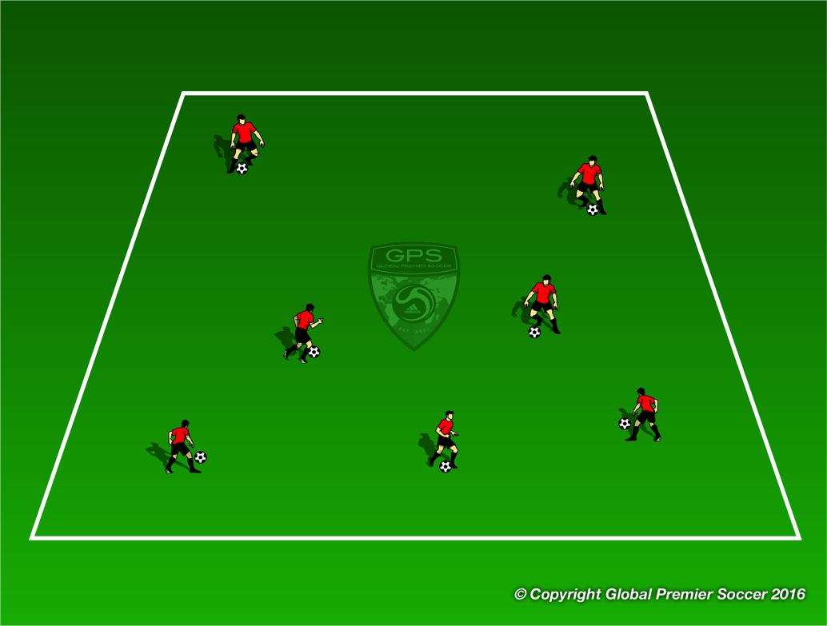
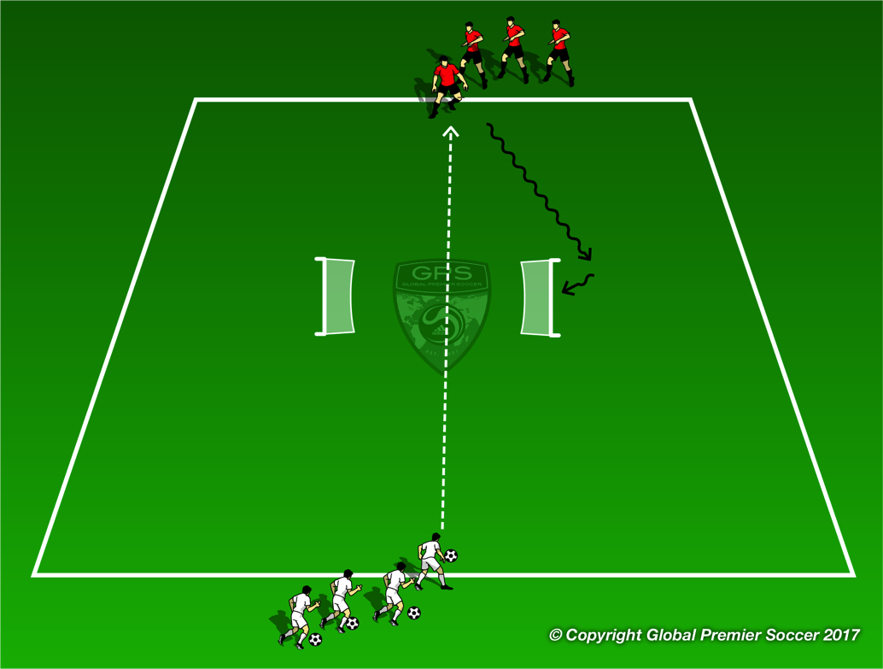
Week 5: Defending 1v1
Organisation
Each player has a ball and dribbles inside the area. On coach command players try and kick everyone else’s ball out of the area.
Progressions
One player without a ball who is defender. How quick can you clear the area of soccer balls
Coaching Points
Force attacker into pressure or to the side line Force mistake or bad touch from attacker Poke ball away Block tackle to win ball.
Organisation
2 groups opposite at each end of the area, with 2 outwards facing goals in the center. White passes to red, who attacks and aims to score in either goal. White defends, switch to opposite group.
Progressions
Players pass back and forth until coach commands “GO”, player with the ball attacks.
Coaching Points
Get to ball quickly Slow feet on approach Force attacker away from goal Patience to wait for good opportunity to tackle

Slide 16
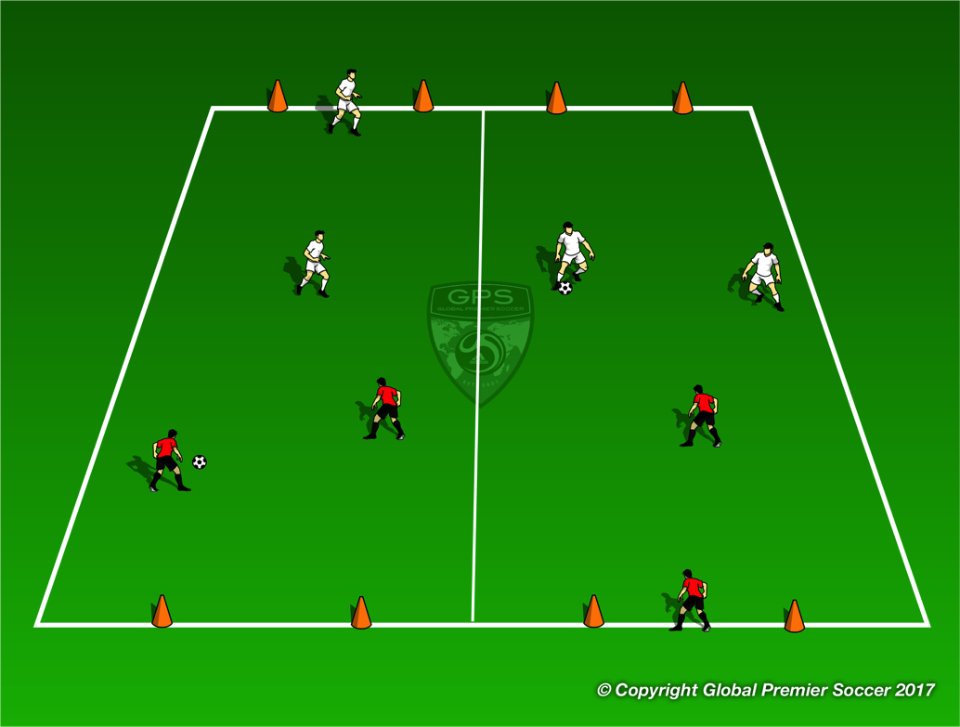
Week 5: Defending 1v1
Organisation
2v2 games. Team without the ball must have one player drop back and become GK leaving 2v1 on the field
Progressions
Coaching Points
Force attacker into pressure or to the side line Force mistake or bad touch from attacker Poke ball away Block tackle to win ball.
Organisation
Play 7v7. Both teams play 1-2-1-2-1.
Progressions
Coaching Points

Slide 17
Week 6

Slide 18
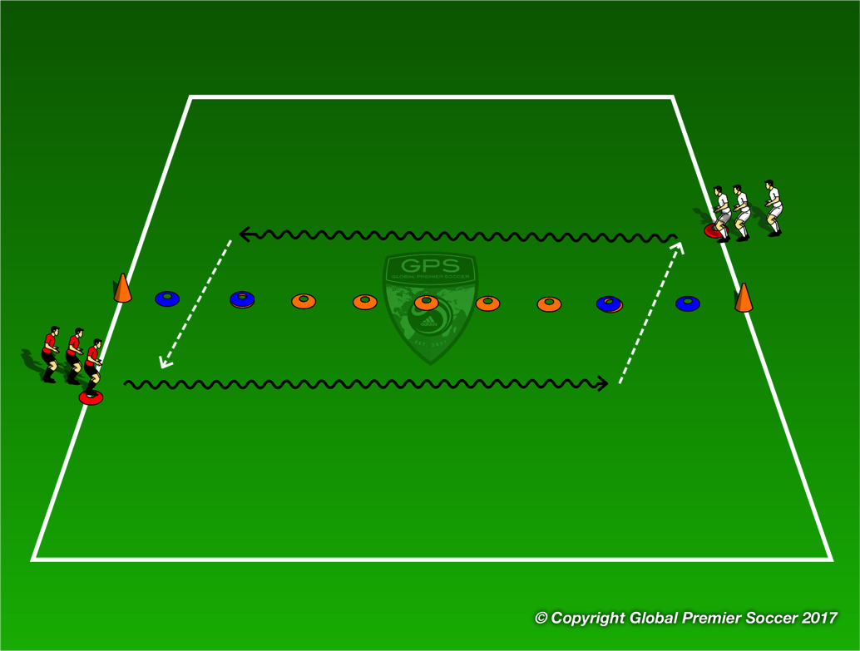
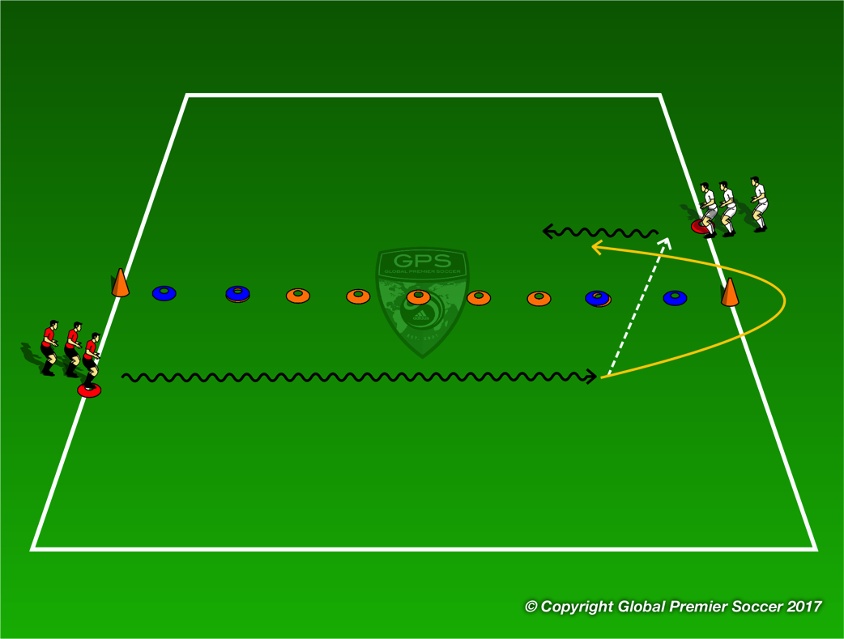
Week 6: Defending
Organisation
Players dribble at speed and pass the ball through the blue cones to the next player in the line joining the line they pass to. Both lines go at the same time.
Progressions
Coaching Points
Good first touch into space Try and move ball without breaking stride Smaller last touch to allow good pass through
Organisation
Player now passes the ball through the blue cones, runs around the orange cone and chases the player on the ball trying to tag them on the back for a point.
Progressions
Coaching Points
Change of speed to chase player Smaller steps around the cone Make run to chase player and try and block pass through the cones.

Slide 19
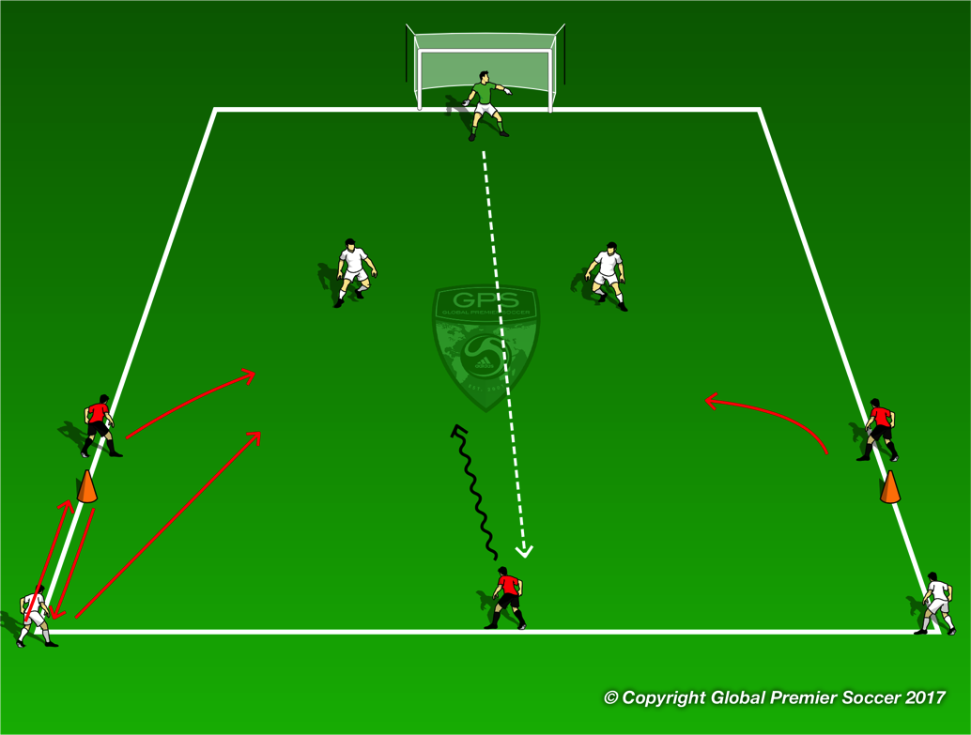
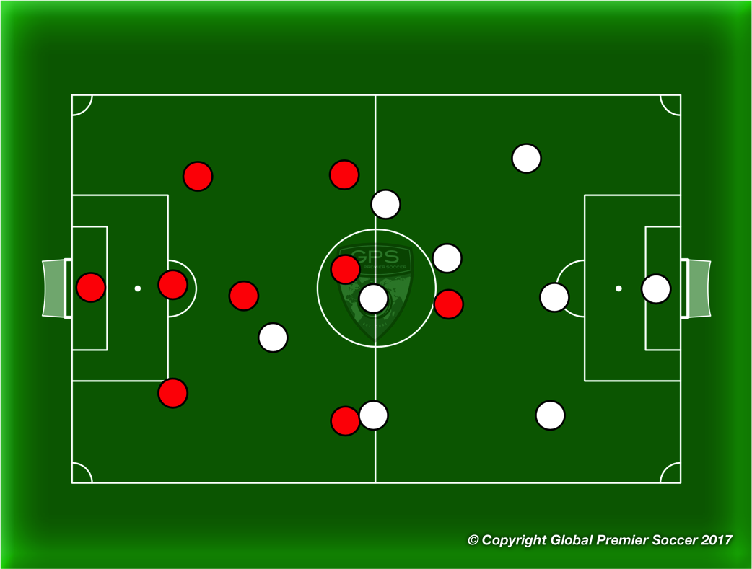
Week 6: Defending
Organisation
GK starts by throwing the ball out to the attacking team. Once an attacker touches the ball the 2 defenders on the outside run around the orange cone and back and then into the area to become recovering defenders creating 4v3 in favour of defenders. Defenders try and pass ball to next waiting defenders to win point. Red team try and score.
Progressions
Coaching Points
angle and distance of cover intercept pass (deny turn, deny penetration) tracking (recovery runs etc.) changing role of pressure and cover visual and verbal communication
Organisation
Play 7v7, 8v8, 9v9
Progressions
Coaching Points
If low numbers play with even teams or have a neutral player who plays for both teams.

Slide 20
Week 7

Slide 21


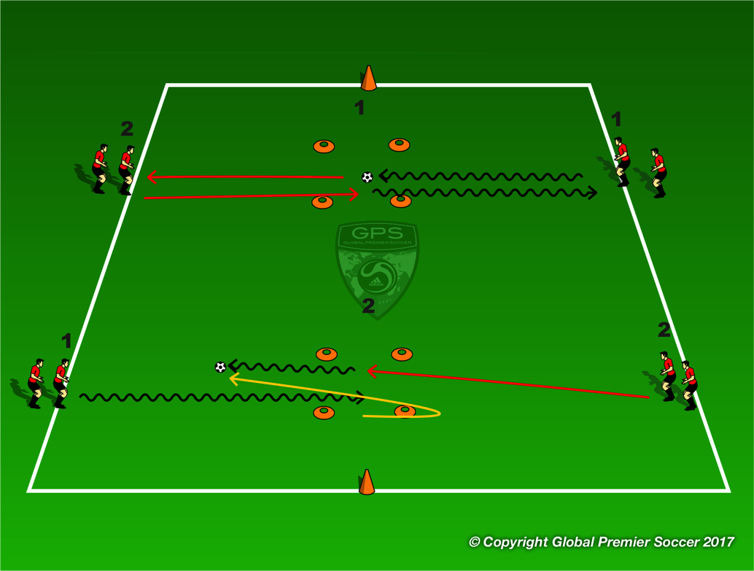
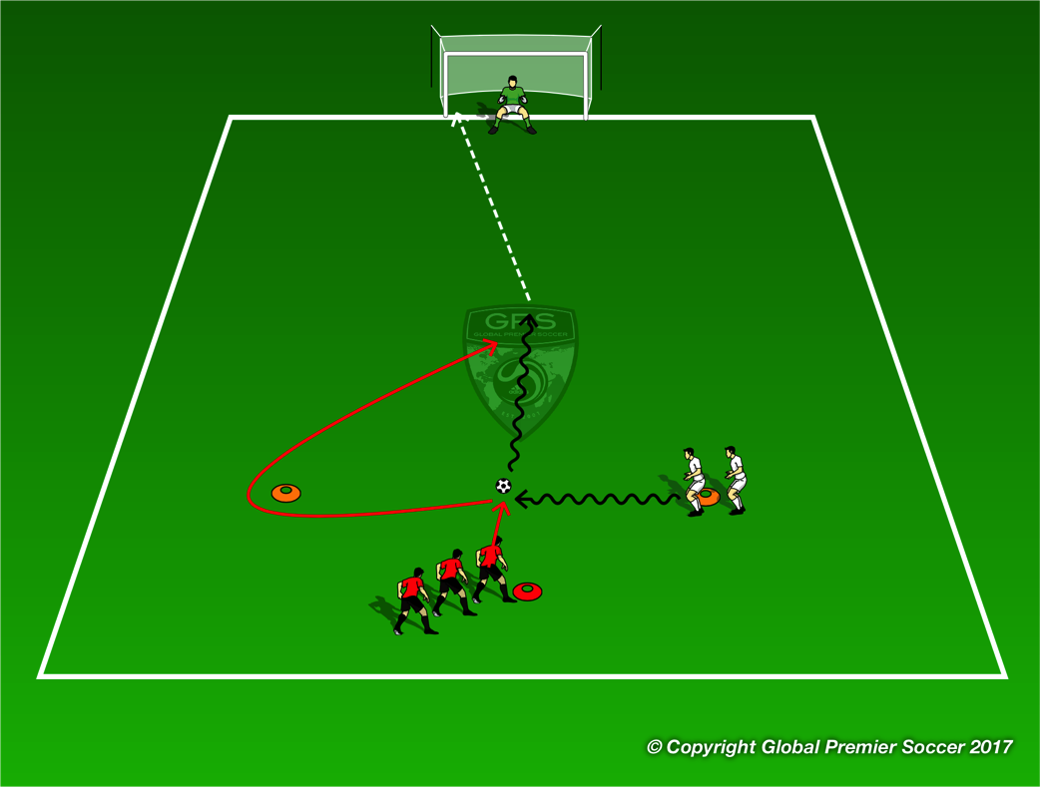
Week 7: Attacking 1v1
Organisation
Top diagram. Player 1 dribbles into the box. Player 2 runes into the box calls ‘take’ and takes the ball back to the line.
Progressions
Diagram 2. Player 1 dribbles the ball into the box stops the ball for player 2 to take. Player 1 runs around the cone and tires to tag player 2 for a point.
Coaching Points
Keep ball close with little touches. Use bottom of the foot to stop the ball Get timing of switch of ball right with little time between one player leaving it and next player taking it.
Organisation
White player dribbles ball towards orange cone. Player stops the ball inline with red player and runs around orange cone. Red player steps out and takes the balll to goal. White player tries to recvoer and stop red player from scoring.
Progressions
Add GK
Coaching Points
Positive touch out of feet towards goal. Touch across or away from defender Small touch to set for shot.

Slide 22
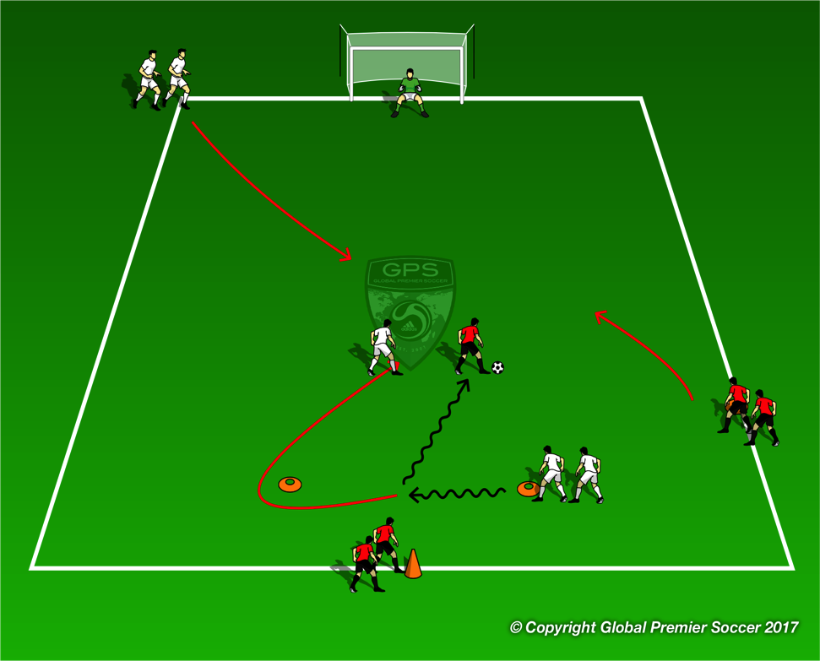
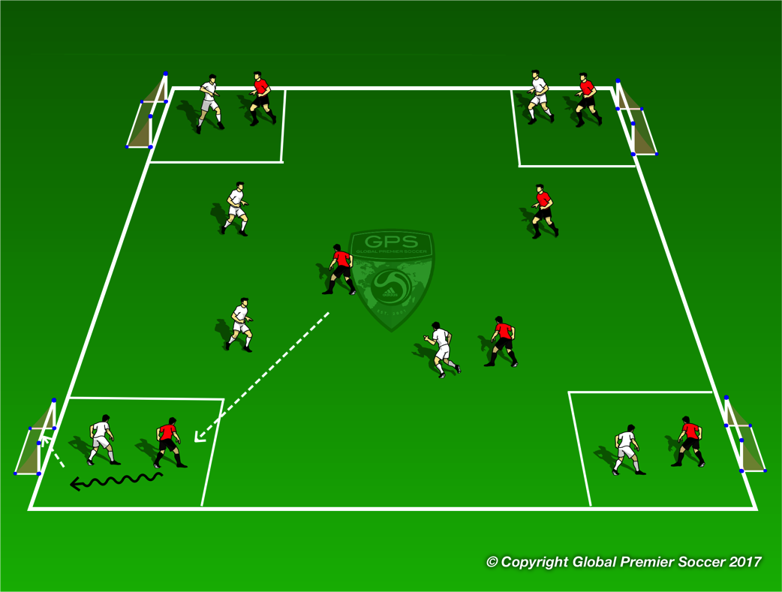
Week 7: Attacking 1v1
Organisation
Same as previous game but now add some attacking and defensive players. All players enter the game one the defender has stopped the ball after first dribble.
Progressions
Team competition
Coaching Points
Positive touch out of feet towards goal. Touch across or away from defender Beat defender 1v1 or combine Small touch to set for shot.
Organisation
Progressions
Coaching Points

Slide 23
Week 8

Slide 24
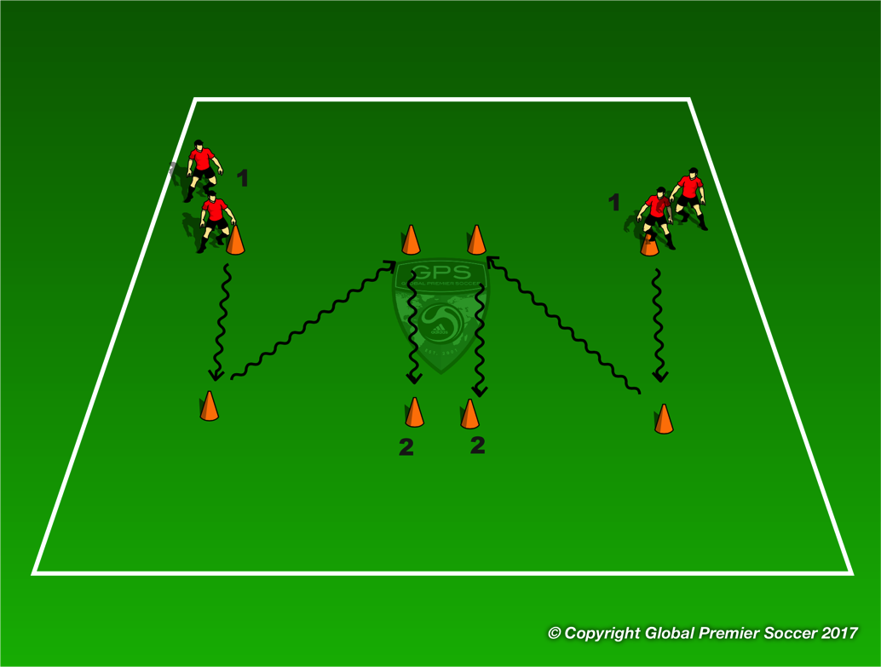
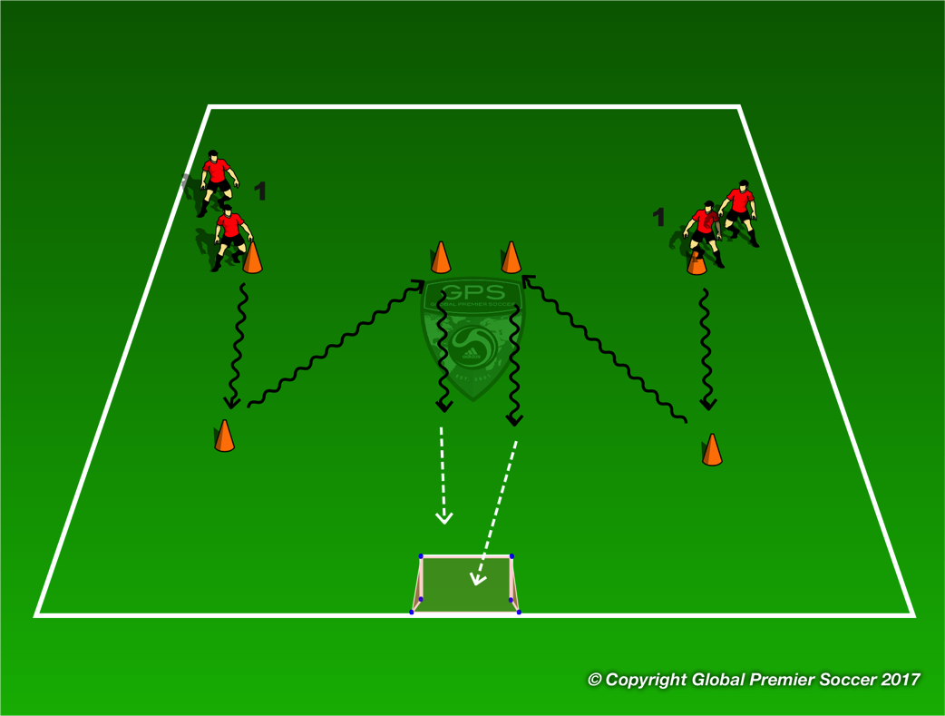
Week 8: Attacking 2v1
Organisation
Players dribble to first cone, turn, dribble to second cone, turn and wait behind third cone.
Progressions
Coaching Points
Little touches Creative turns at cones Change of speed after turn
Organisation
Now add a goal 15 yards behind last cone. Players now dribbles the ball in a race with player scoring first gaining a point for their team.
Progressions
Coaching Points
Little touches Creative turns at cones Change of speed after turn Small touch to set for shot

Slide 25
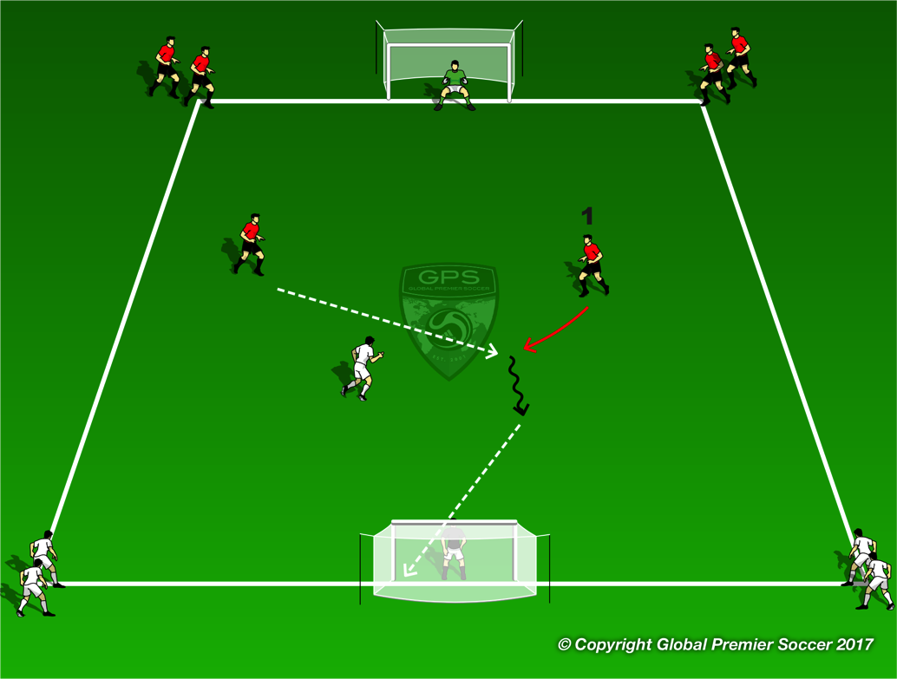

Week 8: Attacking 2v1
Organisation
Split players into two teams. Red team starts with 2 attackers dribbling to goal. One white defender steps into the game. The red player who shoots for goal stays in the game as the next defender. Once the red team shot the white team enter the game. The white plyaer who shoots stays in the game. If defender steals the ball and shoots they stay in as the defender.
Progressions
Coaching Points
Attack at speed Beat defender 1v1 or combine Quick transition to defender.
Organisation
2v2 games. Team without the ball must have one player drop back and become GK leaving 2v1 on the field
Progressions
Coaching Points
Creativity on the ball Play without fear. Try moves Quick sprint back to box when point is gained

Slide 26
Week 9

Slide 27
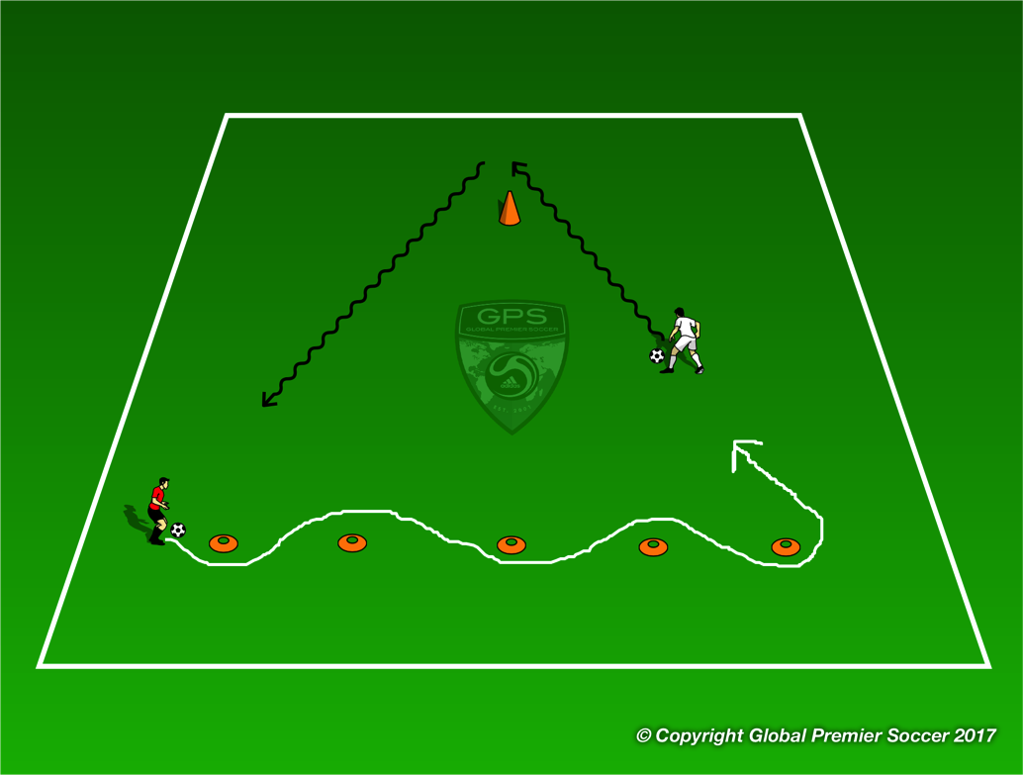
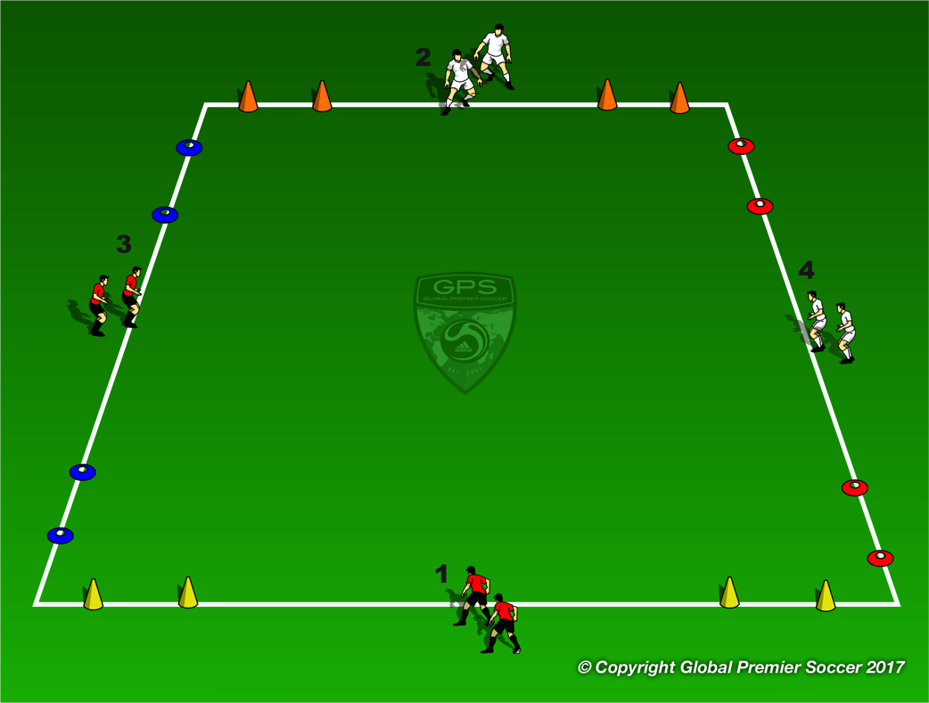
Week 9: Attacking 3v2
Organisation
Players work in groups of 4 and set out cones as shown. Red player chases white player and tries to tag them on the back for a point. Players work for 45 seconds and then rotate. Players start at each end of the orange cones. Players dribble through the cones close together and speed up to dribble around stand alone cone at top of triangle.
Progressions
Chasing player can now change direction at any time.
Coaching Points
Small touches through orange cones Change of speed out and around stand alone cone.
Organisation
Team 1 try and score in orange cones, team 2 in yellow, team 3 in red and team 4 in blue. Team 1 play team 2 and team 3 play team 4. Coach throws a ball to any two of the 4 teams and the player at the fron of each line enters the game.
Progressions
Coach can call team 1v3 and 2v4 to mix up which team plays which.
Coaching Points
Aware ness of goals your team is scoring in and

Slide 28
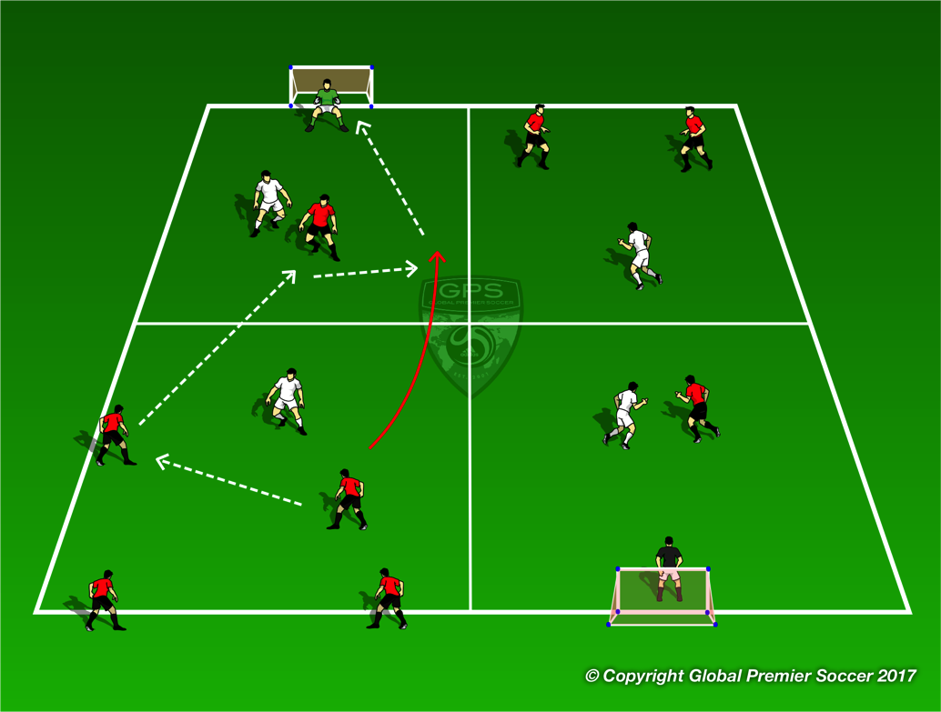
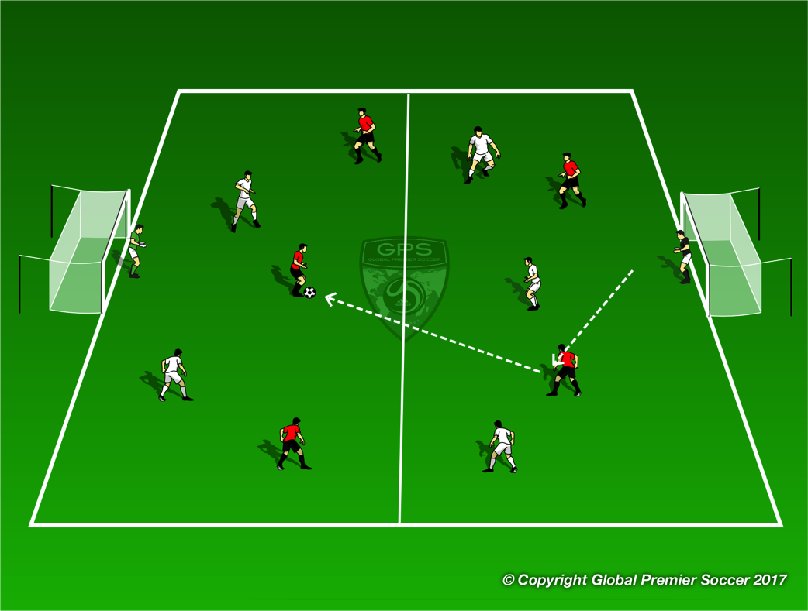
Week 9: Attacking 3v2
Organisation
Set out area as shown. Each box 12x12 yards. 1 defender in each box and one attacker in the box with the goal. Players attack in pairs to create 3v2 in each channel. Defenders are restricted to their defensive zone. 2 attackers can move freely between zones but attacker starting in the game must stay in attacking zone.
Progressions
Attacking pair move to next zone once they have attacked goal
Coaching Points
Attack at speed Pass or dribble Beat defender 1v1 Combinations to beat defender
Organisation
3v2 in each half in favor of the attacking team.. Players can’t leave the zone they start in.
Progressions
One player from each team from defensive zone can step into attacking zone.
Coaching Points
Attack at speed Pass or dribble Beat defender 1v1 Combinations to beat defender

Slide 29
Week 10

Slide 30
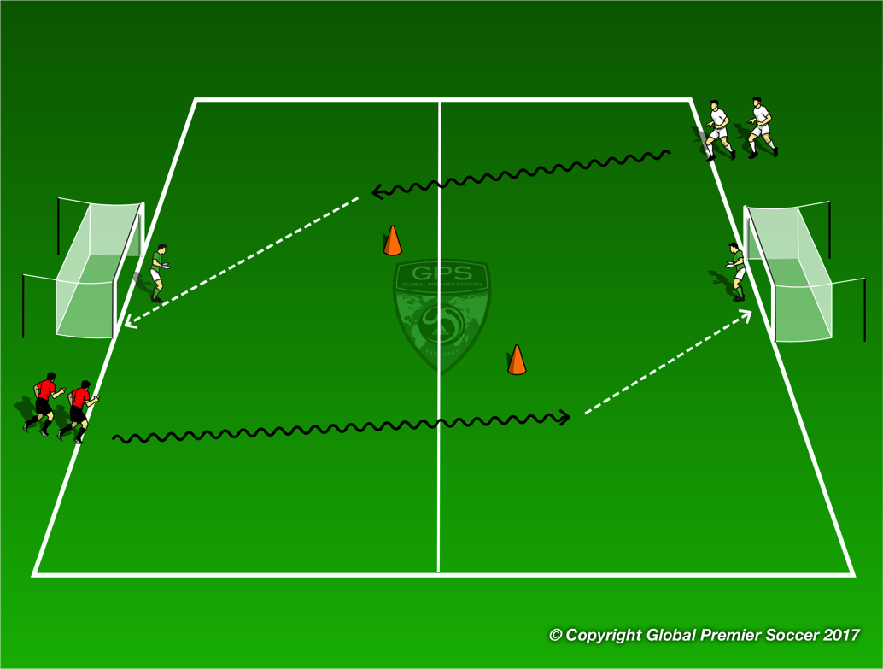
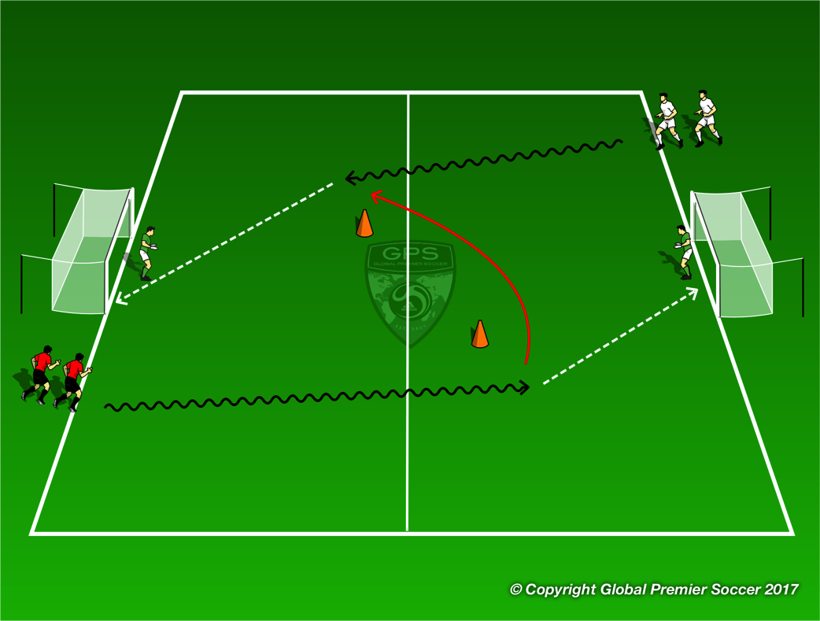
Week 10: Shooting
Organisation
Split players into two teams. First player from each team dribbles towards goal opposite. Players cant shoot until they pass the cone on their half. Player whos ball goes in the goal first gets point for their team.
Progressions
Coaching Points
Big touch out of feet towards goal Positive touches to goal Last touch to set for shot – small angle
Organisation
Red player dribbles and shoots for goal. Once red player has shot white player dribbles towards goal opposite. Red player chases and tries to block shot. Once white player shoots red player goes for goal and white player who just shot now chases. Rotation continues
Progressions
Coaching Points
Big touch out of feet towards goal Positive touches to goal Last touch to set for shot – small angle Transition to defence

Slide 31
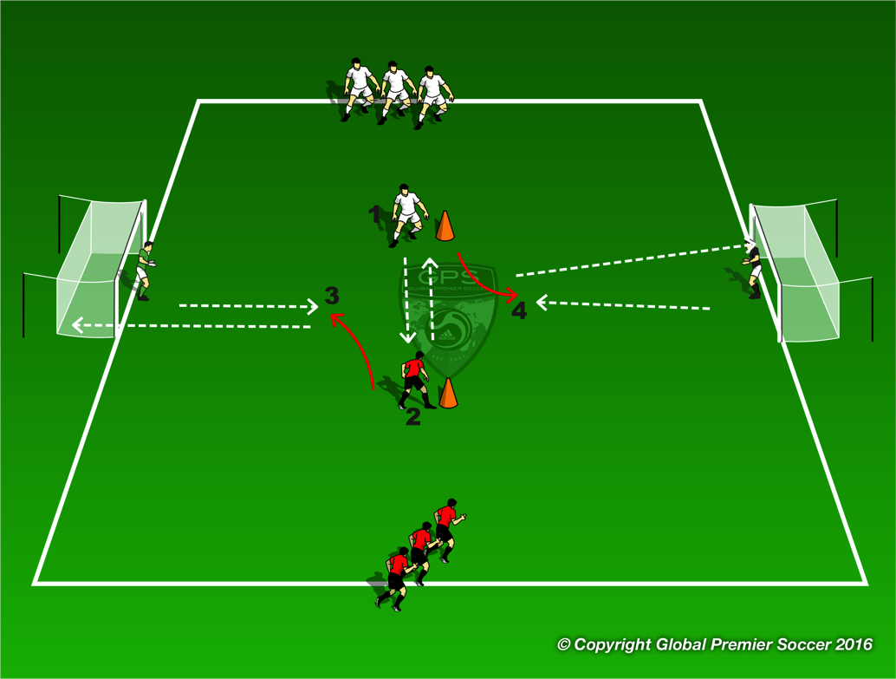
Week 10: Shooting
Organisation
Each player has a ball and passes the ball to the player opposite who set the ball into space. Red player shoot the ball the wihite player sets and visa versa.
Progressions
Players now pass one ball back and forth. The red team can take a touch towards either goal at any point and shoot for goal White player tries to block shot.
Coaching Points
Quality of passes Good touch out of feet – weight of touch Spot position of GK Shot for space in the goal
Organisation
Play 7v7, 8v8, 9v9
Progressions
Coaching Points
If low numbers play with even teams or have a neutral player who plays for both teams.

