Slide 1


Mountain Soccer Club
2018 Coaches Meeting

Slide 2


Board Members
    Christian Collard – President – Vice President
    Dan Falla – Registrar
    Pat Schmol – Treasurer
    Jenna LaPan – Clerk
    John Jarnis – Equipment Coordinator
    Dawn LaBelle – CORI Coordinator
    Sean McLouglin – Rutland Town Rep
    John Jarnis – Sterling Town Rep
    Bill Hume – Princeton Town Rep
    Mark Underkofler – W. Boylston Rep
    Craig Larson – Paxton Town Rep

Slide 3

Coaches Code of Conduct
The Board of Directors of Massachusetts Youth Soccer Association, Incorporated (Mass Youth Soccer) and the leaders of the affiliated Leagues are concerned about the conduct of all coaches and referees during games at all levels, from recreational to premier to ODP.
We want to ensure that games are fair, positive and enjoyable experiences for all of the children and adults involved. A soccer game should be friendly and unifying - a spirited social and athletic occasion for players, coaches, referees and spectators.
To clarify expectations of coach conduct, we jointly expect all coaches to conform to this code of conduct.
• Before, during and after the game, be an example of dignity, patience and positive spirit.
• Before a game, introduce yourself to the opposing coach and to the referee.
• During the game, you are responsible for the sportsmanship of your players. If one of your players is disrespectful, irresponsible or overly aggressive, take the player out of the game at least long enough for him/her to calm down.
• During the game, you are also responsible for the conduct of the parents of your players. It is imperative to explain acceptable player and parent behavior in a preseason meeting.
• Encourage them to applaud and cheer for good plays by either team. Discourage them and you may need to be forceful and direct from yelling at players and the referee.
• During the game, you are also responsible for the conduct of spectators rooting for your team.
• During the game, do not address the referee at all. If you have a small issue, discuss it with the referee calmly and patiently after the game.
• If you have a major complaint, or if you think the referee was unfair, biased, unfit or incompetent, report your opinion to your League. Your reactions will be taken seriously if they are presented objectively and formally.
• After the game, thank the referee and ask your players to do the same.
We stress two points: Referees - especially young and inexperienced ones - are like your players and yourself, in that they need time to develop. You can play an important role in helping them to improve by letting them concentrate on the game. You can help by encouraging them, by accepting their inevitable, occasional mistakes and by offering constructive post-game comments. On the other hand,
you could discourage and demoralize the referees by criticizing their decisions, by verbally abusing them and inciting - or even accepting - your own players' overly aggressive behavior. Your example is powerful, for better or worse. If you insist on fair play, if you concentrate on your players' enjoyment of the game and their overall, long term development, and if you support the referee, your players and their parents will notice. If you encourage (or allow) your players to play outside the rules, if you're overly concerned about results, and if you criticize the referee harshly, your players and their parents will also notice. Think about what you're doing during a game! Uphold the Spirit of the Game! If you follow the expectations described above, the spirit of the game will be alive and well in Massachusetts and will grow, along with the enjoyment of all. Coaches who don't follow the expectations described above will be disciplined or removed

Slide 4

By-Laws
http://www.maysl.com/
I. LEAGUE AFFILIATION
The League will affiliate with the United States Youth Soccer Association (U.S.Y.S.A.), the Massachusetts Youth Soccer Association (Mass Youth), the United States Soccer Federation (U.S.S.F.) and the Federation International De Football Association (F.I.F.A.). Rules of all will be in effect.
II. LAWS OF THE GAME
The F.I.F.A. "Laws of the Game" shall apply to any and all competition in the league per U.S.S.F. Guide for Referees.
III. PLAYER, TEAM AND CLUB ELIGIBILITY
A. Players listed on the roster shall have a residency requirement as noted in section XXX. More than one team may be entered by each club.
B. All players must be registered with the League registrars. NO PLAYER MAY PRACTICE UNTIL REGISTERED WITH Mass Youth AND NO PLAYER MAY PLAY ANY LEAGUE GAME UNTIL REGISTERED WITH M.A.Y.S. No player may be rostered on or play for more than one (1) team entered in the M.A.Y.S. League.

Slide 5
IV. LENGTH OF GAMES, OVERTIME PERIODS, BALL SIZES
The length of games, over-time play and ball sizes for each age group are:
Age Group Game Length Playoff Over-Time Ball Size
Under 19 Two 45 Minute Halves Two 10 Minute Halves 5
Under 18 Two 45 Minute Halves Two 10 Minute Halves 5
Under 18 (Fall) Two 40 Minute Halves Not Applicable 5
Under 16 Two 40 Minute Halves Two 10 Minute Halves 5
Under 14 Two 35 Minute Halves Two 5 Minute Halves 5
Under 12 Two 30 Minute Halves Two 5 Minute Halves 4
Under 10 Two 25 Minute Halves Not Applicable 4
Playoff Overtime is NOT based upon Golden Goal format. Both overtime halves must be played through to completion. If the game remains tied at the conclusion of both overtime periods, then the game will be decided using Kicks from the Penalty Mark according to FIFA.
Play shall be suspended and all participants shall seek shelter when lightning is 6 miles distant, or closer. (In estimating distance of a lightning strike, use the “flash to bang” method. Count the seconds from the time lightning is sighted, until the accompanying thunderclap is heard. If the time is 30 seconds or less, the distance is6 miles or less.) Before resuming play, wait 30 minutes after the last lightning strike within the 6 mile limit. In the event that a game is terminated, it will be considered complete providing that the first half has been completed.

Slide 6
V. SUBSTITUTIONS
The number of substitutions is unlimited. They may be made, with the consent of the referee, at the following times:
Prior to a throw-in in your favor, or a throw-in for the opposing team if BOTH teams have players ready to enter the game.
Prior to a goal kick by either team.
After a goal by either team.
After an injury when the referee stops play.
At Half-time.
Substitutions are NOT allowed at corner kicks or free kicks.

Slide 7
XI. TIMING AND FORFEIT OF GAME
Referee and teams must be present at the field 15 minutes prior to the scheduled kick-off time. If the referee does not arrive within 15 minutes after the scheduled time, he/she may not receive any fee. In this case, the coaches of the two teams will appoint an acting referee and play the game. If a mutually acceptable party cannot be found to act as referee, the game must be re-scheduled. In the event of a team being late, the other team must report it to the League for appropriate action.
If either team has not arrived within 15 minutes after the scheduled time, the referee will leave the field, and will receive payment. In this case, the missing team will forfeit the game.

Slide 8
XII. POSTPONEMENTS
The only legitimate reasons for postponing a game are:
1. Bad weather at the site of the game.
2. Vandalism to the field or field is unavailable. It is suggested that teams swap fields to play the game.
3. Reschedule requests must be submitted to the MAYS President by the Club/Town Rep. Reschedule requests for games during the first 2 weeks of the season must be received by the MAYS President one week prior to the game date. All other reschedule requests for games beyond week 3 must be received no later than 7 days after the first date of games for the age group of the teams impacted by the request. Only one request per team will be allowed. The acceptable reasons for requesting a reschedule is for school event, religious event which prevents a team from fielding the minimum number of required players.
It is the responsibility of the home team to notify both the visiting team coach and the referee assignor of the postponement at least two hours before the scheduled game time.
Only MSC Town reps can close a field or cancel a game. COACHES cant cancel a game. Once at the field, only a REFEREE can cancel a game.

Slide 9
XIII. MAKE UP GAMES
The agreement on a mutually acceptable time and date for the replay of a game that was a valid postponement must be reached by the teams involved within two (2) weeks of the date when the game was postponed and the date of the rescheduled game must be within four (4) weeks of postponed game. Notwithstanding the afore defined requirement, the last available date for making up any postponed game shall be the last day of the regular playing season as specified in the published schedule except with special consideration and prior consent given by the President. Failure to reschedule and play a make up game in accordance with this By-Law shall result in the President determining if any or neither team shall be awarded a forfeit.
If a mutually suitable time for a make-up game can not be agreed upon by the coaches within the time limit stated above, the home team must immediately provide to the President three (3) reasonable game times which are on different dates and within the time limits as stated above. The visiting team must then accept one of these dates or forfeit the game. If alternative game times/dates submitted by the home team are deemed unreasonable by the President, then the President will give the visiting team three (3) dates to choose from within the stated time limit and may schedule the game at the visiting team's field or at a neutral site.

Slide 10
XXIII. GAME DAY ROSTERS
Each coach will provide TWO copies of the team roster approved by M.A.Y.S. to the referee before the start of each game. Failure to do so will result in a $25 fine to the club for an un-verified roster and/or game forfeiture, and $50 fine to the club for no roster and/or game forfeiture. Rosters signed by someone other than MAYS Registrar as the MAYS Registrar will result in a fine of $200 per offense. A registered (carded) coach must sign the roster. A maximum of three coaches are allowed at the bench area.
XXIV. PASS CARDS
Players in Divisions I and II will not be allowed to play unless registered with a valid M.A.Y.S. signed and sealed U.S.Y.S.A. pass card for the Spring season. Coaches must also be registered with pass cards for all seasons.
Photos of players and coaches must be up-to-date. Referees will not allow a game to proceed without a registered (carded) coach present for each team. If the game is allowed to be played without the players’ and/or coaches’ pass cards, the game may be subject to forfeiture. The MAYS league must make the decision within 2 weeks and notify the town representative. If no decision is made within the 2 week period then the result stands.
Division III Players and U10 players will not have pass cards, although all coaches must.

Slide 11
Goal Scoring
Any team that has a differential score of 8 or more goals will receive a warning for the first offense.
Second offense will result in the coach being suspended for one game and the town will be fined $150.
Next occurrence will result in the coach being suspended for eight(8) games and the town will be fined $150.

Slide 12

Where do I get equipment
MSC provides uniforms to all players (shorts, jersey, socks)
MSC provides a coach equipment bag with the following items:
pinnies – two colors
cones
Goalie jersey – not provided – use one of the pinnies
Goalie gloves
Ball pump/needle
2 practice balls
2 game balls
Equipment bag
Ask all your players to bring a ball to practice. Most kids at U10 and above now have an appropriate ball
Check with your town rep if additional equipment is needed. Some of the town recreational soccer programs may provide additional equipment

Slide 13
Game Administration
Show up at least 45-60 minutes prior to every game.
Ask parents to show up at least 45-60 minutes before every game. Parents will get lost, officials & opposing coaches may have questions, etc
You MUST bring 2 copies of your “official” roster to every game. Your team will not be allowed to play without the rosters. MSC will receive a fine for the forfeiture
You MUST bring your player pass cards to every game. Your team will not be allowed to play without the pass cards. (U10 does not need pass cards)
Do NOT add players to your rosters. Players can only be added by the registrar.
Warm up your team and set up your roster based upon players who arrive for play.

Slide 14

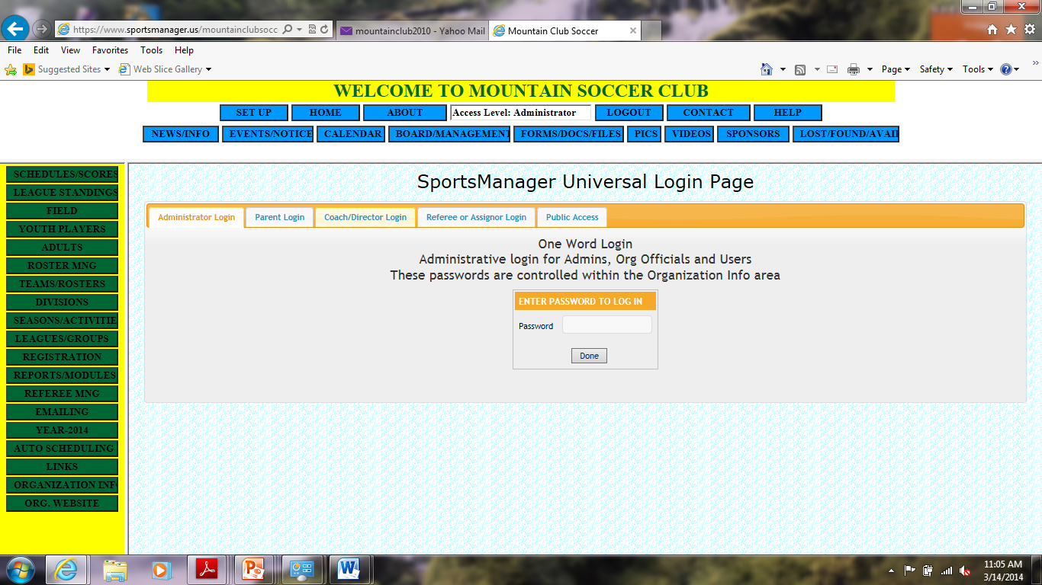
SCHEDULES and SCORES - COACHES
LOG in to SPORTSMANAGER www.sportsmanager.us/mountainclubsoccer.htm
Select “Coach/Director Log-in”

Slide 15
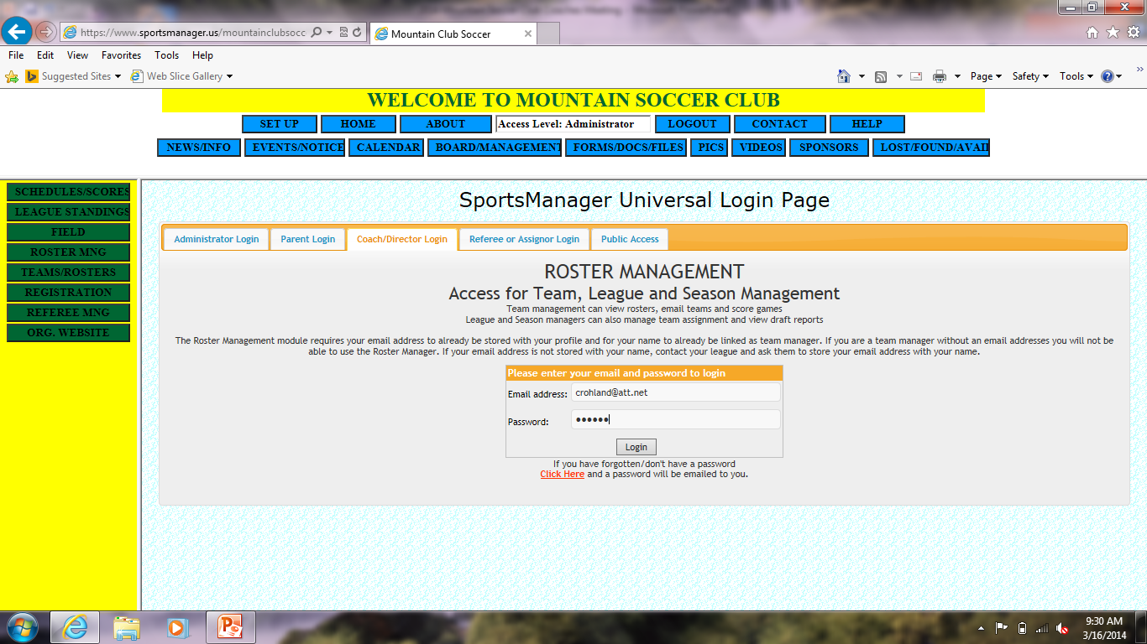
SCHEDULES and SCORES
Enter the email address and password you used to register.

Slide 16
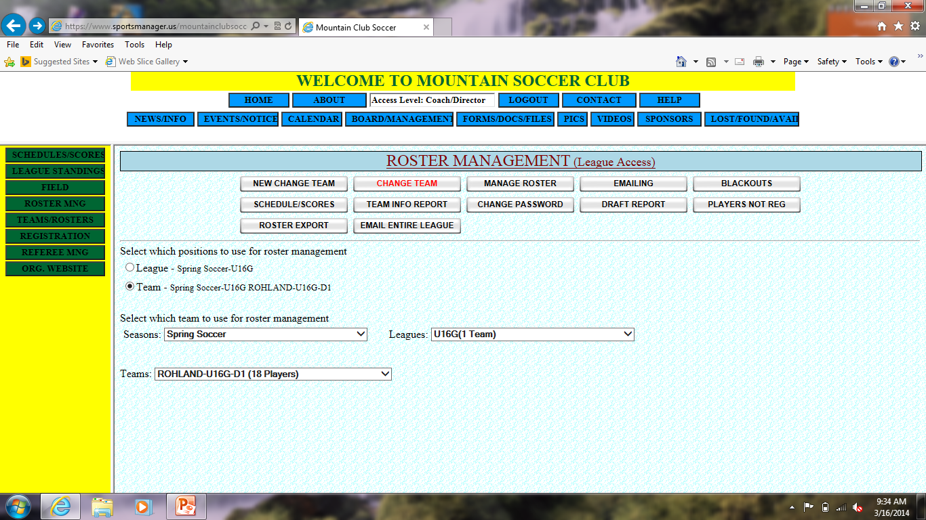
SCHEDULES and SCORES
Select the “Team” button

Slide 17
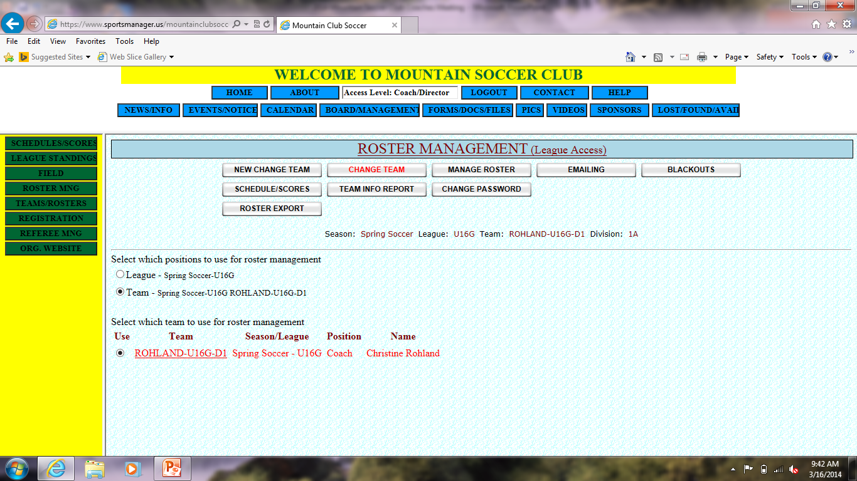
SCHEDULES and SCORES
Select the button for your Team

Slide 18

SCHEDULES and SCORES
Select the “Schedules/Scores” button in the Menu box on the Left

Slide 19
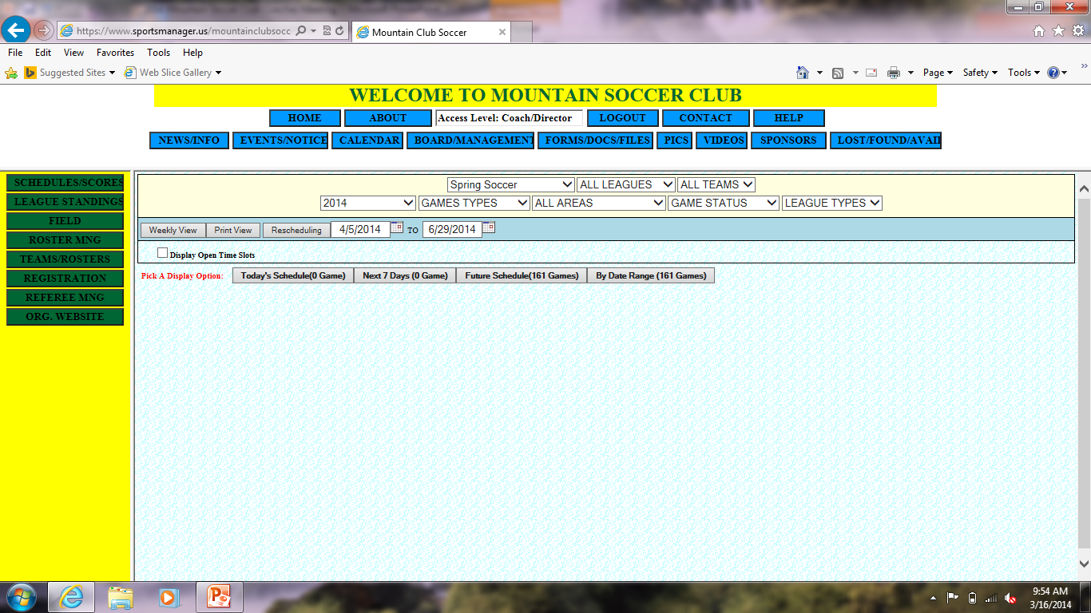
SCHEDULES and SCORES
1. Select your Age group from the “ALL LEAGUES” drop down menu. This will add an extra menu for “DIVISION”.
2. Select your Division (1, 2 or 3) and designation (A, B, or C) from the “DIVISION drop down menu. See your roster for the correct one. (If you cannot find it, ask Christine).
Select your team name from the “All Teams” drop down menu.

Slide 20

SCHEDULES and SCORES
Select “Future Scheduled Games

Slide 21
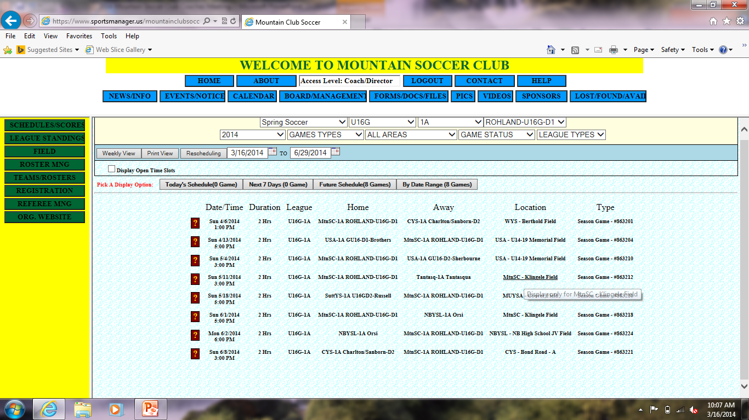
SCHEDULES and SCORES
Select the “?” to get specific information about the game

Slide 22
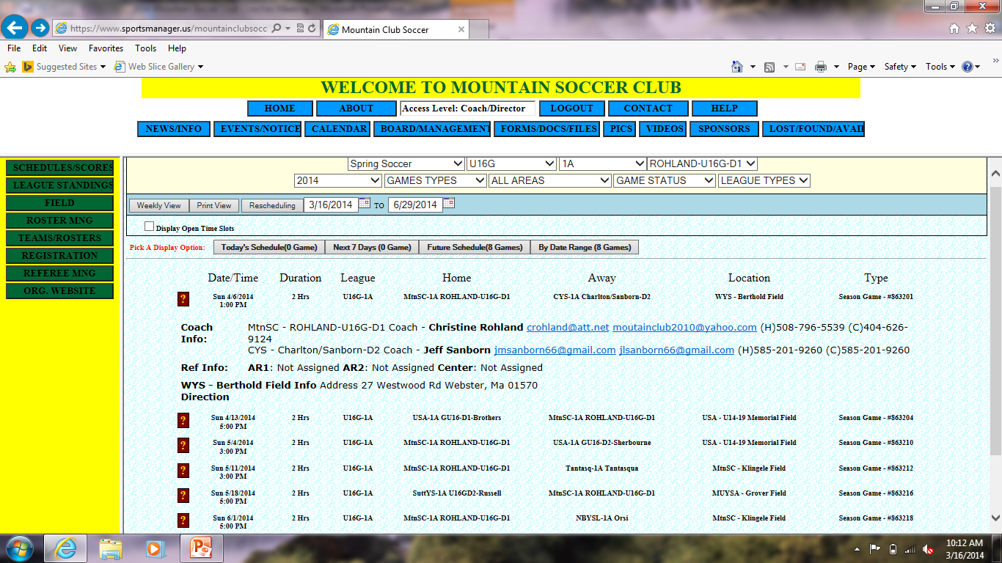
SCHEDULES and SCORES

Slide 23
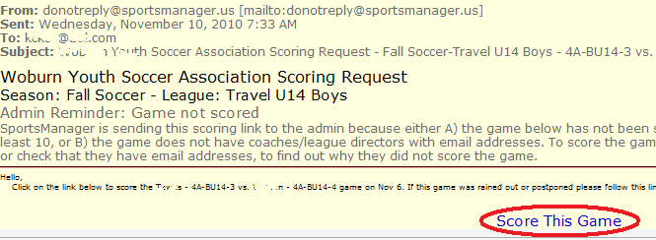
SCORES
Coaches will be entering Game Scores into the System
1. Within 24 hours of a game an email will be sent to the coach.
2. Clicking on the ‘Score This Game’ will take the coach into Sports Manager where they can enter the score

Slide 24
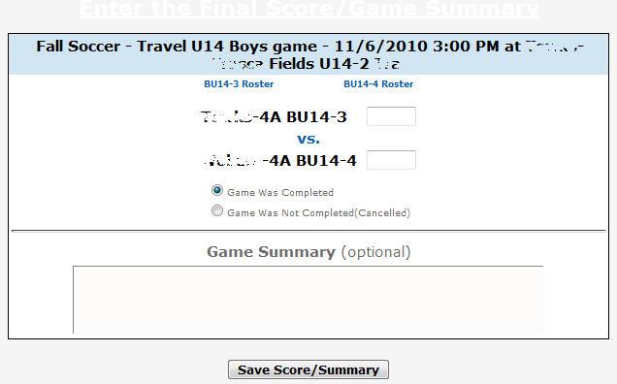
SCORES
Coaches will be entering Game Scores into the System
3. On this screen the game can be marked as Complete or Not-Completed. If for any reason the game was not completed, most likely rain, make sure to mark the game as Not Completed and enter the reason in the game summary.

Slide 25
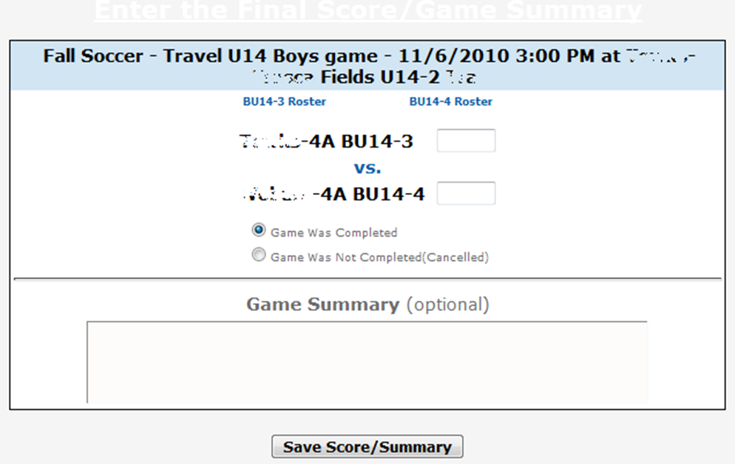

SCORES
Coaches will be entering Game Scores into the System
4. Click the Save Score/Summary to finalize score

Slide 26
SCHEDULES – PARENT ACCESS
LOG in to SPORTSMANAGER www.sportsmanager.us/mountainclubsoccer.htm
Select “Parent Log-In”

Slide 27
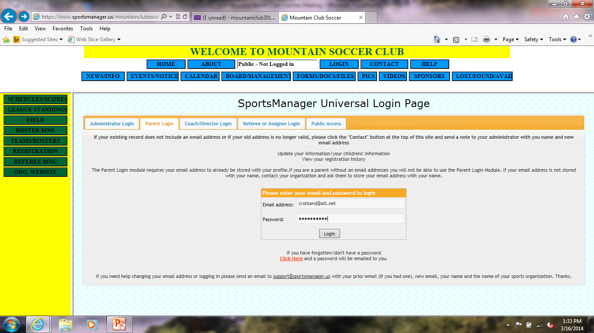
SCHEDULES – PARENT ACCESS
Enter the email address and password you used to register.
Enter email address and password used to register.

Slide 28
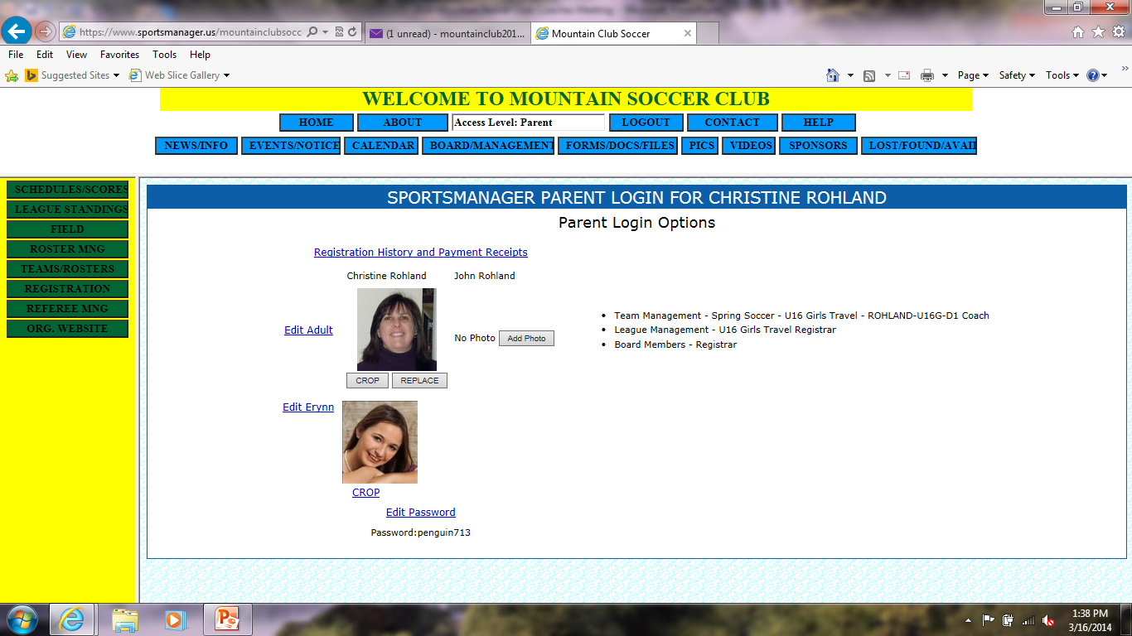
SCHEDULES – PARENT ACCESS
Select the “Schedules/Scores” button from the menu at Left.

Slide 29
SCHEDULES – PARENT ACCESS
Select your Age group from the “ALL LEAGUES” drop down menu. This will add an extra menu for “DIVISION”.
2. Select your team name from the “All Teams” drop down menu.

Slide 30
SCHEDULES – PARENT ACCESS
Select “Future Scheduled Games

Slide 31
SCHEDULES – PARENT ACCESS
Select the “?” to get specific information about the game

Slide 32
SCHEDULES – PARENT ACCESS

Slide 33
What do I need to do next
Review & Sign coaches code of conduct
Send in your Cori Information to Dawn LaBelle – MSC CORI Coordinator (ALL COACHES & ASSISTANT COACHES)
Complete all additional emails for the CORI process
Establish practice space with your town. Your town rep can help if you ask
Contact your team and introduce yourself.
Sign in to www.sportsmanager.us/mountainclubsoccer.htm to access your schedules.
Have a parents meeting at the 1st practice. Review Parents Code of Conduct. Also remind players that NO JEWELRY is allowed. Earrings cant be taped. They must be removed.

Slide 34
Questions?

