Slide 1
Mountain Soccer Club
Coaches Information & Resource Guide
Spring 2022
Created By: MT. Soccer Club Director Of Soccer Development

Slide 2
Why do you Coach?
ZOOM Chat -or- Speak-Up
-type-in your “short” answer that comes to your mind

Slide 3
Why do players, play?
ZOOM Chat -or- Speak-Up
-type-in your “short” answer that comes to your mind

Slide 4
Aligning with the Mountain Soccer Club (MSC) Constitution, By-Laws and Board Members, all MSC Coaches should have the understanding and professional competence to provide a
Safe, Enjoyable and Positive Holistic Developmental Environment for all youth soccer players within the MSC organization.

Slide 5
Mountain Soccer Club - Coaching Philosophy
Safe - before, during, after all practices, games and team events Coaches should always be vigilant of surroundings, and stay actively engaged/attentive with all players, individually and collectively as well as engage/interactive with parents/stakeholders as needed to maintain an overall safe player environment
Enjoyable - at all playing age group levels, Coaches must create and maintain a fun and enjoyable playing experience for all players, during practices, games and team events
Positive Holistic Developmental Environment - Coaches should consistently strive to provide an overall positive holistic developmental environment that will guide and aid all players to achieve successful growth, as a person, player and teammate

Slide 6
Mountain Soccer Club - Other Coaching Standards
-Professional Appearance - Coaches should consistently appear and look professional
-Professional Demeanor - Coaches should consistently and calmly communicate effectively and efficiently with their team has a whole, but also individually with players, parents as well as others they may come into contact with through the duration of the soccer season
-Managing The Environment - Coaches should consistently ensure that players are within a safe and enjoyable environment
-Respect - Coaches should consistently show and provide respect to all within all interactions

Slide 7
Communication
-Pre-Season Player/Parent Meeting
-Setting the standard/desired expectations/group norms
-Player/Parent Meeting should be held as soon as possible
(after 1st or 2nd practice, do not delay having an “all-together” team meeting)
-Provide Players/Parents adequate notice about Player/Parent meeting
-Take time to draft-up a small agenda for yourself
(meeting should be only about 5-10 minutes)
-Team/Parent Meeting talking points are listed below,
*Introduce Yourself (share contact information email/cell phone with Parents)
*email/text, at least 24 hours before not attending practice/game - so Coach can plan accordingly
*Wearing proper soccer gear to practice/games (soccer equipment/uniform/jersey kits)
*Try your best arrive 10 minutes below practices
*Try your best arrive 30 minutes before games, for pre-game warm-up
*Shin Guards, player safety
*Always bring pump-up soccer ball to all practices and games
*No Jewelry, player safety
*Player should not be on Cell Phones during practices and games
*As a Team lining-up soccer bags and keep equipment organized/professional-looking
*Playing Time, Coach will try very best to provide equal playing time and rotate starters
*Allow Coach 72 hours to respond to all communication, please send follow-up if no response
*Speak with all parents, and please highlight the point to them all that they also need to provide a positive/supportive environment for all players, coaches, referees that they may come into contact with, all MT. Club Soccer parents/care-givers/family/friends are also responsible for providing a Safe, Enjoyable, Positive Holistic Developmental Environment for the all MT. Club Soccer Players and Teams
(topics/agenda within your Player/Parent Meeting are up-to-you, just keep it brief/to the point)

Slide 8
Communication
-In-Season Player/Parent Communication
-During Practices/Games
-try your best to greet all players and parents, as they arrive at practice and games
-provide constant positive reassurance/reinformacent
-ask players and team guided questions throughout practices and games
-Pre-Game (warm-up)
-review what was worked-on within practice(s) and can your team apply
-provide game-plan-approach
-provide appropriate positive motivation/inspiration to players
-Half-Time
-ask the team, what was good and what areas of improvement could be
-what is the other team trying to do
-keep it brief, do not overwhelm with information, make clear 1-3 points
-Post-Game
-ask the team, what was good and what areas of improvement could be
-review what was worked-on within practice(s) and did your team apply
-keep it brief, do not overwhelm with information, make clear 1-3 points
-Side-Line Communication during Games
-always, respectful, calm, appropriate and clear communication
-do not “joystick” your players, not a video game, the game belongs to the players, it is a players game
-let players play the game
-let them make mistakes
-let them learn
-coaches guide players/team to discover their own solutions (guided discovery, it is ok to make mistakes/try new things/fail and try again)
-keep your coaching from the Side-Line to a minimum, let players apply what they learned and know from past experiences

Slide 9
Communication
-Self-Reflection after Practices and Games
-ask yourself/your assistant coach;
-what we do well?
-what could we do better?
-were our players safe?
-did players enjoy it?
-strides made towards the overall development person, player, teammate?
-was it organized?
-was it game like?
-were our players challenged?
-what should be our plan for next practice/game?
-Post-Season Player/Parent Communication
-Referee Communication
-Opposing Coaches/Team Communication
-Electronic Communication
try your very best to respond within 72 hours to all communication, if it is urgent and/or emergency respond back as soon as possible, and maintain professional communication at all times, as well as keep records for your safety
-E-Mail
-Phone
-Texting
-WhatsApp (good for creating a “team group text” to stay organized/updated)

Slide 10
Resources To Share With Parents
“You don’t scream at your kid when they are learning how to read or write, so why do it when they are learning to play football (soccer)?” - Sean Dyche, manager/head coach of Burnley FC
Changing The Game In Youth Sports: John O’Sullivan at TEDxBend
(https://www.youtube.com/watch?v=VXw0XGOVQvw&feature=youtu.be)
Freedom To Fail
(https://www.robertglazer.com/friday-forward/freedom-to-fail/)
Improve Your Coaching By Not Coaching
(https://wgcoaching.com/over-coaching/)
The Incredibly Massive Importance Of Play
(https://changingthegameproject.com/the-massive-importance-of-play/)
Four Don’ts of Soccer Coaching
(https://youtu.be/gzHi6fXjm6M)

Slide 11
Coaching Education & Professional Resources
-U.S. Soccer Federation (ussoccer.com)
U.S. Soccer Learning Center (learning.ussoccer.com)
*Free Intro Course, online 20 minutes to complete
-United Soccer Coaches (unitedsoccercoaches.org)
United Soccer Coaches (unitedsoccercoaches.org/education/)
*Yearly Membership Fee, which provides online resource content
-Massachusetts Youth Soccer Association (mayouthsoccer.org)
Massachusetts Youth Soccer Association (mayouthsoccer.org/coaches/session-plans/)
*Free Practice Training Session Plans
*Mass Youth Soccer Grassroots Podcast (Apple Podcasts, listen to 1st episode)
***many additional supportive resources online and YouTube, the power of the internet***

Slide 12
Practice Training Session Plans (In-Season Curriculum / Topic / Ideas / Examples)
KEY NOTES for Coaches below to consider regarding planning your soccer season...
--Spring Soccer Season Duration: early-April through early-June
--Practices: 2 organized-practices per week are recommended (Coaches Discretion)
--Games: 1 game per weekend
--Soccer Season Length: (13 weeks estimation)

Slide 13
Practice Training Session Plans (In-Season Curriculum / Topic / Ideas / Examples)
*take the time to think, plan, prepare your practices and game approaches --- do not procrastinate...your players and team deserve a Safe, Enjoyable and Positive Holistic Developmental Environment
*setting-up your environment is important, success is earned within the details
-soccer equipment (soccer balls, cones, bibs, goals, pump, etc.)
-try your best to arrive 20 minutes before your practice, to set-up your practice
-make sure your practice/game area is safe for all
-try your best to use minimum equipment when setting-up your practices
-plan with the end-in-mind, start with your big ideas and the get small, work backwards
-as you progress throughout practice, all you then need to do is pick-up as you move-on

Slide 14
Practice Training Session Plans (In-Season Curriculum / Topic / Ideas / Examples)
Play - Practice - Play
-Massachusetts Youth Soccer Association (mayouthsoccer.org/coaches/play-practice-play/)
-U.S. Soccer Federation (ussoccer.com/stories/2018/02/five-things-to-know-about-playpractice-play)
-CoachesInsider (coachesinsider.com/soccer/practice-plan-7/)
-World Class Coaching - YouTube (Click Here: Play Practice Play Training Session)
-Murray Soccer Club - YouTube (Click Here: Coach Education - Play Practice Play)

Slide 15
Practice Training Session Plans (In-Season Curriculum / Topic / Ideas / Examples)
WEEK | TOPIC 1 Days: Tuesdays Times: 6pm-7pm Location: TBA | TOPIC 2 Days: Thursdays Times: 6pm-7pm Location: TBA | GAME Days: Sundays Times: 6pm-7pm Location: TBA Opponent: TBA | NOTES & REMINDERS
Week 1 | Small Sided Games | Dribbling | TBA | Player/Parent Meeting
Week 2 | Passing | Striking | TBA
Week 3 | Receiving/Controlling | Small Sided Games | TBA
Week 4 | Winning Ball Back | Control & Connect | TBA
Week 5 | Attacking Space | Finishing/Shooting | TBA
Week 6 | Small Sided Games | Winning Ball Back | TBA
Week 7 | Control & Connect | Attacking Space | TBA | Mid-Season Reflection
Week 8 | Finishing/Shooting | Small Sided Games | TBA
Week 9 | Dribbling | Passing | TBA
Week 10 | Striking | Receiving/Controlling | TBA
Week 11 | Small Sided Games | Control & Connect | TBA
Week 12 | Winning Ball Back | Finishing/Shooting | TBA
Week 13 | Attacking Space | Small Sided Games | TBA | Season Reflection

Slide 16
Attacking Principles - practice / game tactics
*below order is up to your interpretation, all are equally important
-Penetration / Forward
-working individually and collectively as a team to move/progress the soccer ball up the field towards the opponents goal, this can be done my a dribble, pass, cross, shot
-Support
-working individually and collectively as a team in supporting, your teammates within the build-up in attack, the creation of space and spreading-out to create attacking options
-Mobility / Movement
-working individually and collectively as a team in creating movement off-the-ball and creating space along with attacking options
-Width / Spread-Out
-working individually and collectively as a team, making the field as big-as-possible when you have possession of the ball, getting wide to the touch-line to hopefully stretch out the compact defence
-Creativity / Improvisation
-working individually and collectively as a team, allow players to express themselves and encourage them to try-new-things and by creative (ideally, within the final third of the field, when they are closest to the opponents goal trying to score), “coaches must be willing to accept that in order to reap the benefits of exciting and creative players, there will likely be a fair amount unsuccessful attempts at first” let the players be expressive of their talents and skills, encourage them to be confident and believe within themselves and their own ability
Defending Principles - practice / game tactics
*below order 1, 2 ,3, 4 ,5 of importance
Pressure
-role/responsibility of the 1st defender (player closest to soccer ball), provides pressure on player with the ball, providing good pressure is about 1 arm's length away “touch-tight-on-opponent” and working either to steal ball back or to contain opposing player in-front-of-them
Cover
-role/responsibility of the 2nd defender (player that is second closest to the ball and is behind the first defender, and is denying an attacking option), so if the 1st defender is beaten by opponent the 2nd defender can then try and win ball or contain opposing player with the ball
Balance
-role/responsibility of the 3rd defender/4th defender (players that are usually farther behind play that provide stability and structure within the teams defensive unit), players are aware where the ball is located as well as where their surrounding opponents / “threats” are on the field
Compactness
-overall, role/responsibility of the collective team is to make the field as small/compact as possible for other team, and denying/delaying opportunities for opposing team to penetrate forward with a dribble, pass, shot, cross
Concentration / Communication
-overall players should be focused/concentrated on where the ball is as well as what surrounds them, if they are the 1st defender they should be working to win the ball back, if they are the 2nd, 3rd or 4th defender, they should be marking players around them and/or space while making the field as compact as possible, player to player communication will help in beginning aware of moving-around opposing team

Slide 17
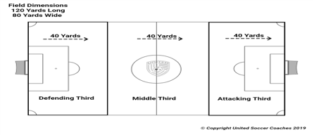
Transitions Within Play - practice / game tactics
Attacking into Defending
-when you team has the ball within attack but then loses possession of ball, how quickly can your team transition into their defensive shape
-field BIG to SMALL - quickly
-collectively as a team, work to win ball back as quickly as possible
Defending into Attacking
-when you team does not have the ball and has to defend, but then wins possession of the ball back, how quickly can your team transition into their attacking shape
-field SMALL to BIG - quickly
-collectively as a team, work to maintain possession of the ball, work forward up the field

Slide 18
Head Coaches and Assistant Coaches - Managing the TEAM Environment
--- Visit https://www.sportsmanager.us/MountainClubSoccer.htm
YES - you are a Coach, but you are also a Manager of your TEAM / PLAYERS
All MT. Clubs Coaches are accountable for knowing all the ins and out of the below headers!
*Coaches Code Of Conduct
*BY-LAWS
*Laws Of The Game
*Player, Team, Club Eligibility
*Length Of Games, Overtime Periods, Ball Size
*Substitutions
*Timing & Forfeit Of Games
*Postponements
*Make Up Games
*Scores
*Soccer Balls
*Game Day Rosters
*Pass Cards
*Zero Tolerance Policy
*Sportsmanship
*For The Good Of The Game
*Equipment
*Game Rosters
*Schedules, Scores & Ref Evals
*Logging Into Sports Manager
*Schedules & Scoring
*Parent Login
*What Do I Need To Do Next
*Questions?
THANK YOU FOR VOLUNTEERING

Slide 19
-Feedback, Suggestions, Questions, Concerns regarding the Mt. Soccer Club
Coaches Information & Resource Guide, please contact the current Mt. Soccer Club Director Of Soccer Development and/or the Mt. Soccer Club Board Members
COACH FOR THE LOVE OF THE GAME!

Slide 20
Mountain Soccer Club
2022 Coaches Information
Find contact information and
current board members
on our website
https://www.sportsmanager.us/MountainClubSoccer.htm

Slide 21
Thank you for agreeing to be a coach
As a RYS coach, you will work with and introduce a group of young people to the game of soccer
Good coaches are the building blocks of great players

Slide 22
Coaches Code of Conduct
Massachusetts Youth Soccer
The Board of Directors of Massachusetts Youth Soccer Association, Incorporated (Mass Youth Soccer) and the leaders of the affiliated Leagues are concerned about the conduct of all coaches and referees during games at all levels, from recreational to premier to ODP.
We want to ensure that games are fair, positive and enjoyable experiences for all of the children and adults involved. A soccer game should be friendly and unifying - a spirited social and athletic occasion for players, coaches, referees and spectators.

Slide 23

No Current Restrictions or Game Modifications
If someone doesn’t feel well, don’t come

Slide 24
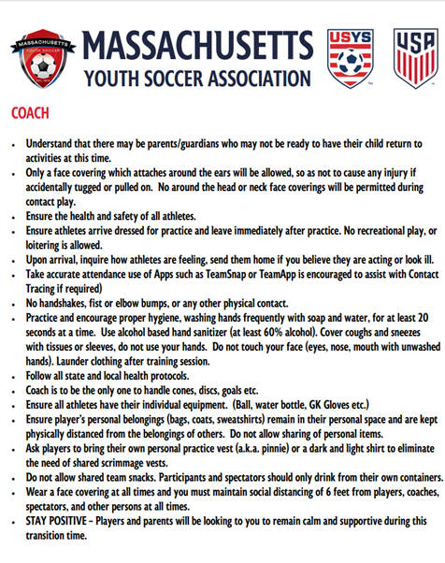
Additional Information as a Coach
MA Youth Soccer COVID Hub
  https://www.mayouthsoccer.org/covid-hub/
  Protocol Documents
  Notification Procedures
  Coach Resources
  COVID-19 Resources

Slide 25

By-laws
http://www.maysl.com/
LEAGUE AFFILIATION The League will affiliate with the United States Youth Soccer Association (U.S.Y.S.A.), the Massachusetts Youth Soccer Association (Mass Youth), the United States Soccer Federation (U.S.S.F.) and the Federation International De Football Association (F.I.F.A.). Rules of all will be in effect.

Slide 26
II. LAWS OF THE GAME
Midland Area Youth Soccer
The F.I.F.A. "Laws of the Game" shall apply to any and all competition in the league per U.S.S.F. Guide for Referees.
Modified rules for 7v7 (U10) play;
  During a goal kick only, the opposing team must move behind the center field line until the ball is put into play
  After the ball is put into play by the goalkeeper, the opposing team can cross the center field line and play resumes as normal.
  The ball is considered in play when it breaks the plane of the penalty area for a goal kick
  It is highly recommended that you check with the ref and opposing coaches prior to each game to make sure everyone agrees that this rule will be, or won’t be, used

Slide 27
III. PLAYER, TEAM & CLUB ELIGIBILITY
Midland Area Youth Soccer
All players must be registered with the League registrars. NO PLAYER MAY PRACTICE UNTIL REGISTERED WITH MASS YOUTH SOCCER AND NO PLAYER MAY PLAY ANY LEAGUE GAME UNTIL REGISTERED WITH M.A.Y.S.
  Division III teams may roster as many players as they wish.
  Division I and II teams have roster limits.

Slide 28
IV. LENGTH OF GAMES, OVERTIME PERIODS, BALL SIZES
Midland Area Youth Soccer
The length of games, over-time play and ball sizes for each age group are:
Age Group | Game Length | Playoff Over-Time | Ball Size
Under 19 | Two 45 Minute Halves | Two 10 Minute Halves | 5
Under 18 | Two 45 Minute Halves | Two 10 Minute Halves | 5
Under 18 (Fall) | Two 40 Minute Halves | Not Applicable | 5
Under 16 | Two 40 Minute Halves | Two 10 Minute Halves | 5
Under 14 | Two 35 Minute Halves | Two 5 Minute Halves | 5
Under 12 | Two 30 Minute Halves | Two 5 Minute Halves | 4
Under 10 | Two 25 Minute Halves | Not Applicable | 4
Playoff Overtime is NOT based upon Golden Goal format. Both overtime halves must be played through to completion. If the game remains tied at the conclusion of both overtime periods, then the game will be decided using Kicks from the Penalty Mark according to FIFA.
Play shall be suspended and all participants shall seek shelter when lightning is 6 miles distant, or closer. (In estimating distance of a lightning strike, use the “flash to bang” method. Count the seconds from the time lightning is sighted, until the accompanying thunderclap is heard. If the time is 30 seconds or less, the distance is6 miles or less.) Before resuming play, wait 30 minutes after the last lightning strike within the 6 mile limit. In the event that a game is terminated, it will be considered complete providing that the first half has been completed.

Slide 29
V. SUBSTITUTIONS
Midland Area Youth Soccer
The number of substitutions is unlimited. They may be made, with the consent of the referee, at the following times:
Prior to a throw-in in your favor, or a throw-in for the opposing team if BOTH teams have players ready to enter the game.
Prior to a goal kick by either team.
After a goal by either team.
After an injury when the referee stops play.
At Half-time.
Substitutions are NOT allowed at corner kicks or free kicks.

Slide 30
XI. TIMING AND FORFEIT OF GAME
Midland Area Youth Soccer
Referee and teams must be present at the field 15 minutes prior to the scheduled kick-off time. If the referee does not arrive within 15 minutes after the scheduled time, he/she may not receive any fee. In this case, the coaches of the two teams will appoint an acting referee and play the game. If a mutually acceptable party cannot be found to act as referee, the game must be rescheduled. In the event of a team being late, the other team must report it to the League for appropriate action.
If either team has not arrived within 15 minutes after the scheduled time, the referee will leave the field, and will receive payment. In this case, the missing team will forfeit the game.

Slide 31
XII. POSTPONEMENTS
Midland Area Youth Soccer
The only legitimate reasons for postponing a game are:
Bad weather at the site of the game.
Vandalism to the field or field is unavailable. It is suggested that teams swap fields to play the game.
Reschedule requests must be submitted to the MAYS President by the Club/Town Rep. Reschedule requests for games during the first 2 weeks of the season must be received by the MAYS President one week prior to the game date. All other reschedule requests for games beyond week 3 must be received no later than 7 days after the first date of games for the age group of the teams impacted by the request. Only one request per team will be allowed. The acceptable reasons for requesting a reschedule is for school event, religious event which prevents a team from fielding the minimum number of required players…
It is the responsibility of the home team to notify both the visiting team coach and the referee assignor of the postponement at least two hours before the scheduled game time.
ONLY MSC Town Reps can close a field or cancel a game
Coaches CANNOT cancel a game
Contact your Town Rep (Sterling – Brent Powers, Paxton – Dan Fontaine, Rutland – Chris Jeffcoat, Princeton – Bill Hume)
Once at the field, ONLY a referee can cancel a game

Slide 32
XIII. MAKE UP GAMES
Midland Area Youth Soccer
The agreement on a mutually acceptable time and date for the replay of a game that was a valid postponement must be reached by the teams involved within two (2) weeks of the date when the game was postponed and the date of the rescheduled game must be within four (4) weeks of postponed game. Notwithstanding the afore defined requirement, the last available date for making up any postponed game shall be the last day of the regular playing season
If a mutually suitable time for a make-up game can not be agreed upon by the coaches within the time limit stated above, the home team must immediately provide to the President three (3) reasonable game times which are on different dates and within the time limits as stated above. The visiting team must then accept one of these dates or forfeit the game. If alternative game times/dates submitted by the home team are deemed unreasonable by the President, then the President will give the visiting team three (3) dates to choose from within the stated time limit and may schedule the game at the visiting team's field or at a neutral site.
Reach out to MSC President or Vice President with additional questions

Slide 33
XVI. SCORES
Midland Area Youth Soccer
Scores, ref evaluations and game information will be entered and record using the software the MAYS board uses to run the League (Sports Manager).
More information on this will be discussed later in this presentation.

Slide 34
XVII. BALLS
Midland Area Youth Soccer
Home teams will provide a regulation ball -- per U.S.Y.S.A. standards.
You will be provided two game balls prior to the start of the season. Both game balls should be given to the referee prior to the start of all home games. Make sure to get them back at the conclusion of the game.

Slide 35
XXIII. GAME DAY ROSTERS
Midland Area Youth Soccer
Each coach will provide TWO copies of the team roster with visible water mark approved by M.A.Y.S. to the referee before the start of each game. Failure to do so will result in a $25 fine to the club for an un-verified roster and/or game forfeiture, and $50 fine to the club for no roster and/or game forfeiture. Rosters must be generated through the MAYS specified rostering system, such as SportsManager.
A maximum of three coaches are allowed at the bench area.
Verified rosters will be emailed to you, and must be printed in COLOR
MSC recommends that all coaches and assistant coaches keep copies of the rosters in their vehicles in case the coach unexpectedly can not make the game

Slide 36
ZERO TOLERANCE POLICY
Midland Area Youth Soccer
All persons responsible for a team and all of the spectators shall support the referee. Coaches are responsible for the team’s spectators and shall address any issue with spectator who is interfering with the match. Should the referee stop play and request the coach to dismiss the spectator the coach will do so or the match will be abandoned. Failure to do so will undermine the referee’s authority and has the potential of creating a hostile environment for players, the referee and all other participants and spectators.
Consequently, the MAYS League has adopted the following rule:
No one is to address the referee during the Match!
Exceptions for persons responsible for a team (Coaches and Managers)
During the Game
At Half Time or the End of the Match
  Responding to a referee initiating communication.
  Making Substitutions
  Pointing out emergencies or safety issues
  A coach/manager can ask a referee to explain a rule(s) in a polite and constructive manner.
  Polite and friendly feedback can be given to a referee.
  Absolutely NO sarcasm, harassment or intimidation.

Slide 37
XXX. SPORTSMANSHIP
Midland Area Youth Soccer
Goal Scoring
  Any team that has a differential score of 8 or more goals will receive a warning for the first offense. Second offense will result in the coach being suspended for one game and the town will be fined $150. Next occurrence will result in the coach being suspended for eight (8) games and the town will be fined $150.
  If you go up by 4 or 5 goals, change your strategy (i.e., can only shoot outside of the 18-yard box, shoot with non-dominant foot, have to complete 6 uninterrupted passes before shooting, increase the number of defenders and only have one attacking forward, quietly pull a player or two off the field, etc.)

Slide 38

Mountain Soccer Club
Administrative
Show up at least 30 minutes prior to every game.
Ask parents to show up at least 30 minutes before every game. Parents will get lost, officials & opposing coaches may have questions, etc.

Slide 39
Where Do I Get Equipment
Mountain Soccer Club Provides:
  Uniforms to all players (shorts, jersey, socks)
  Coach equipment bag with the following items:
- Game Balls - First Aid Kit
- Cones - Pinnies
- 1 Whistle - Extra Ball Pump Needles
- 1 Ball Pump - Goalie Jersey
- Goalie Gloves - Ice Packs
Ask all your players to bring a ball (correct size) to practice. Most kids at U10 and above now have an appropriate ball
Check with your town rep if additional equipment is needed. Some of the town recreational soccer programs may provide additional equipment

Slide 40
GAME ROSTERS
You MUST bring 2 copies of your “official” roster to every game. Your team will not be allowed to play without the rosters. MSC will receive a fine for the forfeiture
Verified rosters will be emailed to you, and must be printed in COLOR
Do NOT add players to your rosters. Players can only be added by the registrar.
Warm up your team and set up your roster based upon players who arrive for play.
Player numbers must be on the roster before handing to refs. You can write them in by hand and then photocopy (in color) or add them through the Sports Manager system).

Slide 41
Schedules, Scores & Ref Evals
Your team schedule is available on Sports Manager
You will receive an email after every game to score the game through Sports Manager
You will receive an email after every game to evaluate the referee’s performance

Slide 42
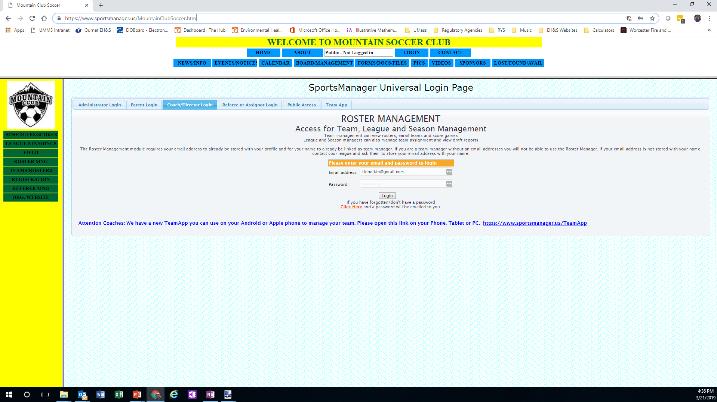
Logging Into Sports Manager
1
2
Enter the email address and password you used to register.
Select “Coach/Director Log-in”
www.sportsmanager.us/mountainclubsoccer.htm

Slide 43
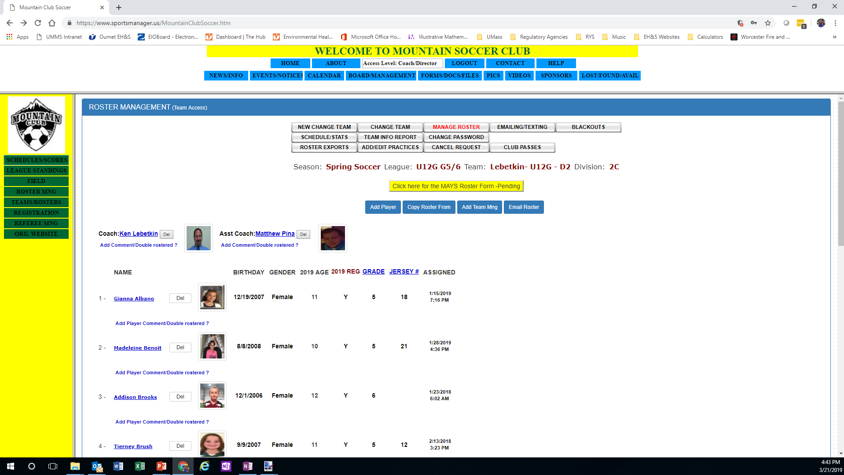
Schedules & Scoring
Select “Schedules/Scores” button in the Menu box on the Left

Slide 44
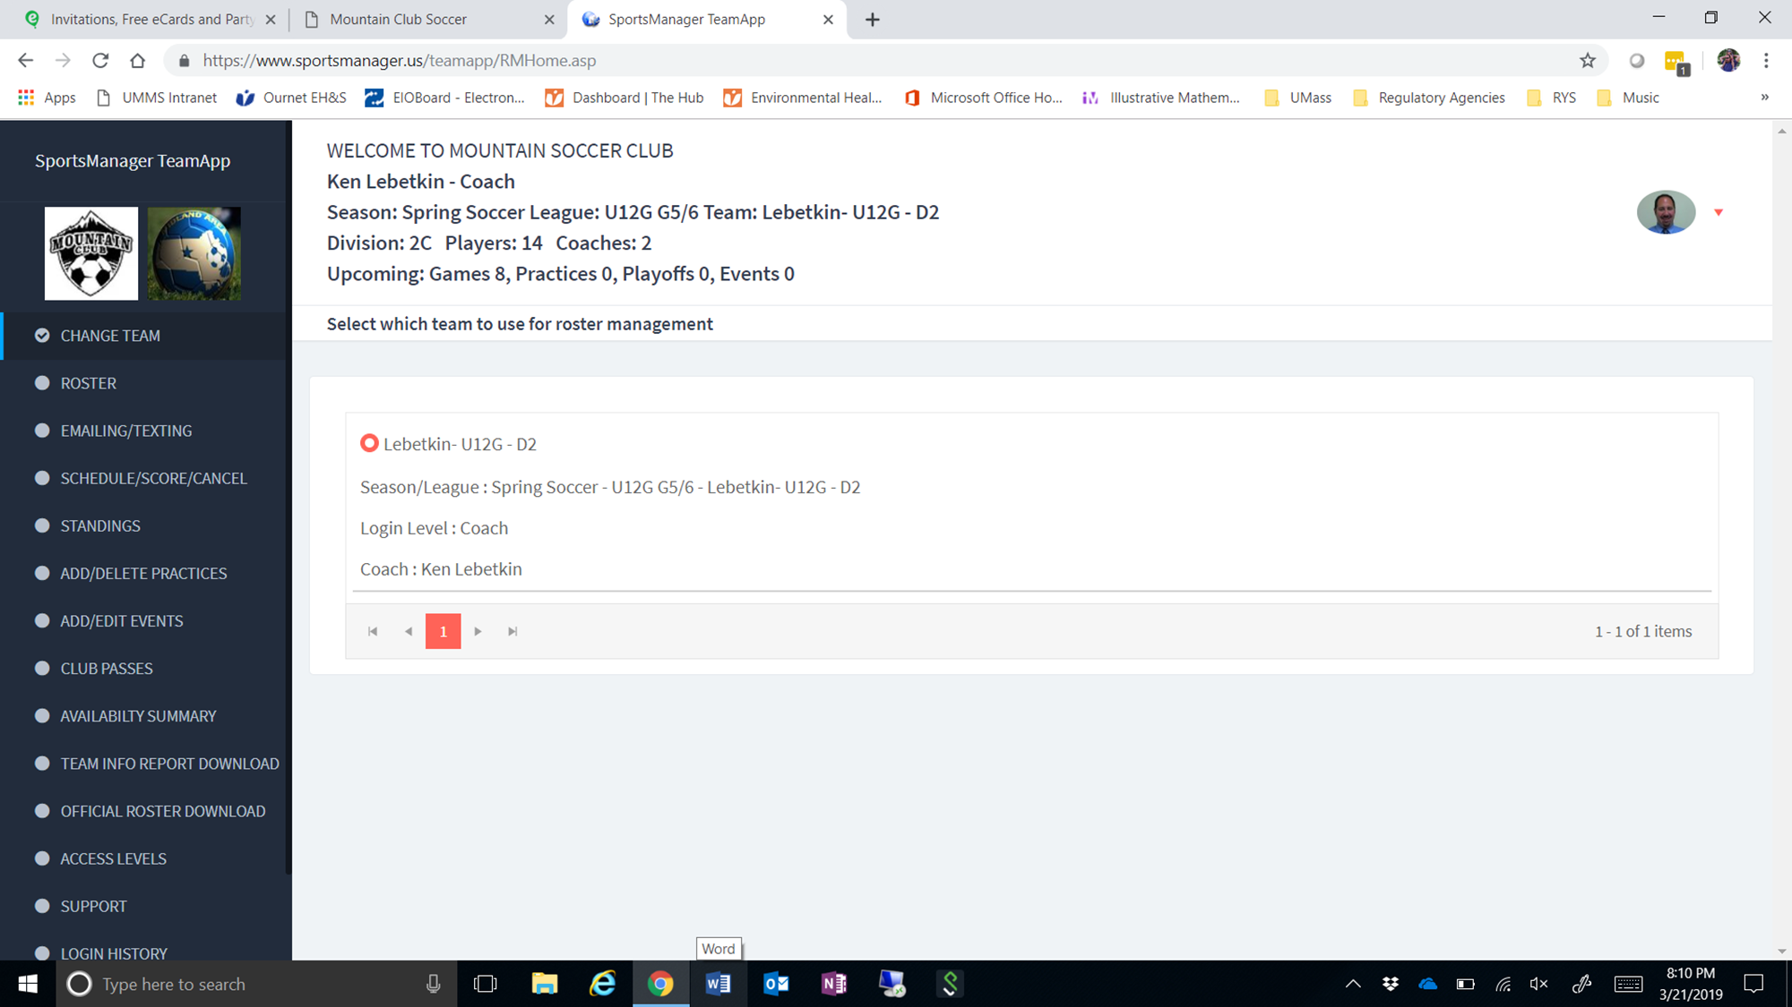
Schedules & Scoring
It could look like this if it takes you to the app view
Select “Schedules/Scores/Cancel” button in the Menu box on the Left

Slide 45
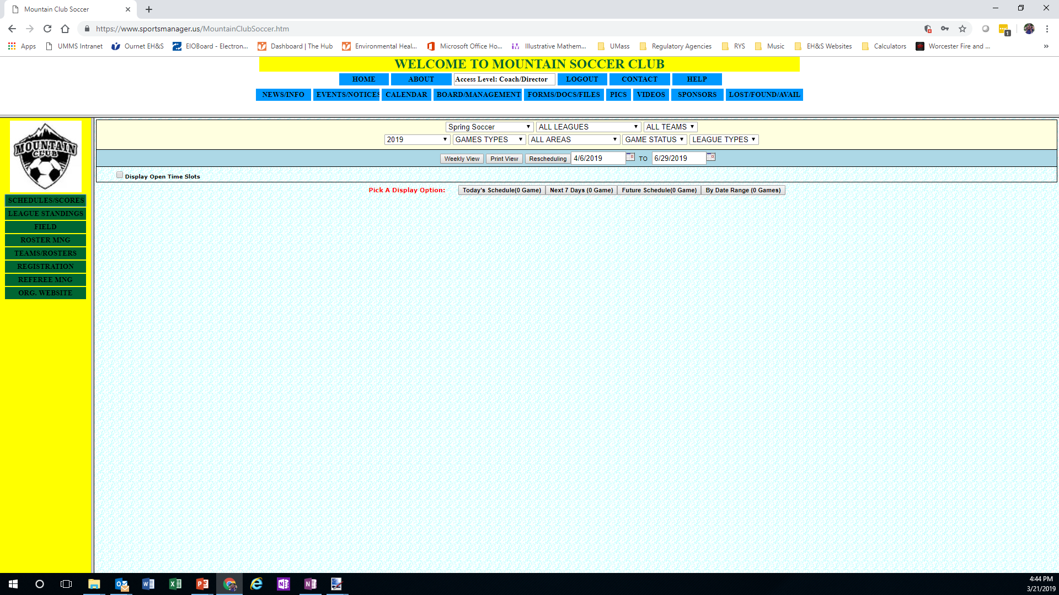
Schedules & Scoring
1
2
3
Select your Age group from the “ALL LEAGUES” drop down menu. This will add an extra menu for “DIVISION”.
Select your team name from the “All Teams” drop down menu.
Select Future Schedule (# Games)

Slide 46
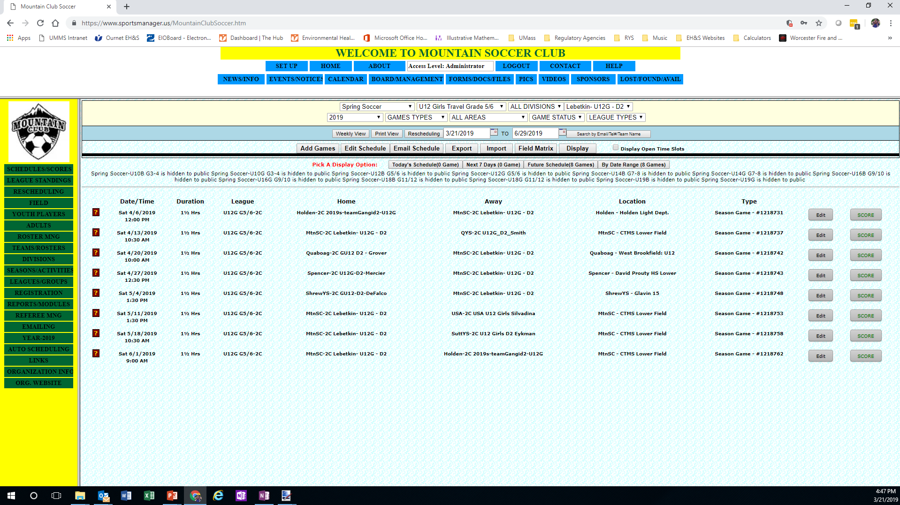
Schedules & Scoring
1
2
Select the “?” to get specific information about the game
Select “Score” to score the game (should be done within 24 hours)

Slide 47
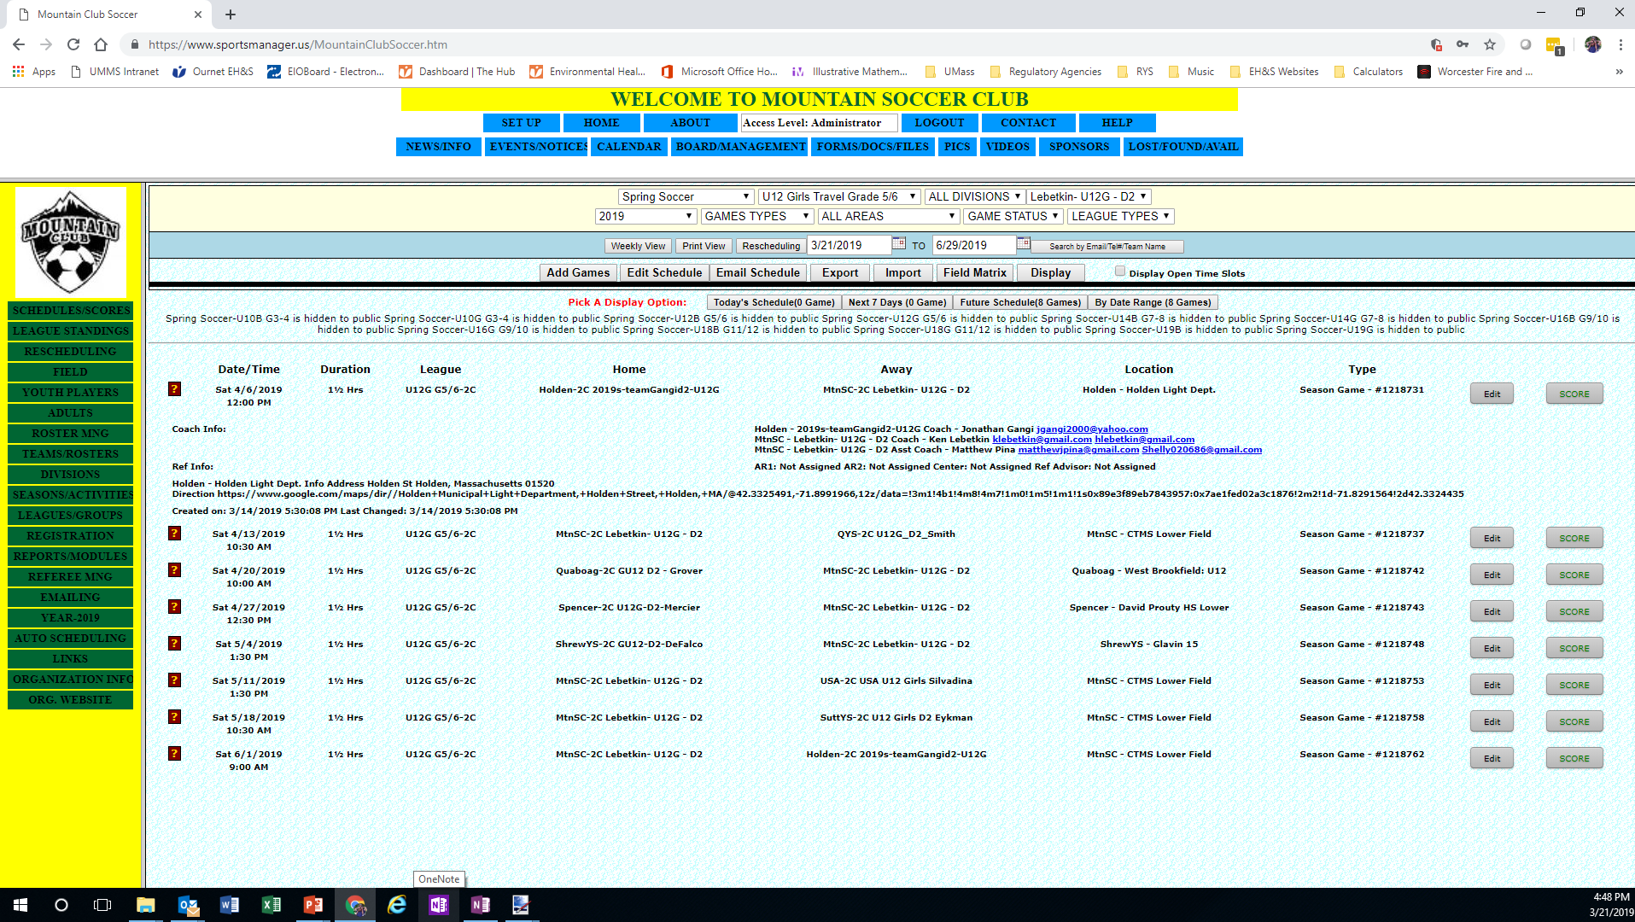
Schedules & Scoring

Slide 48
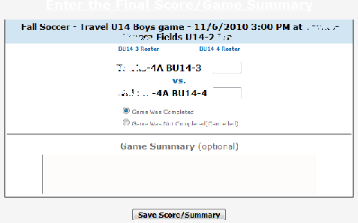
Scoring
1
Enter final score for both teams
Select “Save Score/Summary” to score the game (should be done within 24 hours)
2

Slide 49
Parent Login
Similar process as Coaches
1
2
Enter the email address and password you used to register.
Select “Parent Log-in”

Slide 50
Home Game & Practice Fields
U10 – Muddy Pond Sterling
  Town Rep: Brent Powers
U12 – Krashes Princeton
  Town Rep: Bill Hume
U14 & HS – Klingele Paxton
  Town Rep: Dan Fontaine
Rutland – Glenwood Elementary and CTMS Lower (Practice Only)
  Town Rep: Chris Jeffcoat

Slide 51
What Do I Need To Do Next
Review coaches code of conduct
Send in your Cori Information to Jason Pratt – MSC CORI Coordinator (ALL COACHES & ASSISTANT COACHES)
Complete all additional emails for the CORI process
Work with the town rep in which the field you wish to practice is located to schedule practice days/times
Contact your team and introduce yourself if you haven’t already done so
Sign in to www.sportsmanager.us/mountainclubsoccer.htm to access your schedules.
Have a parents meeting at the 1st practice. Review Parents Code of Conduct. Also remind players that NO JEWELRY is allowed. Earrings can’t be taped. They must be removed. No hard casts. Enjoy the game, cheer the team on and no matter the outcome of the game, the most important thing is that they had fun.

Slide 52
Questions?
Thank You For Volunteering

