Slide 1

U.S. SOCCER GRASSROOTS PLAYER DEVELOPMENT PHILOSOPHY
At the grassroots level, children learn and develop to their full potential through game-like experiences in an enjoyable environment which supports individual growth
PHASE 1: DELIBERATE PLAY
Players
Small Sided Games (2v2, 3v3, 4v4)
Frequent touches on the ball
Get kids started as soon as they arrive
Game like activities support decision making
Coaches
Use of freezes to fine tune the activity
Key Words to stimulate player actions
Use water breaks for guided questions – let the kids come up with the solutions if possible
PHASE 2: PRACTICE SESSION
Coaches
Choose the session based on reflection of previous game / practice
Session is specific to Phase of the Game and Area of the Field. Stick to coaching that phase of the game, rotate players so everyone gets coached
Session should be game like and reinforce the themes from deliberate play
Alter difficulty level based on what you see
Phase rotation practice to practice (offense vs defense)
PHASE 3: SECOND PLAY
- Coaches observe . . . Are the skills learned in practice being applied to the game
→ Session Goals, Player Actions, Key Qualities, Key Words, Guided Questions and Answers are all outlined on each MA Youth Soccer Session Plan.

Slide 2
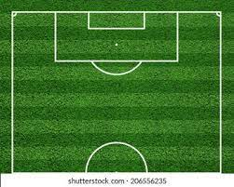

Dribble Pass Warm-Up
Two lines formed at the orange cones
Player dribbles once beyond the blue cone passes to the player at the next orange cone
Skills the can be practiced / observed in this simple warmup
  Dribbling – Using different parts of your foot, changing directions, changing speeds
  Scanning – Awareness of where they are in relations to the cones
  Using non dominant foot – cones set up below for right foot, can be reversed for left foot
Black solid line represents the movement of the ball being dribbled by the player
Black dotted line represents the ball being passed
Blue dash represents the player movement
*

Slide 3
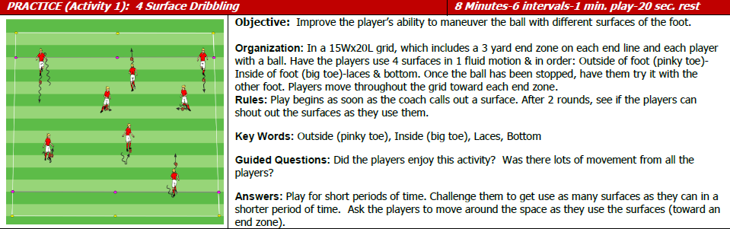
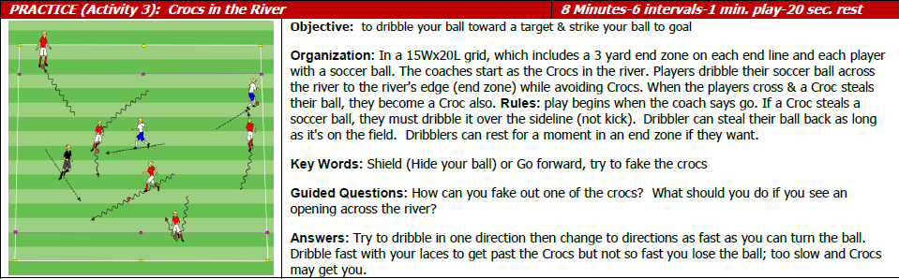
Week 1
Notes:
The focus of the 1st practice will be dribbling. The warm up, the two activities, and the scrimmage should see a linear progression
In the Dribble Cross warm up kids will be free to dribble in whatever way comes natural. Coaches should note how the kids are dribbling and what surfaces of the foot they are using.
Activity 1 will challenge the kids to use 4 different surfaces of the foot. They will be traveling from end zone to end zone, encourage technique over speed. In this activity the kids are playing with no opposition so are free to go across the field freely. This should allow them to learn which surfaces allow them to go faster and which give them the most control
Activity 2 is very similar to activity one with the change that the coaches now provide opposition as the “Crocs” who can steal the ball. This will create a situation that will allow players to use different parts of the foot to change speeds in order to avoid or evade the Crocs – this is step 1 to finding the balance between speed and control. Focus on identifying openings either between the coaches or between the coaches and the sidelines.
Scrimmages will be the time for coaches to evaluate ‘progression’ from how the kids were dribbling in the opening activity. Look for specific examples of players using different surfaces and changing speeds to avoid other players or trying to find openings.
Post Practice Reflection Questions:
Was there a progression from how they were dribbling in the opening drill to how they were performing towards the end of practice?
Did the key words and guided questions translate to the kids performing on the field?
Was there an understanding from the kids on the activities?

Slide 4
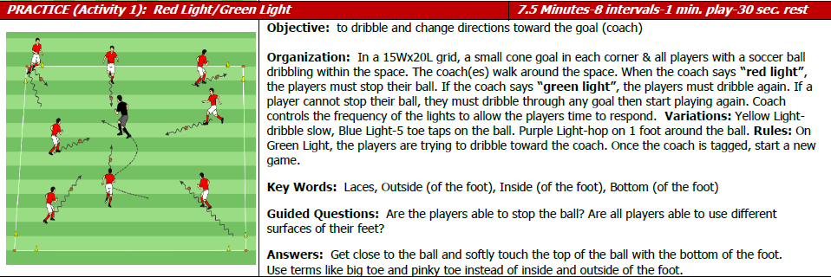
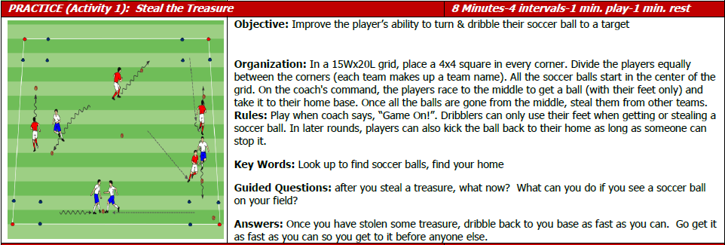
Week 2
Notes:
The focus of week 2 will be taking in information and adapting to what they are doing on the field. We will be continuing the progression from the previous practice’s focus on dribbling by adding verbal cues from coaches / looking around at other players to influence players to use different surfaces of the foot and change speeds.
Dribble Cross Warm Up – coaches should focus on the key concepts from the all of the previous practices:
- Practice 1 - Are they using different surfaces, are they changing speeds, is there more speed / more control?
Activity 1 - This will have players taking verbal cues from the coach and will need the players to mix the different surfaces. This initial activity will again be without opposition and while the players will need to be conscious of where the other players are on the field to avoid them, the focus should be on the verbal cues and quickly transitioning from one surface of the foot to another when cued.
Activity 2 – This will require more decision making and will provide the first real opposition as there will be other players trying to steal the ball after the initial collection of the balls. As a result of that players must pick up their heads to SCAN the field and find both the home base and other balls that can be stolen. Encouraging players to steal the ball from opponents and reinforcing keeping the ball close to their feet to avoid losing the ball are good reminders, the focus should be on picking their heads up and scanning the field to get information.
Scrimmage – Look for and encourage players keeping their heads up when they have the ball (SCAN). The hope is that this will be the beginnings of taking in information and then applying the different dribbling techniques in the game like situation of a scrimmage. At this level focus should be on taking in information and the early concepts of communication, few will be able to give information (i.e. “man on”, “take your space”).

Slide 5
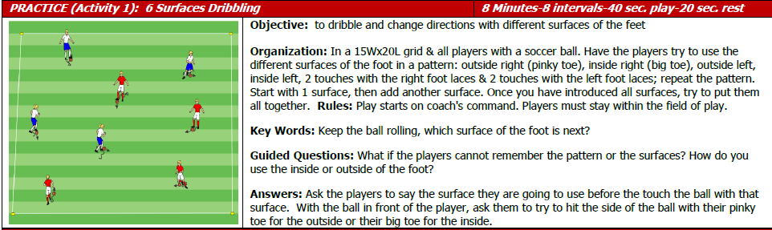
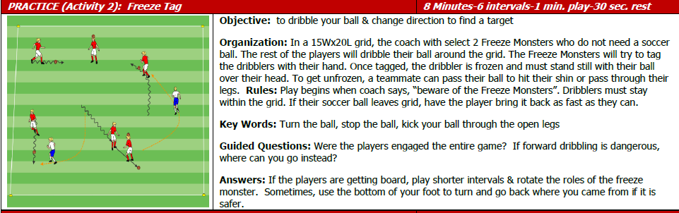
Week 3
Notes:
The focus of week 3 will be using more than just their dominant foot. We will be continuing the progression from the previous practice’s focus of dribbling / communication and using these concepts to have players get outside of their natural habit of using their dominant foot.
Dribble Cross Warm Up – coaches should focus on the key concepts from the previous practices:
- Practice 1 - Are they using different surfaces, are they changing speeds, is there more speed / more control?
- Practice 2 - Are they starting to pick their heads up to take in information (where is the cone)?
Activity 1 - Similar to week 1’s Activity this will focus the kids on using different surfaces of the foot but we will introduce using the non dominant foot in this drill and will also push for sequential touches. We are eliminating the bottom of the foot so there should be constant movement and no stopping.
Activity 2 – This activity should focus on the ability to change direction while dribbling. Encourage players to use different parts of the foot to more rapidly change direction to avoid getting frozen. This should start to give the kids an idea of how to dribble to create separation from opponents.
Scrimmage – Look for players touches with player’s non dominant feet. Note the differences (if any) of the players dribbling in open space vs when they encounter opposition.

Slide 6
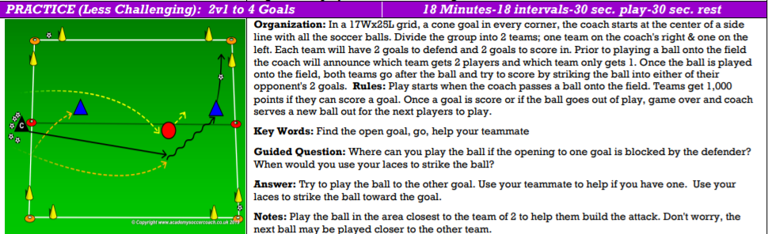
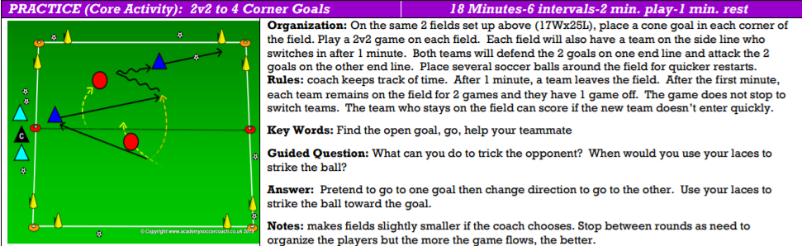
Notes:
The focus of week 4 will start to introduce the concepts of defense while we continue to work on the offensive concepts that we focused on for weeks 1-3. While this is still considered an offensive minded practice, there is heavy opposition so we can start to coach the players on defense. Starting from this session the coaching points below will be split into offense (blue) and defense (red). If there are two coaches or a coach and a mentor it may be best to have one coach the offense and one the defense.
Dribble Cross Warm Up – coaches should focus on the key concepts from the previous practices:
- Practice 1 - Are they using different surfaces, are they changing speeds, is there more speed / more control?
- Practice 2 - Are they starting to pick their heads up to take in information (where is the cone)?
- Practice 3 – ask the players to dribble with their non dominant foot a few times through the line
Activity 1
Offense – In this activity encourage all of the previous concepts – dribbling, taking in information, using both feet so coaches should encourage these. As there is a number advantage passing may also be an option. This will be the first step toward making decisions (pass or shoot, dribble fast or slow, left or right, etc.) – young players aren’t going to make good decisions right away but just stress taking in information (head up) is key.
Defense - For the lone defensive player they will need to work to prevent an immediate threat when the ball is played by applying pressure to the player with the ball. They have a lot to defend as the player with the ball has three options (2 goals and a pass) so positioning and quickly applying PRESSURE to close down options should be encouraged.
Activity 2
Offense – This is going to be pretty similar to activity 1 for the player with the ball. Blue player without the ball should be working to get into position to help – encourage movement without the ball, taking in information to best position yourself.
Defense – The player closest to the ball should apply the pressure while the goal of the other red defender should be to prevent a pass (COVER). The secondary responsibility should be to pressure IF the primary defender gets beaten off the dribble. If a pass is completed the red defensive players need to shift their responsibilities.
Scrimmage – Focus on the defensive side, look for players applying pressure and for secondary defenders being alert and positioning themselves well. Since this is the first session where we are focusing on defense, make sure that we are applauding defensive achievements more than we are applauding goals.

Slide 7
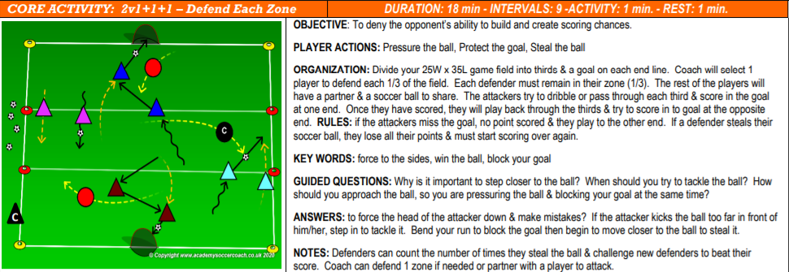
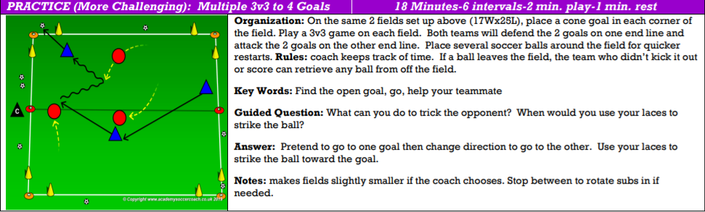
Notes:
Week 5 is going to continue to focus on defense. In the previous week we introduced the concepts of PRESSURE and COVER – this week we will start to very slowly introduce the third component of BALANCE. The coach/mentor assigned to offense should continue to focus on the concept from the previous weeks. There is a tendency for players without the ball to tune out – there should be a focus on trying to get keep those players engaged.
Dribble Cross Warm Up – coaches should focus on the key concepts from the previous practices:
- Practice 1 - Are they using different surfaces, are they changing speeds, is there more speed / more control?
- Practice 2 - Are they starting to pick their heads up to take in information (where is the cone)?
- Practice 3 – ask the players to dribble with their non dominant foot a few times through the line
-
Activity 1 (going to change from multiple pairs to one individual pair of attackers
Offense - In a 2v1 scenario players should be able to read the game (SCAN) and progress from zone to zone. It may be done by dribbling or passing.
Defense – If you are in the zone where the ball is you are always the PRESSURE. The player in the next zone is the COVER, the player in the zone after that is the BALANCE. The PRESSURE player should attack the ball but focus the coaching on the COVER and BALANCE making sure they stay engaged and position themselves well to defend. The COVER should be positioning themselves to be ready if the ball moves to the player off the ball but also to be an option if the PRESSURE gets beat off the dribble. BALANCE should be positioned so they can defend either the PRESSURE being beat off the dribble or providing cover should blue progress to zone 2.
Activity 2 – This will even the numbers and remove the zones but the coaching focus should be exactly the same as Activity 1. Playing to 4 corner goals will again give the player with the ball a lot of options.
Scrimmage – If playing 3v3 use a triangle formation where the player at the back is COVER, PRESSURE/COVER between the two forward players is determined by which side of the field the ball is on. In a 4v4 play a diamond formation which naturally sets up a PRESSURE at the point (offense), two COVER spots (midfield) and a BALANCE (defender). When they advance the keeper can also be a COVER but for now we are going to focus on the field players.

