Slide 1
Closing Fields
Sports Manager

Slide 2
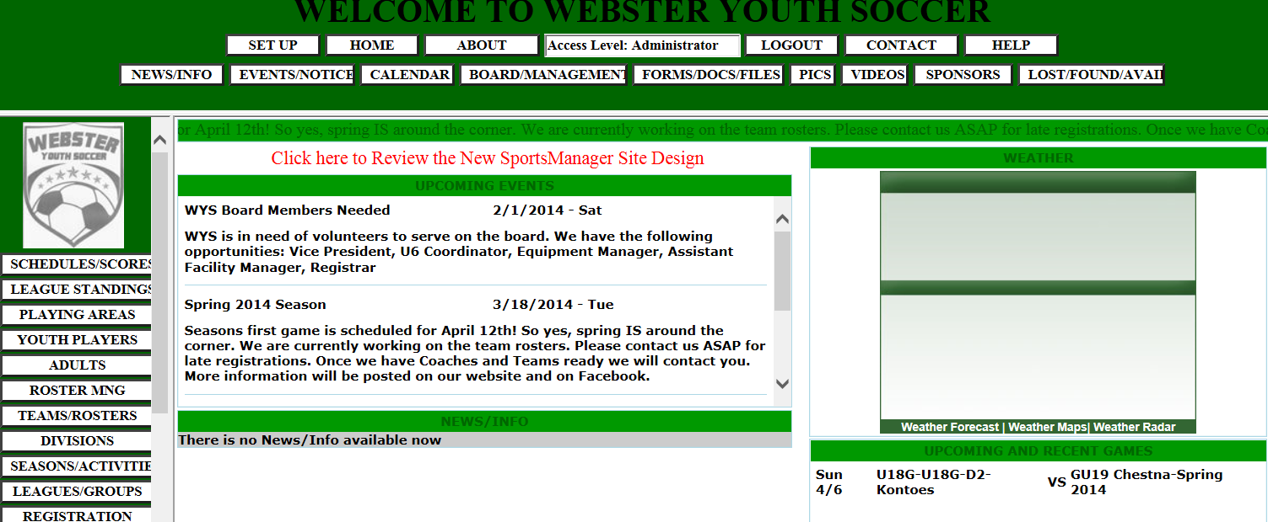
Closing Fields
Town administrators in Sports Manager have the rights to close a field.
First step is to login to your account and click on Playing Areas in the left column

Slide 3
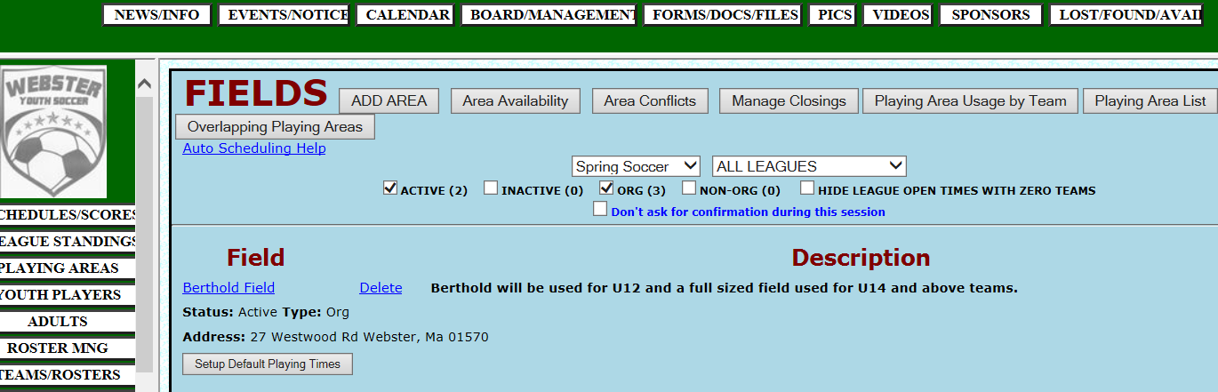
Closing Fields
You should now have a screen that looks like this. The next step is to
Click on Manage Closings Tab.

Slide 4
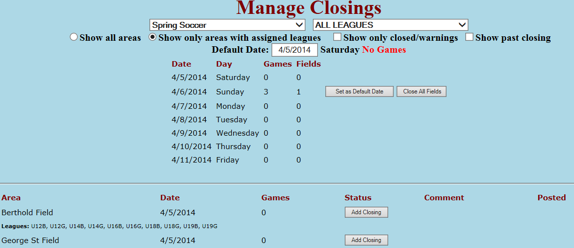
Closing Fields
On this page, only if needed, change the date. This is not required if the field closer is on the page. For this sample I’m going to click on Set as Default Date. This will change the bottom of the screen

Slide 5
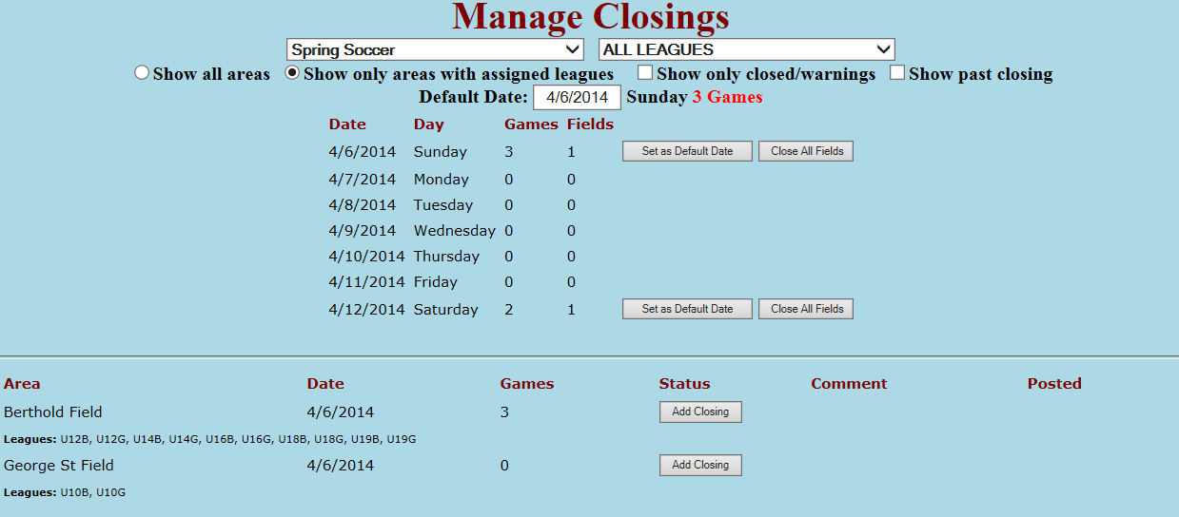
Closing Fields
To close a field, either all the games or only the last one because of rain, click on Add Closing and another screen will open listing the games on this field.

Slide 6
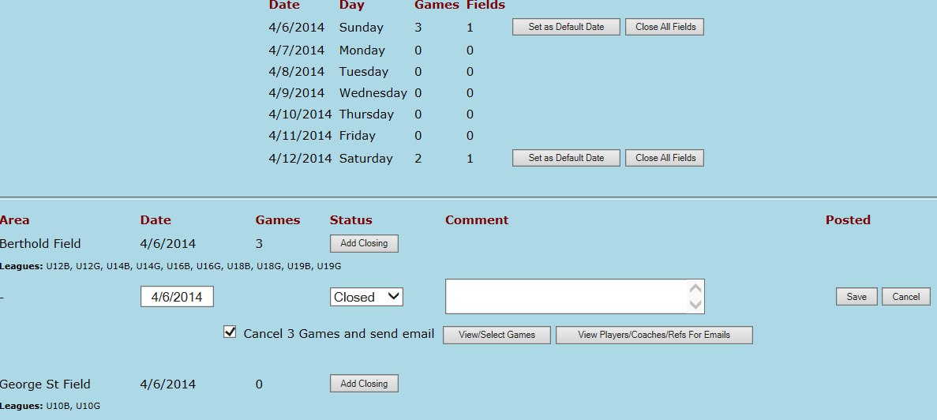
Closing Fields
I f you are closing the field for the day click on Save.
If the rain starts later and you don’t have to cancel the whole day, Click the check mark off then click on View Select Games
Un Check

Slide 7
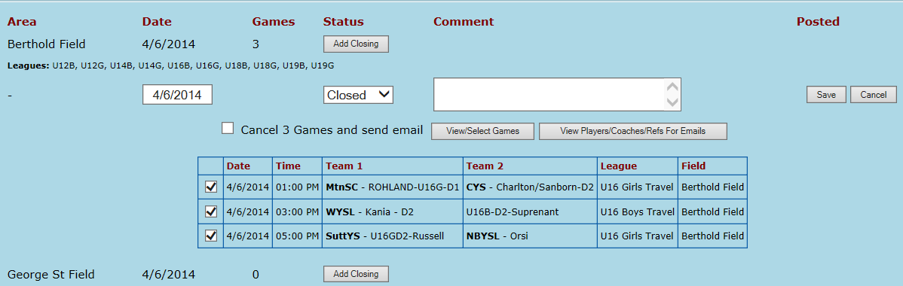
Closing Fields
This new page list all the games on the field that you are about to close.
Example, The rain start early morning and the field was not closed within the 2 hour cutoff. You would un-check the 1’oclock game and leave the 3 and 5 O’clock game checked. This is shown on the next slide

Slide 8
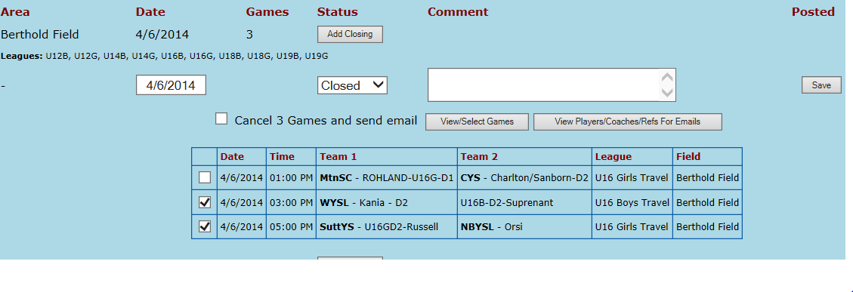
Closing Fields
At this point you would now click on Save. This will send an e-mail to the coaches, refs and parents.

Slide 9
Closing Fields

