Slide 1
Week 1
U8 United Soccer of Auburn
Topic:
Movement to Goal

Slide 2
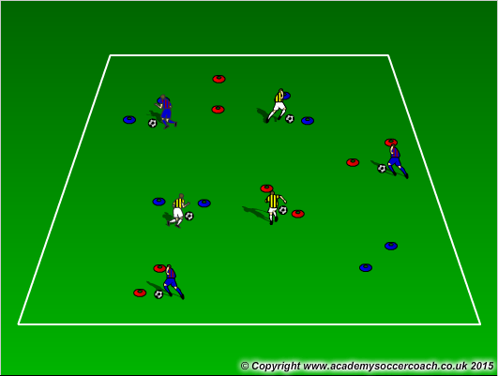
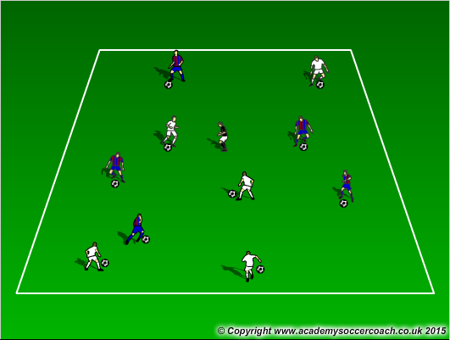
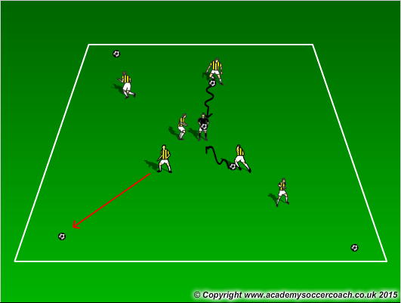
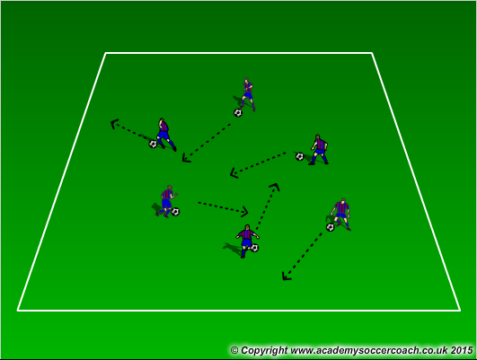
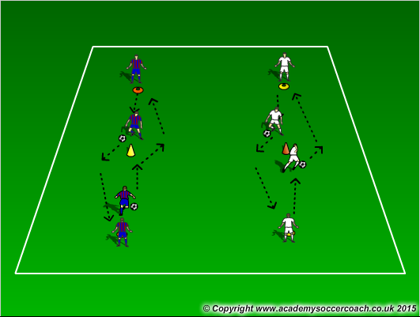
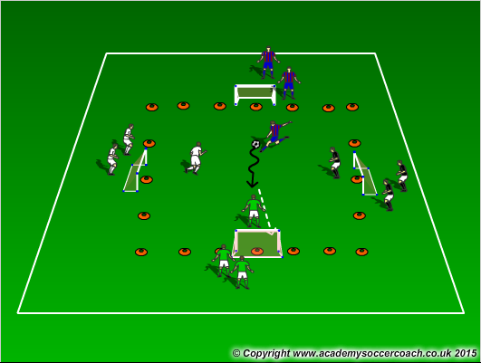
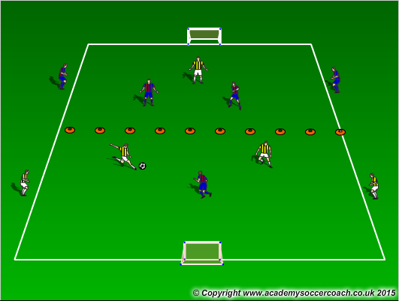
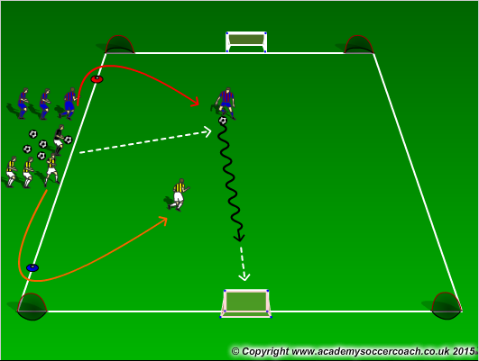
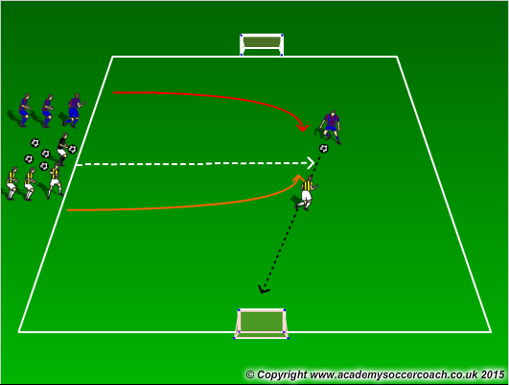
Warm Up
8 mins
Activity 1
10 mins
Activity 2
12 mins
Scrimmage 4v4
25-30 mins

Slide 3
Warm Up
  Gates Dribbling – pair up cones for players to dribble through cone gates. See how many gates they can get through in a certain amount of time. Encourage to pick head and use all surfaces of the foot
  Freeze Tag – All players have a ball except “The Freezer”. Player do not want to get frozen by the Freezer. If tagged by the Freezer, you are frozen with ball over head and legs spread. Players get unfrozen when another players passes the ball between their legs. Play till all have been frozen.
  Fetch – Players bring their ball to coach and the coach rolls, or tosses the ball away. Players are allowed to bring the ball back only using a certain part of the foot the coach would like them to use (example: inside the feet)
Activity 1
  Moves in a box – in a 15x15 box, have the players dribble around. On coach’s command they should perform a move the coach would like. (example: On 1, kids must put foot on ball to stop it, then dribble forward after aka stop n’ go)
  Dribbling to the cone – with cones 12 yards apart, players on opposite ends of the cones must dribble to the cone in the middle and perform a move (example: dribble to the cone and take a touch with the outside of the right foot to get outside the cone)
  Survivor – In a 20x20 grid, this is a 4 goal game where a coach plays a ball in, shouts out a number 1 or 2, and players will play against each other trying to score in any of the other 3 goals. Team to score 5 goals first wins.
Activity 2
  2v1 in attacking half – In a 20x20 grid, cut the field in half. Players will play 2v1 in the attacking half to 1 goal. If defender wins the ball he will look to play to his teammates on the other side
  Numbers game to 3 goals – In a 20x20 grid, players will line up next to the coach. The coach will call out a number (1,2,3), the first players in those lines come out and play to goal. When done, they go to the back of the line
  Steal the bacon - In a 20x20 grid, players will line up next to the coach. The coach will call out a number that the players have already been assigned, and play against the other team. When done, they go back in line
Scrimmage
  4v4

Slide 4
Visual Cues
Make sure they are touching the ball using their laces (instep), sol, inside, and outside.
Encourage to pick their heads up to know where they are going

