Slide 1
Week 1
U10 United Soccer of Auburn
Topic:
Changing Directions

Slide 2
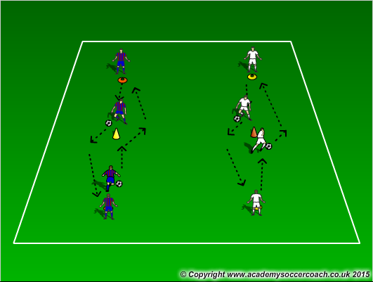
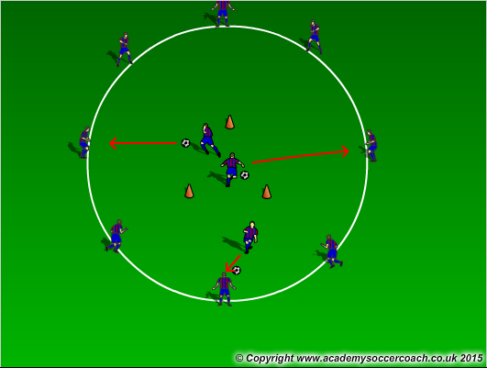
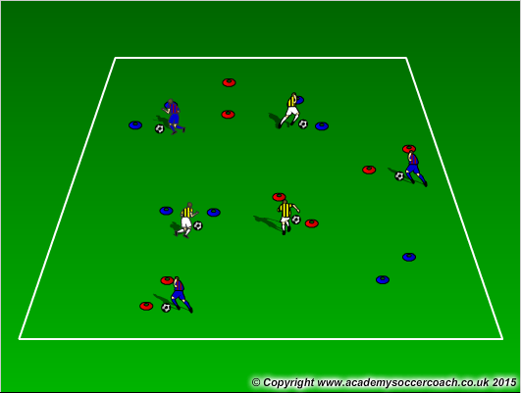
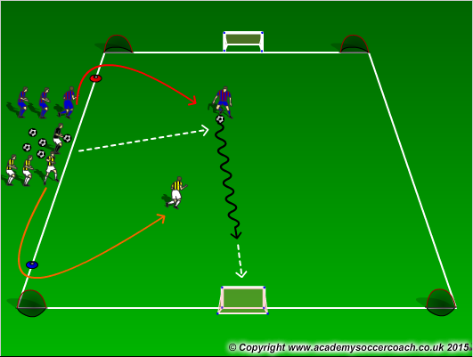
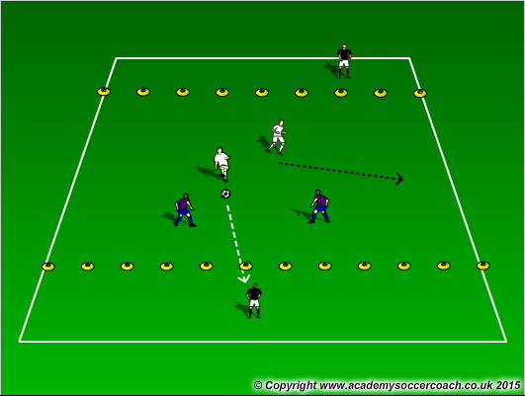
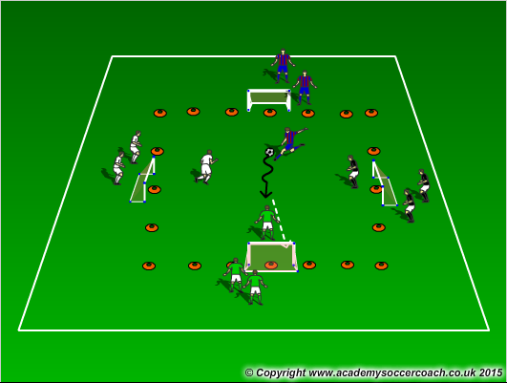
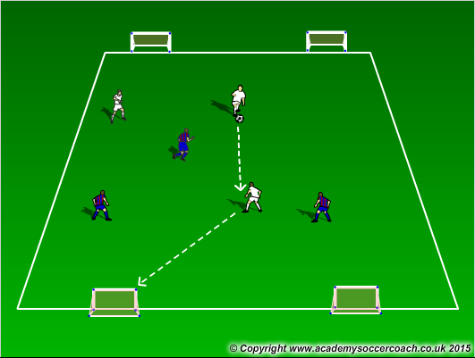
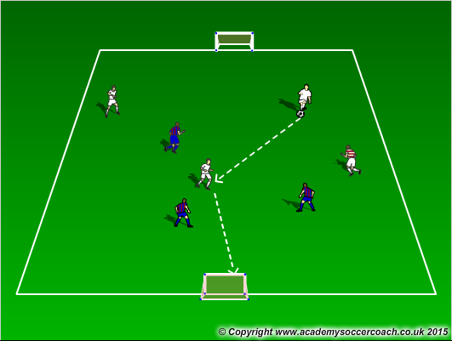
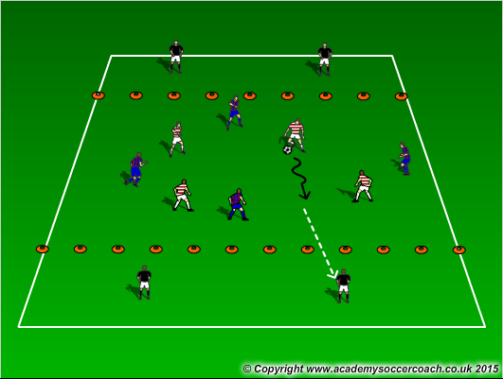
Warm Up
8 mins
Activity 1
10 mins
Activity 2
12 mins
Scrimmage 6v6
25-30 mins

Slide 3
Warm Up
  Dribbling to the cone – with cones 12 yards apart, players on opposite ends of the cones must dribble to the cone in the middle and perform a move (example: dribble to the cone and take a touch with the outside of the right foot to get outside the cone)
  Dutch Circle – Players create a circle with 3 cones in the midle that make a triangle. Players must dribble through the triangle and then dribble to a player on the outside of the circle. That player will then take over. You can ad passing into the warmup. Also players in the middle can go out or stay in if the circle players pass them the ball back.
  Gates Dribbling – pair up cones for players to dribble through cone gates. See how many gates they can get through in a certain amount of time. Encourage to pick head and use all surfaces of the foot
Activity 1
  Numbers game with gates to 3 goals – In a 15x10 grid, players will line up next to the coach. The coach will call out a number (1,2), the first player or first two players in those lines must get around the cones then are allowed to come out and play to goal. When done, they go to the back of the line
  2v2 to end zones – in a 20x15 grid, players play 2v2 in the middle with a 3 yard end zone with target players in it. Players get a point by finding the target players. Target players are able to move in the end zone. Target players will always play the opposite team that is passing to them.
  Survivor – In a 20x20 grid, this is a 4 goal game where a coach plays a ball in, shouts out a number 1 or 2, and players will play against each other trying to score in any of the other 3 goals. Team to score 5 goals first wins.
Activity 2
  3v3 to 2 goals – 3v3 in a 25x20 grid scoring on two goals
  3v3+1 – 3v3 with 1 neutral player who plays on the team with the ball. The grid is in a 25x20 grid. Adding goalkeepers to defend goals can also be used
  4v4 to endzones – In a 30x20 with 2-3 yard end zones on each end. Players play 4v4 in the middle looking to find a target player in the end zone. When a pass or shot is made to that target player, that team gets a point. Make sure it is directional.
Scrimmage
  6v6

Slide 4
Coaching Points
Technique on dribbling the ball and using all surfaces of the foot.
Awareness of when and where to change direction
Changing of direction as well as speed to beat the defender

