Slide 1
Week 2
U8 United Soccer of Auburn
Topic:
Changing Direction

Slide 2
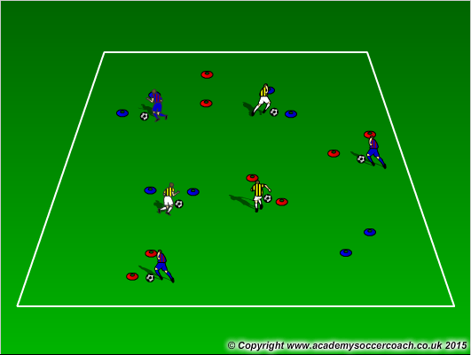
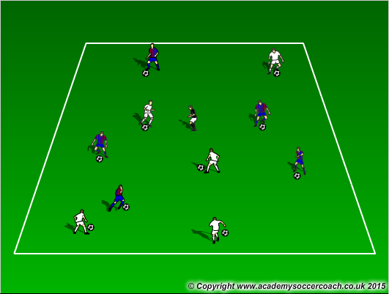
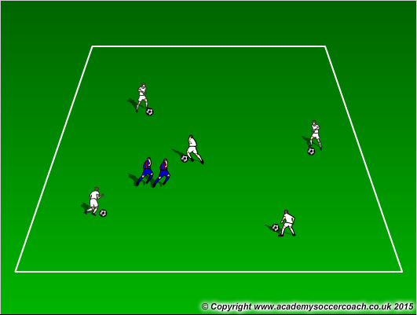
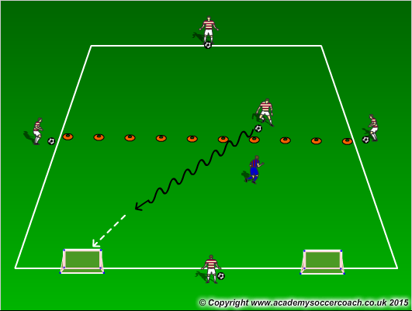
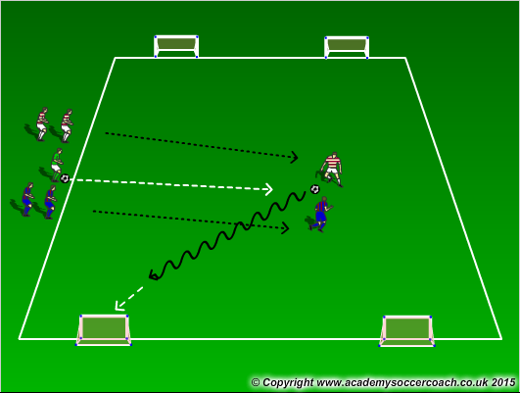
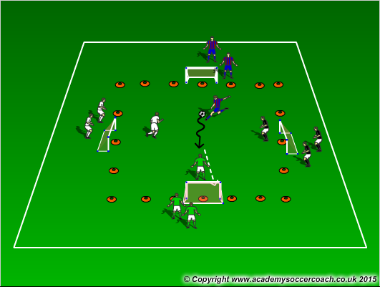
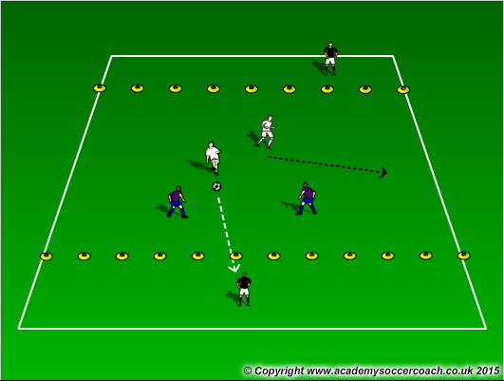
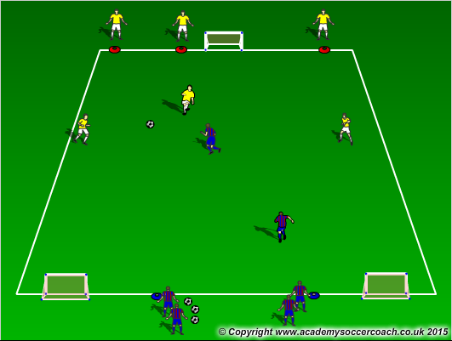
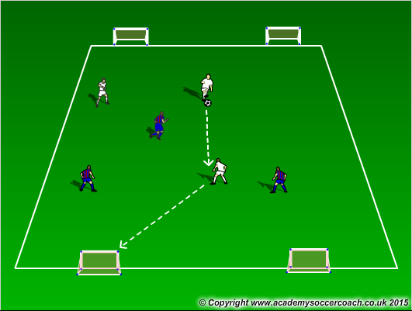
Warm Up
8 mins
Activity 1
10 mins
Activity 2
12 mins
Scrimmage 4v4
25-30 mins

Slide 3
Warm Up (in the warm up, the coach should show the players a couple moves for the day. They should encourage the players to use the sol of their foot (bottom), inside of the foot, outside of the foot, and laces in dribbling and also try the moves the coach has shown them. Keep the ball close and not kick it but push it in the direction they want to go).
  Gates Dribbling – pair up cones for players to dribble through cone gates. See how many gates they can get through in a certain amount of time. Encourage to pick head and use all surfaces of the foot.
  Freeze Tag – All players have a ball except “The Freezer”. Player do not want to get frozen by the Freezer. If tagged by the Freezer, you are frozen with ball over head and legs spread. Players get unfrozen when another players passes the ball between their legs. Play till all have been frozen. If players do a move the coach ahs showed them, then they freeze the freezer for 3 seconds.
  Blobb – Similar to freeze tag but when the Blobb tags or gets another players ball, then the player combines with the Blobb by holding hands. Continue until all players with a ball are eliminated. If players do a move the coach has showed them, then the blobb is stuck for 3 seconds
Activity 1
  1v1 half field to 2 goals – in a 15x15 box cut in half, an attacker is trying to score on the 2 goals in his attacking half. The attacking player can only receive a ball in his defensive half. The defender can play high or low pressure on the attacker. Encourage the player to fake the defender out by going towards 1 goal then speed dribble to the other goal. When the defender gets the ball or the ball is dead (out of play), the attacker will find another player on the outside to get a ball from. Repeat until he has received a ball from all players on the outside.
  1v1 to 2 cones – in a 15x15 yd grid, players line up on each side of the coach and play 1v1 in the grid. Encourage players to attack the defender and fake them out by going to one goal and then the other. If defender wins it continue until the ball is dead (out of play)
  Survivor – In a 20x20 grid, this is a 4 goal game where a coach plays a ball in, shouts out a number 1 or 2, and players will play against each other trying to score in any of the other 3 goals. Team to score 5 goals first wins.
Activity 2
  2v2 (3v3) to target players – In a 20x20 grid, have a 3 yd end zone on each end of the field. Players inside the area will play 2v2 and score by playing the ball to their target in the end zone. Targets are allowed to move in the end zone to receive a ball. Encourage the players in the middle to change directions to create better opportunities to find target players.
  3v2 to 2 goals – Players play 3v2 to 2 goals. Encourage players to attack the defenders and 2nd attackers (player without the ball) to create different direction runs and stay away from defenders
  3v3 to 2 goals – Players play 3v3 to 2 goals looking to change direction in their attack. If everyone shifts to one side of the field can the quickly change direction and shift the other way
  Scrimmage
    4v4

Slide 4
Visual Cues
Make sure players are getting their head up to see where to dribble and change direction.
Players off the ball, can they make the decision to run into the open area and change their direction to find open area on the field.
Look for players to change their direction and also their pace to get away from defenders to be successful

Slide 5
Links
https://youtu.be/MVZBW_fUe_8?list=PL20D5519E202CBD5F
https://youtu.be/96WT8S9Us4w?list=PL20D5519E202CBD5F
https://youtu.be/mQz3l9Ro2nE
https://youtu.be/bsdtt0r0sEE

