Slide 1
Week 2
U10 United Soccer of Auburn
Topic:
1v1 Attacking

Slide 2
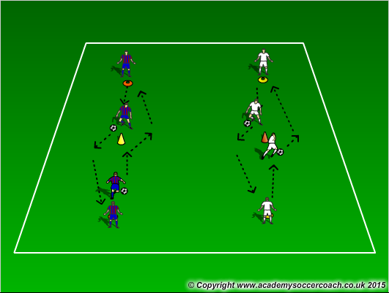
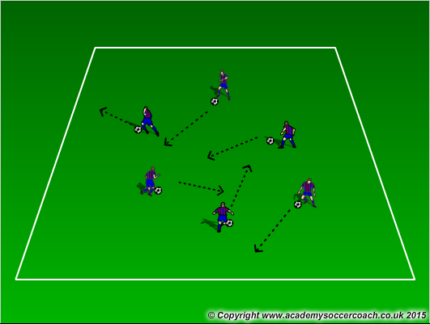
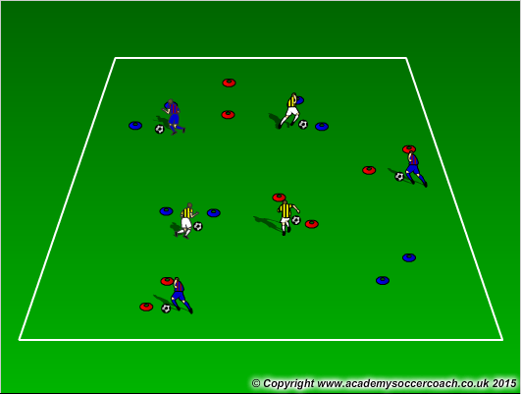
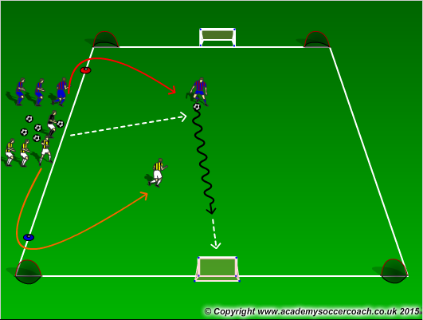
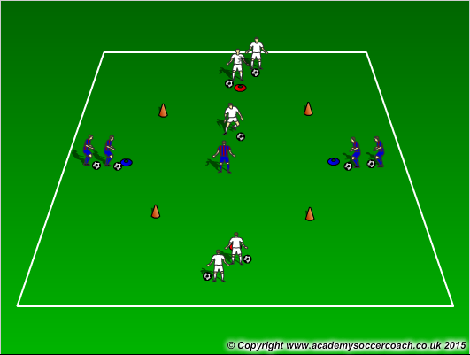
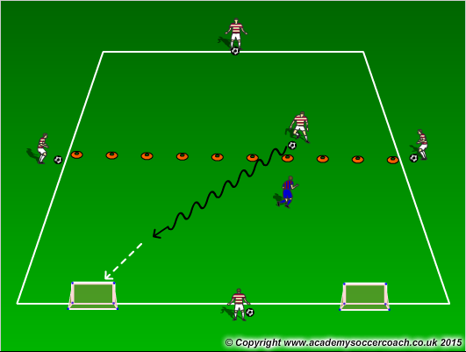
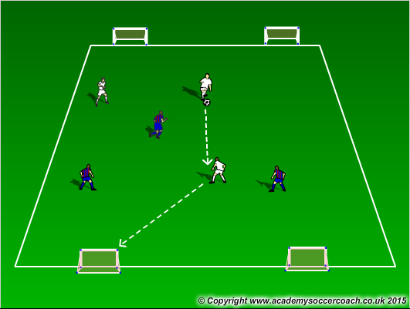
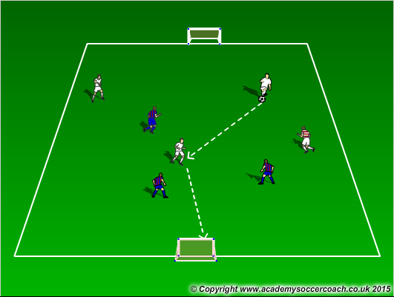
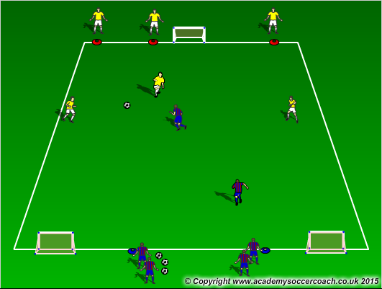
Warm Up
8 mins
Activity 1
10 mins
Activity 2
12 mins
Scrimmage 6v6
25-30 mins

Slide 3
Warm Up
  Dribbling to the cone – with cones 12 yards apart, players on opposite ends of the cones must dribble to the cone in the middle and perform a move (example: dribble to the cone and take a touch with the outside of the right foot to get outside the cone)
  Moves in the grid – Players perform moves that the coach yells out. Since the weekly topic is 1v1 attacking, coaches should try to use attacking moves like scissors, roll-touch, big-toe little-toe, stop n’ go, pull push, step over, etc… Below is a list of links for the move
  Gates Dribbling – pair up cones for players to dribble through cone gates. See how many gates they can get through in a certain amount of time. Encourage to pick head and use all surfaces of the foot. After players have gone through the gates once, have them now do move(s) when entering the gate. Since it is 1v1 attacking use attacking moves moves like scissors, roll-touch, big-toe little-toe, stop n’ go, pull push, step over, etc… Below is a list of links for the move. Make it a competition for first person to get through 10 gates doing the move wins.
Activity 1
  Numbers game with gates to 3 goals – In a 15x10 grid, players will line up next to the coach. The coach will call out a player from each team (1 player) the first players must get around the cones then are allowed to come out and play to goal. When done, they go to the back of the line. Look for players attack the defender, use their moves, and choose what is the best goal to attack and how they will get there.
  In a 10x10 grid, players will play a 1v1 transition game. Players on the same team are lined up across from each other. If the white team has the ball, the blue team is defending them. The white team is looking to cross the line opposite them. If this happens, the white player on the opposite side will attack the blue player and the blue player must try to prevent them from getting over the other white line. Basically, whose ever line the ball crosses, the player of that color in the middle of the grid is out, the opposite player stays on, and the person that was on that line comes out and attacks.
  In a 14x10 grid cut in half, players will play 1v1 in the grid. There will be 4 players on the outside on each side with a ball. The attacker will receive a ball from an outside player and go 1v1 against the defender. The defender is allowed to play high or low pressure. The attacker can only receive a pass or ball when he is on the half where the nets are NOT. That player can only score in the half with the nets. When a ball is stolen or dead (gone out of play), then the attacker must get a ball from an outside player and continue this activity until all 4 players have passed him a ball.
Activity 2
  3v3 to 2 goals – 3v3 in a 25x20 grid scoring on two goals
  3v3+1 – 3v3 with 1 neutral player who plays on the team with the ball. The grid is in a 25x20 grid. Adding goalkeepers to defend goals can also be used
  3v2 to 2 goals – in a 30x20 grid, players will play 3v2 to 2 goals. In this have no restrictions and let them play until the ball is dead. Encourage players to go at defenders in 1v1 situations, look to make correct decisions, and score
Scrimmage
  6v6

Slide 4
Coaching Points
1v1 attacking: look for players to go at defenders
Encourage the player on the ball to use attacking moves to go at defenders
Changing of direction as well as speed to beat the defender(s)

Slide 5
Links
https://youtu.be/6dcW1VhK3Yw
https://youtu.be/Zuu7mDzZA2g?list=LLLSdq6bB5cfOR4cSgl79Trg
https://youtu.be/7UVm3kAfSdM?list=LLLSdq6bB5cfOR4cSgl79Trg
https://youtu.be/biZKX2zE0dQ?list=LLLSdq6bB5cfOR4cSgl79Trg
https://youtu.be/s5FWwJIBmVE
  These are some 1v1 moves coaches can show players to help fake out a defender and improve their technical skills and body coordination.

