Slide 1
Week 2
U12 United Soccer of Auburn
Topic:
Passing & Receiving

Slide 2
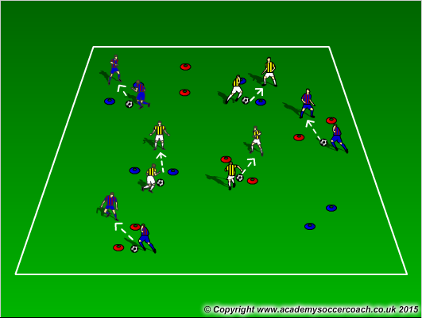
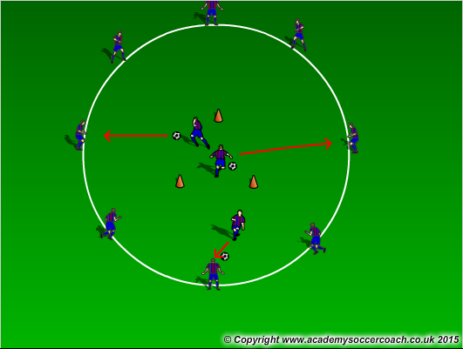
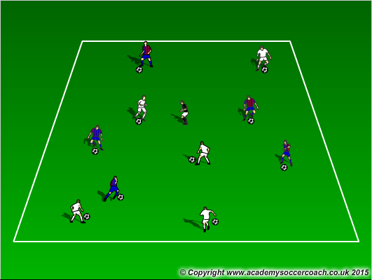
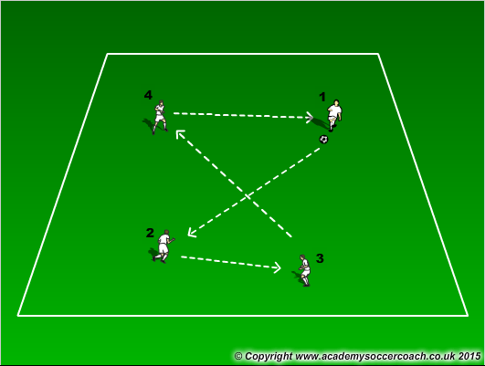
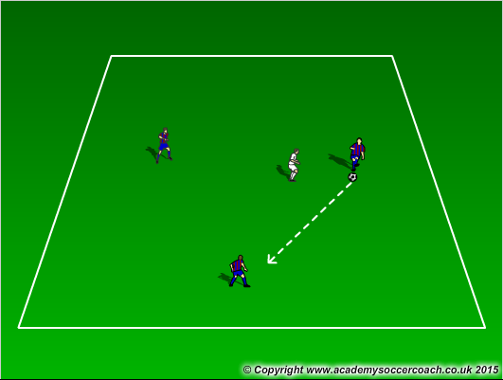
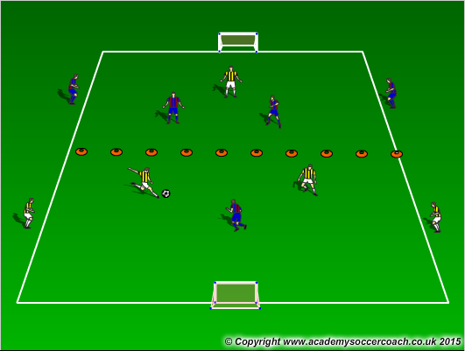
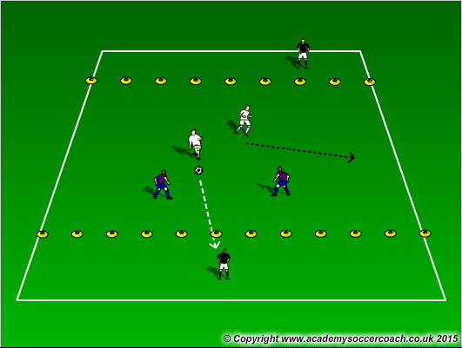
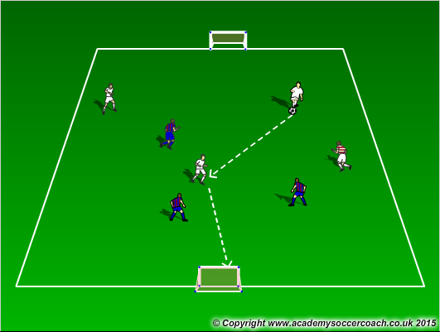
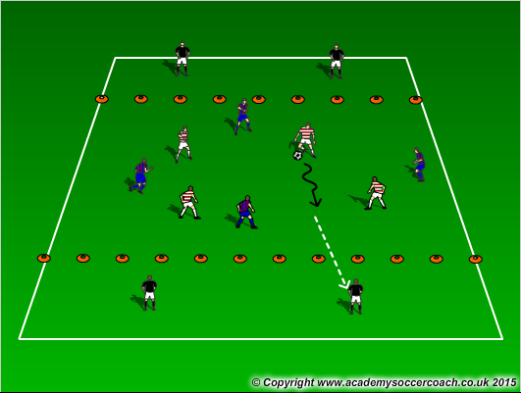
Warm Up
8 mins
Activity 1
10 mins
Activity 2
12 mins
Scrimmage 6v6
25-30 mins

Slide 3
Warm Up
  Gates Dribbling – pair up cones for players to dribble through cone gates. See how many gates they can get through in a certain amount of time. Encourage to pick head and use all surfaces of the foot
  Dutch Circle – Players create a circle with 3 cones in the midle that make a triangle. Players must dribble through the triangle and then pass to a player on the outside of the circle. That player will then take over. Also players in the middle can go out or stay-in if the circle players pass them the ball back.
  Freeze Tag – Players will play freeze tag. A Freezer (without the ball) must try to tag the players with a ball. If a player is frozen they must open their legs and to get unfrozen a player must pass the ball through their legs.
Activity 1
  Number Passing – Assign players numbers. Players must pass to the numbers in ascending order. You also can do descending, odds, evens, etc.
  3v1 keep away – players play a small sided game of 3v1 looking to keep the ball away from the defender. Encourage players to pick their heads up and look where they want to go with the ball.
  In a 20x15 yd field cut in half, players will play 2v1 in their attacking half. Players can not leave their half and must look to pass to a teammate and score. If you have more players, extra players can be bumpers on the outside of the field.
Activity 2
  2v2 to targets – In a 24x16 yard grid with a 3 yard end zone on each end, players will be 2v2 in the middle looking to score points by finding their target. If the target receives the ball, he will then play it to the opposite team. If you have added players, put them as side bumpers that get 1 or 2 touches.
  3v3+1 – 3v3 with 1 neutral player who plays on the team with the ball. The grid is in a 25x20 grid. Adding goalkeepers to defend goals can also be used
  4v4 to endzones – In a 30x20 with 2-3 yard end zones on each end. Players play 4v4 in the middle looking to find a target player in the end zone. When a pass or shot is made to that target player, that team gets a point. Make sure it is directional.
Scrimmage
  7v7

Slide 4
Coaching Points
Technique in passing. Look to have the plant foot’s toe facing the receiver (there may be some deception)
Proper is inside the foot with the heel down and toe up creating a big surface area to strike the ball as well as having a locked ankle
Players should try to identifying their receiver before passing. Try not to send out a blind pass
When receiving the ball, have the heel down and toe up as well and look to cushion the ball’s impact on the foot.
Player receiving should try to get the ball about a yard out from under their feet when receiving.
https://youtu.be/tWmoIbznHac

