Slide 1
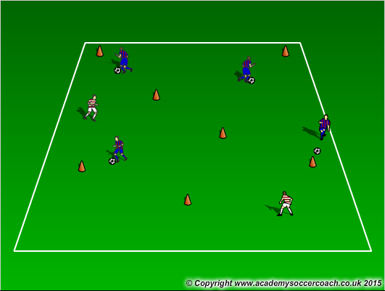
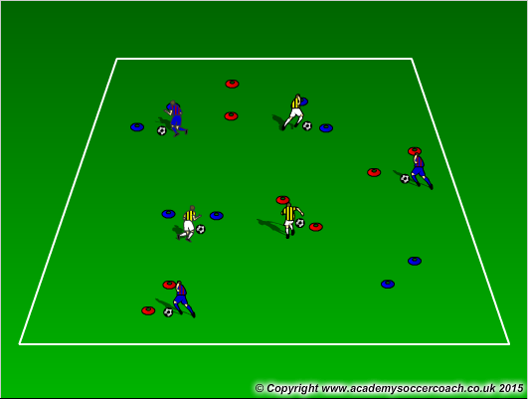
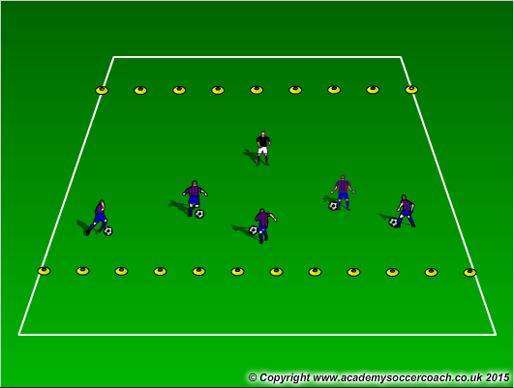
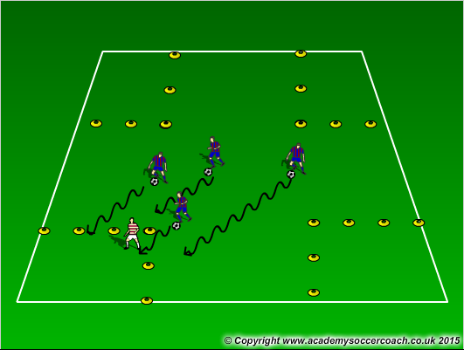
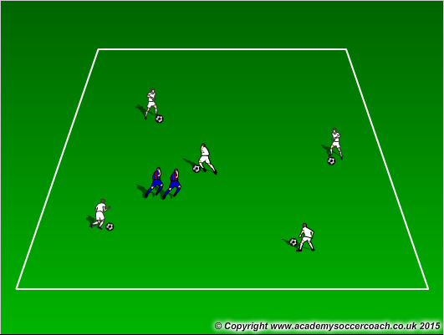
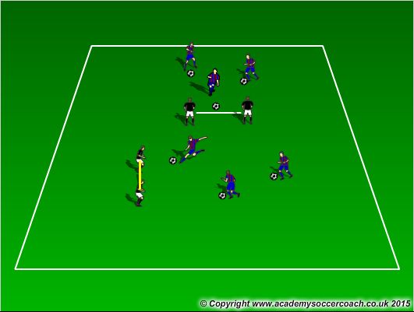
Cops and
Robbers
Gates
Dribbling
Vacation
Land
Red Light
Green Light
Blobb
Moving
Goals

Slide 2
Week 3
Try to get through at least 3-4 games before
scrimmage (last 20-30 minutes)
Cops and Robbers – Assign 1 or 2 players as the cops. The rest of the players are robbers, with a ball. On the call “jail break” the robbers go around the field and try to knock the balls off the cones with their balls on the field. If you have tall cones, those can be used as replacements, and the robbers must knock those over. The cops, without a ball, must keep all the cones from being knocked over or all the balls from being knocked over for a certain amount of time. If all balls or cones are knocked over the robbers win. If all the cones and balls are in their correct spots then the cops win.
Gates Dribbling – Players on a set time limit must dribble through as many gates as possible. Coach can first start off without a ball then move on with a ball. Coach can also add objectives such as players are only allowed to dribble with the laces, or dribble with inside the feet, etc… Another is if a coach has multi colored cones, players are only allow to go through certain colors when coach instructs by color out the color.
Red Light, Green Light – Players start on one end of the field and dribble to the other. The coach will give commands of “Red Light” players should put their foot on the ball. “Green Light” players should dribble. Yellow Light – players speed up. Purple Light – Players dance around the ball, Blue Light – Players hide behind their ball.
Vacation Land – At the four corners of the field, each is designated as an vacation spot (or a place in Auburn). Coach’s create a story and have the players dribble to the desginated area. One square could be Crystal Caves and coach mentions he wants the team to go play mini-golf at Crystal Caves. Players should dribble to that square.
Blobb – In a game of tag, players start with the ball and 2 separate players are Blobbs (players linked up holding hands looking to tag players with the ball). If a player is tagged by the Blobb then the player becomes part of the Blobb. Play until all players with a ball are gone
Moving Goals – 2 coaches use a pinnie to hold to create a goal. Players look to kick the ball through the two coaches. Coaches move around the field and stay stationary for players to shoot. After players have scored or after standing still for 8 seconds, coaches will move around again. Coaches can also use their legs as goals, or the Pugg Goals.

