Slide 1
Week 3
U12 United Soccer of Auburn
Topic:
Combination Play to Goal

Slide 2
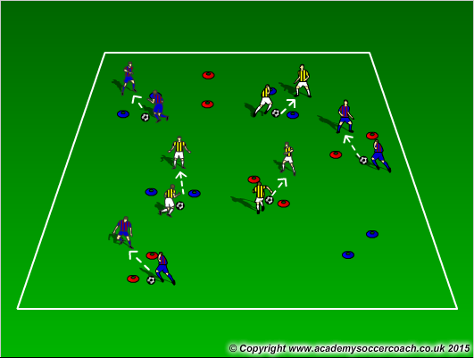
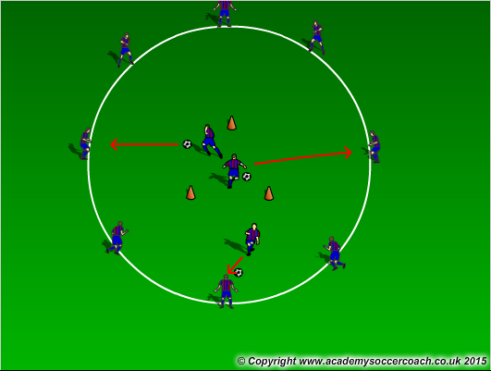
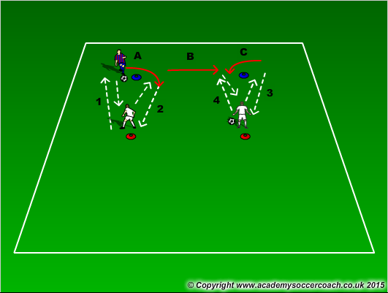
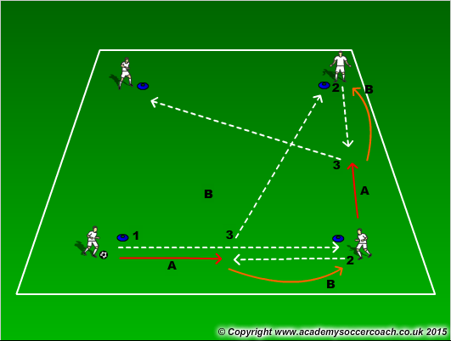
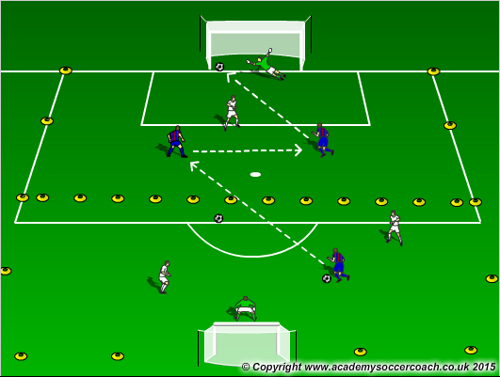
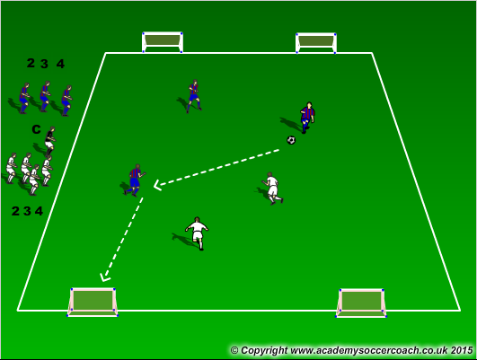
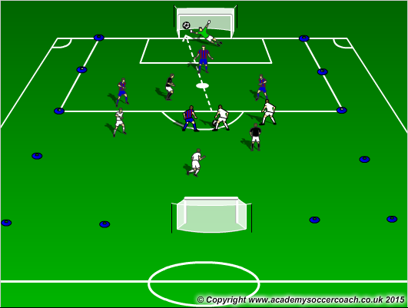
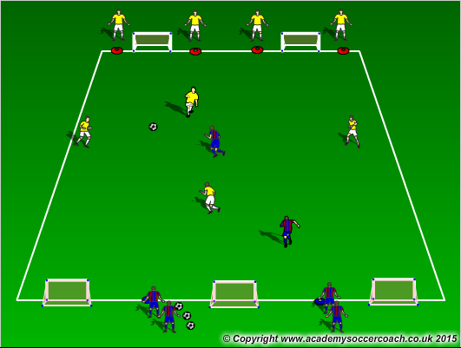
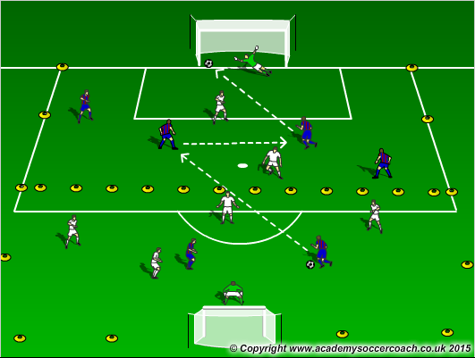
Warm Up
8 mins
Activity 1
10 mins
Activity 2
12 mins
Scrimmage 6v6
25-30 mins

Slide 3
Warm Up
  Gates Passing – In pairs, players go around the field completing passes with their teammate through the gates. Each gate is worth 1 point. Do this in a set amount of time. Have them do multiple rounds with variations (colored cones, must pass it twice through the same cones for it to count). Create combinations that they must do at the gate (double pass, give and go)
  Dutch Circle – Players create a circle with 3 cones in the midle that make a triangle. Players must dribble through the triangle and then pass to a player on the outside of the circle. That player will then take over. Also players in the middle can go out or stay-in if the circle players pass them the ball back.
  Give and go warm up – Ball starts out a the player in White. (1) White passes to Blue. Blue passes to white and (A) moves to the other side of the cone and does the same as 1 (2). Blue player then moves to the far side of the opposite cone and repeats the process going the other way. This will help work on double passes and movement for give and goes. Start of with 2 touches and then challenge them to 1 touch.
Activity 1
  Passing Pattern – Player (1) plays a long ball across and the moves half way between cones (A). (2) ball gets passed back to the first player from player receiving the long pass and (3) a diagonal ball is passed to the next cone. Player 1 would stay at Player 2’s cone and Player 2 would then move halfway down his line (A) to continue the pattern. Look for the technique and accuracy in the passing. Start off two touch. The sequence should go through out the entire box and be continuous.
  2v1 in half – In a grid 30x20. Players will play 2v1 in their half looking to score on goal. Encourage players to combine with their teammate and be creative in their play. Give and goes, overlaps, layoffs, double passes are all combinations and can you try to get the players going to goal.
  Odd Number game to 2 goals – Players will play to 2 goals. Coach will shout out 2 numbers (1 for each team). Look to play in odd number situations (2v1, 3v1, 3v2…)
Activity 2
  4v4+2 – 4v4 with 2 neutral player who plays on the team with the ball. The grid is in a 40x28 grid. Adding goalkeepers to defend goals can also be used. Look for players to combine and create combination play going to goal.
  3v2 to 3 goals – In a 30x20 yd grid, Play 3v2 to 3 goals with attacking players looking to score and get behind the defense. Encourage them to combine with other players and create scoring opportunities through that. After a certain amount of time have the teams switch sides.
  In a 40x28 grid cut in half, players will play 4v2 in each half. Players should look to combine and go to goal, creating opportunities through combination play. Encourage them and help them get the give goes, overlaps, double passes, and lay offs when they are available.
Scrimmage
  7v7

Slide 4
Coaching Videos
https://youtu.be/SiQUZU6FNcE
http://www.mysoccer.pro/youth-soccer-coaching/the-double-pass
http://www.soccerpilot.com/tactic/articles/soccer-training-tactics-overlapping.html
https://youtu.be/2Jr5ygIatkI
Last one is a good give and go exercise (simple)

