Slide 1
Week 5
U10 United Soccer of Auburn
Topic:
Combination Play to Goal

Slide 2
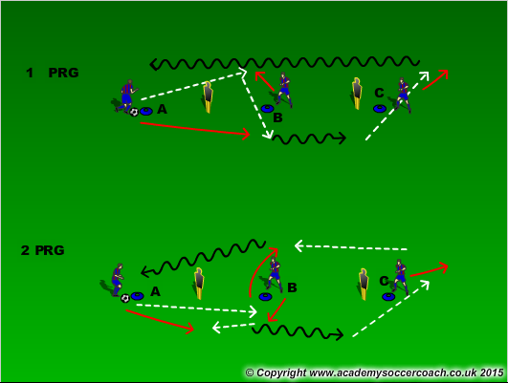
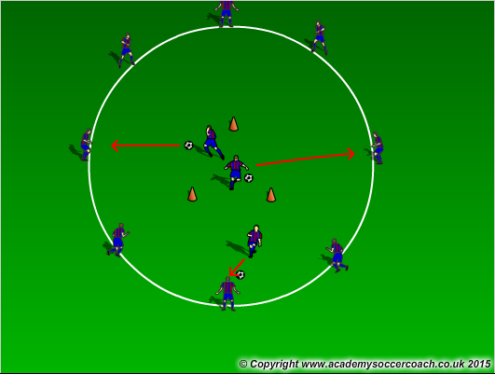
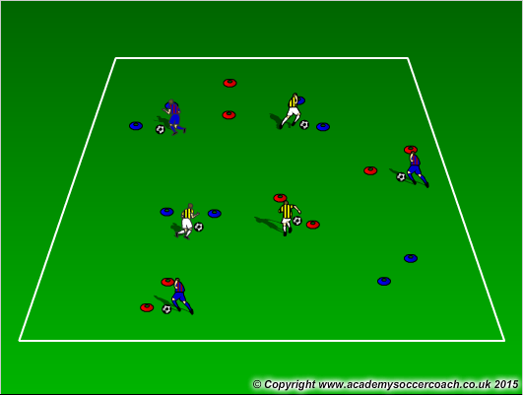
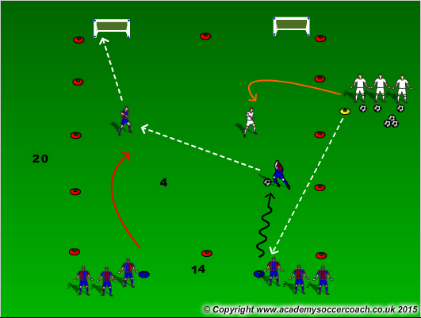
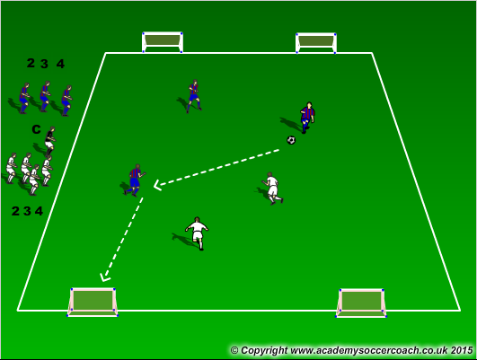
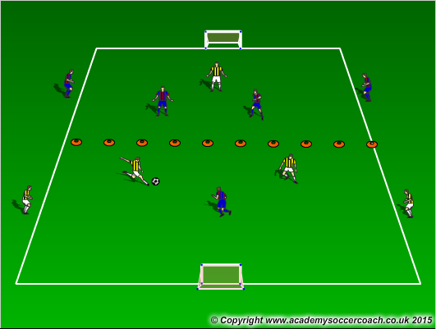
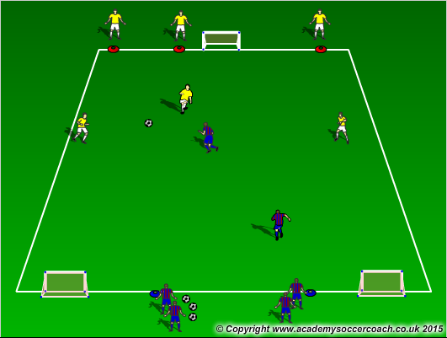
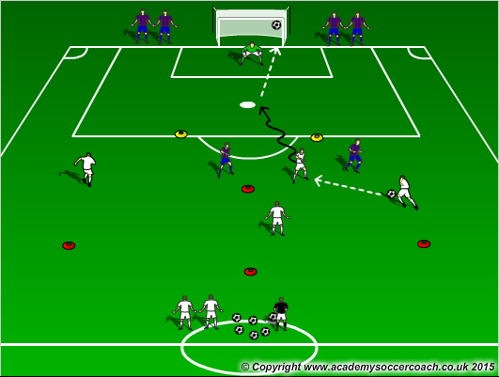
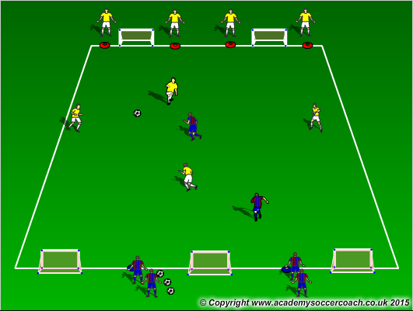
Warm Up
8 mins
Activity 1
10 mins
Activity 2
12 mins
Scrimmage 6v6
25-30 mins

Slide 3
Warm Up
  Progression 1: B pops out to make sight for A. A passes and moves to receive a pass (give and go) from B. B then plays C. C dribbles down. A goes to cone B, B goes to cone C, and C goes to cone A. Progression 2: B pops out to make sight for A. A passes to B, B passes back to A (double pass). A will then dribble to C where C will make sight for A and get a pass. B will pop out to the opposite side and receive from C. B will then dribble to cone A. This time then letters will go descending. A-C, C-B, B-A.
  Dutch Circle: 3 players in the middle they will look to make combination plays with players in the middle. Example, Player in middle passes ball to player on outside, outside passes back to player in middle, player on outside gets around the closest person on the outside and get the ball back for a give and go. They would then switch roles. Another is 3 players in the middle pass to players on the outside and players on the outside pass to player(s) in middle (double pass). 3 players in the middle would stay in for certain amount of time.
  Gates Dribbling – Players on a set time limit must dribble through as many gates as possible. Coach can first start off without a ball then move on with a ball. Coach can also add objectives such as players are only allowed to dribble with the laces, or dribble with inside the feet, etc… Another is if a coach has multi colored cones, players are only allow to go through certain colors when coach instructs by color out the color.
Activity 1
  2v1 to goal: Defender plays a ball out to either attacker and look to combine and score goals on either goal. Can they look for double passes, give and goes, overlaps, and take-overs. Looks for players to do the combination but the big things is WHEN to do it. Don’t force something that isn’t on.
  Numbers game to 2 goals: Coach calls out a number 2 or more and players will play that to goal.
  In a 24x16 yard grid cut in half, players will play 2v1 in their attacking half looking to combine on the outside. If the ball goes out, have the players on the outside knock a ball back in.
Activity 2
  3v2 to 2 goals: In a 30x20 yd grid, Play 3v2 to 2 goals with attacking players looking to score and get behind the defense. Encourage them to combine with other players and create scoring opportunities through that. After a certain amount of time have the teams switch sides.
  4v2 time trial: Attacking players will need to start at their cone and once all are at their cone the coach will play a ball in to the attackers. Attackers will look to play quick and combine to score. If the ball is scored or dead players will need to get back to their cones. If defenders win the ball they will look to play coach and the play isn’t done until the ball gets to the coach. The attacking side will go for a certain time limit (1 minute) to see how many goals they can create and score.
  4v2 to 3 goals: In a 30x20 yd grid, Play 4v2 to 3 goals with attacking players looking to score and get behind the defense. Encourage them to combine with other players and create scoring opportunities through that. After a certain amount of time have the teams switch sides.
Scrimmage
  6v6

Slide 4
Coaching Points
Technique on passing the ball and using all surfaces of the foot.
Awareness of where to be as second attacker to receive a pass
Awareness of the area around and know when and where to attack

