Slide 1
Week 5
U8 United Soccer of Auburn
Topic:
Defending

Slide 2
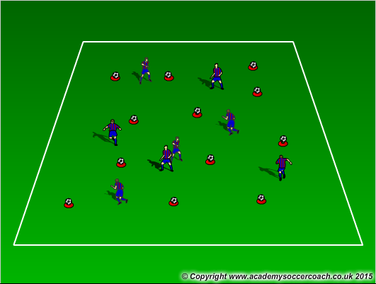
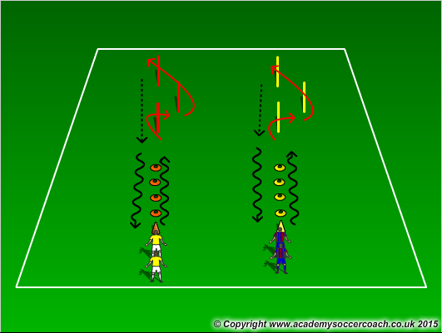
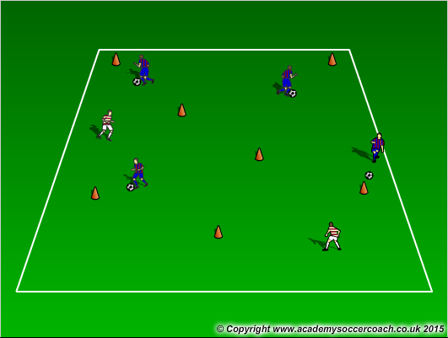
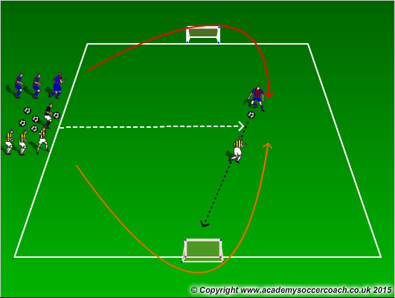
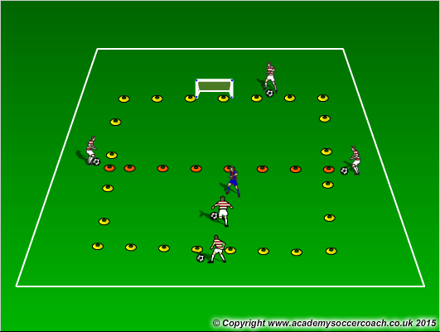
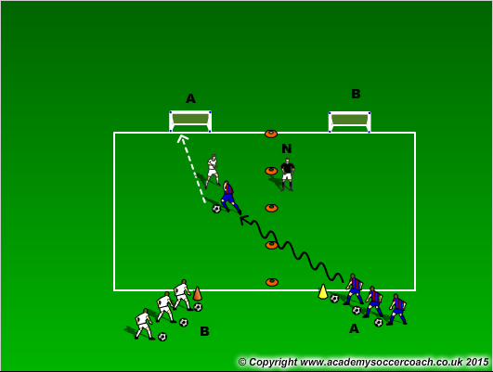
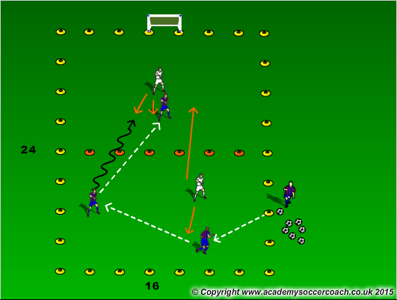
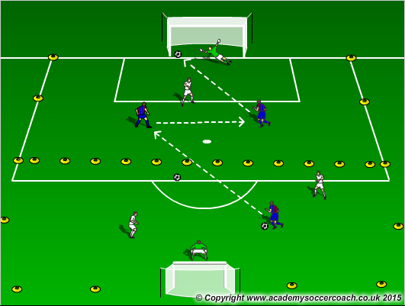
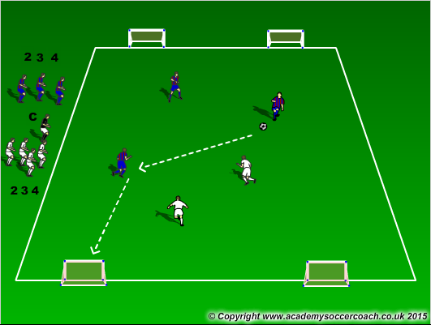
Warm Up
8 mins
Activity 1
10 mins
Activity 2
12 mins
Scrimmage 4v4
25-30 mins

Slide 3
Warm Up
  Defensive cones: Scatter cones around the field with ball on top of cones, players will use different movement variations to get warmed up (job, shuffle, skip, back shuffle, etc), on the coach’s call players will need to get to a cone in a defensive stance. As they approach they should look to approach at an angle, slow down when closer, body should start high then end small as they slow down, balls of their feet, side-on, front arm up, and eyes on the ball.
  Relay Race: Ladder cones into weaving. Do first 2 sets without a ball and last 2 sets with a ball. Make it fun and competitive for the kids
  Cops and Robbers – Assign 1 or 2 players as the cops. The rest of the players are robbers, with a ball. On the call “jail break” the robbers go around the field and try to knock the balls off the cones with their balls on the field. If you have tall cones, those can be used as replacements, and the robbers must knock those over. The cops, without a ball, must keep all the cones from being knocked over or all the balls from being knocked over for a certain amount of time. If all balls or cones are knocked over the robbers win. If all the cones and balls are in their correct spots then the cops win.
Activity 1
  Numbers Around Goal: Coach will call out a number on each team (1 or 2), players will need to run around the goal and play that amount of players to goal. Ball is out and players return to lines
  1v1 half: In a 12x8 grid, players will play 1v1. The attacking player can only receive the ball in his half further from the goal. 4 players will be on the outside who will pass the ball into the attacker. When done the attacker becomes defender, defender replaces a player on the outside, outside player becomes attacker.
  Angle Goals: Players will play 1v1 to angle goals. Players will attack the goal diagonal from them. After the attacker (Blue) scores or losses possession, that player will defend and the defender (Red) on that play will go back in his line. The next player (Red) in line will then attack the diagonal goal and the defender will need to transition. You as a coach can make the decision for letting the defender get back, or work on transitioning and getting across quick. You can also build up to it so they understand it.
Activity 2
  In a 24x16 grid cut in half, attackers will play 2v1 in their defensive half with a supporting attacker in the attacking half. When the ball enters their attacking half (pass or dribble), 1 attacker from the defensive half is allowed to enter the attacking half. Defenders have 1 defender in the each half. When the ball enters the defenders defensive half, both defenders are allowed to go in that half.
  Make the grid the size of the 18 in width and 30 yards long. Cut the grid in half and on each half play 2v1 to goal. You can add defenders in later and make it 2v2 on each half or 3v2 pending on your numbers you have.
  Numbers game: Have higher numbers in this (2,3,4) and have the players go to two goals.
Scrimmage
  4v4

Slide 4
Visual Cues
Make sure players start high and end low when pressuring
  Knees bent, side on, controlled in the approach
Players should bend their run when approaching and not go straight on
Strong in tackles and go through the ball
Try to take away attackers strong side forcing them to their weaker foot

