Slide 1
Coach Orientation
Spring 2018
United Soccer of Auburn
www.unitedsoccerofauburn.com

Slide 2



Organization Structure
Other State Orgs
Midland Area Youth Soccer (MAYS)
Other Regional Orgs
27 Other Towns/Regions

Slide 3
Governing Bodies
Bylaws and Laws of the Game are found on
  US Youth Soccer
  Massachusetts Youth Soccer
  MAYS
Basically FIFA with some age-appropriate modifications

Slide 4
Questions/Issues/Concerns
Coordinators
  U5u6@usauburn.com
  U8@usauburn.com
  girls@usauburn.com (travel)
  boys@usauburn.com (travel)
  tops@usauburn.com
Executive Board
  president@usauburn.com
Travel/League
  Must go through Town Rep (currently Jeff LaBonte)
  Please do not contact MAYS directly

Slide 5
United Soccer of Auburn
Board of Directors
Executive Board
  President, Vice President, Secretary, Treasurer
    Program/Age Coordinators, Registrar, Director, Fields, Equipment
Members (Voting)
  BOD + coaches from prior 2 season

Slide 6
Governance
Bylaws/Constitution
  Policies
Monthly BOD meetings
  2nd Sunday @7pm Pakachoag Church
Annual General Meeting
  November
Corporate Meeting
  June

Slide 7
Philosophy and Objectives
Fun
Player and Coach Retention
Fun
Develop Players and Coaches
Fun
Notes:
Engaged
Practice planning
FC Puma
Other Outside instruction
Licensing
Online resources
Mass Youth Soccer
US Youth Soccer
NSCAA

Slide 8
USA Policies
Coach, Player and Parent Codes of Conduct
  www.unitedsoccerofauburn.com/coaches/code-of-conduct/
Equal Playing Time
  www.unitedsoccerofauburn.com/forms-and-documents/
Playing “Up”
  www.unitedsoccerofauburn.com/forms-and-documents/
Special Accommodations

Slide 9
Background Check
Mass Youth Soccer Registration
  MUST do this first
  NOT the CORI check
  MA Youth Soccer Registration
CORI Submission
  Reply to the e-mail you will receive AFTER Mass Youth Registration
List is maintained by Mass Youth Soccer
  Not on the list – not CORId.

Slide 10
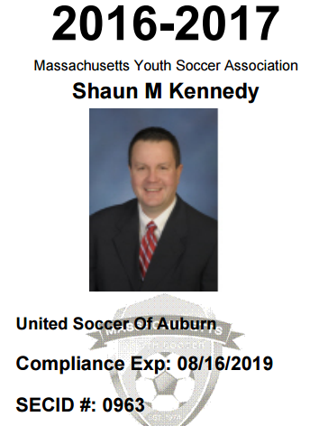
Passcard
Only required for coaches in fall season
Mass Youth is phasing in credentials that must be worn at all practices and games
  Soft rollout fall 2016
  Mandatory Spring 2017
No passcard = no coach
  You cannot be on a sideline without a passcard
  If no coach has a passcard, the fame will be forfeit, and United Soccer will be fined.
Photos must be a clear head shot.
  No sunglasses, no other people, etc.

Slide 11
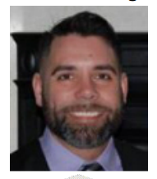
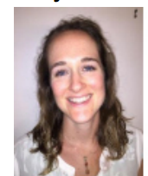

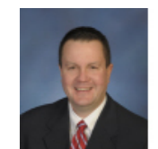
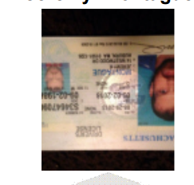
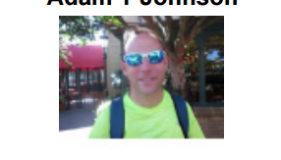
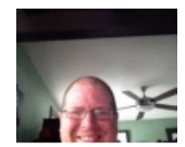
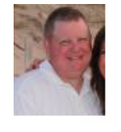
Passcard photos
Photos must be a clear head shot.
  No sunglasses, no other people, etc.
These are good
Nope

Slide 12
SportsManager
Communicating with your team
  Should be cleared to contact very soon
  Log in as a Coach/Director
    Your e-mail and password. Use password reset if you forgot.
  Select the team you want to e-mail
  Select “E-mailing”
  Compose your e-mail
Print approved roster from this page
Team info report
  Keep it in your bag

Slide 13
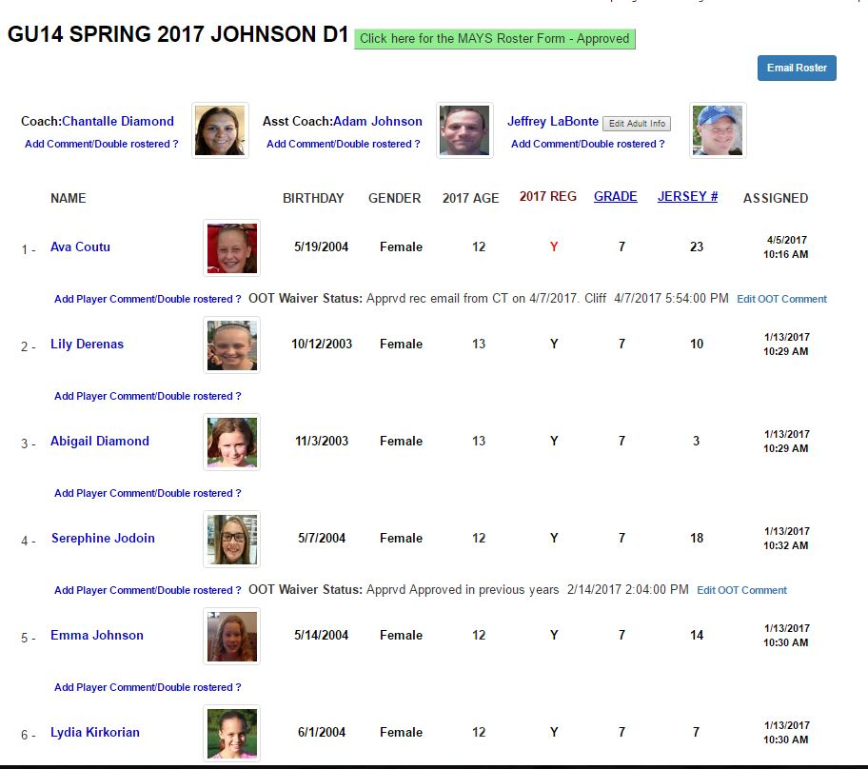

Slide 14
In-Town (Recreational) vs. Travel (Competitive)
U4/5/6
  Introduction
  Develop motor skills
  Basic soccer principals through fun activities
U8
  Instill Fundamentals
  Introduce Game Situations
  Non-competitive
Notes:
Team parity is the objective for in-town
U8 – no scores, standings, playoffs

Slide 15
Scrimmages/Games
U4 – NA
U5/U6
  20-25 minutes
  Make field big enough – we want them to have space
  Coaches play ball in
    Don’t worry about restarts at this level
  LET THEM PLAY

Slide 16
Scrimmages/Games
U8
  Regulated
  4 x 12 minutes quarters
  Restarts part of the game
    Introduced at pre season practices
  Referees
    These are 11-13 year old kids. Do NOT yell at refs. EVER.
  LET THEM PLAY!!!
Notes:
They are reffing a 6 -7 year old soccer game. This is training for future refs. They are learning just like the kids. You If there are parents getting on the referee, coaches need to talk to them.
Let them play - limit the in-game coaching.

Slide 17
Cancellations
Weather
  In most cases coordinator will make the call
  Soccer is played in the rain
At the field (weather or conditions)
  Use best judgment – safety first
  If you hear thunder you can be struck by lightning. Get indoors.
Team conflicts
  Go through coordinator

Slide 18
Development Opportunities
F License
  Reimbursed
USA-Sponsored
  Workshops
  Direct
Online Resources
  Mass Youth
  US Youth
  NSCAA
  Plentiful – see handout

Slide 19
Travel Leagues

Slide 20
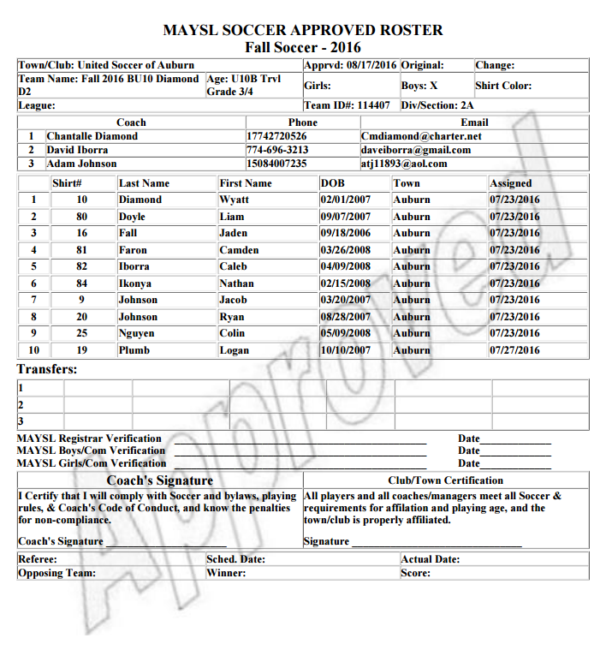
Approved Roster
You must bring TWO (2) signed approved rosters each game.
Anytime there is a change to your team your roster will be “”no longer approved”.
Changes made before 8pm on Thursday will be approved in time for weekend games (unless change is rejected)
Always print a copy of your rosters BEFORE any changes; if your roster is not approved for the game you can use the last ‘Approved’ version.
  No ‘Approved’ roster = $ fine and/or forfeit
  Wrong roster = fine, no roster = forfeit
I save copies of everyone’s rosters from beginning of season if you get into a pinch

Slide 21
Zero Tolerance
Coaches are responsible for the team’s spectators and shall address any issue with spectator who is interfering with the match. Should the referee stop play and request the coach to dismiss the spectator the coach will do so or the match will be abandoned.

Slide 22
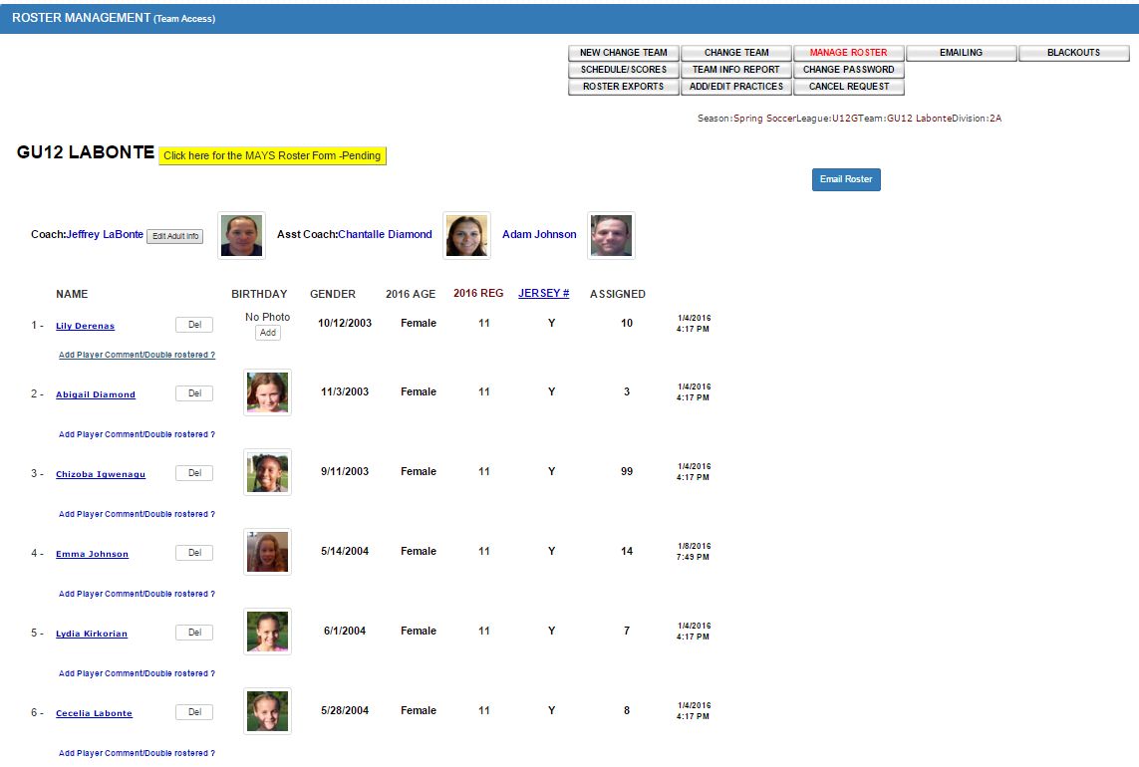

Slide 23
SportsManager
Communicating with your team
  Log in as a Coach/Director
    Your e-mail and password. Use password reset if you forgot.
  Select the team you want to e-mail
  Select “E-mailing”
  Compose your e-mail
Print approved roster from this page
Team info report
  Keep it in your bag

Slide 24
Player Safety
Conditioning
  ACL info on our website
  Reliant presentation March 20
Concussion
  Please review concussion info on our website
Field Conditions
Weather
Don’t leave alone
  Restroom in pairs or send adult, after practice, etc.
Any, ANY concern call 911 for medical attention or police

Slide 25
Cancellations/Blackouts
Weather
  In most cases coordinator(s) will make the call
  Soccer is played in the rain
At the field (weather or conditions)
  Referee will make the call
  If you hear thunder you can be struck by lightning. Get indoors.
Team conflicts
  MUST let me know ASAP if your team cannot play
    School events, First communion, etc.
      Being on vacation or missing player(s) is not a valid reason to request postponment

Slide 26
Coach Cancellation Request
NOTE: Weather cancellations automatically set off the reschedule process
  Coach can click the “Cancel Request” button
  Must enter the valid reason and be within minimum time requirements
  This will send the request to MAYS
  If MAYS Approve it the game is cancelled
  Notices will go out and the game will start the rescheduling process
  Email to Coach if Not Approved
  Tracking in MAYS and Smgr Rescheduling Module

Slide 27
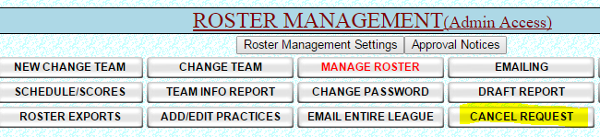
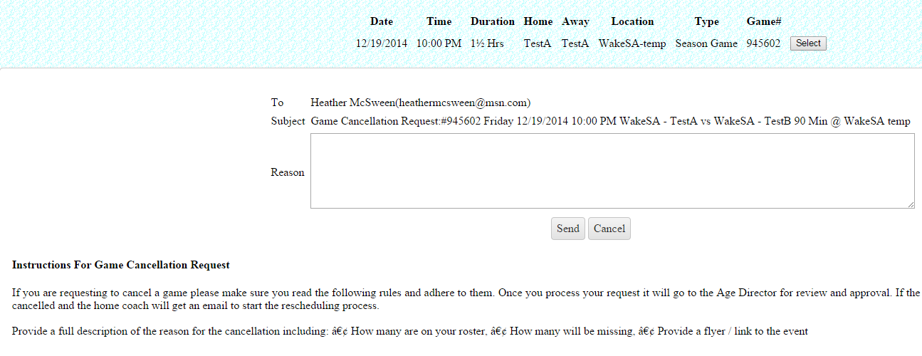
Game Cancellation Cont.
A page requiring the reason pops up for the Coach to fill out. Instructions and rules
Are displayed on the page so the coach knows what is required to Cancel.

Slide 28
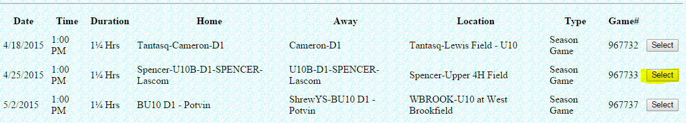
Game Selection page for cancellation request – Click the Select button

Slide 29
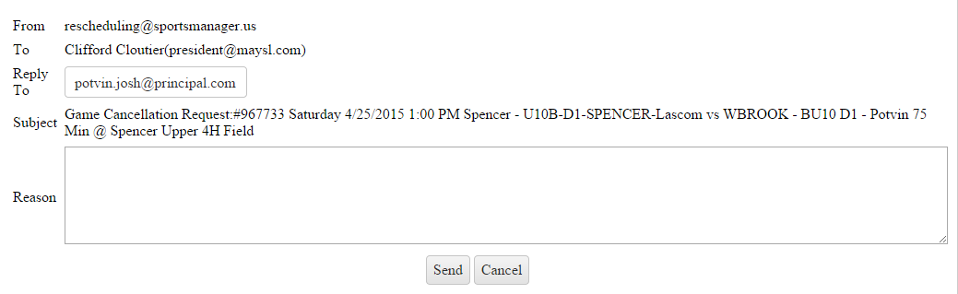
Enter reason for cancellation request and click send.

Slide 30
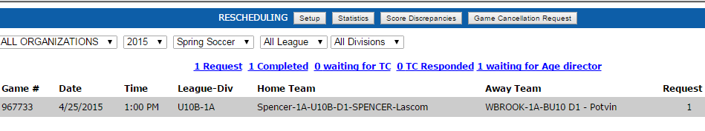
The request is shown in the queue on the MAYSL site as waiting for approval

Slide 31
Schedules
Gives date, time location and opponent
  Click question mark to view field address and opposing coach(es)
  Always e-mail opposing coach during the week to inform of field restrictions, see if they need directions, etc.
    Note there has been some confusion with new AMS and old AMS (SWIS); be sure teams know the difference between AMS and AHS

Slide 32
Turf Fields
AMS & Pappas
It is your responsibility to e-mail the opposing coach(es) and inform them of field restrictions. Email contacts are found on your schedule,
  Nothing but water – no food, no sports beverages, no coffee, etc.
  No strollers, folding chairs, benches, pets
  Parents/spectators should remain outside fence or in bleachers

Slide 33
Field Setup
First game of the day
  Equipment is in storage box next to shed at AMS, inside shed at Pappas. Lockbox on the storage box (AMS and Bryn Mawr) or on the field side of shed Pappas) underneath bleachers
    Combinations will be e-mailed
    Key is in lockbox
    Storage boxes have 2 locks; one under each front corner
  Put out corner flags
  Put out goal weights
  Game balls
  Open restrooms
    Restroom keys for AHS and Pappas are also with storage box key, but Pappas will be open.

Slide 34
Game Time
2 copies of your APPROVED roster
  As soon as you are approved, print a bunch of copies
  I have copies for emergencies
Coach Passcards
  Every coach on sideline
  Max 3 per team
Player Passcards
  Not required in fall

Slide 35
Field Breakdown
If you are the last team of the day
  Put corner flags, goal weights and game balls back in the storage box
  Be sure restrooms are LOCKED. Even if there is another group behind you, if they are not United Soccer of Auburn, then lock everything up. If those groups are supposed to have access to restrooms, they will have a key.
  Make sure the keys are NOT in the storage box
  Lock the storage box
  Replace keys in lockbox and be sure lockbox is locked

Slide 36
Game Management
Equal playing time
Do not address referees during match (see MAYS guidelines)
Sportsmanship is paramount
We coaches are responsible for our parents
8 goal rule

Slide 37
Tournament Play
Will post on our website as we receive them
Many Opportunities
Does not need to just be “your” rostered team
  Note: As long as any player you take on your team has been registered spring 2016, or fall 2016 they are covered by insurance.
Out of state play requires Mass Youth waiver unless you are participating as a separate organization or have separate insurance coverage
Boarded indoor soccer is never covered, and you cannot participate as a United Soccer of Auburn-affiliated organization

Slide 38
Indoor Play
USA does not organize indoor soccer leagues - individual coaches may do so
  We will be running futsol this winter
Boarded indoor soccer is specifically excluded from Mass Youth Soccer Insurance coverage:
  Do not use the SportsManager site to communicate for indoor soccer
    You can grab contact info but don’t use system for e-mailing please
  You are on your own as far as liability – the fee and waiver you sign with the complex covers them, not you
    NSCAA membership includes $1 million liability. Not a bad idea

Slide 39
Spring Postseason
U10 – NA
U12 & U14 D3
  Gaffney Cup June 4 & 5 Usually Ruell in Oxford
U12 and up, D1 and D2
  MAYS playoffs begin in early June
  MTOC late June in Lancaster
    MAYS Champs at each age level and division

